Slide 1
How to Model Services
Chapter 3

Slide 2
What Makes a Good Microservice Boundary?

Slide 3
Information Hiding
Information hiding describes a desire to hide as many details as possible behind a module (or, in our case, microservice) boundary.
Benefits:
Improved development time
By allowing modules to be developed independently, we can allow for more work to be done in parallel and reduce the impact of adding more developers to a project.
Comprehensibility
Each module can be looked at in isolation and understood in isolation. This in turn makes it easier to understand what the system as a whole does.
Flexibility
Modules can be changed independently from one another, allowing for changes to be made to the functionality of the system without requiring other modules to change. In addition, modules can be combined in different ways to deliver new functionality.

Slide 4
High Cohesion
the code that changes together, stays together.
We want related behavior to sit together, and unrelated behavior to sit elsewhere.
Why?
Well, if we want to change behavior, we want to be able to change it in one place, and to release that change as soon as possible.

Slide 5
Loose Coupling
When services are loosely coupled, a change to one service should not require a change to another.
A loosely coupled service knows as little as it needs to about the services with which it collaborates.

Slide 6
The Interplay of Coupling and Cohesion
Cohesion applies to the relationship between things inside a boundary (a microservice in our context), whereas coupling describes the relationship between things across a boundary.

Slide 7
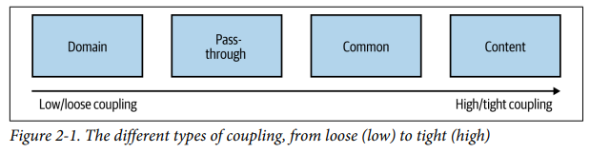
Types of Coupling

Slide 8
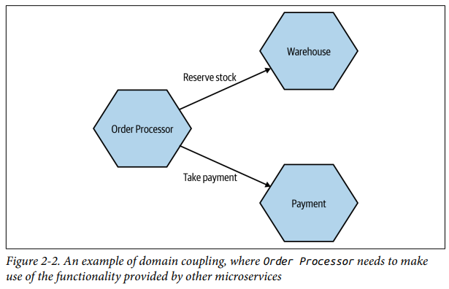
Domain Coupling
Domain coupling describes a situation in which one microservice needs to interact with another microservice, because the first microservice needs to make use of the functionality that the other microservice provides.
Notes:
In Figure 2-2, we see part of how orders for CDs are managed inside MusicCorp. In this example, Order Processor calls the Warehouse microservice to reserve stock, and the Payment microservice to take payment. The Order Processor is therefore dependent on, and coupled to, the Warehouse and Payment microservices for this operation. We see no such coupling between Warehouse and Payment, though, as they don’t interact.
In a microservice architecture, this type of interaction is largely unavoidable.

Slide 9
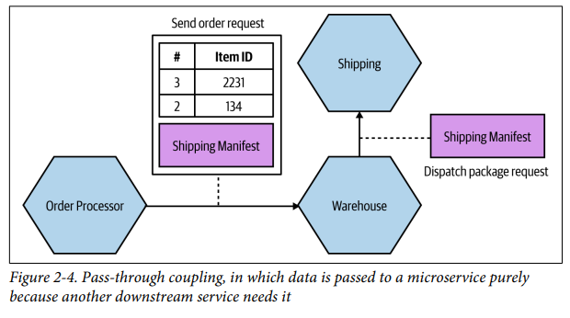
Pass-Through Coupling
“Pass-through coupling” describes a situation in which one microservice passes data to another microservice purely because the data is needed by some other microservice further downstream.
Notes:
As an example of pass-through coupling, let’s look more closely now at part of how MusicCorp’s order processing works. In Figure 2-4, we have an Order Processor, which is sending a request to Warehouse to prepare an order for dispatch. As part of the request payload, we send along a Shipping Manifest. This Shipping Manifest contains not only the address of the customer but also the shipping type. The Ware house just passes this manifest on to the downstream Shipping microservice.

Slide 10
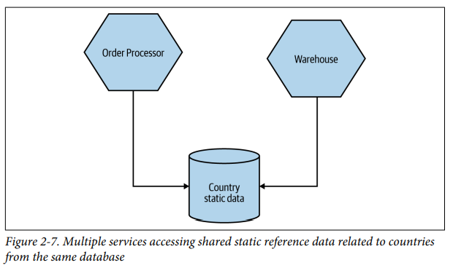
Domain Coupling
Common coupling occurs when two or more microservices make use of a common set of data. A simple and common example of this form of coupling would be multiple microservices making use of the same shared database, but it could also manifest itself in the use of shared memory or a shared filesystem.
Notes:
As an example of pass-through coupling, let’s look more closely now at part of how MusicCorp’s order processing works. In Figure 2-4, we have an Order Processor, which is sending a request to Warehouse to prepare an order for dispatch. As part of the request payload, we send along a Shipping Manifest. This Shipping Manifest contains not only the address of the customer but also the shipping type. The Ware house just passes this manifest on to the downstream Shipping microservice.

Slide 11
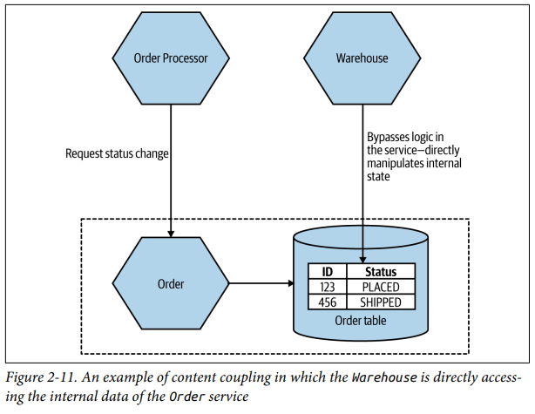
Content Coupling
Content coupling describes a situation in which an upstream service reaches into the internals of a downstream service and changes its internal state. The most common manifestation of this is an external service accessing another microservice’s database and changing it directly.
Notes:
The differences between content coupling and common coupling are subtle. In both cases, two or more microservices are reading and writing to the same set of data. With common coupling, you understand that you are making use of a shared, external dependency. You know it’s not under your control. With content coupling, the lines of ownership become less clear, and it becomes more dif‐ ficult for developers to change a system.

Slide 12
Domain-Driven Design

Slide 13
Ubiquitous Language
Defining and adopting a common language to be used in code and in describing the domain, to aid communication.
Notes:
Ubiquitous language refers to the idea that we should strive to use the same terms in our code as the users use. The idea is that having a common language between the delivery team and the actual people will make it easier to model the real-world domain and also should improve communication.

Slide 14
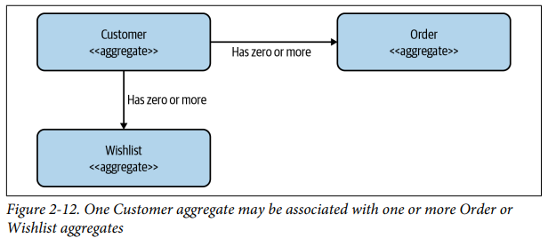
Aggregate
A collection of objects that are managed as a single entity, typically referring to real-world concepts.
Aggregates can have relationships with other aggregates.
If these relationships between aggregates exist inside the scope of a single microservice, they could easily be stored using something like a foreign key relationship if using a relational database. If the relationships between these aggregates span micro‐ service boundaries, though, we need some way to model the relationships.
Notes:
an aggregate is a representation of a real domain concept—think of something like an Order, an Invoice, a Stock Item, and so on. Aggregates typically have a life cycle around them, which opens them up to being implemented as a state machine.
In Figure 2-12, we have a Customer aggregate that is associated with one or more Orders and one or more Wishlists. These aggregates could be managed by the same microservice or by different microservices.

Slide 15
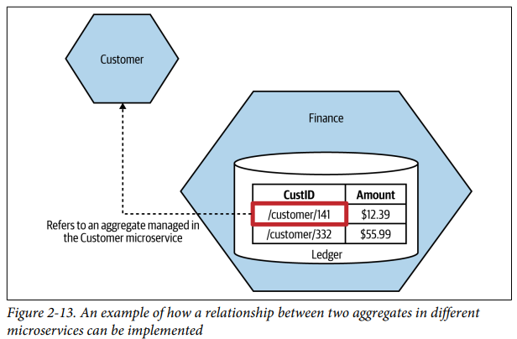
Aggregate
Notes:
In Figure 2-13, we have changed things to make the relationship explicit. Rather than a vanilla ID for the customer reference, we instead store a URI, which we might use if building a REST-based system.12
The benefits of this approach are twofold. The nature of the relationship is explicit, and in a REST system we could directly dereference this URI to look up the associated resource

Slide 16
Bounded Context
An explicit boundary within a business domain that provides functionality to the wider system but that also hides complexity.
Shared Models
Hidden Models
Notes:
Bounded Context

Slide 17
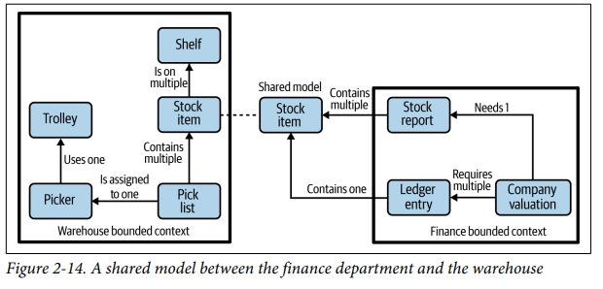
Bounded Context
Notes:
The finance department doesn’t need to know about the detailed inner workings of the warehouse. It does need to know some things, however; for example, it needs to know about stock levels to keep the accounts up to date. Figure 2-14 shows an example context diagram. We see concepts that are internal to the warehouse, like a picker (someone who picks orders), shelves that represent stock locations, and so on. Like‐ wise, entries in the general ledger are integral to finance but are not shared externally here.

Slide 18
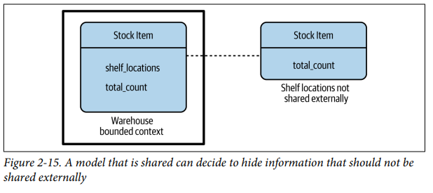
Bounded Context
Notes:
To be able to work out the valuation of the company, though, the finance employees need information about the stock we hold. The stock item then becomes a shared model between the two contexts. However, note that we don’t need to blindly expose everything about the stock item from the warehouse context. In Figure 2-15, we see how Stock Item inside the warehouse bounded context contains references to the shelf locations, but the shared representation contains only a count. So there is the internal-only representation and the external representation we expose. Often, when you have different internal and external representations, it may be beneficial to name them differently to avoid confusion—in this situation, one approach could be to call the shared Stock Item a Stock Count instead.

Slide 19
Mapping Aggregates and Bounded Contexts to Microservice
The aggregate is a self-contained state machine that focuses on a single domain concept in our system, with the bounded context representing a collection of associated aggregates, again with an explicit interface to the wider world.

Slide 20
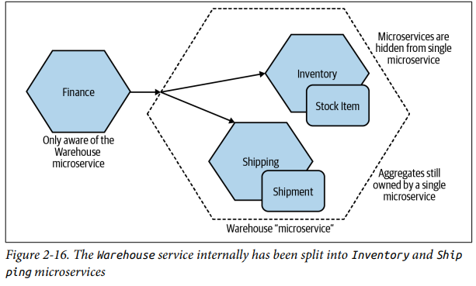
Notes:
The decision to decompose a service into smaller parts is arguably an implementation decision, so we might as well hide it if we can. In Figure 2-16 we see an example of this. We’ve split Warehouse down into Inventory and Shipping. As far as the outside world is con‐ cerned, there is still just the Warehouse microservice. Internally though, we’ve further decomposed things to allow Inventory to manage Stock Items and have Shipping manage Shipments. Remember, we want to keep the ownership of a single aggregate inside a single microservice.

