Slide 1
Splitting the Monolith
Chapter 3

Slide 2
What to Split First?
the decision about which functionality to split into a microservice will end up being a balance between these two forces
how easy the extraction is versus the benefit of extracting the microservice in the first place.

Slide 3
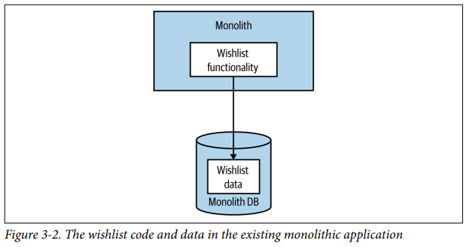
Decomposition by Layer
Notes:
Let’s consider Figure 3-2, where we are looking to extract functionality related to managing a customer’s wishlist. There is some application code that lives in the monolith, and some related data storage in the data‐ base. So which bit should we extract first?

Slide 4
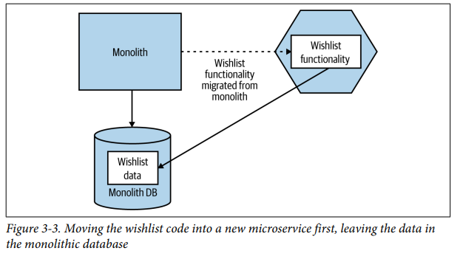
Decomposition by Layer – Code First
Notes:
In Figure 3-3, we have extracted the code associated with the wishlist functionality
into a new microservice. The data for the wishlist remains in the monolithic database
at this stage—we haven’t completed the decomposition until we’ve also moved out
the data related to the new Wishlist microservice

Slide 5
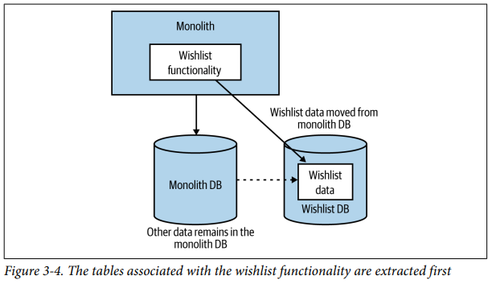
Decomposition by Layer – Data First
Notes:
In Figure 3-4, we see the data being extracted first, before the application code. I see
this approach less often, but it can be useful in situations in which you are unsure
whether the data can be separated cleanly. Here, you prove that this can be done
before moving on to the hopefully easier application code extraction.

Slide 6
Useful Decompositional Patterns

Slide 7
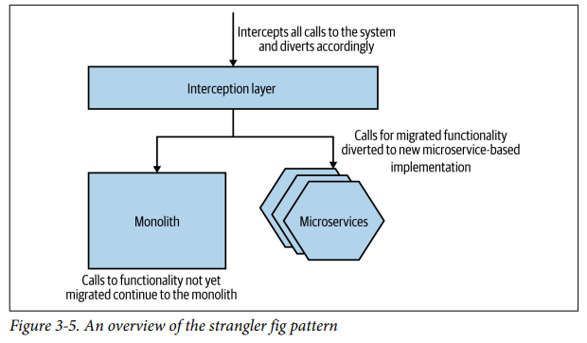
Strangler Fig Pattern
Notes:
The approach as shown in Figure 3-5 is straightforward. You intercept calls to the existing system—in our case the existing monolithic application. If the call to that piece of functionality is implemented in our new microservice architecture, it is redi‐ rected to the microservice. If the functionality is still provided by the monolith, the call is allowed to continue to the monolith itself.

Slide 8
Parallel Run
Running both your monolithic implementation of the functionality and the new microservice implementation side by side, serving the same requests, and comparing the results.

Slide 9
Feature Toggle
A feature toggle is a mechanism that allows a feature to be switched off or on, or to switch between two different implementations of some functionality.

Slide 10
Data Decomposition Concerns

Slide 11
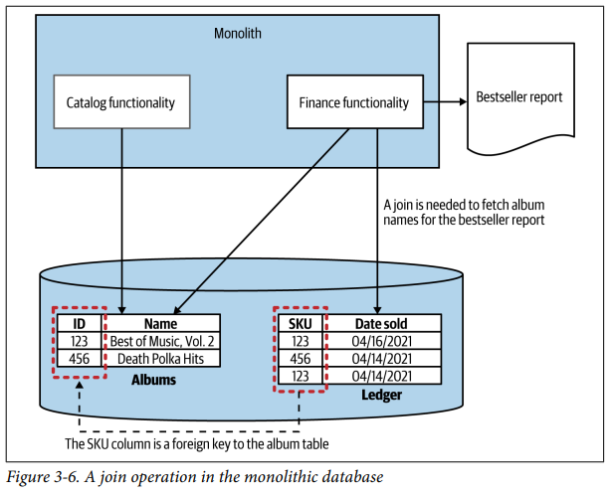
Performance
Notes:
Consider Figure 3-6, which illustrates a situation we find ourselves in regarding
MusicCorp. We’ve decided to extract our catalog functionality—something that can
manage and expose information about artists, tracks, and albums. Currently, our
catalog-related code inside the monolith uses an Albums table to store information
about the CDs that we might have available for sale. These albums end up getting ref‐
erenced in our Ledger table, which is where we track all sales. The rows in the Ledger
table record the date on which something is sold, along with an identifier that refers
to the item sold; the identifier in our example is called a SKU (stock keeping unit), a
common practice in retail systems.3
At the end of each month, we need to generate a report outlining our best-selling
CDs. The Ledger table helps us understand which SKU sold the most copies, but the
information about that SKU is over in the Albums table. We want to make the reports
nice and easy to read, so rather than saying, “We sold 400 copies of SKU 123 and
made $1,596,” we’d add more information about what was sold, saying instead, “We
sold 400 copies of Now That’s What I Call Death Polka and made $1,596.” To do this,
the database query triggered by our finance code needs to join information from the
Ledger table to the Albums table, as Figure 3-6 shows.

Slide 12
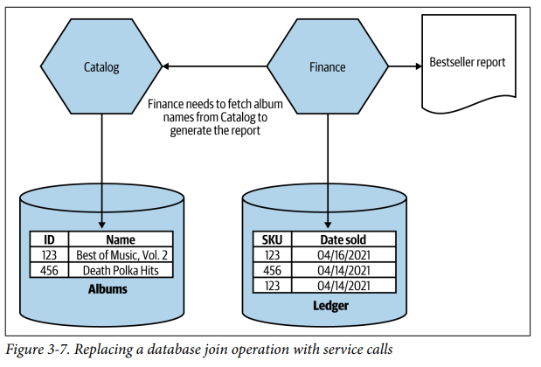
Performance
Notes:
In our new microservice-based world, our new Finance microservice has the respon‐
sibility of generating the bestsellers report but doesn’t have the album data locally. So
it will need to fetch this data from our new Catalog microservice, as shown in
Figure 3-7. When generating the report, the Finance microservice first queries the
Ledger table, extracting the list of best-selling SKUs for the last month. At this point,
the only information we have locally is a list of SKUs and the number of copies sold
for each SKU.
Next, we need to call the Catalog microservice, requesting information on each of these SKUs. This request in turn will cause the Catalog microservice to make its own local SELECT on its own database.
Logically, the join operation is still happening, but it is now happening inside the Finance microservice rather than in the database. The join has gone from the data tier to the application code tier.

Slide 13
Data Integrity
Databases can be useful in ensuring integrity of our data.
Coming back to Figure 3-6, with both the Album and Ledger tables being in the same database, we could (and likely would) define a foreign key relationship between the rows in the Ledger table and the Album table.
This would ensure that we’d always be able to navigate from a record in the Ledger table back to information about the album sold, as we wouldn’t be able to delete records from the Album table if they were referenced in Ledger.
With these tables now living in different databases, we no longer have enforcement of the integrity of our data model.
There is nothing to stop us from deleting a row in the Album table, causing an issue when we try to work out exactly what item was sold.

Slide 14
Transactions
Once we start splitting data across multiple databases, though, we lose the safety of the ACID transactions we are used to.

Slide 15
Tooling
Changing databases is difficult for many reasons, one of which is that limited tools remain available to allow us to make changes easily.

Slide 16
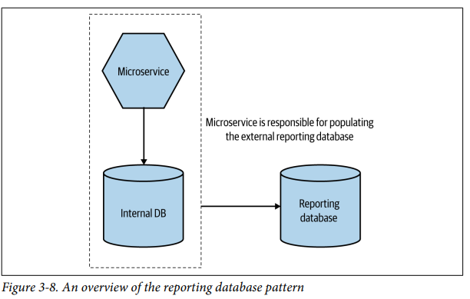
Reporting Database
Notes:
With a reporting database, we instead create a dedicated database that is designed for external access, and we make it the responsibility of the microservice to push data from internal storage to the externally accessible reporting database, as seen in Figure 3-8.
The reporting database allows us to hide internal state management, while still pre‐ senting the data in a database—something which can be very useful. For example, you might want to allow people to run off ad hoc defined SQL queries, run large-scale joins, or make use of existing toolchains that expect to have access to a SQL endpoint. The reporting database is a nice solution to this problem

Slide 17
Reporting Database – Key Benefits
Firstly, we still want to practice information hiding. So we should expose only the bare minimum of data in the reporting database. This means that what is in the reporting database may be only a subset of the data the microservice stores.
The second key point is that the reporting database should be treated like any other microservice endpoint, and it is the job of the microservice maintainer to ensure that compatibility of this endpoint is maintained even if the microservice changes its internal implementation detail.

