Slide 1
Building Microservices - Chapter 8: Deployment

Slide 2

Introduction to Deployment
Importance of deployment strategies in ensuring reliability and scalability.
Transition from logical to physical deployment.

Slide 3
Multiple Instances
Running multiple instances of a microservice for scalability and reliability.
Techniques for load balancing across instances.
Importance of avoiding single points of failure.

Slide 4
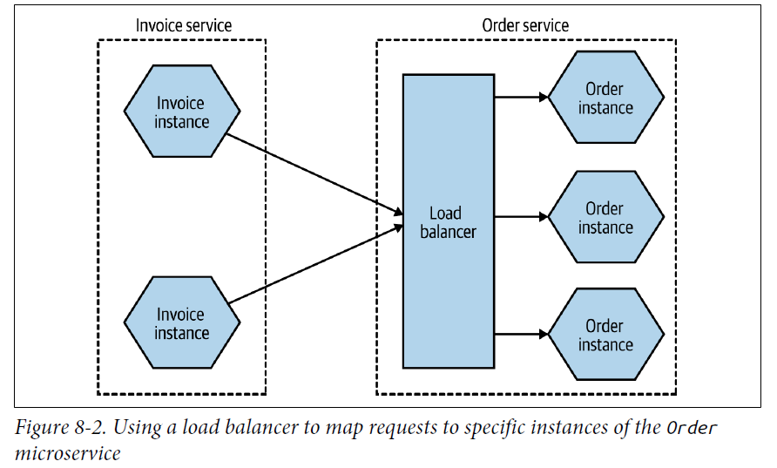
Multiple Instances

Slide 5
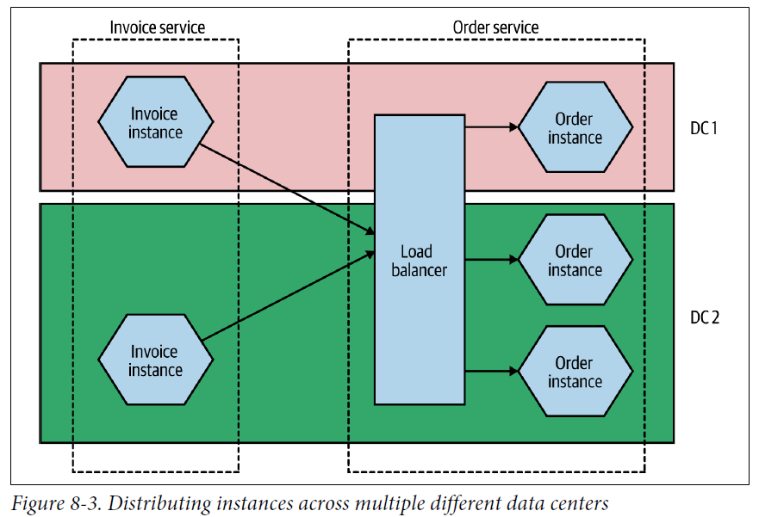
Multiple Instances

Slide 6
The Database
Approaches to managing databases in microservices.
Ensuring data consistency and integrity.
Strategies for database deployment, including single shared database vs. database per service.

Slide 7
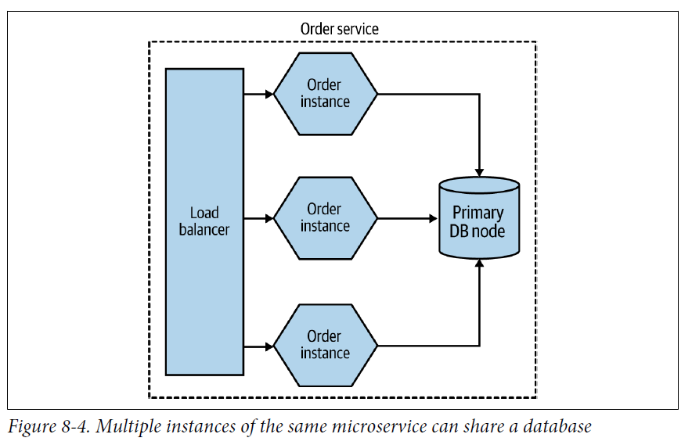
The Database

Slide 8
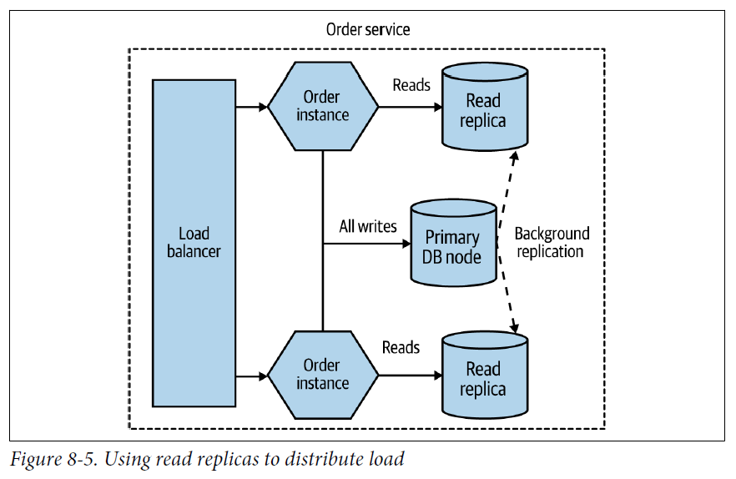
The Database

Slide 9
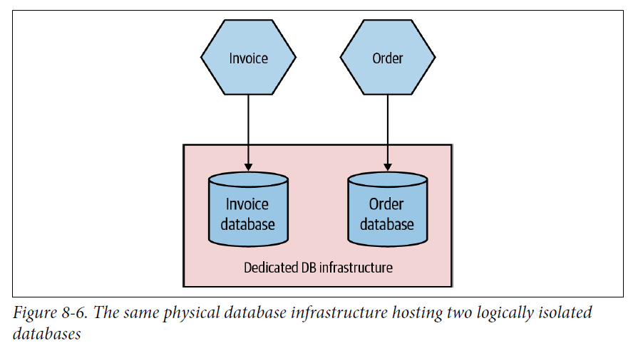
The Database

Slide 10
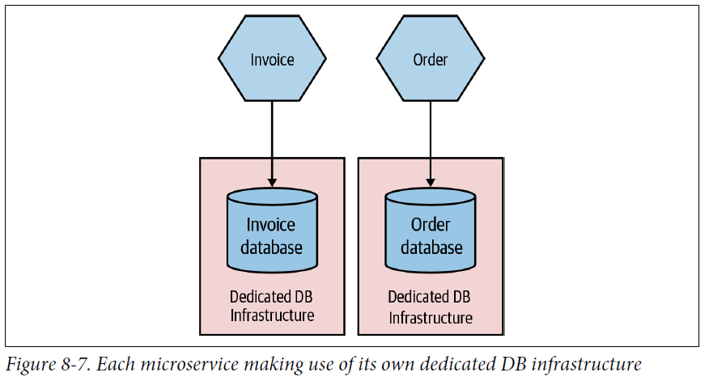
The Database

Slide 11
Environments
Different environments: development, testing, staging, production.
Managing configurations across environments.
Ensuring consistency and reliability through the deployment pipeline.

Slide 12
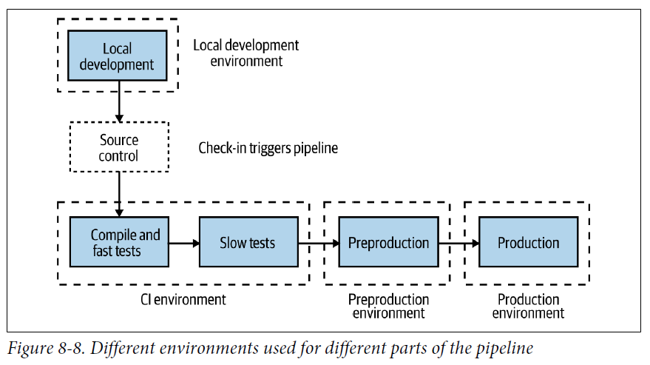
Environments

Slide 13
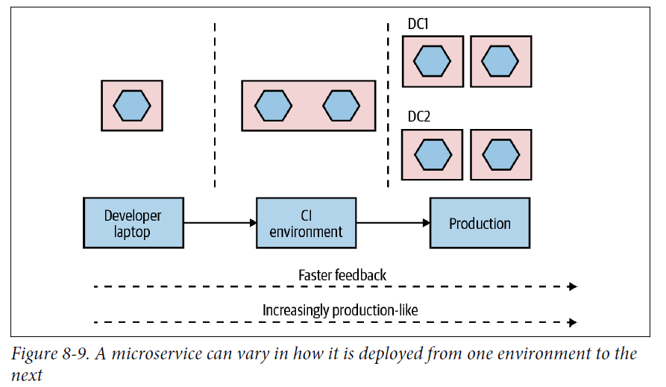
Environments

Slide 14
Principles of Microservice Deployment
Isolated Execution: Ensuring services run independently.
Focus on Automation: Automating deployment processes.
Infrastructure as Code (IAC): Managing infrastructure through code.
Zero-Downtime Deployment: Strategies for minimizing downtime during deployments.
Desired State Management: Ensuring the system reaches and maintains a desired state.

Slide 15
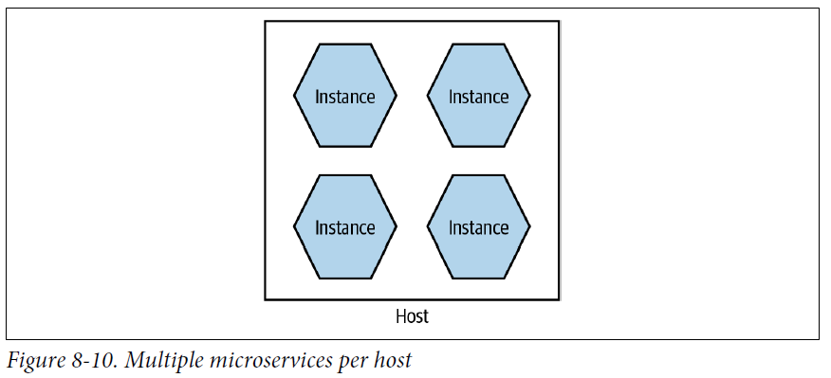
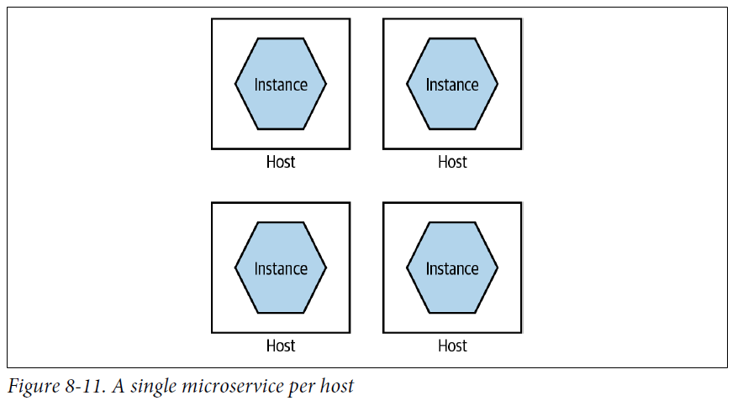
Isolated Execution

Slide 16
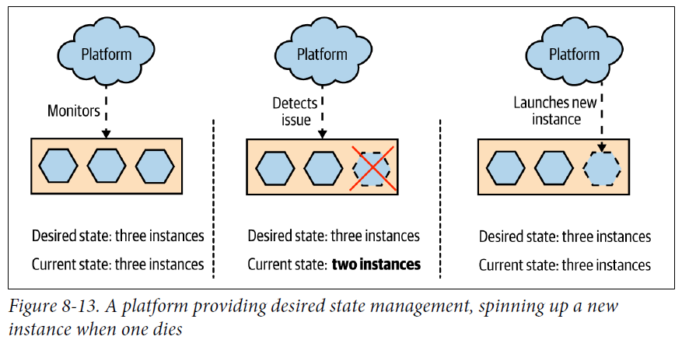
Desired State Management

Slide 17
Deployment Options
Physical Machines: Traditional approach, less flexible.
Virtual Machines: More flexible, easier to manage.
Containers: Lightweight, portable, and consistent environments.
Application Containers: Running microservices in application containers like Docker.
Platform as a Service (PaaS): Managed services for deploying applications.
Function as a Service (FaaS): Serverless architectures for event-driven applications.

Slide 18
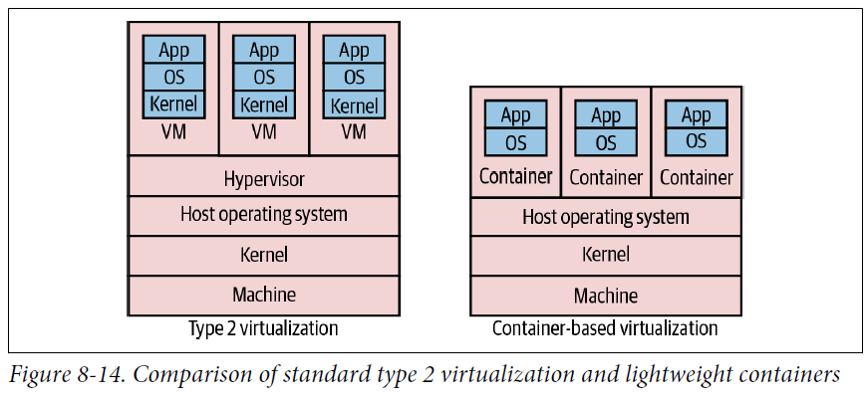
Virtual Machines

Slide 19
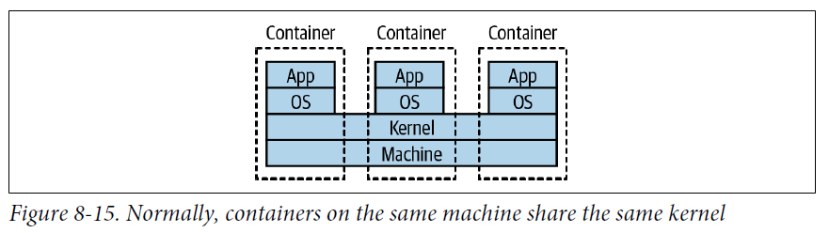
Containers

Slide 20
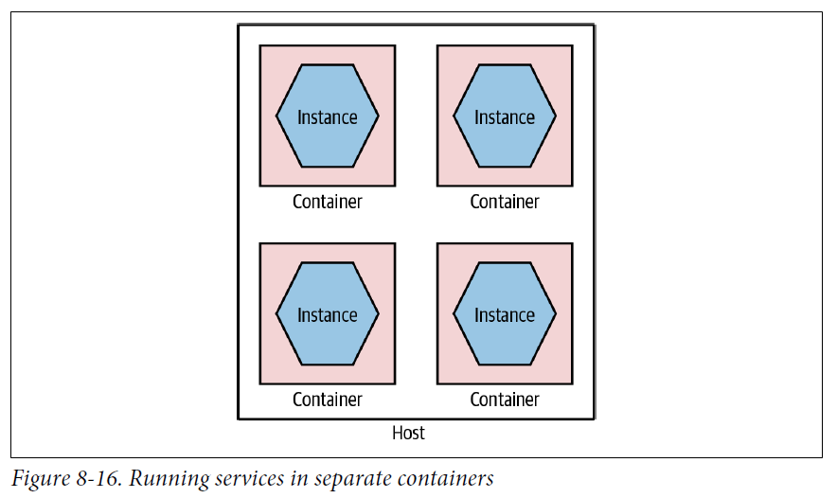
Containers

Slide 21
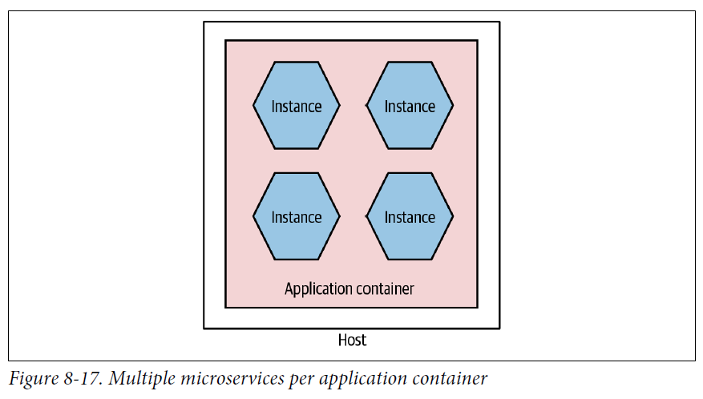
Application Containers

Slide 22
Choosing the Right Deployment Option
Factors to consider: scalability, flexibility, cost, complexity.
Pros and cons of different deployment options.
Examples of use cases for each deployment strategy.

Slide 23
Container Orchestration with Kubernetes
Benefits of using container orchestration platforms.
Simplified view of Kubernetes concepts: pods, services, deployments.
Advantages of using Kubernetes for microservice deployment.

Slide 24
Progressive Delivery
Separating deployment from release.
Techniques for progressive delivery: feature toggles, canary releases, parallel run.
Benefits of progressive delivery in minimizing risk and improving feedback loops.

Slide 25
Summary
Deployment strategies are critical for microservice architectures.
Various deployment options and principles to ensure reliability and scalability.
Role of container orchestration and progressive delivery in modern deployments.

