Slide 1


Bidding for Farmers
presented by
TRUIST Rangers

Slide 2


COntent
Problem Statement
How can we use technology to solve the problem
Process road map and the Sequence diagram

Slide 3

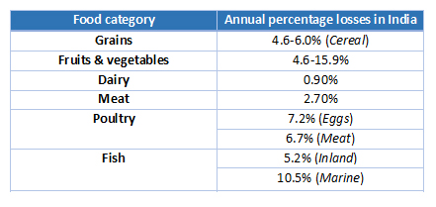
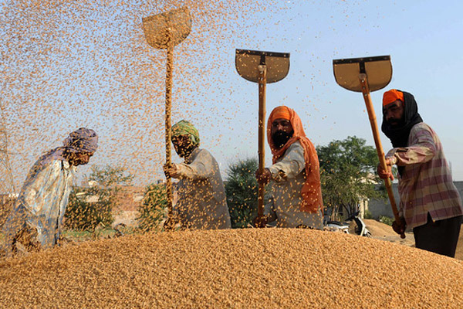
A key issue is the availability of surplus food grains with FCI, well above its buffer capacity. For instance, its rice stocks were at 21 MT in January this year compared to a buffer requirement of 7 MT. This happens as local farmers do not have idea on estimated demand
Estimated Produce wastage due to lack of consumption/sell in 2018od

Slide 4
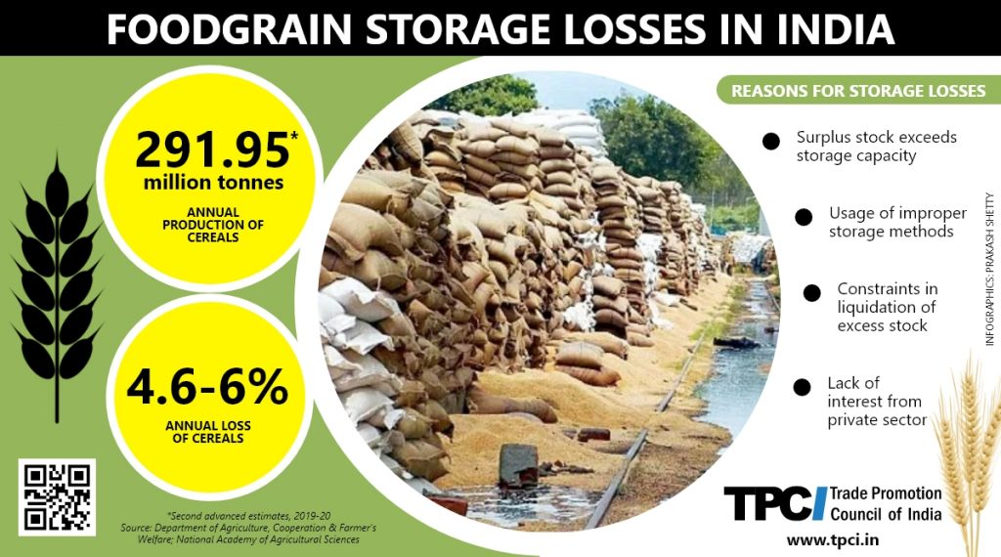

Slide 5
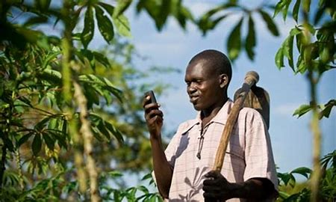
How can we use technology to solve the problem
A bidding system to enable farmers to get the best value of their products from multiple co-operatives and for Co-operatives to get the best quality at the best bid for buyers. This will encourage speedy consumption of the farm produce and thus will avoid food wastage.

Slide 6
Tender Initiation:
Analyze market trend products available
Create a open Tender(Product quantity, Quality, offer price)
Notification to registered farmer about open tender

Slide 7
Collection of Bids from Farmers and Approval:
Farmer responds to notification
AI/ML Processing
Notification to Co-op
Bid approval
Notification to Farmer

Slide 8
Sequence Diagram

Slide 9
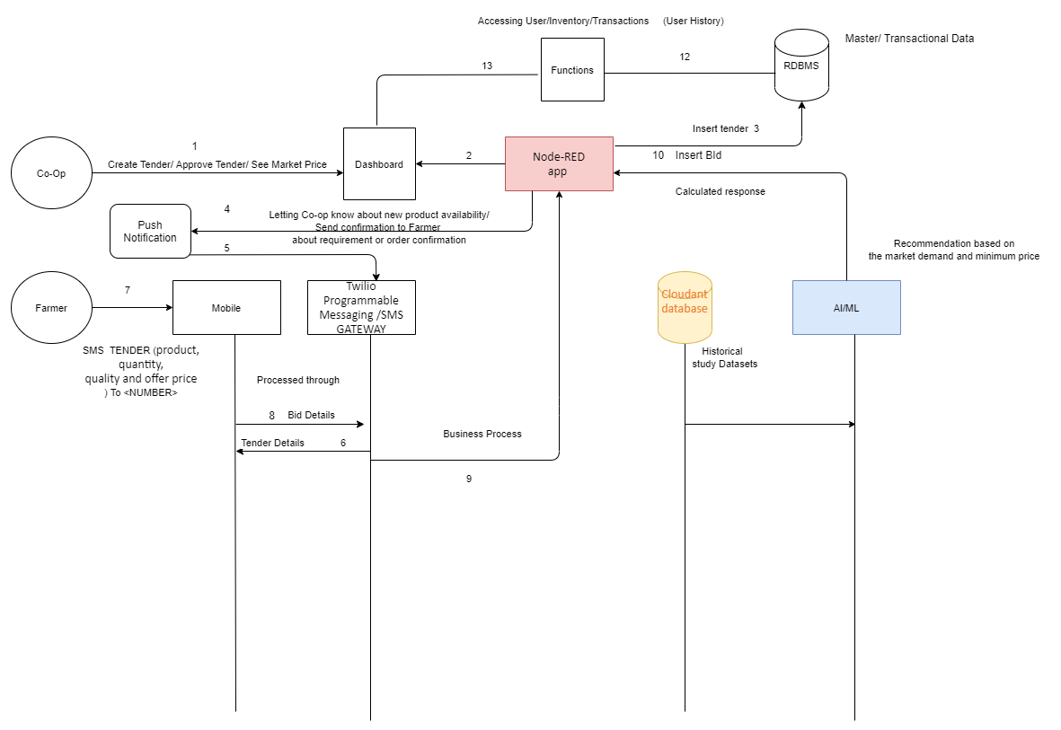

Slide 10
Thank you
Credits
Team Name TRUIST Rangers
Team member names: Rahul D Yadav
Manisha Kale
Sushma Tiwary
Sayantan Banerjee
Meetu Chandra

