Slide 1
Team 5
Marcus, David, Matt, Kenneth

Slide 2
Project Proposal
For our project we will be implementing an application to handle students in the advising center.
The application will be have multiple forms for personal information, course information, appointments, and student lookup.
Option for manual input from the student or automatic retrieval of information by scanning their UTSA ID card in a card reader.

Slide 3
Card Reader
Card reader is a USB device that you can plug into the computer.
When the card is scanned it will output information of the student to the current text field.
In the student sign in form, if the student chooses to scan the card, it should be able to fill in the rest of the information.
When the banner id appears in the text field, it will begin a search within a simple student database for that banner id, and retrieve the rest of the information.

Slide 4
Student Database
The database will most likely be a MySQL database and will use the necessary java libraries in order to carry out querying to the database.
Will use XAMPP and phpmyadmin in order to create the physical database.

Slide 5
Appointments and Walk-Ins
Another database will store the current appointments with assigned dates and students.
There will also be a GUI for a waitlist to handle walk-ins and will operate like a standard queue that could be implemented with ArrayList.

Slide 6
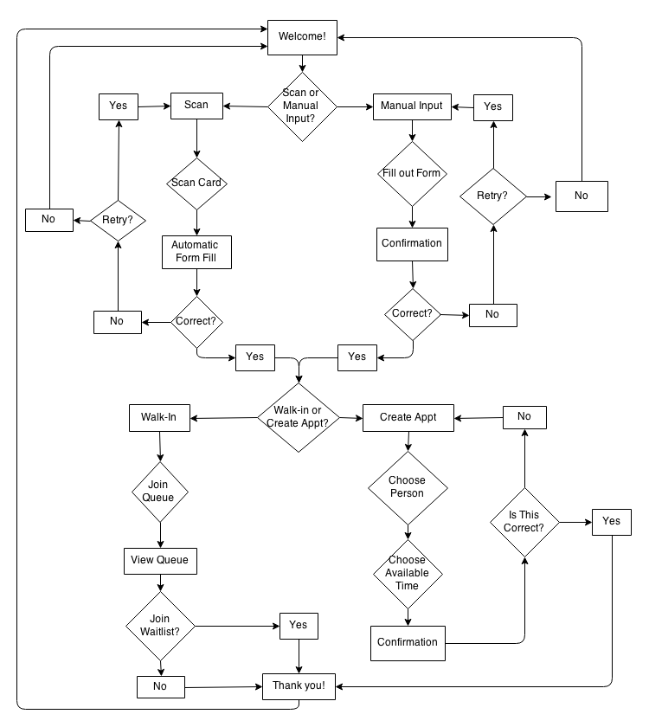
Flowchart

Slide 7
Milestones
Card reader integration, GUI forms, appointments, walk-ins
Integration with physical database such as MySQL
GUI application that will show student their current classes taken, and the classes that they can take next semester in their major.
Will have to interact with ASAP somehow to get listings of classes, or just download a csv of the semester and determine what classes can be taken for that major.

