Slide 1
Gam-Eco
Gaming e-Commerce Database
Marcus Lorenzana, Desiree Johnson, Marcos Gonzales, Marvin Lopez

Slide 2
Basic Overview of Store
E-Commerce video game digital store
The products are video games in the form of redeemable codes
The customer will be able to purchase a digital game
  redeem the code online from the relative platform (Xbox, Playstation, etc.)
Content is entirely digital
  no shipping of products
  distribution by email
    sent to the customer immediately after purchase
    Email contains the order confirmation and redeemable code.
The codes are provided by multiple sellers who will receive royalty on each purchase

Slide 3
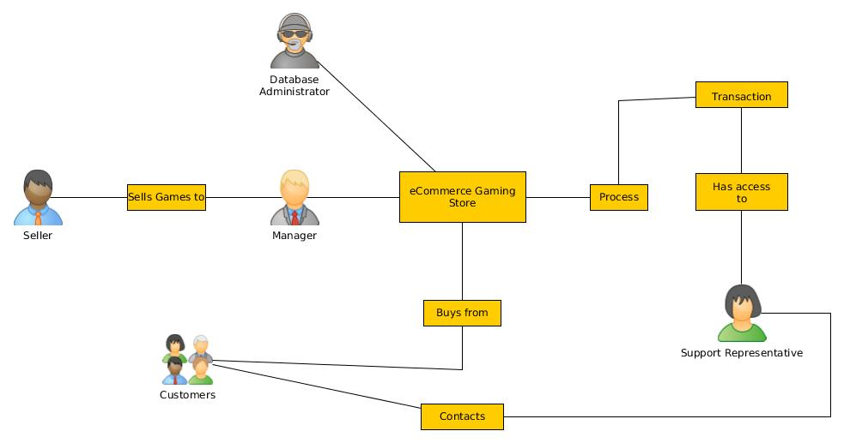
ORGANIZATION SNAPSHOT

Slide 4
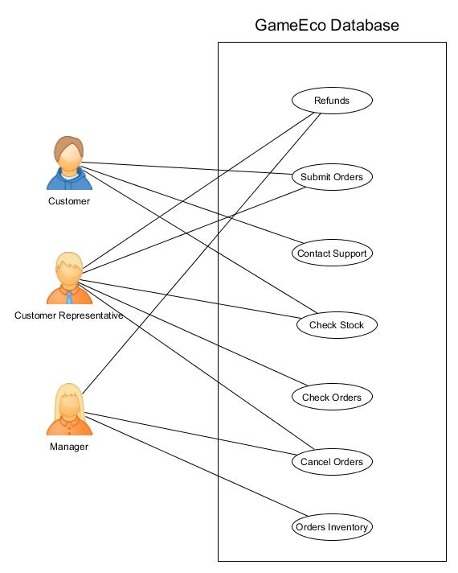
Three Main Users of the Gam-Eco Database
Several Actions the Users will perform

Slide 5
Conceptual Schema Description
PERSON: This entity contains customer and employee information. ID is the primary key for each person.
EMPLOYEE: Information about employee such as title, department, etc. Manager and customer service rep are employees.
CUSTOMER: Contains personal information about the customer such as street, name, state, phone#. Can purchase from the e-Commerce store as well as contact customer service.
SUPPLIERS: Suppliers have a m to n relationship with our company; many suppliers and supply multiple games to the company. Manager interacts with the supplier to retrieve new orders. SID is the primary key for suppliers.
MANAGER: Places orders for new game inventory.

Slide 6
Conceptual Schema Description
CUSTOMER SERVICE REPRESENTATIVE: Employee who interacts with the customer when problems arise. Has access to the customers' order history and basic personal information.
GAMES: Contains information about the game such as price, title, genre, platform, and key code. Key code will be unique to each game and will serve as the candidate key. Also contains inventory account and availability.
TRANSACTIONS: Information about customer transactions. Each transaction has a unique transaction ID.

Slide 7
Actions
CONTACTS: Many customers are able to contact many customer service representatives to resolve issues.
SUPPLIES: Many suppliers supply multiple games to the company.
PURCHASES: Many customers can purchase multiple games.
ORDERS: One manager is in charge of ordering multiple games.

Slide 8
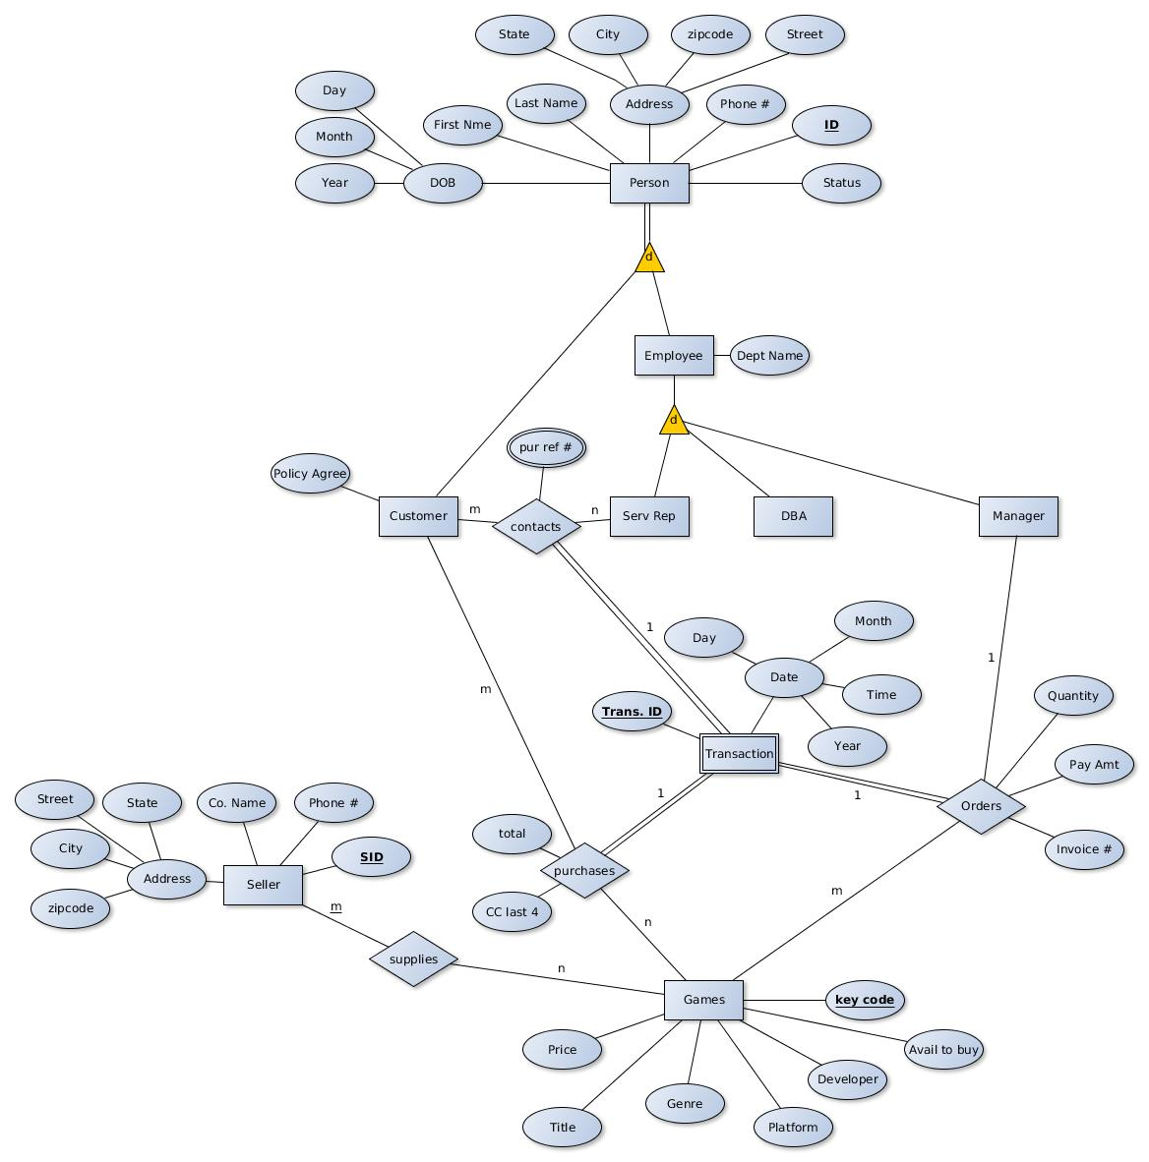
ER Diagram

Slide 9
Relational Schema
Person (ID, Status, Phone#, Street, ZipCode, City, State, LastName, FirstName, DOB_Day,
DOB_Month, DOB_Year)
FDs:
ZipCode,State → City
ID → Status,FirstName,LastName,DOB_Day,DOB_Month,DOB_Year
Phone#
Street
Normal Form: BCNF/3NF
_____________________________________________________
Employee ( DeptName, EID)
FDs:
EID → DeptName
Normal Form: BCNF
Customer (PolicyAgree, CID)
FDs:
CID → PolicyAgree
Normal Form: BCNF
__________________________
ServRep (SRID)
FDs:
SRID
Normal Form: BCNF

Slide 10
Relational Schema
Data Base Administrator (DID)
FDs:
DID
Normal Form: BCNF
_______________________________________
Manager (MID)
FDs:
MID
Normal Form: BCNF
_______________________________________
Transactions (TransID, Day, Month, Time, Year)
FDs:
TransID → Day,Month,Time,Year
Normal Form: BCNF/3NF
**Orders (Quantity, PayAmt, Invoice#, MID, Trans_ID, KeyCode)
**original table converted to two tables to increase normalization
Orders_Invoice (Quantity, PayAmt, Invoice#, Trans_ID)Trans_ID ref TransID
FDs:
Invoice# → Quantity,PayAmt, TransID
TransID → Invoice#
Normal Form: 3NF
Orders (Trans_ID, KeyCode, MID) MID ref MID, Trans_ID ref TransID, KeyCode ref Key_Code
FDs:
TransID → Key_Code,MID
Key_Code → TransID,MID
Normal Form: 3NF

Slide 11
Relational Schema
Supplier ( SID, Phone#, Co_Name, State, Street, City, Zipcode)
FDs:
Zipcode,State → City
SID → Co_Name, Phone#
Street
Normal Form: BCNF/3NF
________________________________________
Purchase (CID, Key_Code , Trans_ID, Total, Last4_CC#)
FDs:
Trans_ID → Total,Last4_CC#,CID, Key_Code
Key_Code → CID,Trans_ID
Normal Form: 3NF
Supplies (SID, Key_Code)
FDs:
Key_Code → SID
Normal Form: 3NF
_____________________________________________________
Contacts (TransID, CID, SRID, purchase_ref_#)
FDs:
purchase_ref_# → CID (purchase_ref_# not part of any candidate key)
TransID → CID,SRID
Normal Form: 2NF
_____________________________________________________
Games (Key_Code, Avail_To_Buy, Developer, Platform, Genre, Title, Price)
FDs:
Key_Code → Developer,Platform,Genre,Title,Price, Avail_To_Buy (superkey)
Platform → Developer (trivial)
Normal Form: 3NF

