Slide 1
Examining Hotelling’s law
CS-302 Modeling and Simulation
Prof. Mukesh Tiwari
DA-IICT
Karan Jivani (201501401)
Kishan Thesiya (201501409)
Utsav Patel (201501443)
Meet Rayvadera (201501444)

Slide 2
Problem
Different stores will apply different strategies to compete with each other, these strategies include actions like changing price of product, changing location of store, etc.
Hotelling’s law: “There is an undue tendency for competitors to imitate each other in quality of goods, in location and in other essential ways.”
Purpose: Model different strategies using Cellular Automata by defining rules for store actions and then observing collective behavior and examining Hotelling’s law

Slide 3
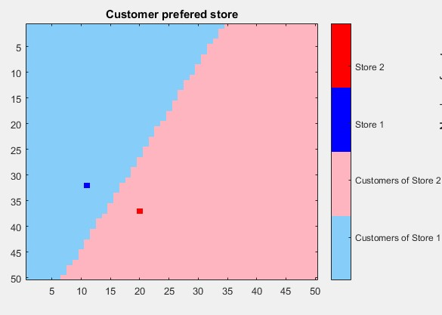
Model
Cellular Automata based model. Each cell represents either Customer or Store.
If customer then value will be prefered store number.
If store then value will be store number (shifted by total number of stores to differentiate from customer cell).
Assumptions
Consider only changing location of store and price of product (same and only one product at each store) as actions
All stores apply same set of rules for actions
All stores will follow same strategy
Instantaneous change in Customer preference

Slide 4
Rules
Store Action: Changing location
Store will choose one of the 4 directions which are possible and unfilled.
If there is no any such direction then it will stay.
Else it will check share of customers at new position.
If share of customer is higher than previous, then it will move to new location
Else it will stay
Store Action: Changing price
If customer share of store is higher than equally distributed customer share (1/(Number of stores)), then it will increase price by constant value
Else keep it constant or decrease it by constant randomly
Rule for customer: Customer will buy product from only one store which offers lowest cost according to new defined cost formula (cost = price + physical distance bet. Customer and store)

Slide 5
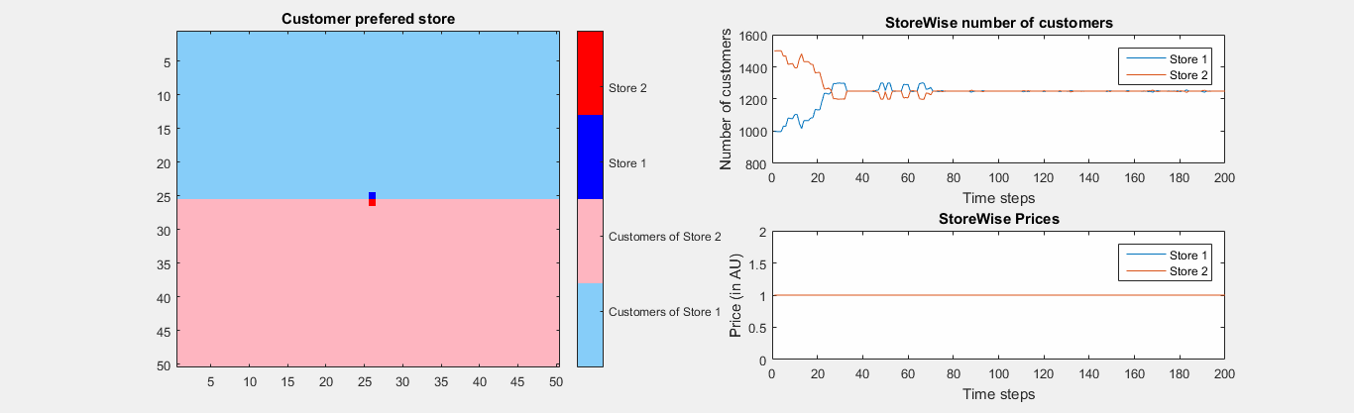
Strategy 1: Change Location Only (Same prices)
Real world interpretation: Vendors on the beach

Slide 6
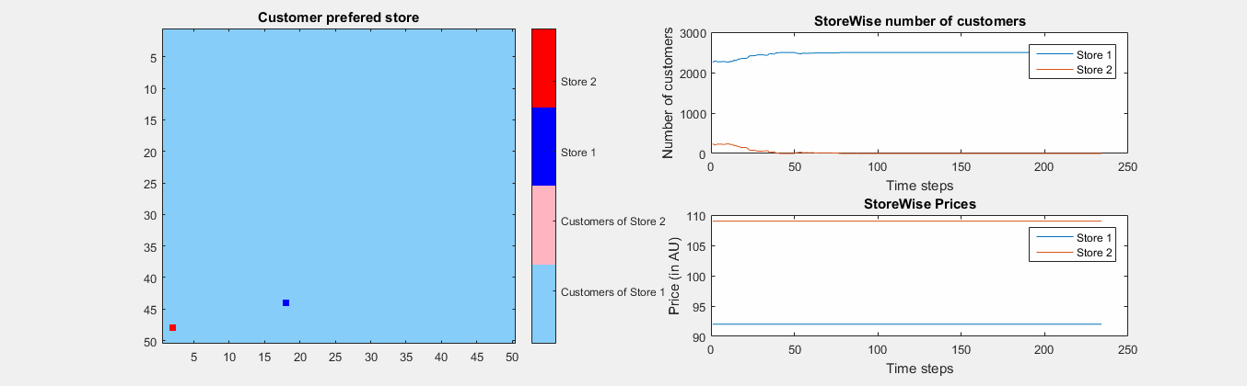
Strategy 1: Change Location Only (Different prices)

Slide 7
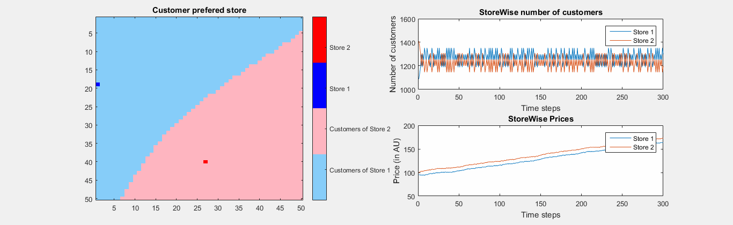
Strategy 2: Change Price Only
Real world interpretation: Store at the Centre of City vs. Store on Outskirts

Slide 8
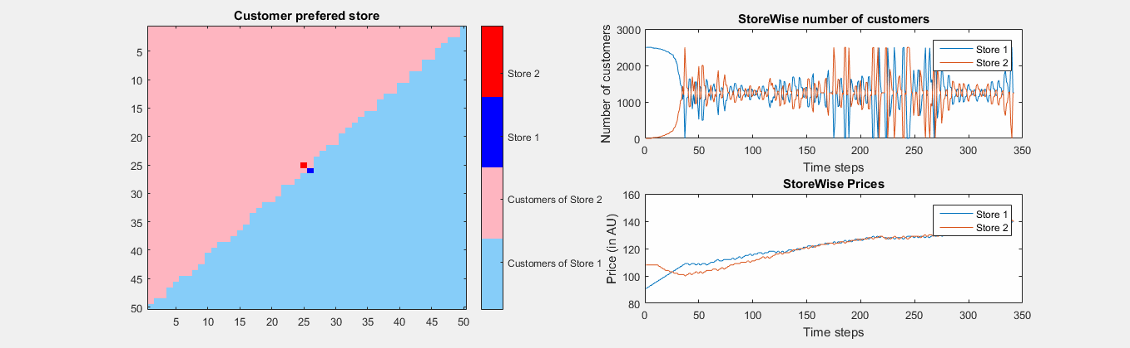
Strategy 3: Alternate Change in Price and Location

Slide 9
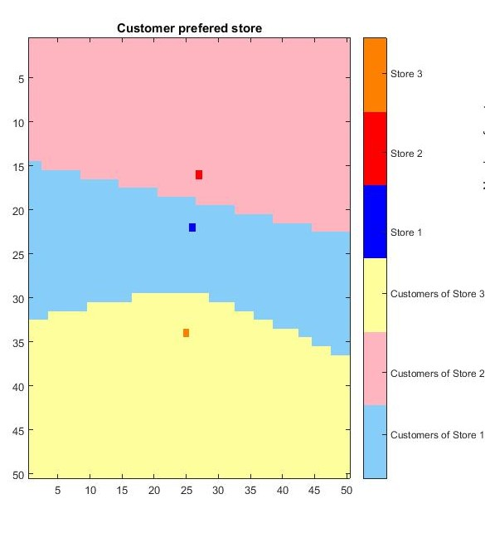
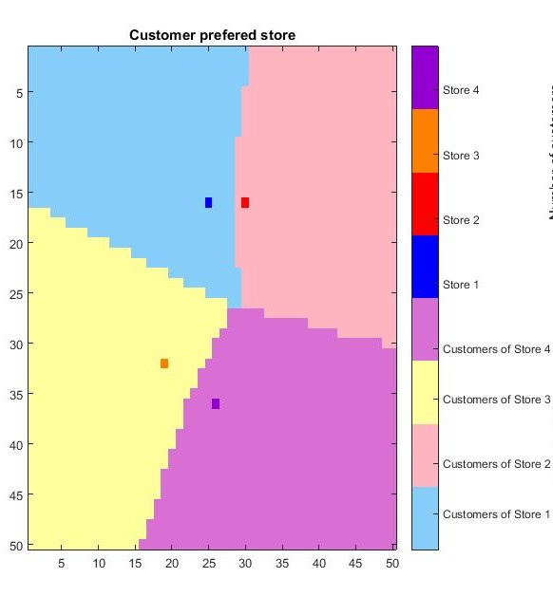
Higher number of stores & Strategy 3

Slide 10
Any Questions?

