Slide 1
Plotting Mandelbrot Set
Meet Rayvadera (201501444)
Utsav Patel (201501443)
CS 301 High Performance Computing Project
Instructor: Prof. Bhaskar Chaudhury

Slide 2

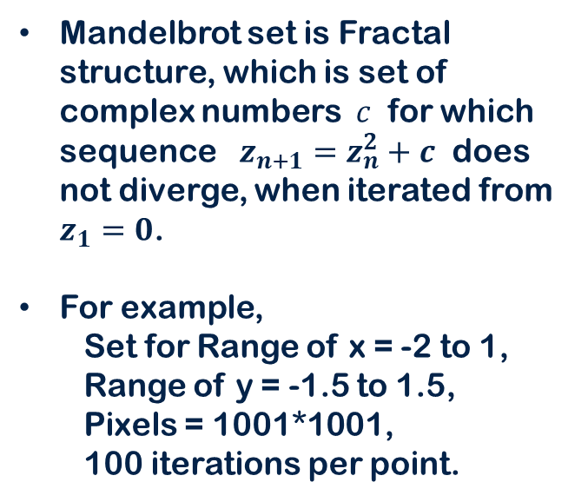
Mandelbrot Set

Slide 3

Zooming Mandelbrot Set
Mandelbrot set shows fantastic hidden patterns as we zoom in.
This pattern is for
Range of x: 0.139 to 0.14
Range of y: 0.639 to 0.64
Number of terms in sequence: 120
Number of pixels: 1001*1001

Slide 4
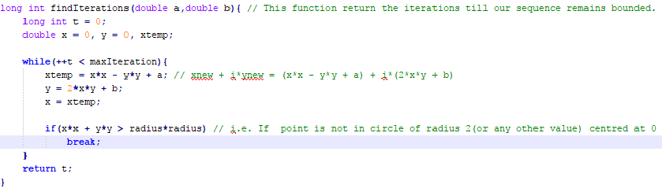
Serial Implementation
Go through all points, Find number of Iterations for each point, Assign color accordingly.

Slide 5
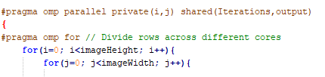
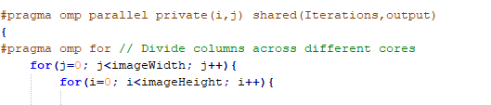
Parallel Implementation
Row-wise
Column-wise

Slide 6
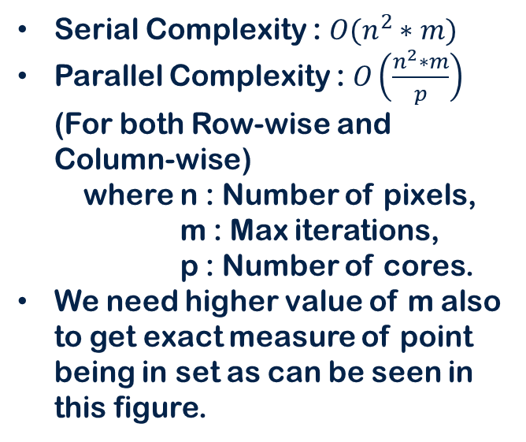
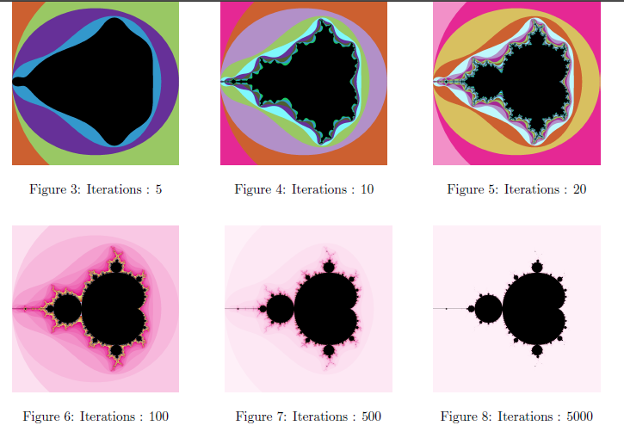
Complexity

Slide 7
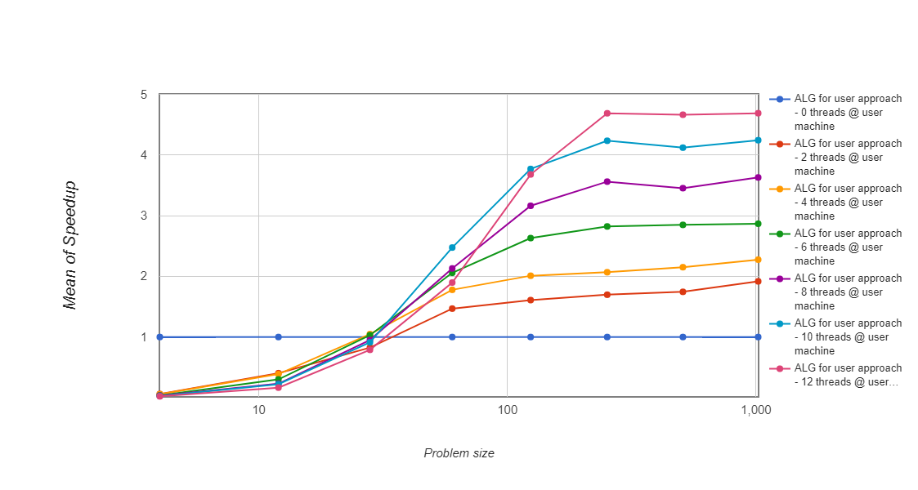
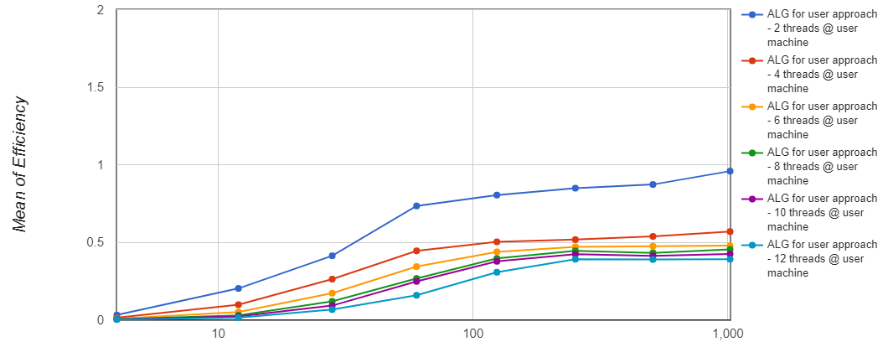
Speedup
Efficiency
*For Row-Wise Approach

Slide 8
Analysis
Parallel overheads or factors decreasing speedup
Synchronization
Rows or Columns which have to calculate more black part will take more time than others because for those points it will have to check until last term of sequence. So each core will take different time to finish.
That is why efficiency is highest for 2 cores because for 2 cores black part of image would be divided equally. But in Column-wise approach, that won’t happen because there black part won’t be divided equally.
No use of increased Cache
One of major benefit of parallel cores is increased cache but in this code there is not much use of cache because we are just writing into cache. So that won’t contribute to speedup.
*For Row-Wise Approach

Slide 9
Further Analysis
Number of rows need not be multiple of number of cores, so last core has to take care of more rows than other cores. This can result into less speedup.
Speedup will be much less than we get theoretical speedup from Amdahl’s Law because of Synchronization overhead. Code will have large parallel fraction, so theoretical speedup would be near to number of cores.
Coarse Grained Parallelism: More computations compared to communication between threads.
Not Scalable: No matter how much cores we set, there will be issue of load imbalance, as we don’t which row is going to take large amount of time before execution.
*For Row-Wise Approach

Slide 10
Further Scope
Another Approach for parallelizing
Problem is computationally expensive because of 2 parameters,
Number of pixels in image
Number of terms in sequence for each point
We have divided first one across cores (Row and Column wise), we can divide second also. We can specify each core to do computations for some range for all points.
There will be dependency because 2nd core can’t do further computations until previous core gives its result. To solve this dependency we can use Pipelining approach, points will go through Pipeline to find its successive iterations and stops when gets diverged.
Still there will be Synchronization issue because each point doesn’t have to go through end of Pipeline, so cores at the end of Pipeline will take less time to finish. So all cores have to wait until first core finishes.

Slide 11
Further Scope
Solving Synchronization issue of all 3 approaches
Task Scheduling can be used to solve Synchronization issue. A scheduler is what carries out the scheduling activity. Schedulers are often implemented so they keep all computer resources busy (load balancing), so maximum Speedup can be achieved.
In Row-wise approach, we can first schedule all cores to determine upper half of image and then solve lower half of image

Slide 12
Thank You

