Slide 1
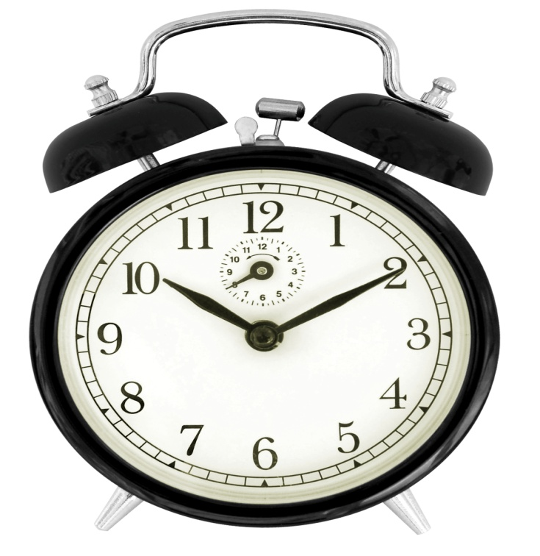
INNOVATIVE ASSIGNMENT GROUP 14
“Alarmy” GUI Interface using Tkinter and Pygame in Python.
19BCE246
19BCE268
19BCE299

Slide 2
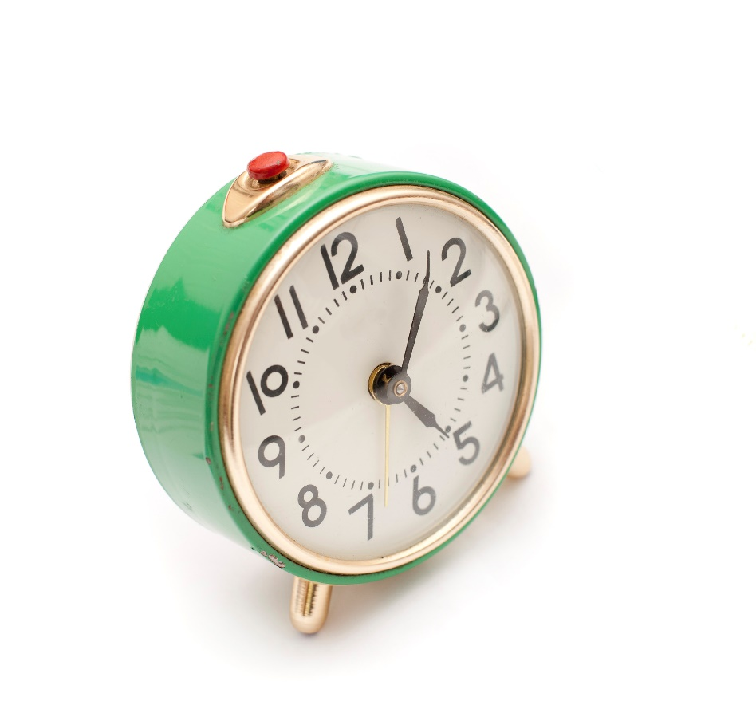
INDEX
Project Statement & Objective.
Description of Interface.
Packages Used.
Description of Code.
Execution Images.

Slide 3

Project Statement & Objective
Making an Alarm Clock which consists of different tasks/quizzes/ games, which only on completion makes the alarm stop ringing.
Alarmy GUI interface is specially designed for those who sometimes again fall asleep after switching off the Alarm set by them. This GUI interface makes users do some task on waking up so that the brain becomes active and not sleep again. This GUI interface can be used by all the age group of people and also beneficial to all.

Slide 4
Description of Interface
In this GUI interface we let users set their time for Alarm to ring, when the alarm starts ringing users get choice whether to play a game, or to answer some basic mathematics questions or to apply for a quiz. Further quiz contains 3 options i.e. to apply for a Science quiz, a General Knowledge quiz or an Odd One Out quiz.
Rules to make Alarm stop ringing:
On choosing Game to play, user needs to score a minimum of 5 points.
On choosing Mathematics, user needs to guess 5 correct answers out of many.
On choosing Quiz (any), user needs to correctly answer 3 out of 5 questions.
Failing to complete any of the above mentioned tasks, Alarm clock will not stop ringing. Again user will be provided with choices as to whether to play a game, to answer some basic mathematics questions or to apply for a quiz.

Slide 5
Packages Used
from tkinter import *
for importing everything from tkinter library.
from threading import *
for importing everything from thread library
from pygame import mixer
in order to play music/audio files in pygame, pygame.mixer is used
import datetime as dt
datetime module supplies classes to work with date and time.
import tkinter
tkinter is the standard GUI library for Python.
import time
allows us to handle various operations regarding time
import pygame
open-source cross-platform library for the development of multimedia GUI interface locations
import random as r
to generate random variables
import math as m
to use various math functions like square root or trigonometric identities
import random
to generate random variables
from PIL import Image,ImageTk
contains support to create and modify Tkinter BitmapImage and PhotoImage objects from PIL images

Slide 6
Description of Code
The code begins with the welcome page which uses simple tkinter API, then as the user clicks on the proceed button which calls the next window using functions OpenWindow() , this function has other sub functions like play_music(), stop_music(), alarm() etc.
This sub functions are responsible for creating different windows. alarm( ) creates window where the user sets alarm, and when its time the alarm starts playing music using play_music() function. The play_music() function creates a window which asks user to select the task in order to stop the alarm.
On selecting the function the user is taken to a specific window on the basis of his task, when the requirement of that task I fulfilled the stop_music() function executes and the alarm stops if not then vice versa.
After the alarm stops, alarm() checks whether the user has set alarm for other days, if yes then it ticks till alarm for those specific selected days is executed.

Slide 7
EXECUTION IMAGES

Slide 8
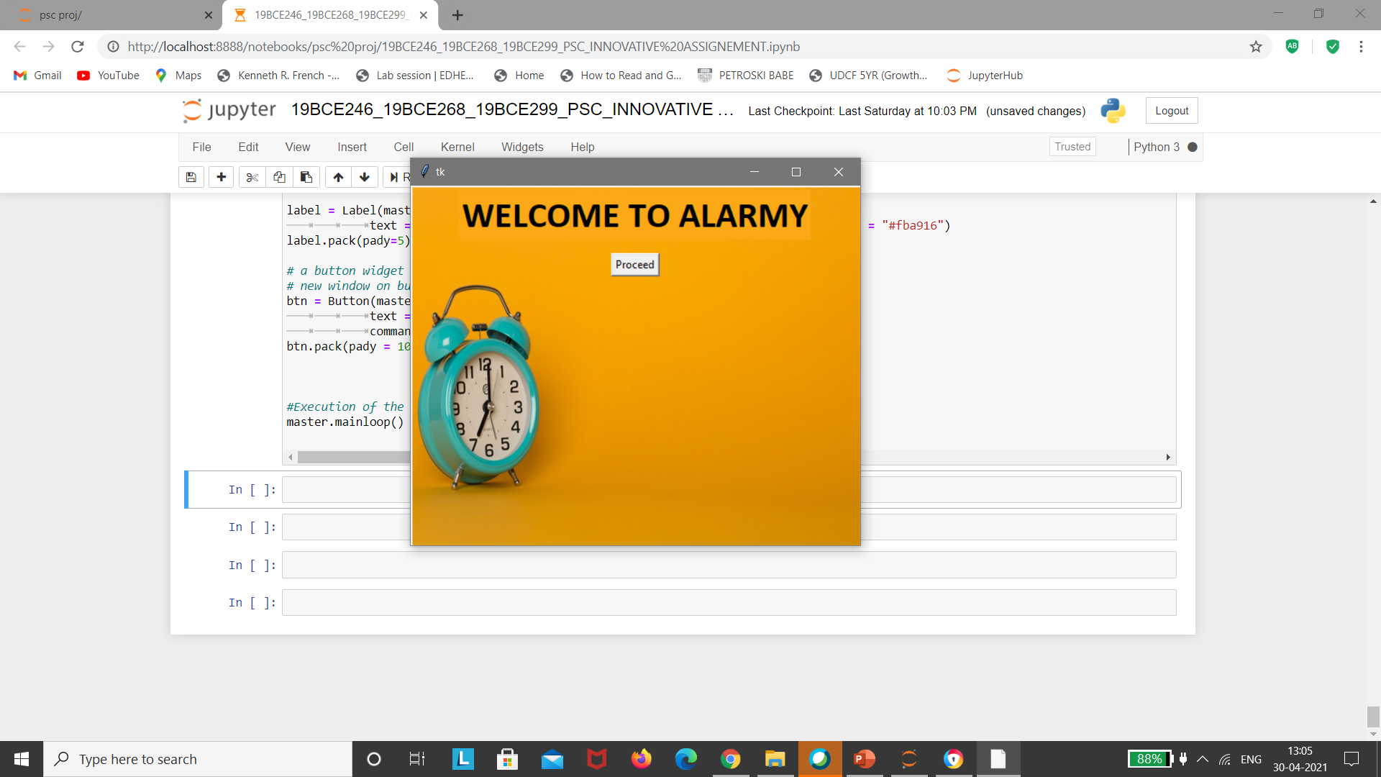
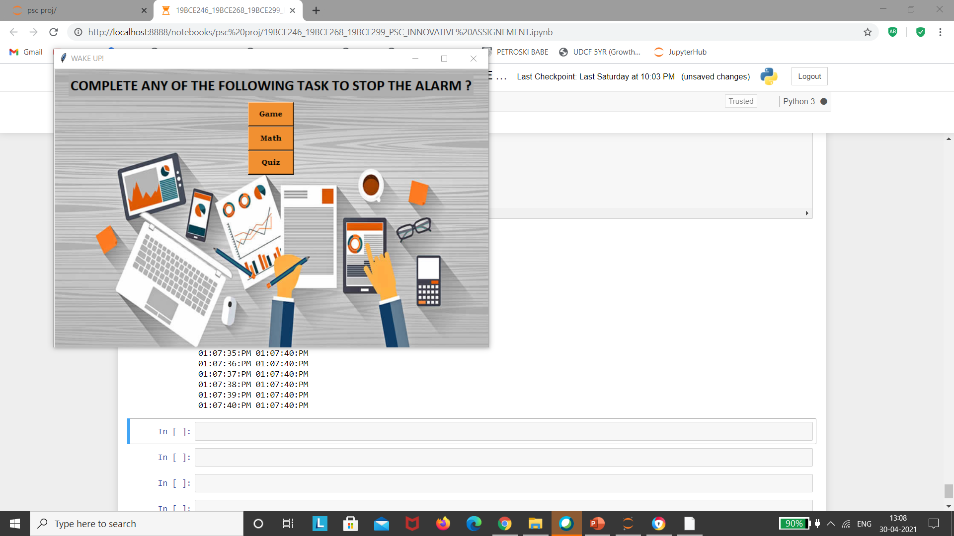
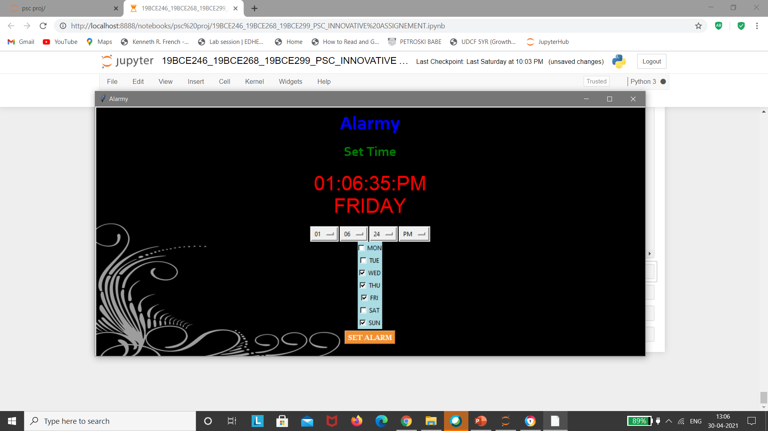

Slide 9
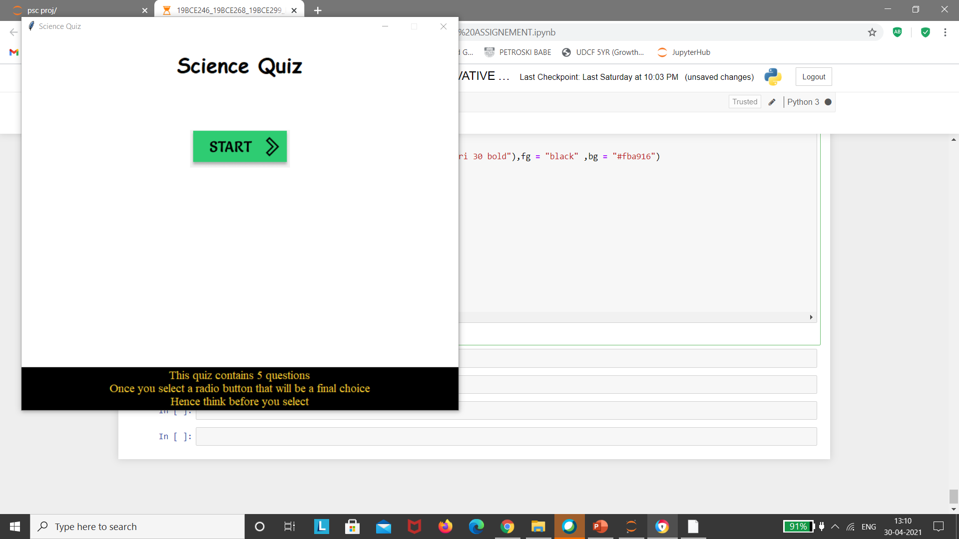
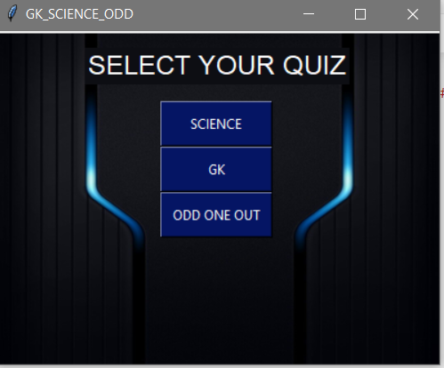
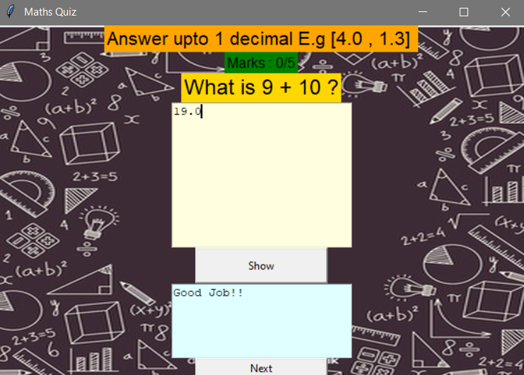
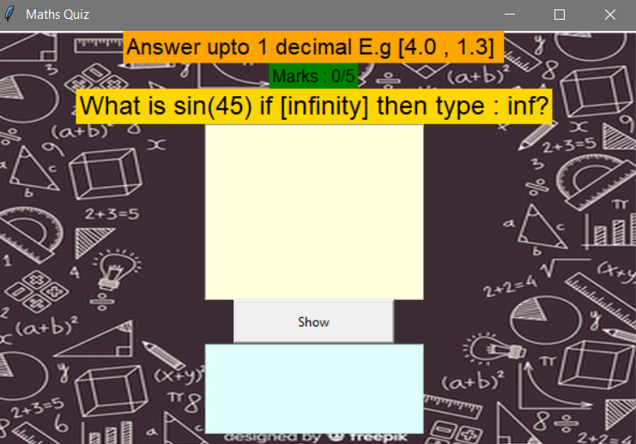

Slide 10
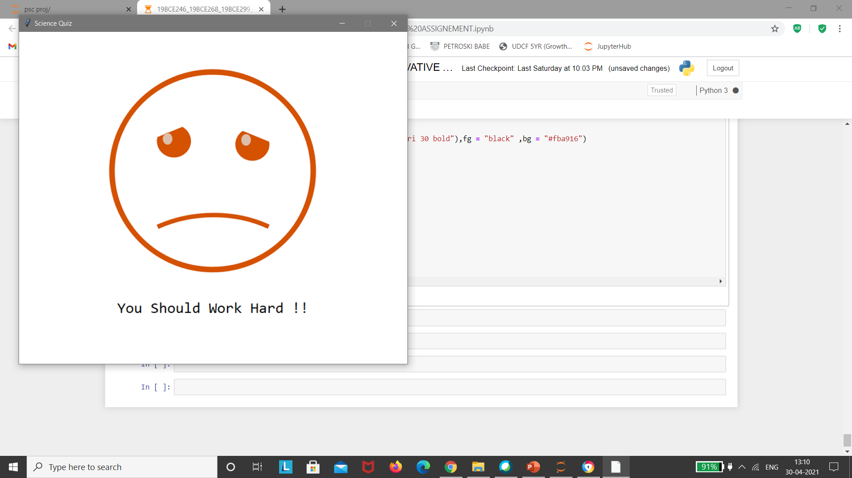
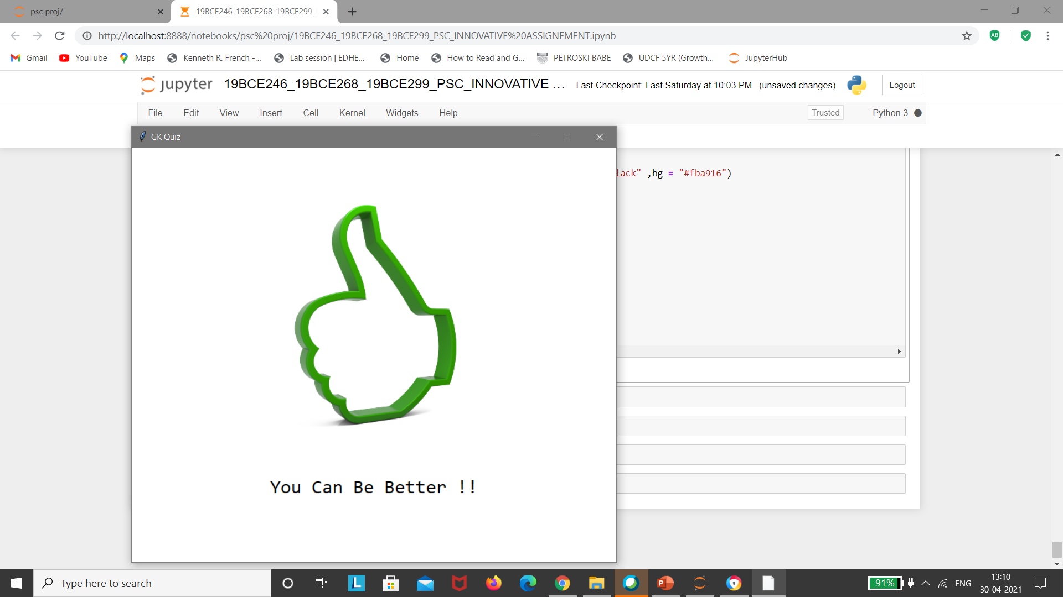
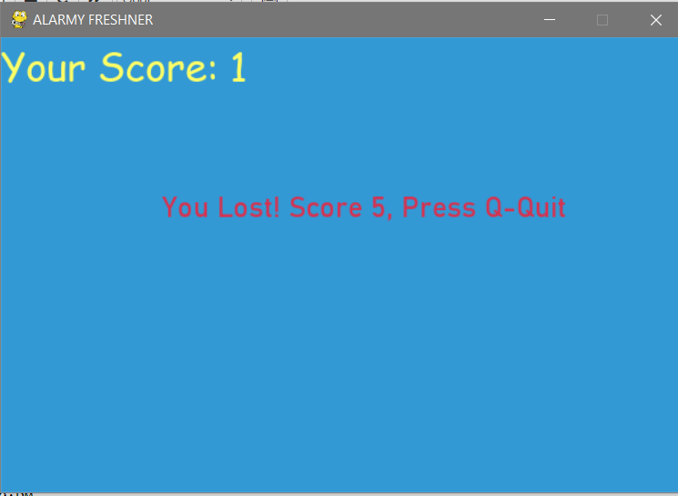
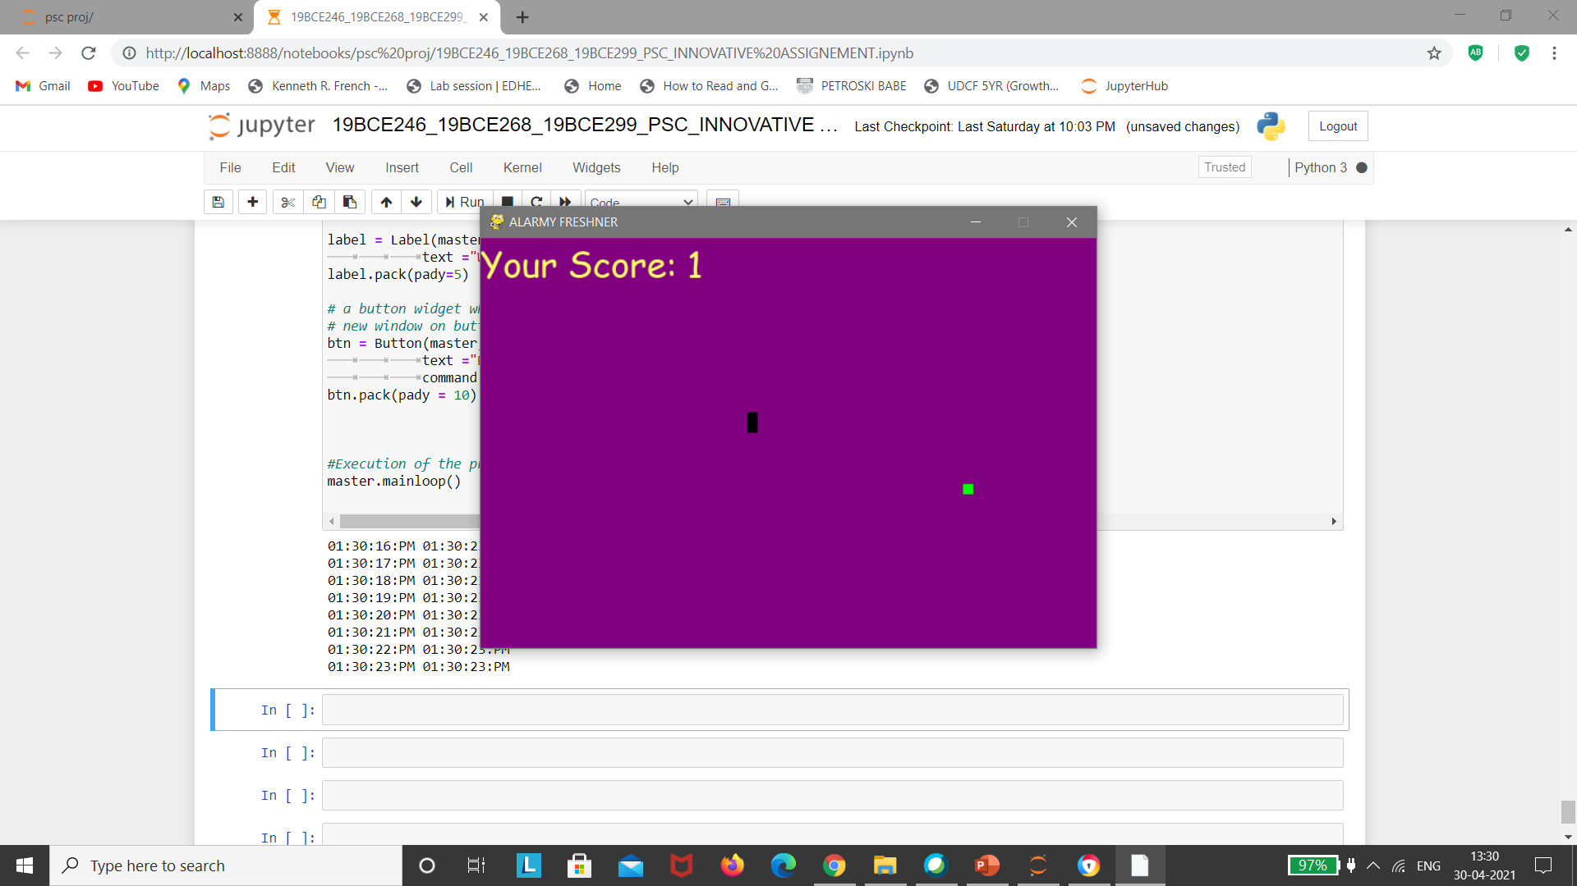

Slide 11
THANK YOU
To see the full execution of code, refer the following video
https://drive.google.com/drive/u/0/folders/19rBs4rUN1DzGgKGykIt5Uap8LuFPhniJ

