Slide 1
ABC Call Volume Trend Analysis Presentation
Present by: Meet Hadeeya

Slide 2
Project analysis slide 2
Description
This project involves handling incoming calls from existing or prospective customers. The goal is to attract, engage, and delight customers, turning them into loyal advocates for the business.
Problem statement : analyzing any difficulty that customers are facing like call abandoned, transferred and not reachable at night, And providing measures that needs to be taken to increase customer satisfaction.
Dataset : contains information on over 117988 customer call information
Dataset specifications : agent, agent id, waiting time, call duration, call status etc..
A Customer Experience (CX) team plays a crucial role in a company. They analyze customer feedback and data, derive insights from it, and share these insights with the rest of the organization. This team is responsible for a wide range of tasks, including managing customer experience programs, handling internal communications, mapping customer journeys, and managing customer data, among others.

Slide 3
Project analysis slide 2
Tech Stack Used
Microsoft Excel 2019 Professional Plus.
MS Excel provides plethora of functions to deal with different analysis scenarios and can easily transform the analysis into stunning visualizations with the help of charts, pivot tables etc.
Extra Tools – Data Analysis tools
Hyperlink for Excel Sheet
https://docs.google.com/spreadsheets/d/1dJ5gd4ez_F6v_v3aImXPv0u3uwZ2qjkZ/edit?usp=sharing&ouid=112032062031627115755&rtpof=true&sd=true
Microsoft PowerPoint Presentation 2019 Professional Plus.

Slide 4
Project analysis slide 2
Approach
1
DATA CLEANING
DATA ANALYTICS TASK
2
3
INSIGHTS
RESULT
4
5
FEEDBACK

Slide 5
Project analysis slide 2
Data Cleaning
In agent name and agent id column we have #NA values mainly because of abandoned call status with no assigned agent, so we have to keep those.
Column named wrapped by contains some null values but we are not going to use it for our analysis, so removing them is not necessary for us.

Slide 6
Project analysis slide 3
Project Analysis
TASK - 1
TASK-2
TASK-3
TASK-4
Average Call Duration
Call Volume Analysis
Manpower Planning
Night Shift Manpower Planning

Slide 7
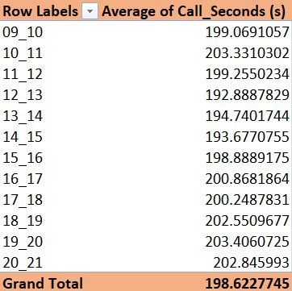
Project analysis slide 4
Task-1
Determine the average duration of all incoming calls received by agents. This should be calculated for each time bucket.
Creating a pivot chart in MS Excel with time bracket as rows and Average call seconds as values.
Filtering out those calls only which were answered and not including abandoned or transferred calls.
Creating a bar chart.
Tasks
Management Objectives
Implementation lan
Schedules
Customer Objectives
Resources

Slide 8
Project analysis slide 4
Task-1
Tasks
Insights:
During 12PM to 3 PM avg call duration remains low
Highest avg call duration during 10AM to 11AM & 7PM to 8PM
Management Objectives
Implementation lan
Schedules
Customer Objectives
Resources

Slide 9
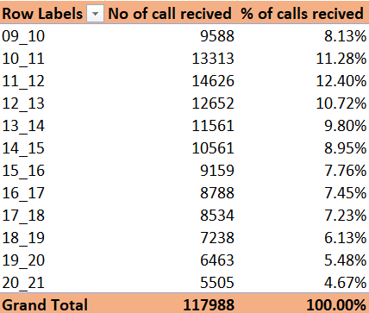
Project analysis slide 4
Task-2
Visualize the total number of calls received. This should be represented as a graph or chart showing the number of calls against time. Time should be represented in buckets (e.g., 1-2, 2-3, etc.).
Tasks
Creating a pivot chart in MS Excel with time bracket as rows and Count of call received as values.
Adding extra column which shows its percentage values.
Creating a bar chart
Management Objectives
Implementation lan
Schedules
Resources

Slide 10
Project analysis slide 4
Task-2
Tasks
Insights:
Highest total call received during 11AM to 12PM slot.
Lowest during 8PM to 9PM.
Management Objectives
Implementation lan
Schedules
Customer Objectives
Resources

Slide 11
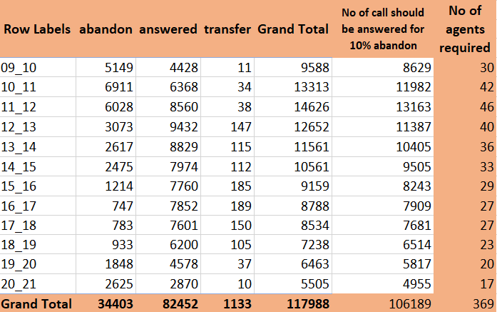
Project analysis slide 4
Task-3
The current rate of abandoned calls is approximately 30%. Propose a plan for manpower allocation during each time bucket (from 9 am to 9 pm) to reduce the abandon rate to 10%. In other words, you need to calculate the minimum number of agents required in each time bucket to ensure that at least 90 out of 100 calls are answered.
Tasks
Management Objectives
Creating a pivot chart in MS Excel with time bracket as rows, call status as column and Count of call received as values.
Creating column for attaining 90% response to the total call received.
Calculating no of agents needed to achieve the call response target
Implementation lan
Schedules
Resources

Slide 12
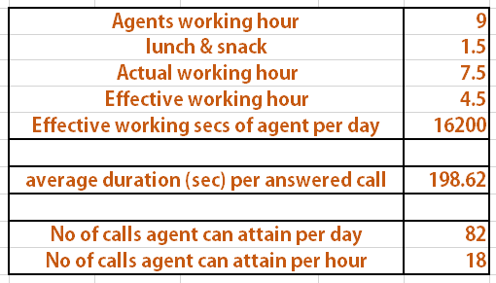
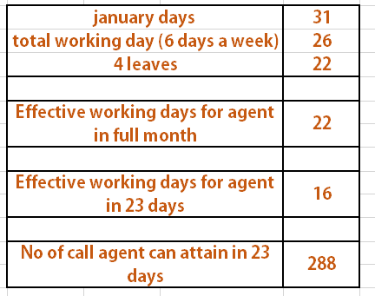
Project analysis slide 4
Task-3
Tasks
Management Objectives
Implementation lan
Schedules
Resources

Slide 13
Project analysis slide 4
Task-3
Tasks
Management Objectives
Implementation lan
Schedules
Resources

Slide 14
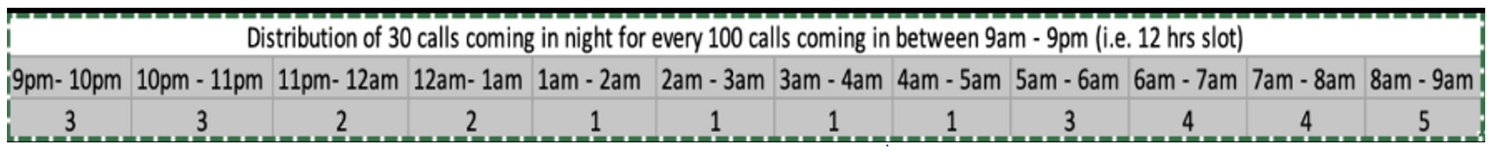
Project analysis slide 4
Task-4
Customers also call ABC Insurance Company at night but don't get an answer because there are no agents available. This creates a poor customer experience. Assume that for every 100 calls that customers make between 9 am and 9 pm, they also make 30 calls at night between 9 pm and 9 am.
Tasks
Task : Propose a manpower plan for each time bucket throughout the day, keeping the maximum abandon rate at 10%.
Condition : Assume that for every 100 calls that customers make between 9 am and 9 pm, they also make 30 calls at night between 9 pm and 9 am
The distribution of these 30 calls is as follows:
Management Objectives
Implementation lan
Schedules
Resources

Slide 15
Project analysis slide 4
Task-4
Tasks
We already have data on number of call should be received for retaining 10% abandon rate during day shift.
Out of that 30%, which is total of 31857 call should be received during night shift.
And as per given distribution we have distributed 31857 into each time bucket.
Then same task being done to find the number of agents needed
Management Objectives
Implementation lan
Schedules
Resources

Slide 16
Project analysis slide 4
Task-4
Tasks
Management Objectives
Implementation lan
Schedules
Resources

Slide 17
Project analysis slide 2
Result
This Project helped me learn more about creating combined charts and Bubble chart as a part of my data handling skills
Task of finding number of agents needed to decrease the abandon rate below 10% gave me some challenge to brainstorm and further develop analytical thinking.
It will be easy for client to recruit the just needed agents to deal with the round the clock customer reach and engage new customers by keeping abandon rate below 10%, also it will help them to optimize the workforce during the peak and lean hours of call center.

Slide 18
Thank You

