Slide 1
Touch Screen Smart Mirror
Kyle Skey

Slide 2
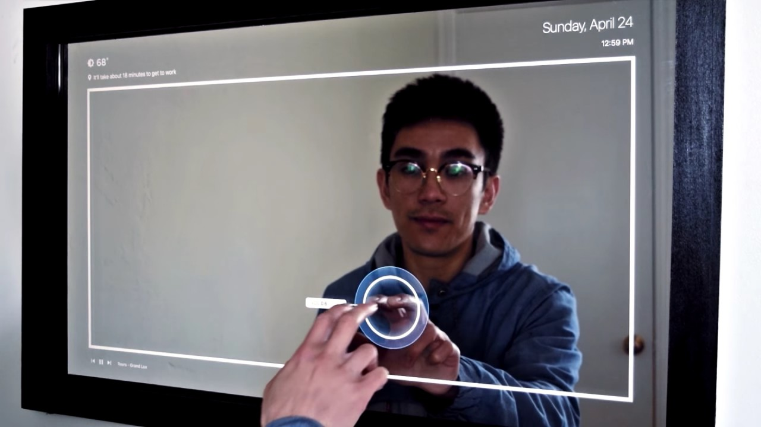
Smart Mirror Concept
“Smart” Mirror that displays news and information
Touch screen for App selection
(Required) One finger touch with large grid resolution (16x9)
(Optional) One finger touch with better resolution
(Optional) Two finger touch

Slide 3
Design Elements/IP
IR Grid Touch Screen Grid Assembly
Intellectual Property
Tx Controller
Circuit and PCB Design of Rx/Tx Modules
Modulation/Filtering Scheme if needed
Mechanical Packing Design
Detection Algorithm
IR Tx Array
IR Beam
I2C Protocol
Signal Filtering & Integrator
8-Ch ADC
I2C Serial
Rx Controller
IR Rx Array
Computer
Display

Slide 4
IR Grid Theory
Tx IR LEDs
Normal state all sensors are illuminated
Finger breaks beam in vert/horiz axis
“Dark” Rx sensors mapped to coordinate system
Rx controller sends coordinates to computer
Rx IR Phototransistors
Tx IR LEDs
“Dark”
Finger
Rx IR Phototransistors
“Dark”

Slide 5
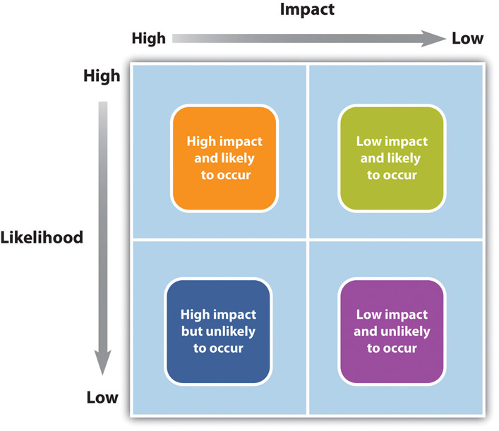
Risks and Concerns
Mechanical Alignment and Tollerances
IR Interference
Serial Protocol Issues
Funding
PCB Fab Errors
Design Errors
App Development Issues
Schedule
Full assembly Integration problems

