Slide 1
Student Community Intelligence Report
This report summarizes 15 students. The strongest visible theme is leading. Faculty should use the community and matching results to support peer learning, mentoring, and targeted programming.

Slide 2
Key Insights
Total students: 15
20.0% of students are interested in Leading
6.7% of students are interested in Music Going
6.7% of students are interested in Gaming
6.7% of students are interested in Football Going

Slide 3
Communities
Cluster 1 (3)
Cluster 2 (5)
Gaming Legends (3)
Fitness Warriors (3)
Cluster 3 (1)
Gaming Legends (1)
Fitness Warriors (1)
Creative Makers (1)

Slide 4
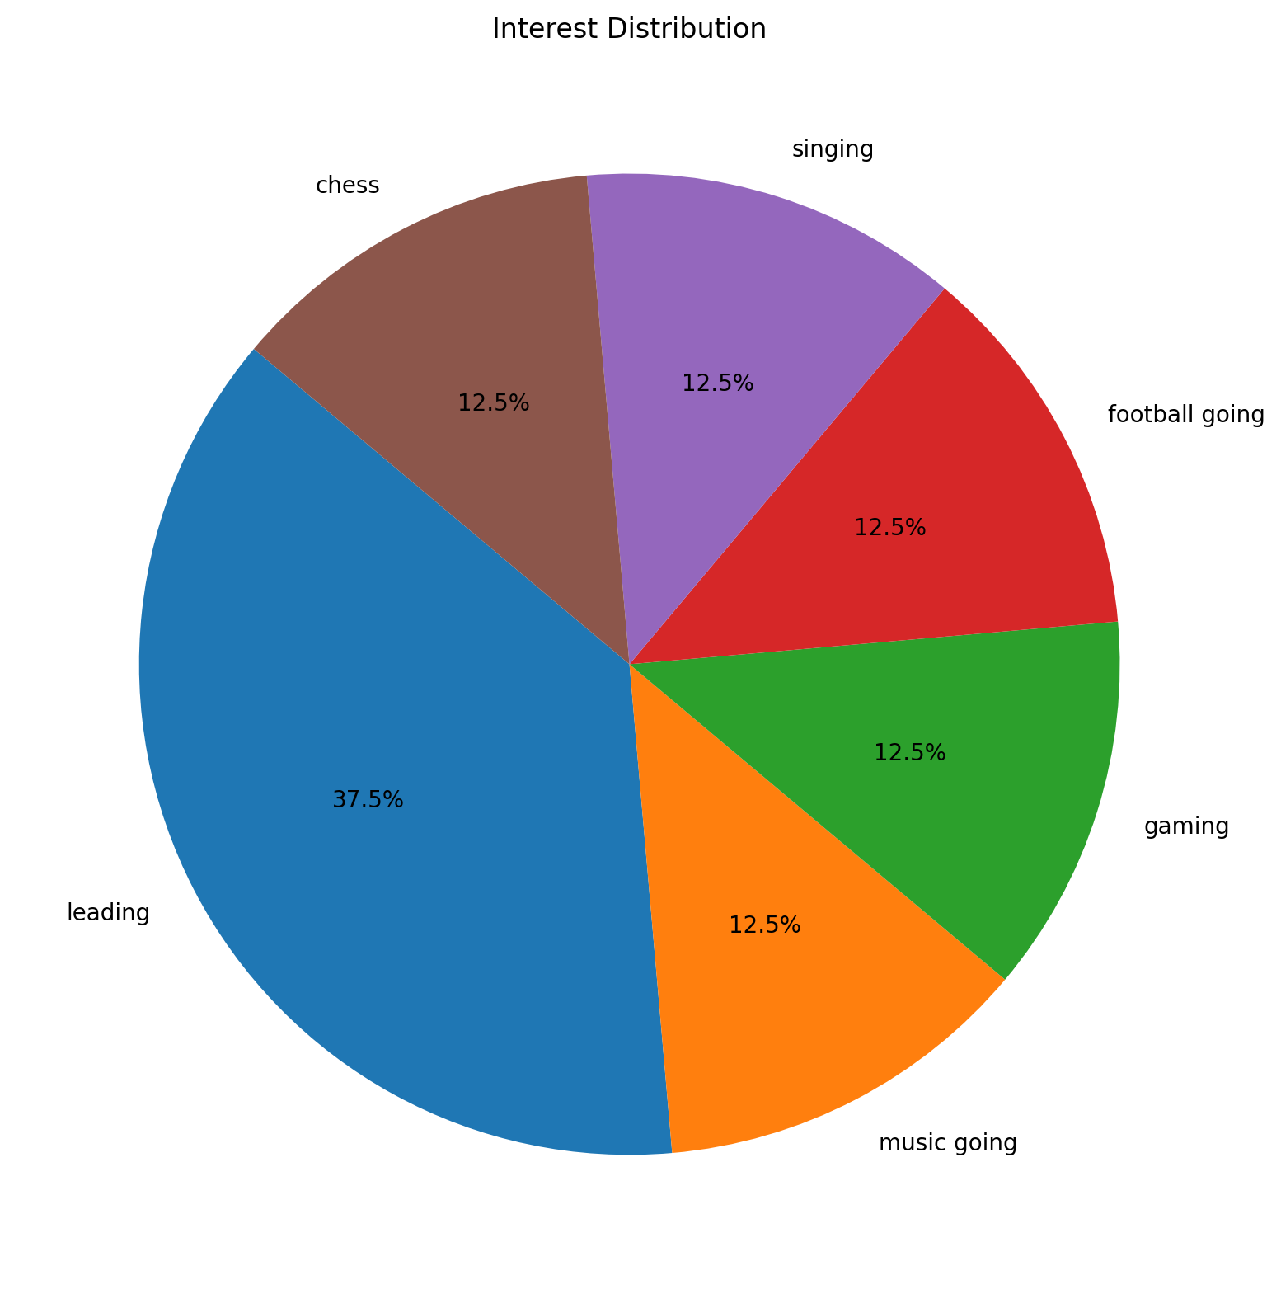
Interest Distribution

Slide 5
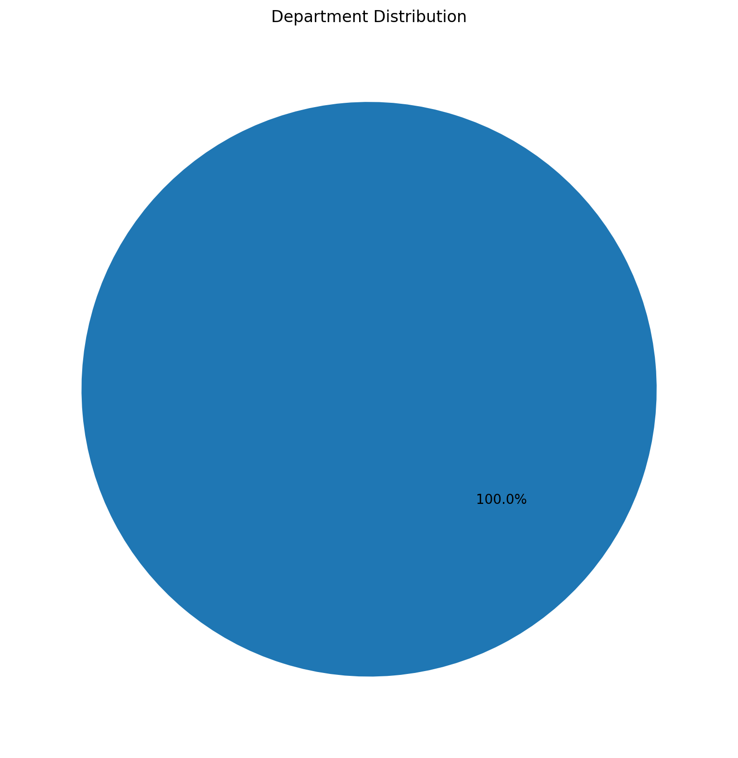
Department Distribution

Slide 6
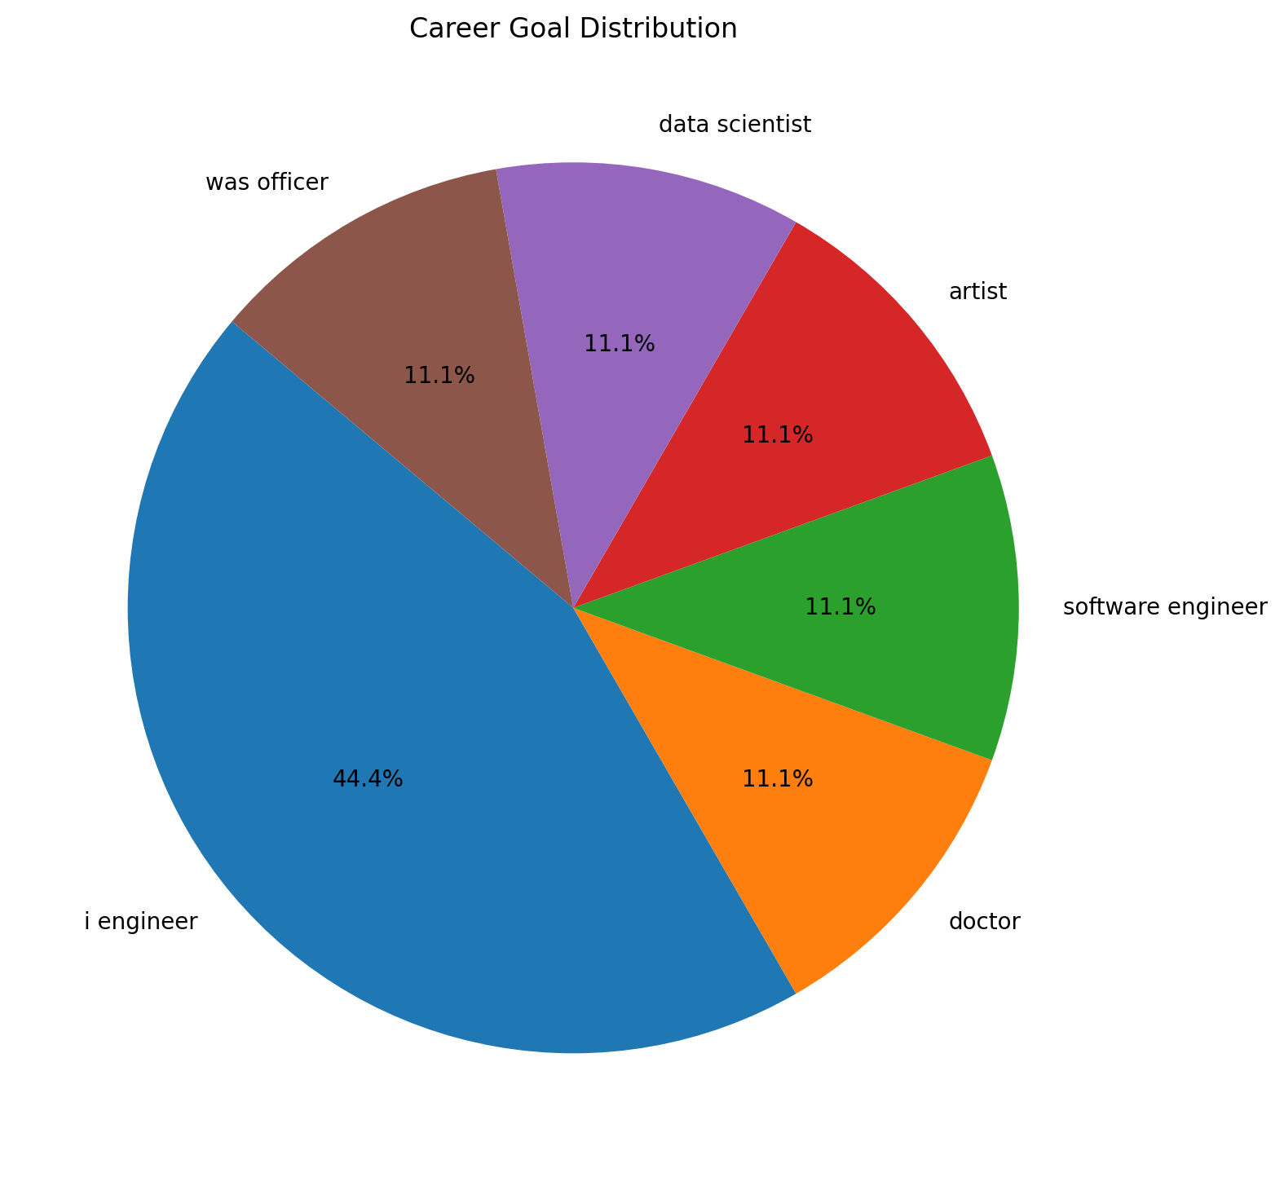
Career Goal Distribution

Slide 7
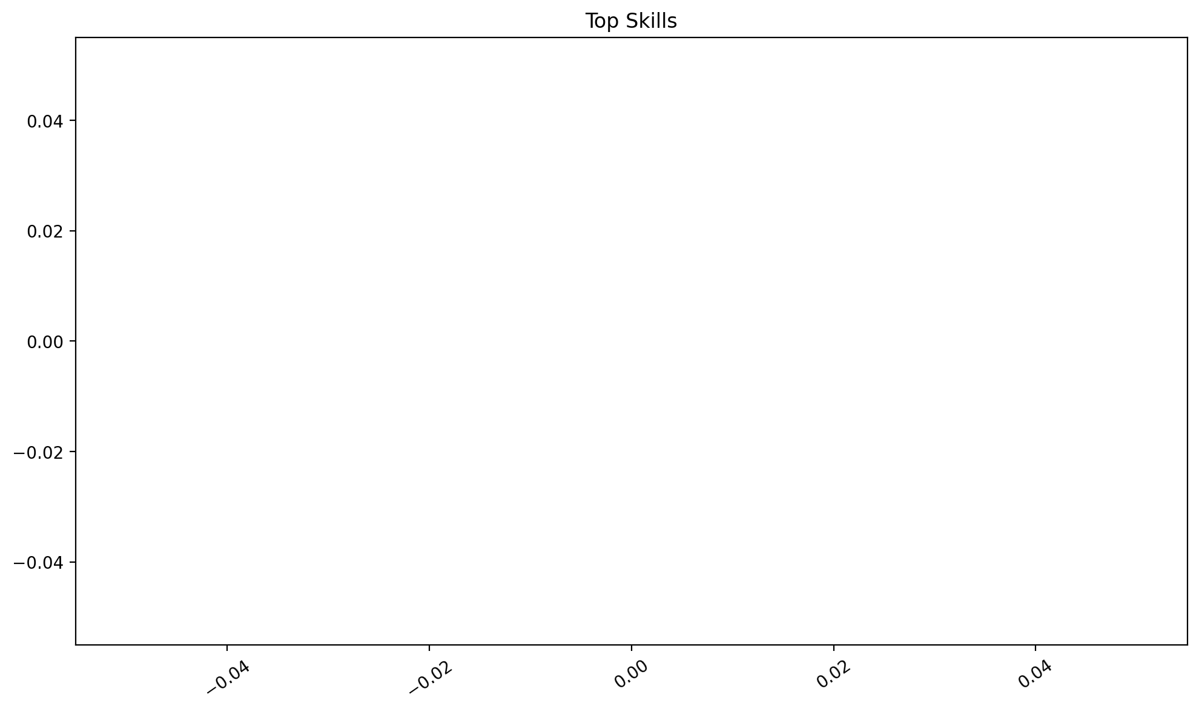
Top Skills

Slide 8
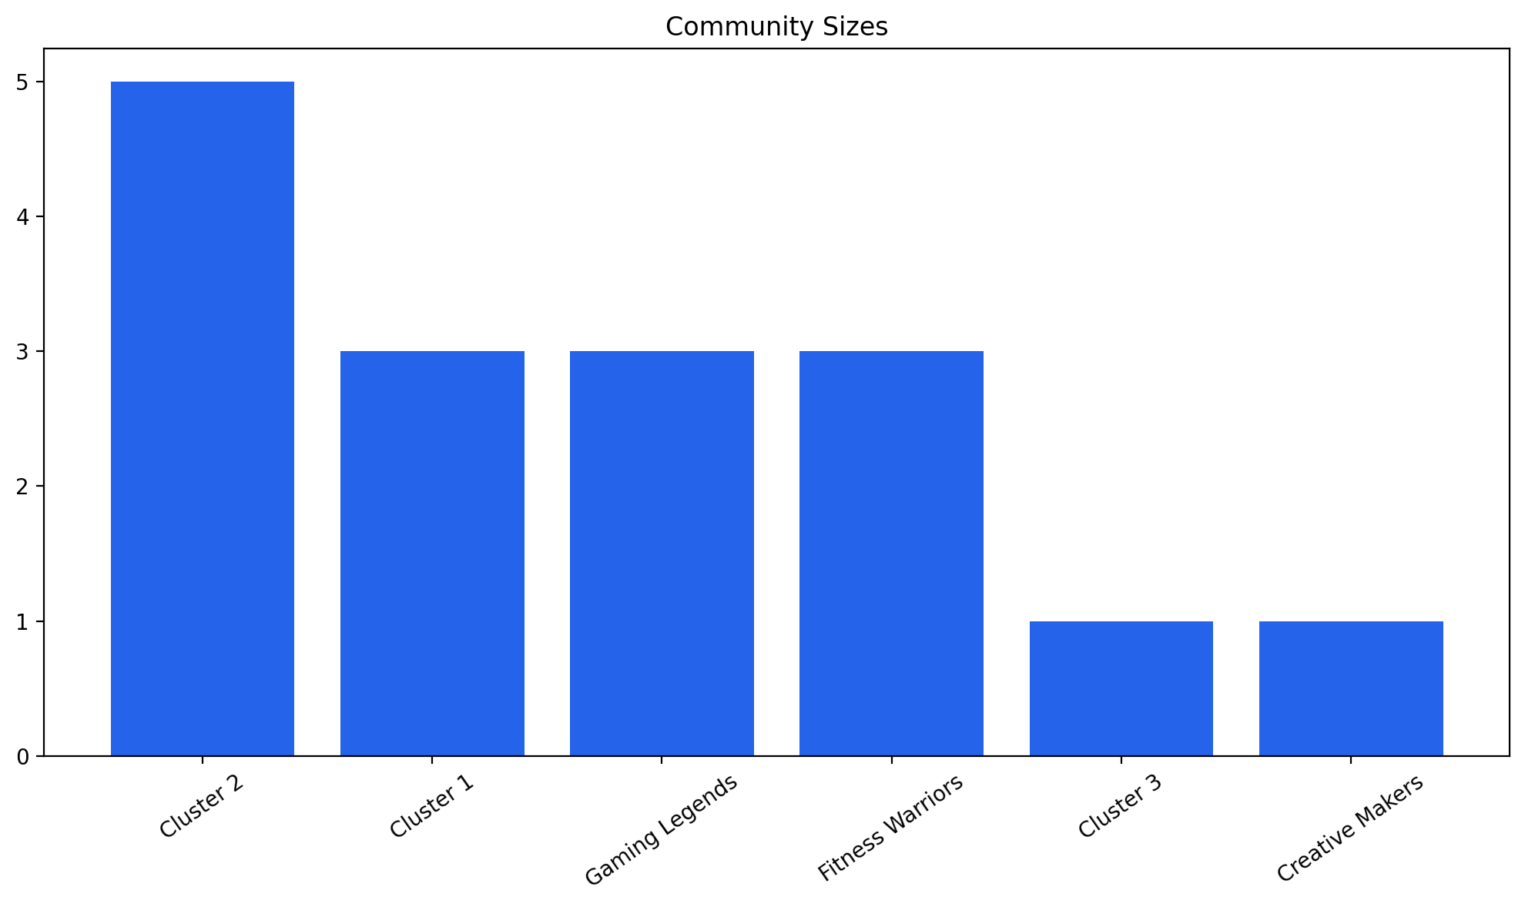
Community Sizes

