Slide 1
Secure Data Hiding In Images Using Steganography
CAPSTONE PROJECT
Presented By: Meet Panchal
Student Name : Meet Panchal
College Name & Department :
Aditya Silver Oak Institute of Technology,Computer Engineering

Slide 2
OUTLINE
Problem Statement
Technology used
Wow factor
End users
Result
Conclusion
Git-hub Link
Future scope

Slide 3
PROBLEM STATEMENT
Secure communication is essential in today’s digital world. This project implements a Python-based steganography tool that allows users to hide encrypted text messages inside images using LSB steganography. A user-provided password ensures that only authorized users can extract the hidden message. The tool generates an encrypted image, "EncryptedImage.png", which appears visually unchanged. A separate decryption module retrieves the message using the correct password, ensuring confidential and secure communication.

Slide 4
TECHNOLOGY USED
Programming Language: Python.
Libraries:
OpenCV (cv2) – For image processing and manipulation.
NumPy – For handling image arrays and data conversion.
Tkinter – For building the graphical user interface (GUI).
Platform: Windows.
System type - 64-bit operating system, x64-based processor.
Tools: Visual Studio Code.

Slide 5
WOW FACTORS
Dual-Layer Security – Combines LSB steganography with AES encryption, ensuring double protection for hidden messages.
Password-Protected Extraction – Only users with the correct password can retrieve the hidden message, preventing unauthorized access.
Undetectable Data Hiding – The encrypted image looks identical to the original, making it nearly impossible to detect the presence of hidden data.
User-Friendly GUI – A simple Tkinter-based interface makes encryption and decryption easy for all users.
Versatile Image Support – Works with JPEG and PNG formats, allowing flexibility in secure communication.

Slide 6
END USERS
Government Agencies – For secure intelligence communication and confidential data exchange.
Corporations & Businesses – To protect sensitive business information from cyber threats and industrial espionage.
Journalists & Whistleblowers – Ensures private and secure communication in restrictive environments.
General Users & Privacy Enthusiasts – Allows individuals to share secret messages without detection.
Cybersecurity Professionals & Researchers – Useful for exploring data security, encryption, and steganography techniques.

Slide 7
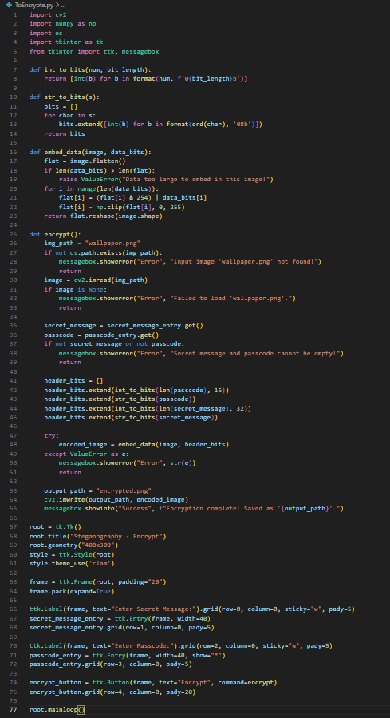
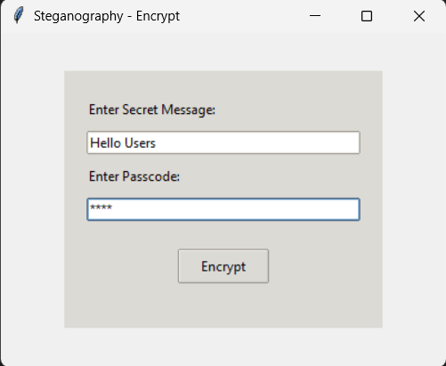
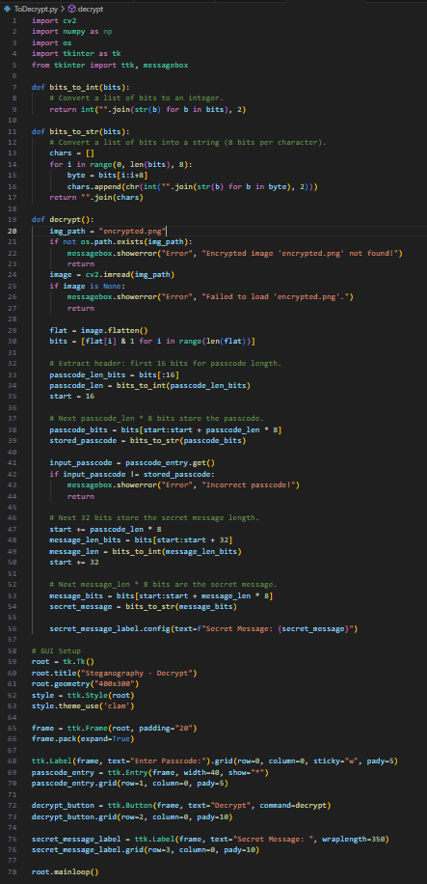
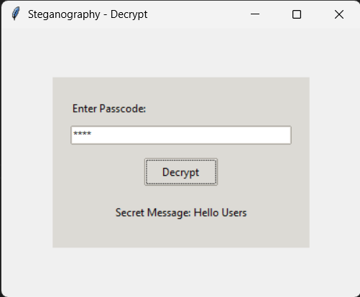
RESULTS
Encrypt: Output: Decrypt: Output:

Slide 8
CONCLUSION
This project successfully demonstrates secure communication using image steganography and encryption. By embedding hidden messages within images using LSB steganography and protecting them with a password, it ensures confidentiality and prevents unauthorized access. The tool provides a user-friendly interface for both encryption and decryption, making it accessible to various users, from cybersecurity professionals to general users. This approach offers an efficient and undetectable method for secure data transmission. With further advancements like AI-driven optimization and mobile integration, the project holds great potential for enhancing digital privacy and security.

Slide 9
GITHUB LINK
https://github.com/Meet6499/Secure-Data-Hiding-In-Images-Using-Steganography

Slide 10
FUTURE SCOPE
AI-Driven Steganography – Implementing deep learning models to optimize image selection and enhance security.
Quantum-Safe Encryption – Integrating encryption techniques resistant to future quantum computing threats.
Cloud-Based Steganography – Developing a web-based or cloud platform for secure online message hiding and retrieval.
Mobile Application – Expanding the project to Android & iOS for on-the-go secure communication.
Multi-Layer Steganography – Embedding data across multiple images to further enhance security and detection resistance.

Slide 11
THANK YOU

