Slide 1

Unit – 1 Binary Systems and Logic Circuits
Hardik Doshi
 99789 11553
→ hardik.doshi@darshan.ac.in
Digital Electronics (2131004) Darshan Institute of Engineering & Technology

Slide 2
Topics to be covered
The Advantage of Binary
Number Systems
Use of Binary in Digital Systems
Logic Gates
Logic Family Terminology

Slide 3
Advantages of Number System
Unit – 1: Review of Mathematical Theory Darshan Institute of Engineering & Technology

Slide 5
Number Systems
Unit – 1: Binary Systems & Logic Circuits Darshan Institute of Engineering & Technology

Slide 6
Common Number Systems
System | Base | Symbols | Used by Humans? | Used in Computers?
Decimal | 10 | 0, 1, … 9 | Yes | No
Binary | 2 | 0, 1 | No | Yes
Octal | 8 | 0, 1, … 7 | No | No
Hexa- decimal | 16 | 0, 1, … 9, A, B, … F | No | No

Slide 7
Quantities / Counting
Decimal | Binary | Octal | Hexa- decimal
0 | 0 | 0 | 0
1 | 1 | 1 | 1
2 | 10 | 2 | 2
3 | 11 | 3 | 3
4 | 100 | 4 | 4
5 | 101 | 5 | 5
6 | 110 | 6 | 6
7 | 111 | 7 | 7
Decimal | Binary | Octal | Hexa- decimal
8 | 1000 | 10 | 8
9 | 1001 | 11 | 9
10 | 1010 | 12 | A
11 | 1011 | 13 | B
12 | 1100 | 14 | C
13 | 1101 | 15 | D
14 | 1110 | 16 | E
15 | 1111 | 17 | F

Slide 8
Conversion among Bases
Possibilities
Example
Decimal
Octal
Binary
Hexadecimal
25₁₀ = 11001₂ = 31₈ = 19₁₆
Base

Slide 9
Decimal to Binary
Decimal
Binary
Technique
Divide by two, keep track of the remainder
First remainder is bit 0 (LSB, least-significant bit)
Second remainder is bit 1 and so on

Slide 10
Example (Decimal to Binary)
125₁₀ = ?₂
2
125
1
2
62
0
2
31
1
2
15
1
2
7
1
2
3
1
2
1
1
0
125₁₀ =
1111101₂

Slide 11
Example (Decimal to Binary)
0.6875₁₀ = ?₂
integer
fraction
0.6875 x 2 =
1.3750
1
+
0.3750
0.3750 x 2 =
0.7500
0
+
0.7500
0.7500 x 2 =
1.5000
1
+
0.5000
0.5000 x 2 =
1.0000
1
+
0.0000
0.6875₁₀ =
0.1011₂

Slide 12
Exercise
(32)₁₀ = ( )₂
(555)₁₀ = ( )₂
(12999)₁₀ = ( )₂
(157.63)₁₀ = ( )₂
(64.125)₁₀ = ( )₂

Slide 13
Binary to Decimal
Binary
Decimal
Technique
Multiply each bit by 2^{n}, where n is the “weight” of the bit
The weight is the position of the bit, starting from 0 on the right
Add the results

Slide 14
Example (Binary to Decimal)
1 0 1 0 1 1
1 x 2⁵
+
0 x 2⁴
+
1 x 2³
+
0 x 2²
+
1 x 2¹
+
1 x 2⁰
32
+
0
+
8
+
0
+
2
+
1
43₁₀
101011₂ =
43₁₀

Slide 15
Example (Binary to Decimal)
1 1 . 1 1
1 x 2¹
+
1 x 2⁰
+
1 x 2⁻¹
+
1 x 2⁻²
2
+
1
+
0.5
+
0.25
3.75₁₀
11.11₂ =
3.75₁₀

Slide 16
Exercise
(11011)₂ = ( )₁₀
(101101)₂ = ( )₁₀
(11101111)₂ = ( )₁₀
(110.011)₂ = ( )₁₀
(1001.0010)₂ = ( )₁₀

Slide 17
Decimal to Octal
Decimal
Octal
Technique
Divide by eight
Keep track of the remainder

Slide 18
Example (Decimal to Octal)
125₁₀ = ?₈
8
125
5
8
15
7
8
1
1
0
125₁₀ =
175₈

Slide 19
Example (Decimal to Octal)
0.6875₁₀ = ?₈
integer
fraction
0.6875 x 8 =
5.5000
5
+
0.5000
0.5000 x 8 =
4.0000
4
+
0.0000
0.6875₁₀ =
0.54₈

Slide 20
Exercise
(32)₁₀ = ( )₈
(555)₁₀ = ( )₈
(12999)₁₀ = ( )₈
(157.63)₁₀ = ( )₈
(64.125)₁₀ = ( )₈

Slide 21
Octal to Decimal
Octal
Decimal
Technique
Multiply each bit by 8^{n}, where n is the “weight” of the bit
The weight is the position of the bit, starting from 0 on the right
Add the results

Slide 22
Example (Octal to Decimal)
7 2 4
7 x 8²
+
2 x 8¹
+
4 x 8⁰
448
+
16
+
4
468₁₀
724₈ =
468₁₀

Slide 23
Example (Octal to Decimal)
4 3 . 2 5
4 x 8¹
+
3 x 8⁰
+
2 x 8⁻¹
+
5 x 8⁻²
32
+
3
+
0.25
+
0.0781
35.3281₁₀
43.25₂ =
35.3281₁₀

Slide 24
Exercise
(32)₈ = ( )₁₀
(555)₈ = ( )₁₀
(12333)₈ = ( )₁₀
(157.63)₈ = ( )₁₀
(64.125)₈ = ( )₁₀

Slide 25
Decimal to Hexa-Decimal
Decimal
Hexa-Decimal
Technique
Divide by 16
Keep track of the remainder

Slide 26
Example (Decimal to HexaDecimal)
1234₁₀ = ?₁₆
16
1234
2
16
77
13=D
16
4
4
0
1234₁₀ =
4D2₁₆

Slide 27
Exercise
(32)₁₀ = ( )₁₆
(555)₁₀ = ( )₁₆
(12999)₁₀ = ( )₁₆
(157.63)₁₀ = ( )₁₆
(64.125)₁₀ = ( )₁₆

Slide 28
Hexa-Decimal to Decimal
Hexa-Decimal
Decimal
Technique
Multiply each bit by 16^{n}, where n is the “weight” of the bit
The weight is the position of the bit, starting from 0 on the right
Add the results

Slide 29
Example (HexaDecimal to Decimal)
A B C
A x 16²
+
B x 16¹
+
C x 16⁰
10 x 16²
+
11 x 16¹
+
12 x 16⁰
2560
+
176
+
12
2748₁₀
ABC₁₆ =
2748₁₀

Slide 30
Exercise
(FA8)₁₆ = ( )₁₀
(9AC3)₁₆ = ( )₁₀
(1A74D)₁₆ = ( )₁₀
(1AC.9A)₁₆ = ( )₁₀
(ABC.5AC)₁₆ = ( )₁₀

Slide 31
Octal to Binary
Octal
Binary
Technique
Convert each octal digit to a 3-bit equivalent binary representation

Slide 32
Example (Octal to Binary)
705₈ = ?₂
7 0 5
111
000
101
705₈ =
111000101₂

Slide 33
Exercise
(463)₈ = ( )₂
(2056)₈ = ( )₂
(2057.64)₈ = ( )₂
(6543.04)₈ = ( )₂
(7476.47)₈ = ( )₂

Slide 34
Binary to Octal
Binary
Octal
Technique
Group bits in threes, starting on right
Convert to octal digits

Slide 35
Example (Binary to Octal)
1011010111₂ = ?₈
001
011
010
111
1
3
2
7
1011010111₂ =
1327₈

Slide 36
Exercise
(11011)₂ = ( )₈
(101101)₂ = ( )₈
(11101111)₂ = ( )₈
(110.011)₂ = ( )₈
(1001.0010)₂ = ( )₈

Slide 37
Hexa-Decimal to Binary
Hexa-Decimal
Binary
Technique
Convert each hexadecimal digit to a 4-bit equivalent binary representation

Slide 38
Example (Hexa-Decimal to Binary)
10AF₁₆ = ?₂
1 0 A F
0001
0000
1010
1111
10AF₁₆ =
1000010101111₂

Slide 39
Exercise
(FA8)₁₆ = ( )₂
(9AC3)₁₆ = ( )₂
(1A74D)₁₆ = ( )₂
(1AC.9A)₁₆ = ( )₂
(ABC.5AC)₁₆ = ( )₂

Slide 40
Binary to Hexa-Decimal
Binary
Hexa-Decimal
Technique
Group bits in fours, starting on right
Convert to hexadecimal digits

Slide 41
Example (Binary to Hexa-Decimal)
1011010111₂ = ?₁₆
0010
1101
0111
2
D
7
1011010111₂ =
2D7₁₆

Slide 42
Exercise
(11011)₂ = ( )₁₆
(101101)₂ = ( )₁₆
(11101111)₂ = ( )₁₆
(110.011)₂ = ( )₁₆
(1001.0010)₂ = ( )₁₆

Slide 43
Octal to Hexa-Decimal
Octal
Hexa-Decimal
Technique
Convert Octal to Binary
Regroup bits in fours from right
Convert Binary to Hexa-Decimal

Slide 44
Example (Octal to Hexa-Decimal)
1076₈ = ?₁₆
1 0 7 6
001
000
111
110
0010
0011
1110
2
3
E
1076₈ =
23E₁₆

Slide 45
Exercise
(463)₈ = ( )₁₆
(2056)₈ = ( )₁₆
(2057.64)₈ = ( )₁₆
(6543.04)₈ = ( )₁₆
(7476.47)₈ = ( )₁₆

Slide 46
Hexa-Decimal to Octal
Hexa-Decimal
Octal
Technique
Convert Hexa-Decimal to Binary
Regroup bits in three from right
Convert Binary to Octal

Slide 47
Example (Hexa-Decimal to Octal)
1F0C₁₆ = ?₈
1 F 0 C
0001
1111
0000
1100
000
001
111
100
001
100
0
1
7
4
1
4
1F0C₁₆ =
17414₈

Slide 48
Exercise
(FA8)₁₆ = ( )₈
(9AC3)₁₆ = ( )₈
(1A74D)₁₆ = ( )₈
(1AC.9A)₁₆ = ( )₈
(ABC.5AC)₁₆ = ( )₈

Slide 49
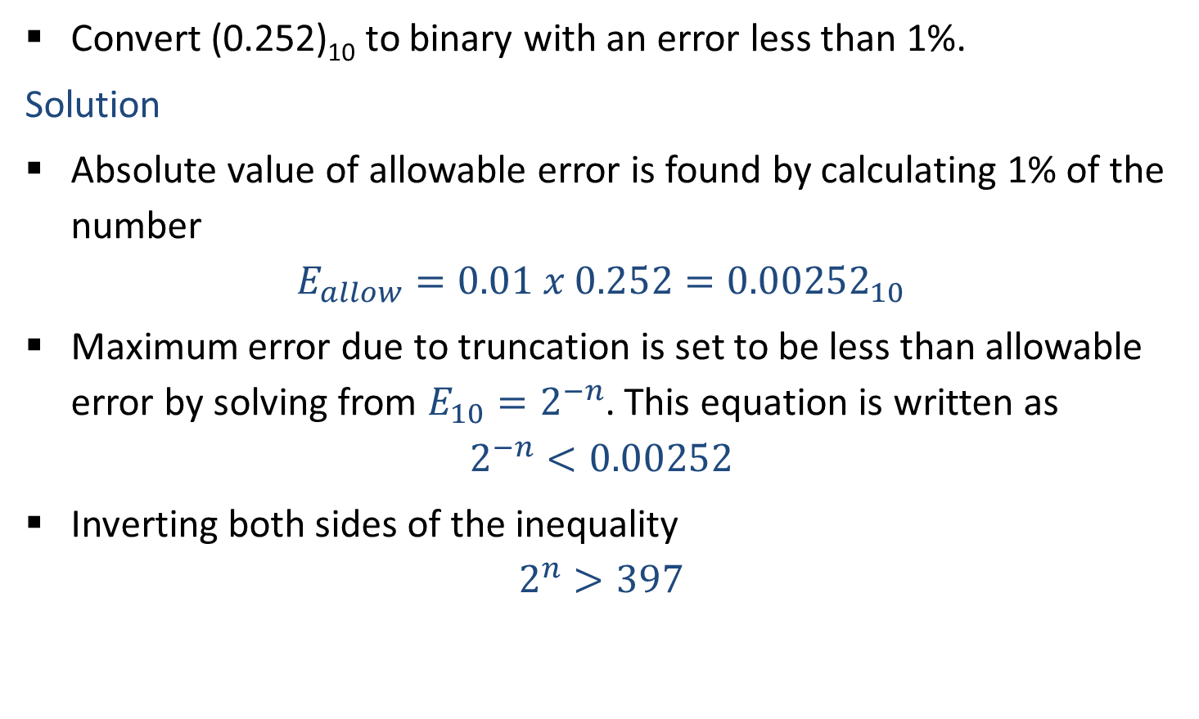
Accuracy in Binary Number Conversion
Convert (0.252)₁₀ to binary with an error less than 1%.
Solution
Absolute value of allowable error is found by calculating 1% of the number
$$E_{allow}=0.01 x 0.252={0.00252}_{10}$$
Maximum error due to truncation is set to be less than allowable error by solving from $E_{10}=2^{−n}$. This equation is written as
$$2^{−n}<0.00252$$
Inverting both sides of the inequality
$$2^{n}>397$$

Slide 50
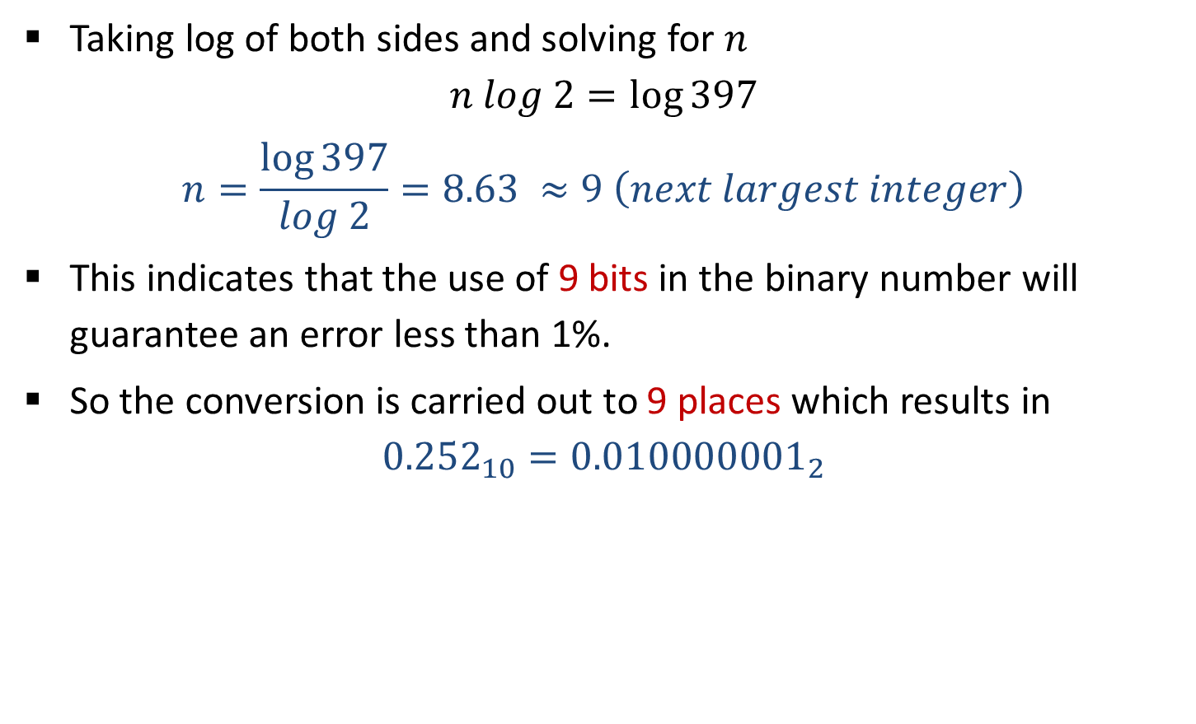
Accuracy in Binary Number Conversion
Taking log of both sides and solving for $n$
$$n log 2=\log{397}$$
$$n=\frac{\log{397}}{log 2}=8.63 ≈9 \left(next largest integer\right)$$
This indicates that the use of 9 bits in the binary number will guarantee an error less than 1%.
So the conversion is carried out to 9 places which results in
$${0.252}_{10}={0.010000001}_{2}$$

Slide 51
9’s Complement
9’s complement of a decimal number is obtained by subtracting each digit of that decimal number from 9.
Example
9
9
9
9
9
9
9
.
9
9
-
3
4
6
5
-
7
8
2
.
5
4
6
5
3
4
2
1
7
.
4
5
(9’s complement of 3465)
(9’s complement of 782.54)

Slide 52
10’s Complement
10’s complement of a decimal number is obtained by adding 1 to its 9’s complement.
Example
9
9
9
9
9
9
9
.
9
9
-
3
4
6
5
-
7
8
2
.
5
4
6
5
3
4
2
1
7
.
4
5
+
1
+
1
6
5
3
5
2
1
7
.
4
6
(10’s complement of 3465)
(10’s complement of 782.54)

Slide 53
Subtraction using 9’s complement
Obtain 9’s complement of subtrahend
Add the result to minuend and call it intermediate result
If carry is generated then answer is positive and add the carry to Least Significant Digit (LSD)
If there is no carry then answer is negative and take 9’s complement of intermediate result and place negative sign to the result

Slide 54
Example
1) 745.81 – 436.62
7
4
5
.
8
1
7
4
5
.
8
1
-
4
3
6
.
6
2
9’s complement
+
5
6
3
.
3
7
3
0
9
.
1
9
1
3
0
9
.
1
8
+
1
3
0
9
.
1
9

Slide 55
Example
2) 436.62 - 745.81
4
3
6
.
6
2
4
3
6
.
6
2
-
7
4
5
.
8
1
9’s complement
+
2
5
4
.
1
8
-
3
0
9
.
1
9
6
9
0
.
8
0
9’s complement
-
3
0
9
.
1
9
As carry is not generated, so take 9’s complement of the intermediate result and add ‘ – ‘ sign to the result

Slide 56
Subtraction using 10’s complement
Obtain 10’s complement of subtrahend
Add the result to minuend
If carry is generated then ignore it and result itself is answer
If there is no carry then answer is negative and take 10’s complement of result and place negative sign to the result

Slide 57
Example
1) 745.81 – 436.62
7
4
5
.
8
1
7
4
5
.
8
1
-
4
3
6
.
6
2
10’s complement
+
5
6
3
.
3
8
3
0
9
.
1
9
1
3
0
9
.
1
9
Ignore the carry

Slide 58
Example
2) 436.62 - 745.81
4
3
6
.
6
2
4
3
6
.
6
2
-
7
4
5
.
8
1
10’s complement
+
2
5
4
.
1
9
-
3
0
9
.
1
9
6
9
0
.
8
1
10’s complement
-
3
0
9
.
1
9
As carry is not generated, so take 10’s complement of the intermediate result and add ‘ – ‘ sign to the result

Slide 59
Binary Addition
Rules for binary addition
0 + 0 = 0
0 + 1 = 1
1 + 0 = 1
1
1
1
1
1
1
1 + 1 = 10 i.e. 0 with a carry of 1
1
1
0
1
.
1
0
1
+
0
1
1
1
.
0
1
1
1
0
1
0
1
.
0
0
0

Slide 60
Binary Subtraction
Rules for binary subtraction
0 - 0 = 0
1 – 1 = 0
1 – 0 = 1
1
0
1
1
1
0
0
1
1
0
1
0
.
0
1
0
0 – 1 = 1, with a borrow 1
1
-
0
1
1
1
.
1
1
1
0
0
1
0
.
0
1
1

Slide 61
Binary Multiplication
1 0 1 1 1
x
1 0 0 1 1
1
0
1
1
1
1
0
1
1
1
0
0
0
0
0
0
0
0
0
0
1
0
1
1
1
1
1
0
1
1
0
1
0
1

Slide 62
Binary Division
110
1 0 1 1 0 1
0
1
1
1
.
1
0 0 0
1 0 1
1
1 1 0
1 0 1
0
1 1 0
1 0 0
1
1 1 0
1 1
0
1 1 0
0 0 0

Slide 63
1’s Complement
1’s complement of a binary number is obtained by subtracting each digit of that binary number from 1.
Example
1
1
1
1
1
1
1
.
1
1
-
1
1
0
1
-
1
0
1
.
0
1
0
0
1
0
0
1
0
.
1
0
(1’s complement of 1101)
(1’s complement of 101.01)

Slide 64
2’s Complement
2’s complement of a binary number is obtained by adding 1 to its 1’s complement.
Example
1
1
1
1
1
1
1
.
1
1
-
1
1
0
0
-
1
0
1
.
0
1
0
0
1
1
0
1
0
.
1
0
+
1
+
1
0
1
0
0
0
1
0
.
1
1
(2’s complement of 1100)
(2’s complement of 101.01)

Slide 65
Subtraction using 1’s Complement

Slide 66
Subtraction using 2’s Complement

Slide 67
Exercise
Express -45 in 8-bit 2’s complement form.
Express -73.75 in 12 bit 2’s complement form.

Slide 68
Binary Codes
Unit – 1: Binary Systems & Logic Circuits Darshan Institute of Engineering & Technology

Slide 69
8421 BCD Code (Natural BCD Code)
Each decimal digit, 0 through 9, is coded by 4-bit binary number
8, 4, 2 and 1 weights are attached to each bit
BCD code is weighted code
1010, 1011, 1100, 1101, 1110 and 1111 are illegal codes
Less efficient than pure binary
Arithmetic operations are more complex than in pure binary
Example
Decimal
1 4
BCD
0001
0100
Binary
1110

Slide 70
Binary Codes
Decimal | Binary | BCD
0 | 0 | 0000
1 | 1 | 0001
2 | 10 | 0010
3 | 11 | 0011
4 | 100 | 0100
5 | 101 | 0101
6 | 110 | 0110
7 | 111 | 0111
Decimal | Binary | BCD
8 | 1000 | 1000
9 | 1001 | 1001
10 | 1010 | 0001 0000
11 | 1011 | 0001 0001
12 | 1100 | 0001 0010
13 | 1101 | 0001 0011
14 | 1110 | 0001 0100
15 | 1111 | 0001 0101

Slide 71
BCD Addition
2
5
0
0
1
0
0
1
0
1
+
1
3
+
0
0
0
1
0
0
1
1
3
8
0
0
1
1
1
0
0
0
No carry, no illegal code. So, this is the correct sum.

Slide 72
BCD Addition
679.6
0110
0111
1001
.0110
+
536.8
+
0101
0011
0110
.1000
1216.4
1011
1010
1111
.1110
All are illegal codes
+0110
+0110
+0110
+.0110
Add 0110 to each
10001
10000
10101
1.0100
Propagate carry
+
1
+
+
1
1
+
1
0001
0010
0001
0110
.0100
Corrected Sum

Slide 73
BCD Subtraction
3
8
0
0
1
1
1
0
0
0
-
1
5
-
0
0
0
1
0
1
0
1
2
3
0
0
1
0
0
0
1
1
No borrow. So, this is the correct difference.

Slide 74
BCD Subtraction
206.7
0010
0000
0110
.0111
-
147.8
-
0001
0100
0111
.1000
0000
1011
1110
.1111
Borrows are present
58.9
-0110
-0110
-.0110
Subtract 0110
0101
1000
.1001
Corrected difference

Slide 75
Excess Three (XS-3) Code
Excess Three Code = 8421 BCD + 0011(3)
XS-3 code is non-weighted BCD code
Also known as self complementing code
0000, 0001, 0010, 1101, 1110 and 1111 are illegal codes
Example
Decimal
1 4
BCD
0001
0100
XS-3
0100
0111

Slide 76
XS-3 Addition
3
7
0
1
1
0
1
0
1
0
+
2
8
+
0
1
0
1
1
0
1
1
6
5
1
0
1
1
1
0
1
0
1
+
Propagate carry to next group
1
Add 0011 to group which generated carry
Subtract 0011 to group which do not generated carry
1
1
0
0
0
1
0
1
-
0
0
1
1
+
0
0
1
1
1
0
0
1
1
0
0
0

Slide 77
XS-3 Addition
247.6
0101
0111
1010
.1001
+
359.4
+
0110
1000
1100
.0111
607.0
1011
1111
10110
1.0000
Carry generated
+
+
1
1
Propagate carry
Add 0011 to group which generated carry
Subtract 0011 to group which do not generated carry
1011
10000
0111
.0000
+
1
1100
0000
0111
.0000
- 0011
+0011
+0011
+.0011
1001
0011
1010
.0011
Corrected Sum in XS-3

Slide 78
XS-3 Subtraction
267
0101
1001
1010
-
175
-
0100
1010
1000
092
0000
1111
0010
+0011
-0011
+0011
Subtract 0011 to group which generated borrow
Add 0011 to group which do not generated borrow
0011
1100
0101

Slide 79
XS-3 Subtraction
57.6
1000
1010
.1001
-
27.8
-
0101
1010
.1011
29.8
0010
1111
.1110
+0011
-0011
-.0011
Subtract 0011 to group which generated borrow
Add 0011 to group which do not generated borrow
0101
1100
.1011

Slide 80
Gray Code
Only one bit changes between each pair of successive code words (Unit distance code).
Gray code is a reflected code.
Gray codes are designed recursively using following rules:
1-bit Gray code has two code words, 0 and 1.
The first 2^{n} code words of an (n+1)-bit Gray code equal the code words of n-bit gray code, written in order with a leading 0 appended.
The last 2^{n} code words of an (n+1)-bit Gray code equal the code words of n-bit gray code, but written in reverse order with a leading 1 appended.

Slide 81
Gray Code |  |  |  | Decimal | 4-bit Binary
1-bit | 2-bit | 3-bit | 4-bit
0 | 0 0 | 0 0 0 | 0 0 0 0 | 0 | 0000
1 | 0 1 | 0 0 1 | 0 0 0 1 | 1 | 0001
 | 1 1 | 0 1 1 | 0 0 1 1 | 2 | 0010
 | 1 0 | 0 1 0 | 0 0 1 0 | 3 | 0011
 |  | 1 1 0 | 0 1 1 0 | 4 | 0100
 |  | 1 1 1 | 0 1 1 1 | 5 | 0101
 |  | 1 0 1 | 0 1 0 1 | 6 | 0110
 |  | 1 0 0 | 0 1 0 0 | 7 | 0111
 |  |  | 1 1 0 0 | 8 | 1000
 |  |  | 1 1 0 1 | 9 | 1001
 |  |  | 1 1 1 1 | 10 | 1010
 |  |  | 1 1 1 0 | 11 | 1011
 |  |  | 1 0 1 0 | 12 | 1100
 |  |  | 1 0 1 1 | 13 | 1101
 |  |  | 1 0 0 1 | 14 | 1110
 |  |  | 1 0 0 0 | 15 | 1111

Slide 82



Binary to Gray Conversion
Conversion of n-bit Binary number (B) to Gray Code (G) is as follows:
Example: Convert (1001)₂ to Gray Code.
$$G_{n}=B_{n}$$ | $$G_{n−1}=B_{n}⨁{ B}_{n−1}$$ | $$G_{n−2}=B_{n−1}⨁{ B}_{n−2}…$$ | $$G_{1}=B_{2}⨁{ B}_{1}$$
Binary
1
$$⨁$$
0
$$⨁$$
0
$$⨁$$
1
Gray
1
1
0
1

Slide 83



Gray to Binary Conversion
Conversion of n-bit Gray Code (G) to Binary Number (B) is as follows:
Example: Convert Gray code 1101 to Binary.
$$B_{n}=G_{n}$$ | $$B_{n−1}=B_{n}⨁{ G}_{n−1}$$ | $$B_{n−2}=B_{n−1}⨁{ G}_{n−2}…$$ | $$B_{1}=B_{2}⨁{ G}_{1}$$
Gray
1
1
0
1
$$⨁$$
$$⨁$$
$$⨁$$
Binary
1
0
0
1

Slide 84
Logic Gates
Most basic logical unit of the digital system is gate circuit
Types of gate circuits are as follows
AND Gate
OR Gate
NOT Gate (Inverter)
NOR Gate
NAND Gate
XOR Gate
XNOR Gate

Slide 85


1. AND Gate
AND Gate has an output which is normally at logic level “0” and only goes “HIGH” to a logic level “1” when ALL of its inputs are at logic level “1”
2-input AND Gate
Logic Notation
A
$$C=A∙B$$
C
B
Truth Table
A | B | C
0 | 0 | 0
0 | 1 | 0
1 | 0 | 0
1 | 1 | 1

Slide 86


2. OR Gate
OR Gate or Inclusive-OR gate has an output which is normally at logic level “0” and only goes “HIGH” to a logic level “1” when one or more of its inputs are at logic level “1”.
2-input OR Gate
Logic Notation
A
$$C=A+B$$
C
B
Truth Table
A | B | C
0 | 0 | 0
0 | 1 | 1
1 | 0 | 1
1 | 1 | 1

Slide 87

3. NOT (Inverter) Gate
NOT gate has an output which is always opposite to input level.
Inverter Gate
Logic Notation
$$C=\overline{A} or C=A′$$
A
C
Truth Table
A | C
0 | 1
1 | 0

Slide 88

4. NOR Gate
NOR Gate is an OR gate followed by an inverter.
2-input NOR Gate
Logic Notation
A
$$C={\left(A+B\right)}^{′}$$
C
B
Truth Table
A | B | C
0 | 0 | 1
0 | 1 | 0
1 | 0 | 0
1 | 1 | 0

Slide 89

5. NAND Gate
NAND Gate is an AND gate followed by an inverter.
2-input NAND Gate
Logic Notation
A
$$C=(A∙B)′$$
C
B
Truth Table
A | B | C
0 | 0 | 1
0 | 1 | 1
1 | 0 | 1
1 | 1 | 0

Slide 90

6. Exclusive-OR (X-OR) Gate
X-OR gate that has 1 state when one and only one of its two inputs assumes a logic 1 state and has 0 state when all of its input are same.
Also known as anti-coincidence gate or inequality detector.
2-input XOR Gate
Logic Notation
A
$$C=A ⨁ B$$
C
B
Truth Table
A | B | C
0 | 0 | 0
0 | 1 | 1
1 | 0 | 1
1 | 1 | 0

Slide 91

7. Exclusive-NOR (X-NOR) Gate
X-NOR gate that has 1 state when all of its input are same and has 0 state when one of its input has 0 state and other input is 1 state.
Also known as equality detector.
2-input XNOR Gate
Logic Notation
A
$$C=A ⨀ B$$
C
B
Truth Table
A | B | C
0 | 0 | 1
0 | 1 | 0
1 | 0 | 0
1 | 1 | 1

Slide 92
NAND as Universal Gate
(AB)’
((AB)’)’ = AB
A
A
A’
B
NOT using NAND
AND using NAND
A’
A
(A’B’)’ = (A+B)
B
B’
OR using NAND

Slide 93
NOR as Universal Gate
(A+B)’
((A+B)’)’ = A+B
A
A
A’
B
NOT using NOR
OR using NOR
A’
A
(A’+B’)’ = AB
B
B’
AND using NOR

