Slide 1
Finmate Smart Investment Advisory
Team 23 | Use Case 1
Meet Dholakia | Eliza Das | Raman Pradhan | Gaurav Dhyani | Aastha Garg | Prerna Jain

Slide 2
Introduction
Finmate is an intelligent personal finance and investment advisory platform designed to help individuals make smarter financial decisions.

Slide 3
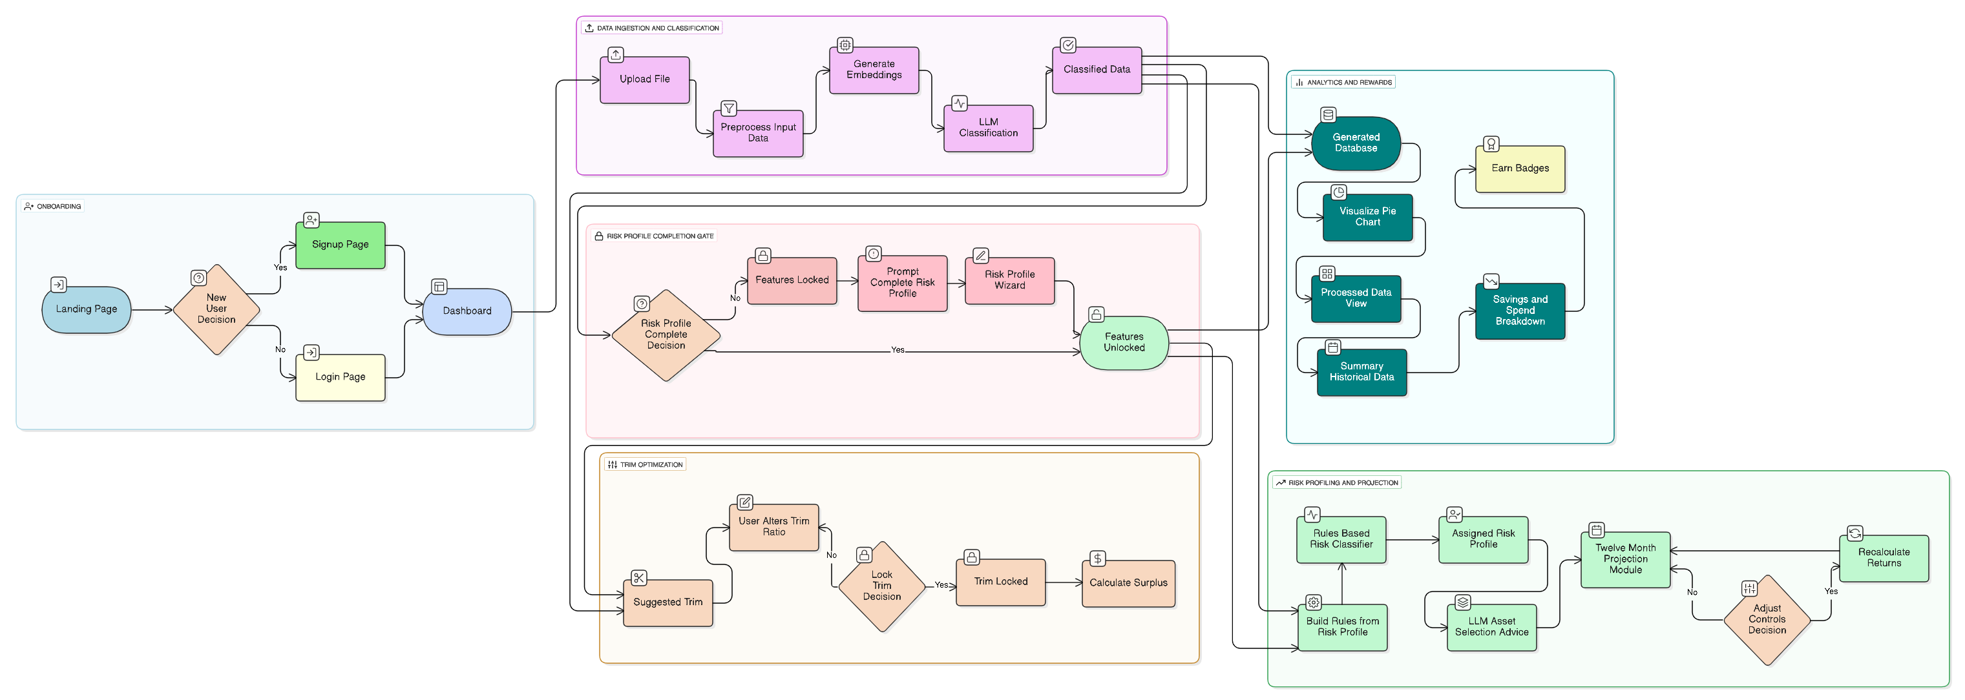
Flow Diagram

Slide 4
Outcomes Delivered
User login & upload
Smart transaction categorization
Spend trim advisory
Risk profile assessment
Tailored portfolio allocation
Investment knowledge center
Interactive analytics dashboard
PDF report export
Gamified user badges
Financial tools & videos

Slide 5

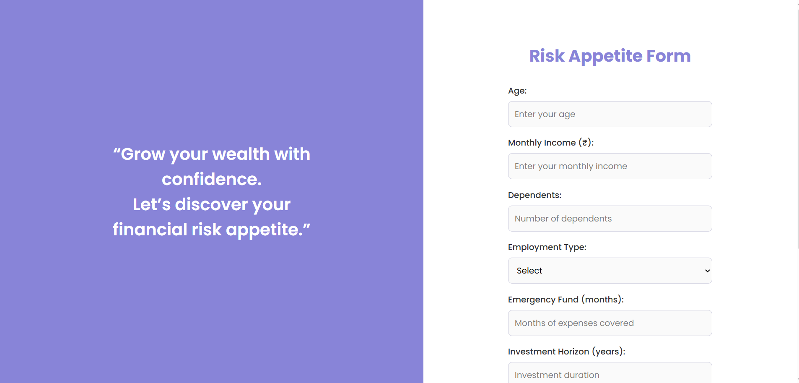
Registration and Risk Appetite Form

Slide 6
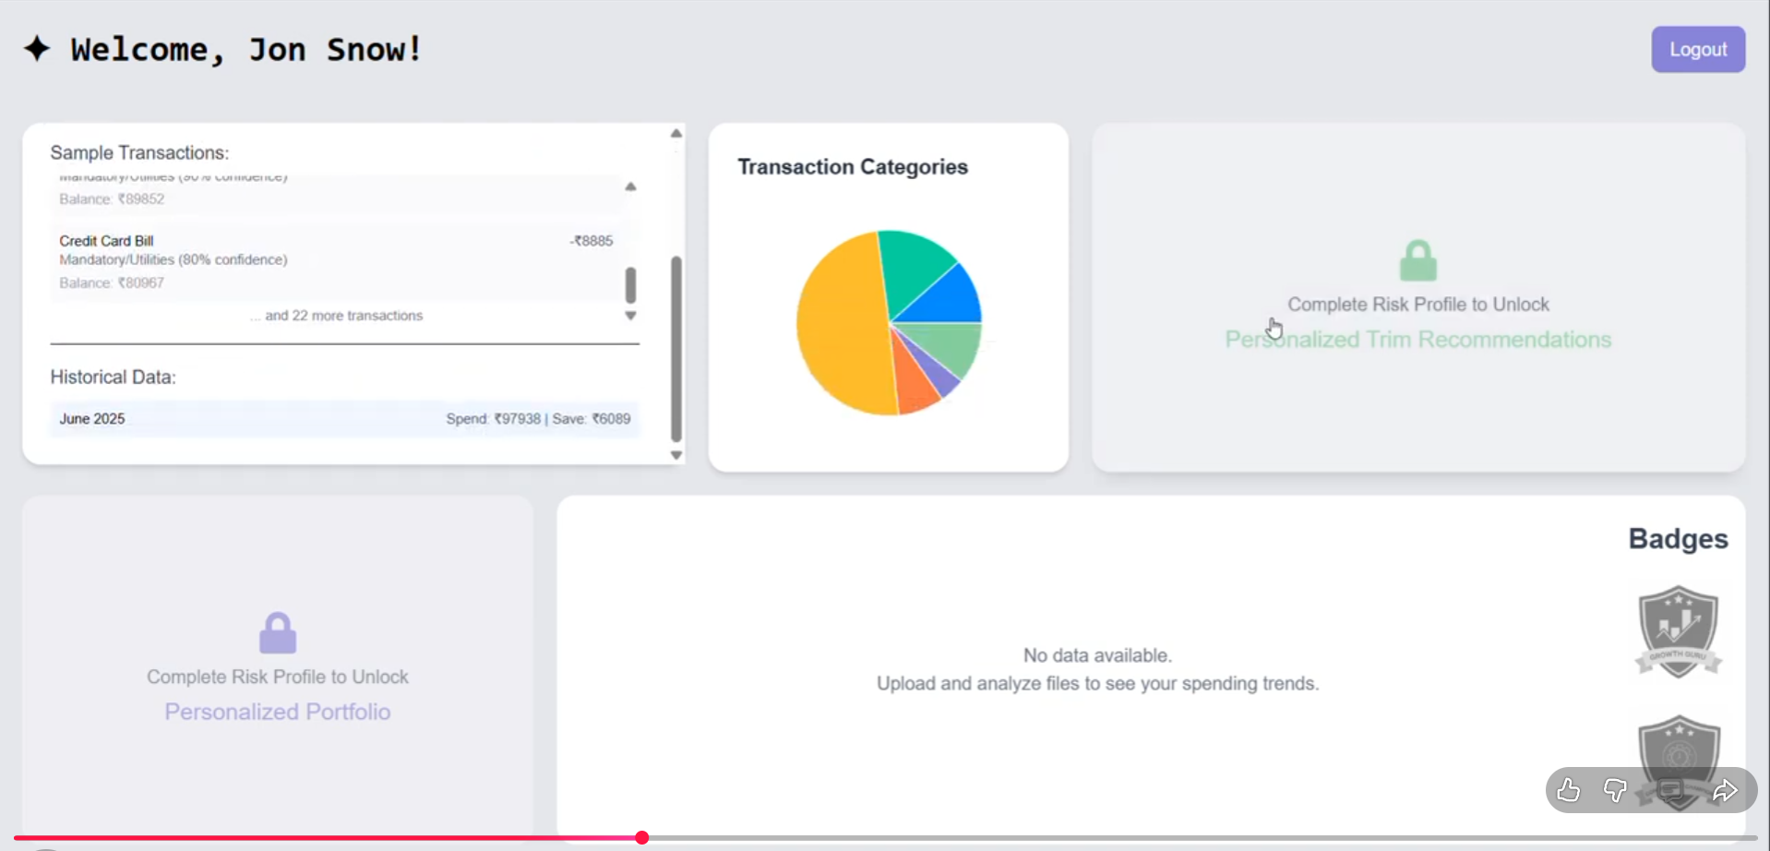
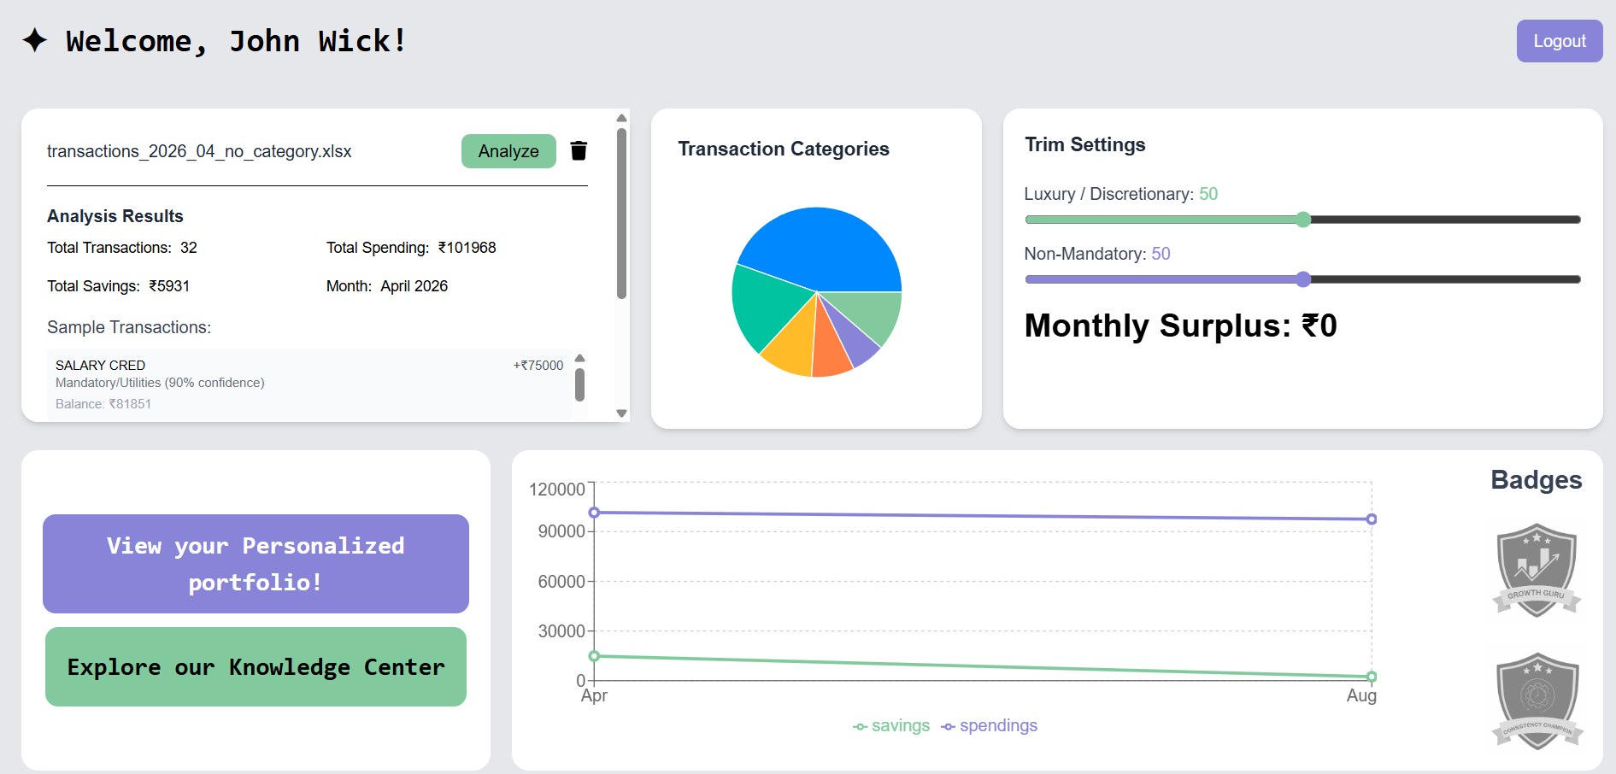
Dashboard

Slide 7
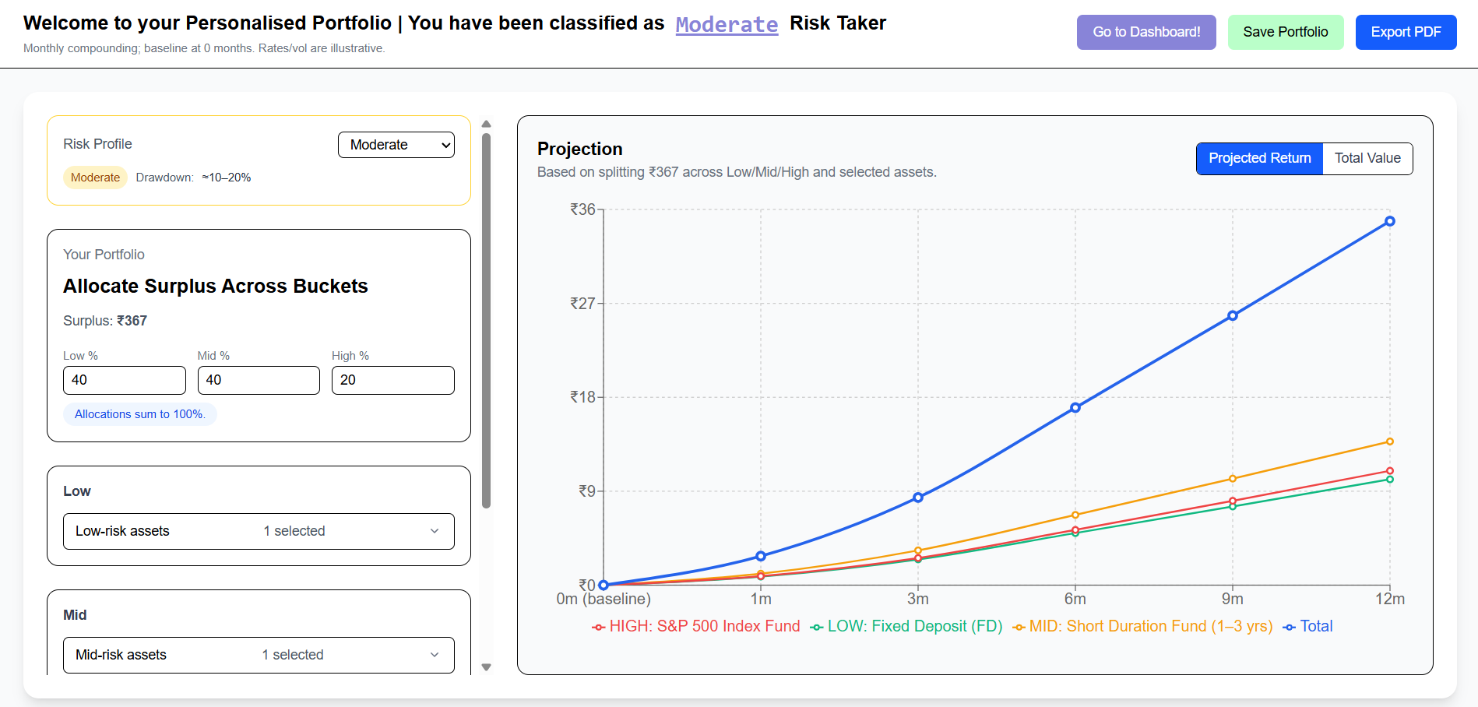
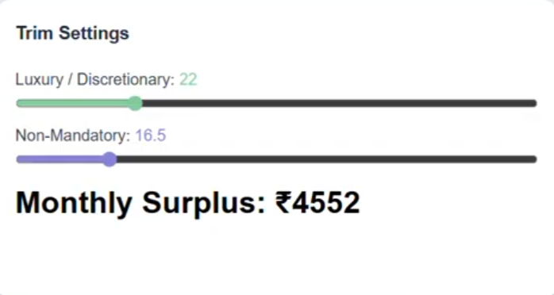
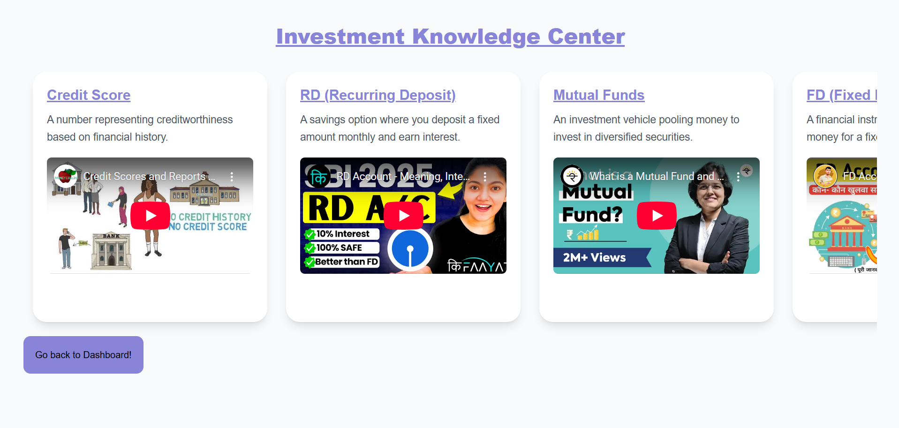
Trim, Portfolio & Knowledge center

Slide 8
Project Demo

Slide 9

Overcoming Nervousness
10 Brains,
10 Ways
Mirage of
fixation
Breakdown of Communication

Slide 10
Thank you!!
We are open for questions!

