Slide 1
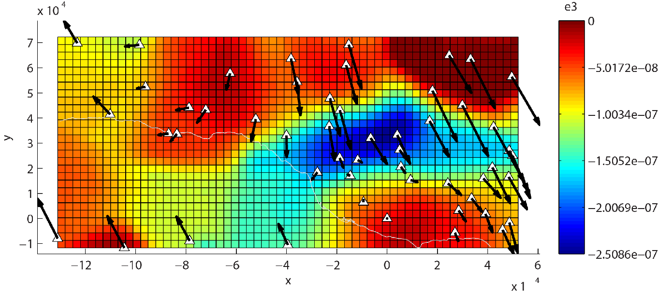
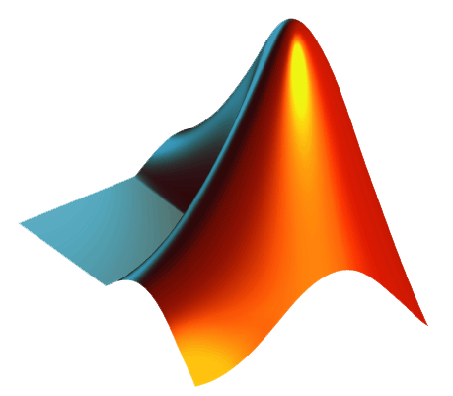
Advanced Plotting Techniques
Chapter 11
Above: Principal contraction rates calculated from GPS velocities. Visualized using MATLAB.

Slide 2
Advanced Plotting
We have used MATLAB to visualize data a lot in this course, but we have only scratched the surface…
Mainly used ‘plot’, ‘plot3’, ‘image’, and ‘imagesc’
This section will cover some of the more advanced types of visualizations that MATLAB can produce
Vector plots
Streamline plots
Contour plots
Visualizing 3D surfaces
Making animations (if there is time)
In general, if you can picture it, MATLAB can probably do it
If not, visit MATLAB central, and it is likely that someone has written a script/function to do what you want
http://www.mathworks.com/matlabcentral/fileexchange/

Slide 3

Vector Plots
Plotting vectors is very useful in Earth sciences
Wind velocities
Stream flow velocities
Surface velocities or displacements
Glacier movements
Ocean currents
…and many more!
Conventions:
Spatial coordinates: [x, y, z]
I.e. the location of the tail of the vector
Vector magnitudes: [u, v, w]
I.e. the [east, north, up] components of the vector
MATLAB typically needs to know:
In 2D: x, y, u, v
In 3D: x, y, z, u, v, w
[u, v] = [2.50, 4.33]
60°
[x, y] = [2, 3]

Slide 4
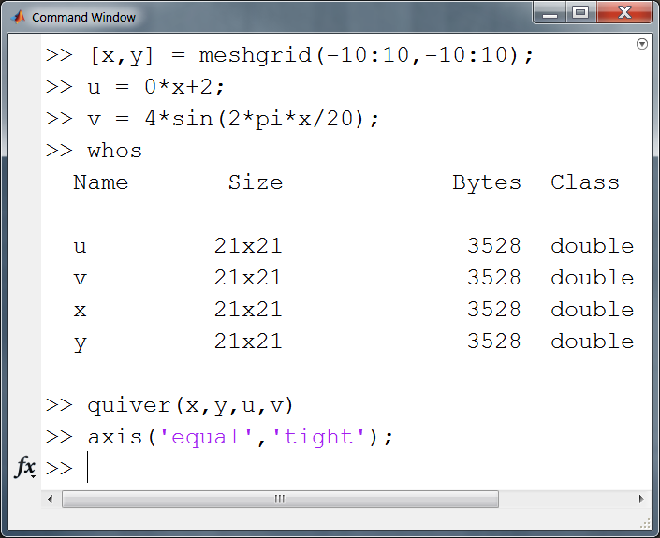
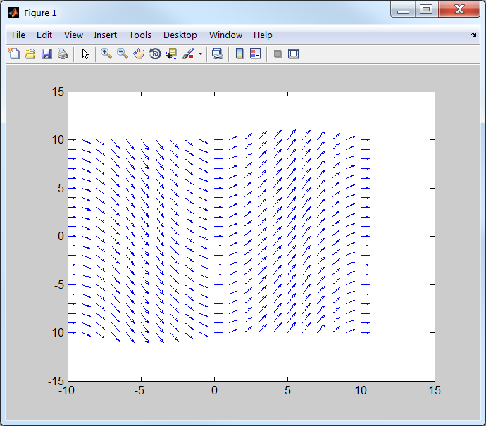
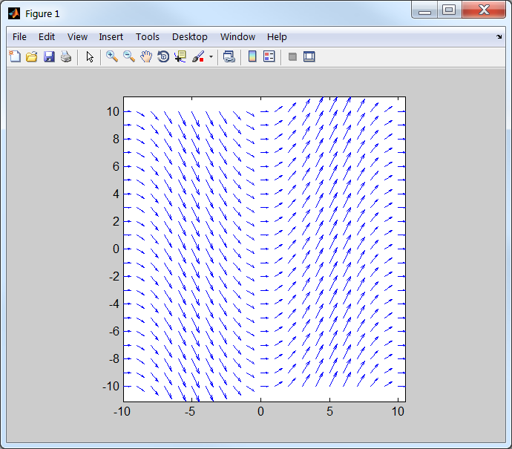
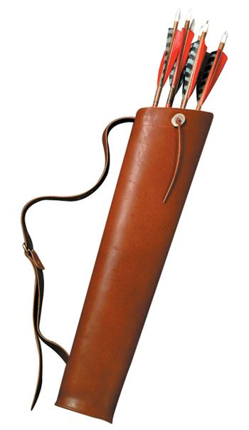
Quiver Plots
MATLAB provides several built-in commands for plotting vectors
I will only cover ‘quiver’ and ‘quiver3’
Keys to success:
x, y, u, and v must all be the same dimensions
Can accept vectors or matrices
WARNING! Quiver automatically scales vectors so that they do not overlap
The actual visualized vector length is not at the same scale as x/y axes

Slide 5
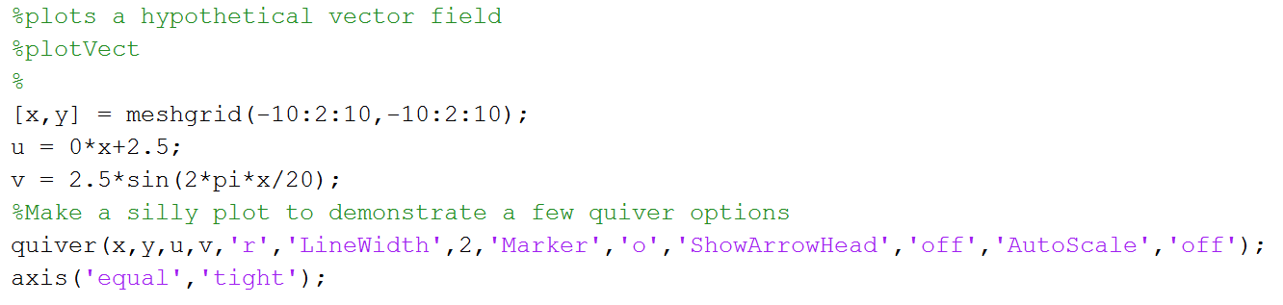
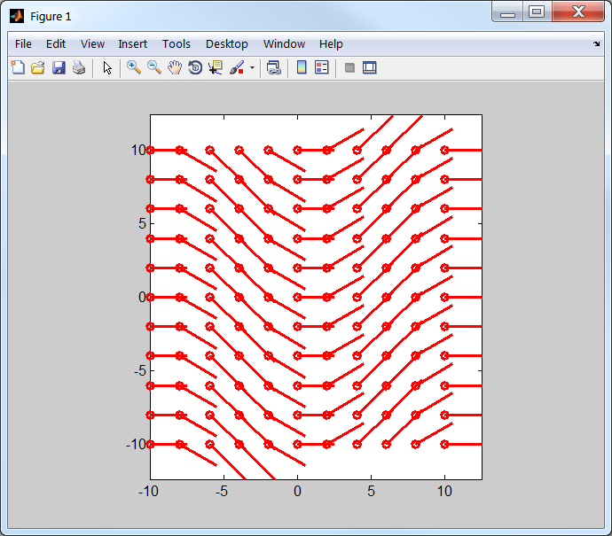
Quiver Options
quiver has lots of options
The plot shown here is silly
Made only to demonstrate some options
For list of all options
>> doc quivergroup

Slide 6
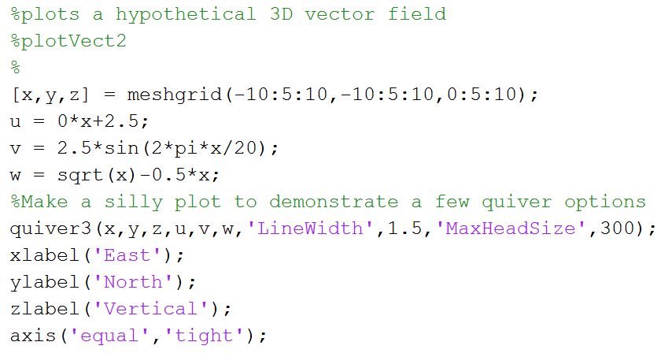
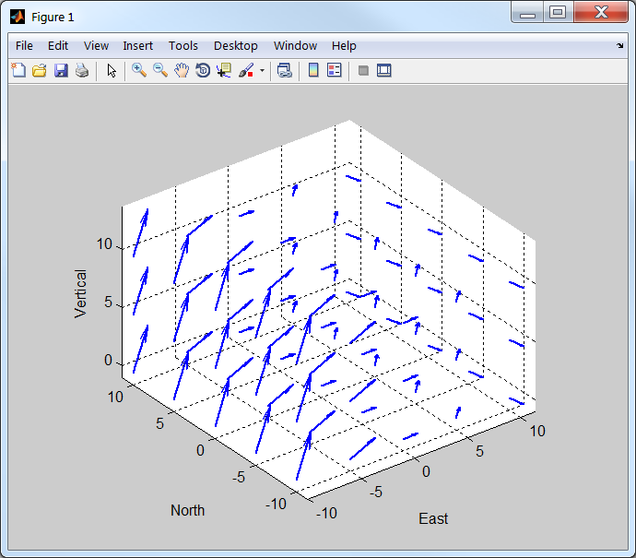
Quiver3: 3D Vectors
‘quiver3’ works just like ‘quiver’ except that three locations [x,y,z], and three vector components [u,v,w] are required
Uses same “quivergroup” properties

Slide 7
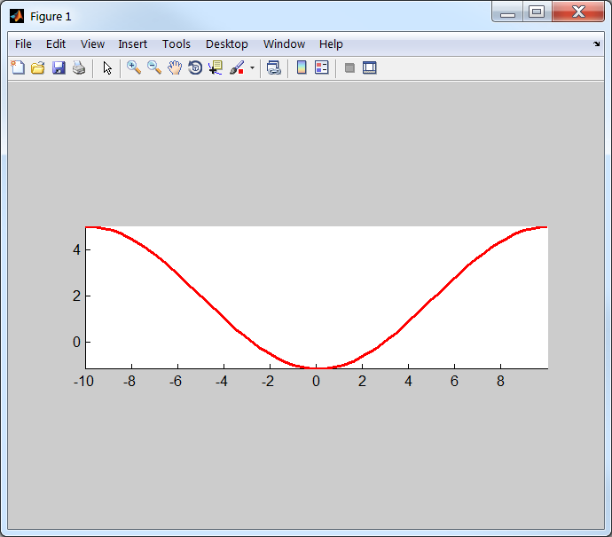
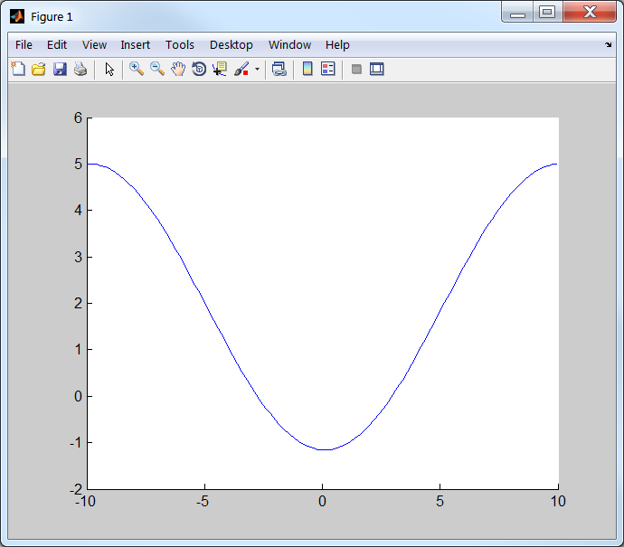
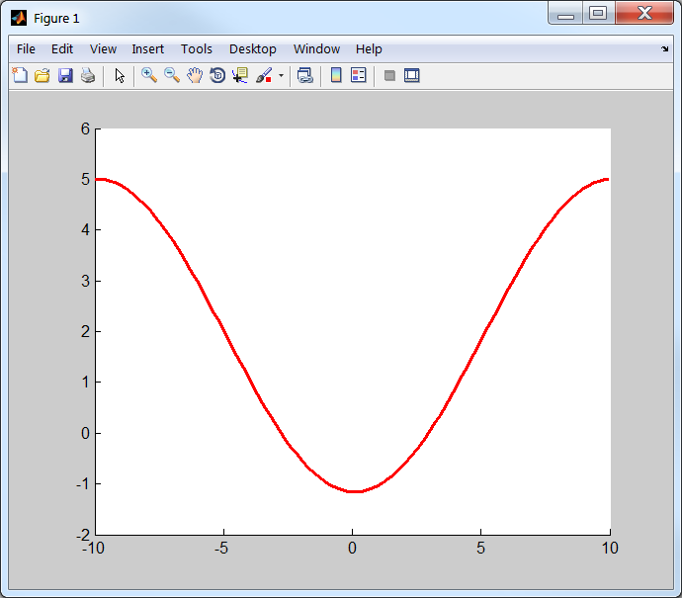
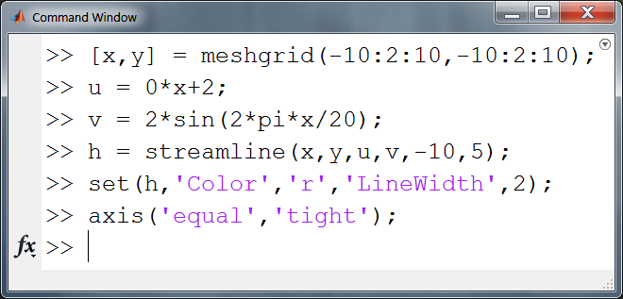
Streamline Plots
streamline: predicts & plots the path of a particle that starts within the data range
Requires a vector field
I.e. locations of many vectors and the vector magnitudes/directions
Useful for tracking contaminants, and lots more
Will not extrapolate
Works with 2D or 3D data

Slide 8
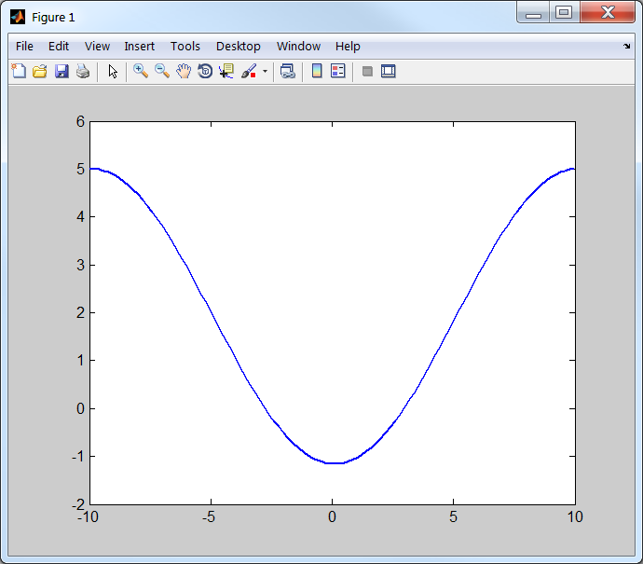
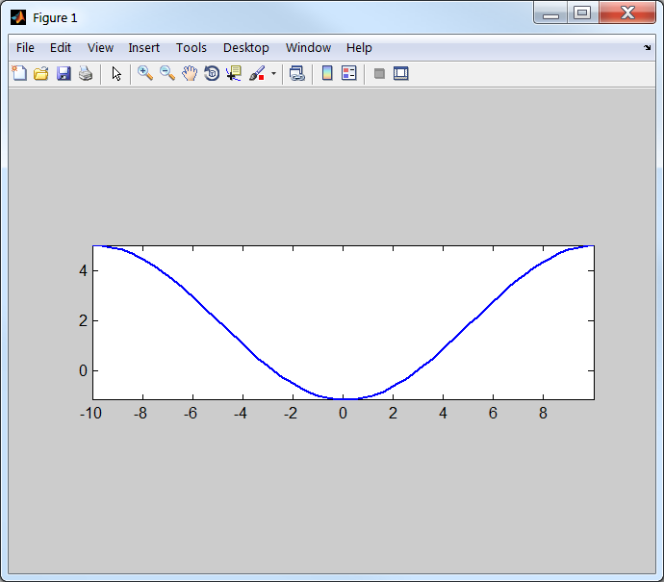
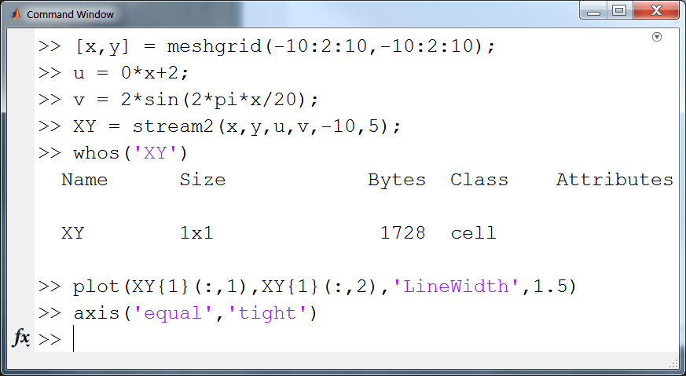
Calculating Particle Paths: stream2
stream2: calculates particle paths given a velocity field
Requires x,y,u, and v
Output is a cell. [x,y] vals are in columns in the cell
For 3D paths, see stream3
Sometimes you only want the [x,y] path
E.g. you may want to plot on a map projection

Slide 9
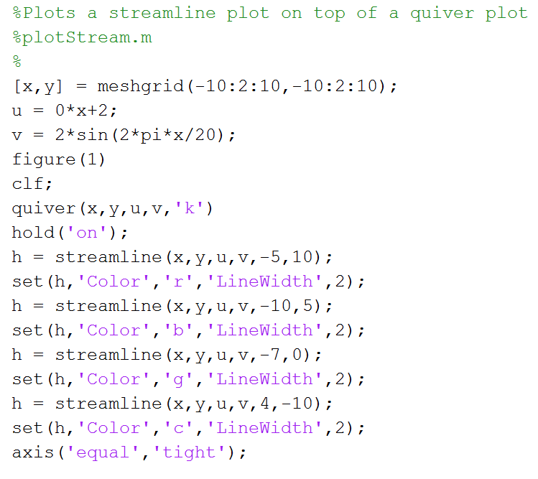
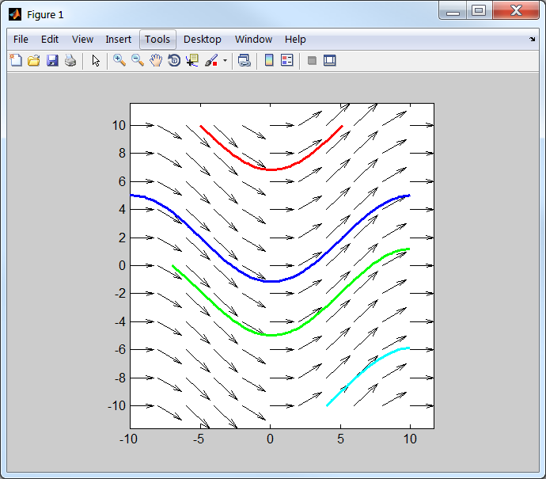
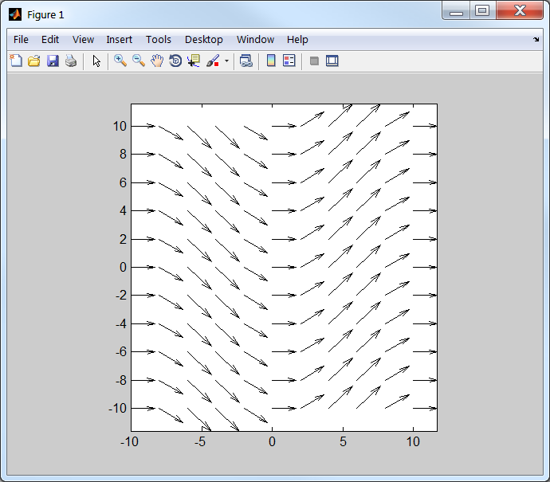

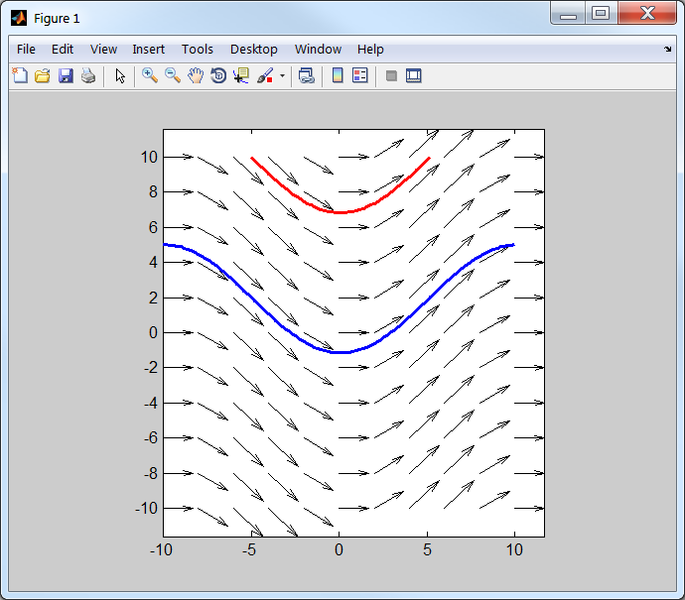
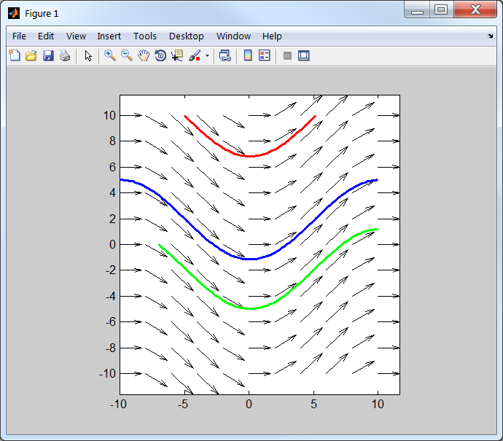
Streamline Plot: Example 1

Slide 10
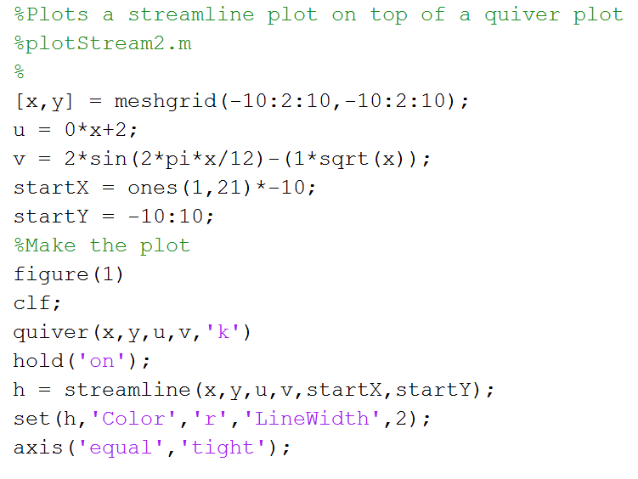
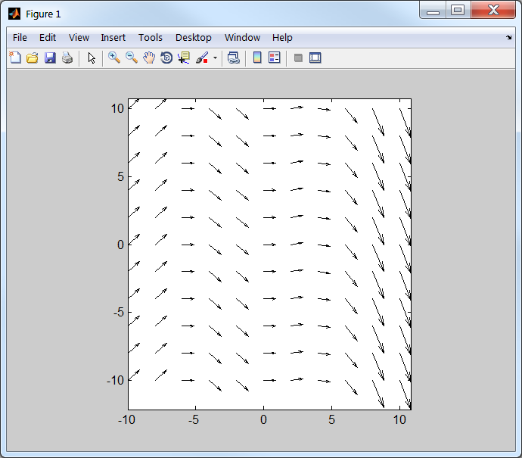
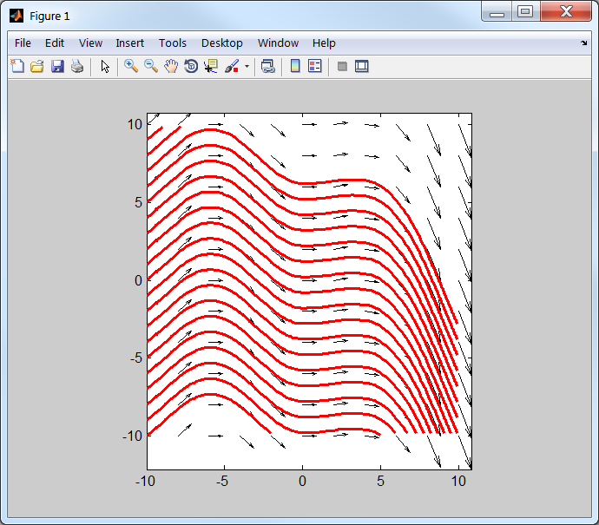
Streamline Plot: Example 2
Recall that streamline does not extrapolate

Slide 11
Visualizing 3D Data
MATLAB provides several built-in visualization functions to display 3D data
2D Plots of 3D Data:
Contour Plots
‘contour’
Contour Filled Plots
‘contourf’
3D Plots of 3D Data:
3D Surfaces
‘surf’
‘trisurf’
Most of these functions require gridded data
We will cover 2D/3D interpolation and gridding

Slide 12
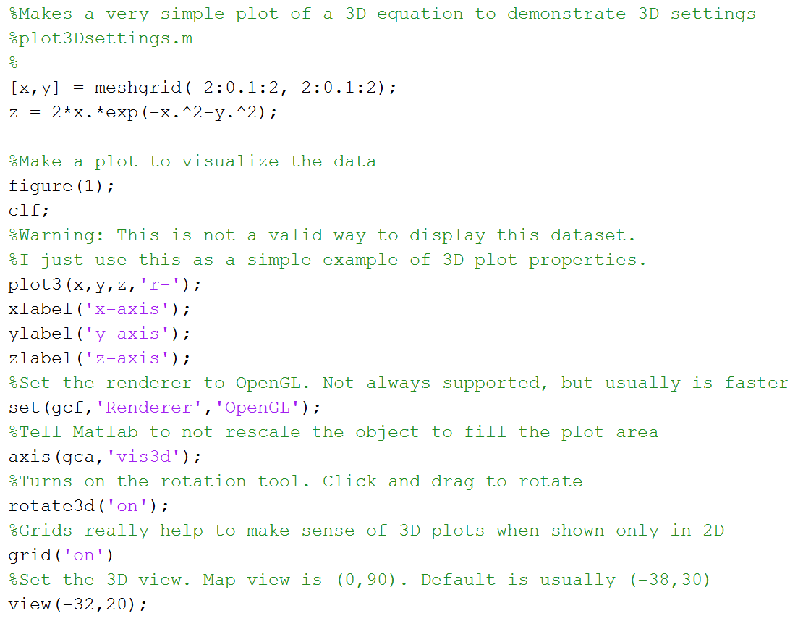
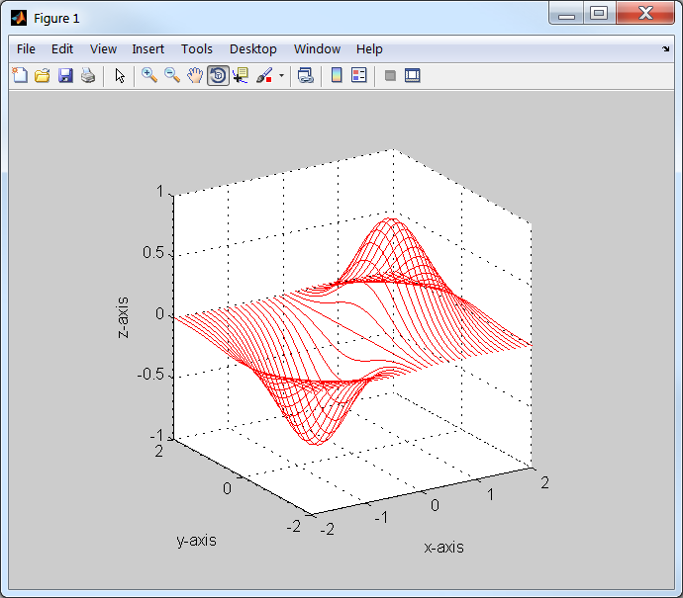
Some Useful Options for 3D Plotting
Let’s contour this equation using MATLAB!

Slide 13
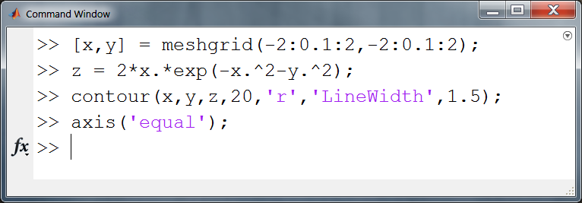
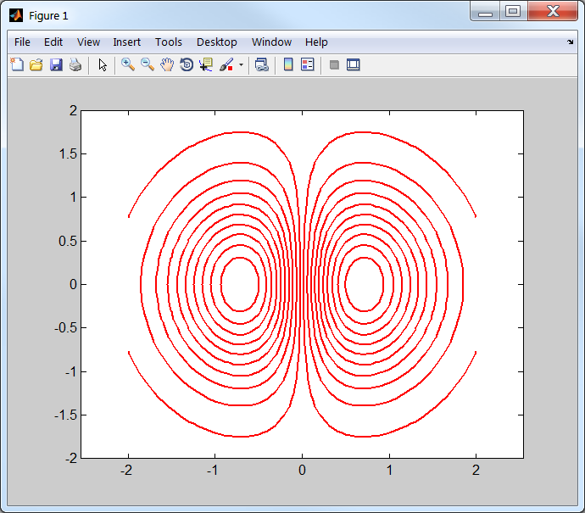
Contour Plotting Gridded Data
If your data is already regularly gridded in meshgrid format, contouring is easy…
Are these both positive peaks, or negative, or a combination?
Need to either:
Label contours with text
Draw contours using a colormap

Slide 14
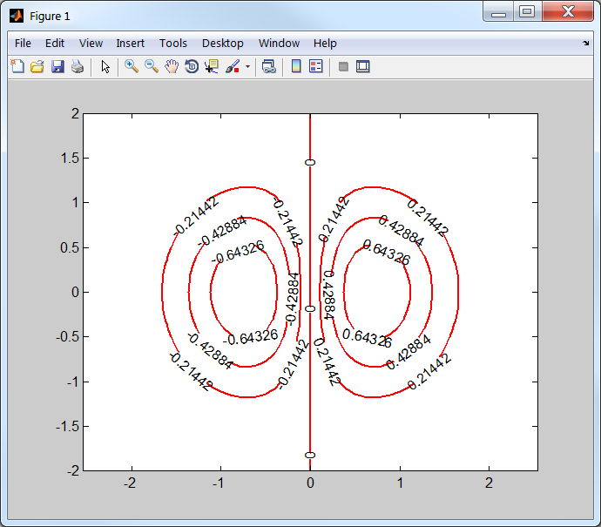
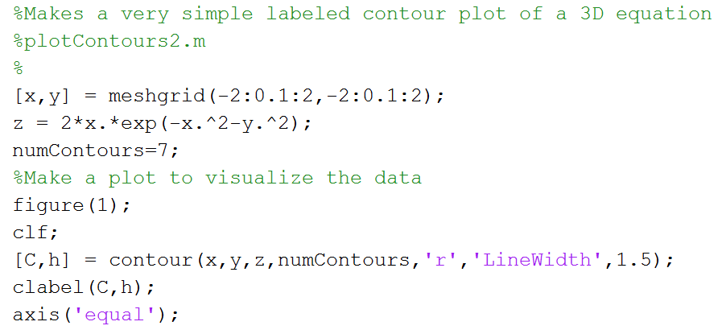
Labeling Contours
contour can label contours
C contains contour info
h is the handle to the contour group
Often the labels are at awkward intervals
How can I specify which contours to plot?

Slide 15
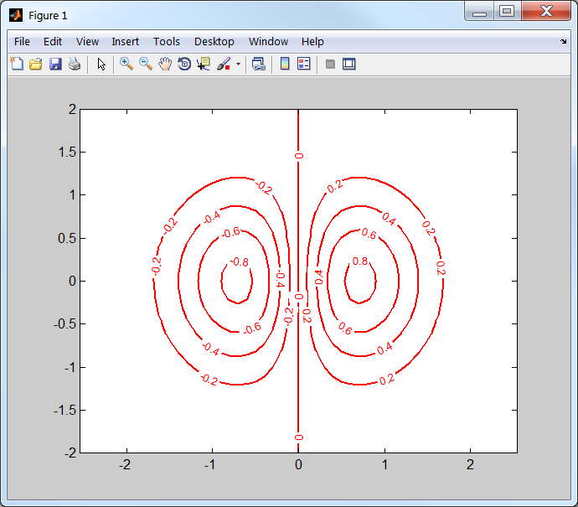
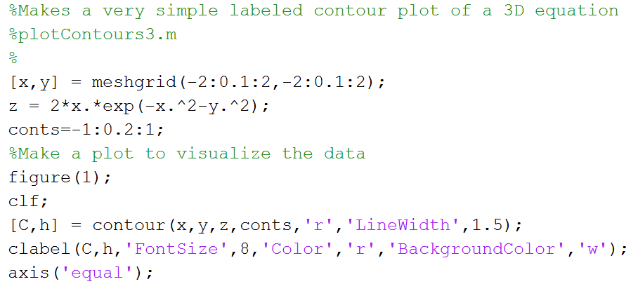
Specifying Contour Labels
Contour labeling is very flexible and customizable
For more information and settings read the documentation
>> doc contour
>> doc clabel

Slide 16
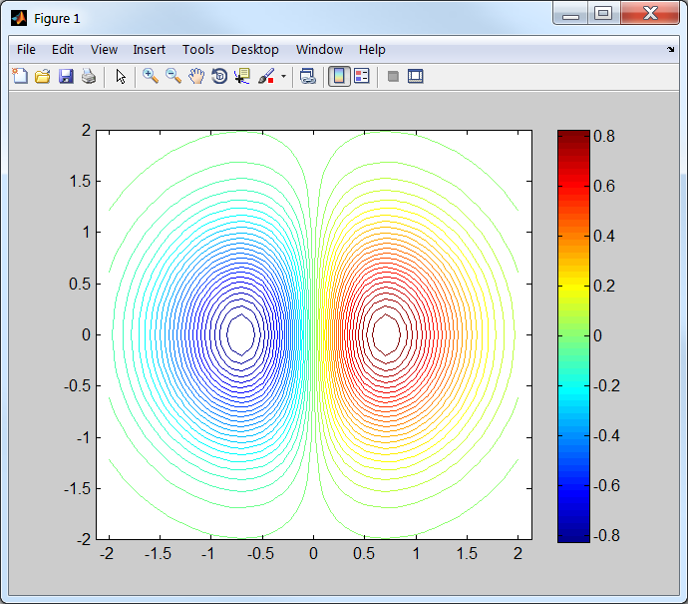
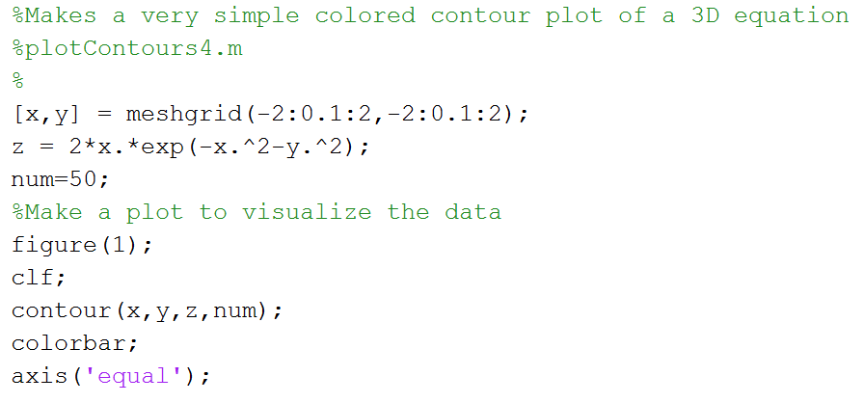
Coloring Contours Using a Colormap
If no color is specified, MATLAB uses the default colormap, jet, to color the contour lines
Use colorbar to display the colorbar
How can I specify the colormap and the colormap limits?

Slide 17
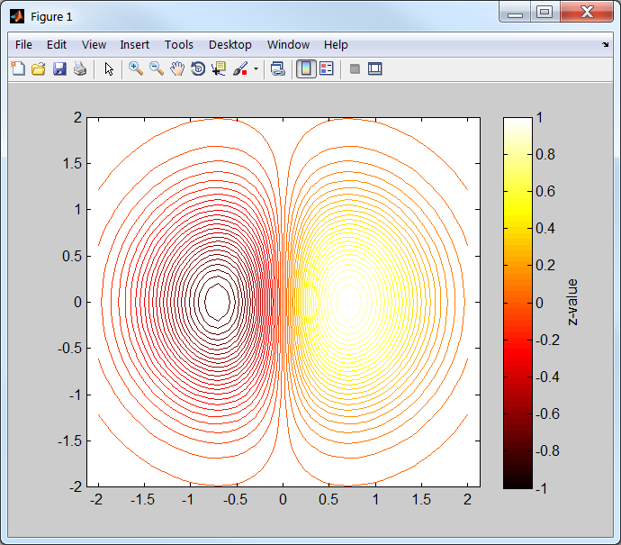
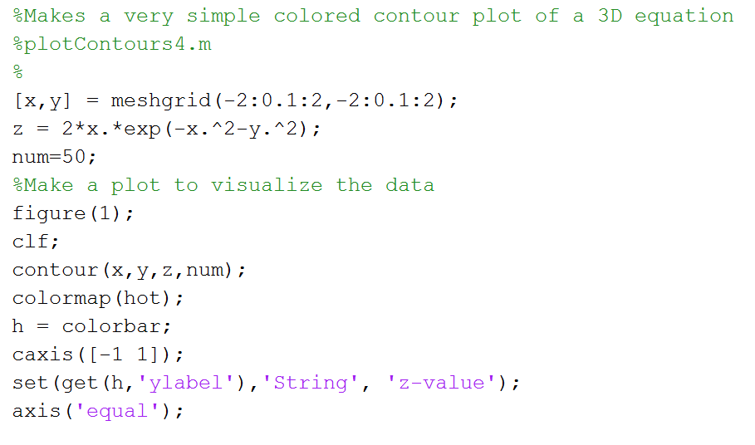
Coloring Contours Using a Colormap
Color maps and ranges can be specified!
How can make a color filled contour plot?
Dr. Marshall’s favorite!

Slide 18
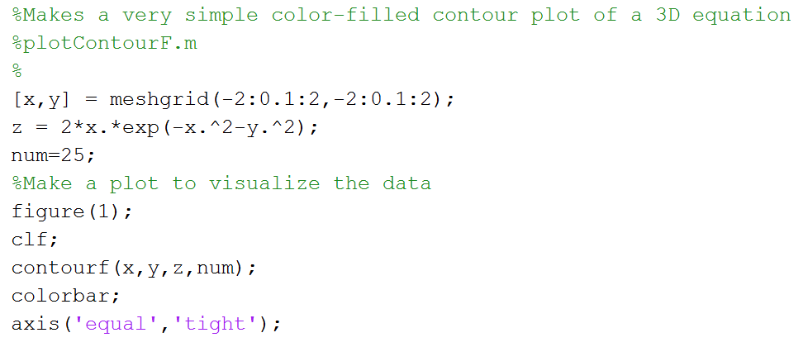
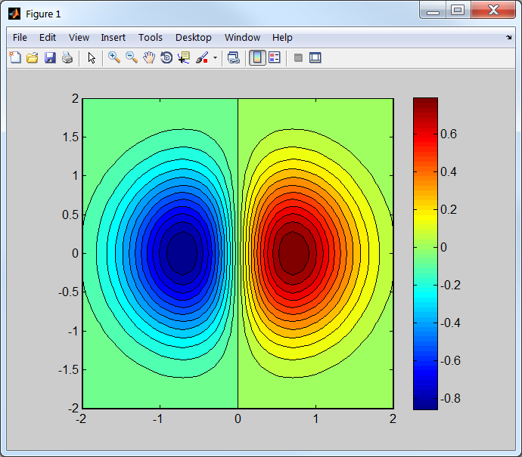
Filled Contour Plots
contourf makes color-filled contour plots
Can specify the colormap and caxis range if needed

Slide 19
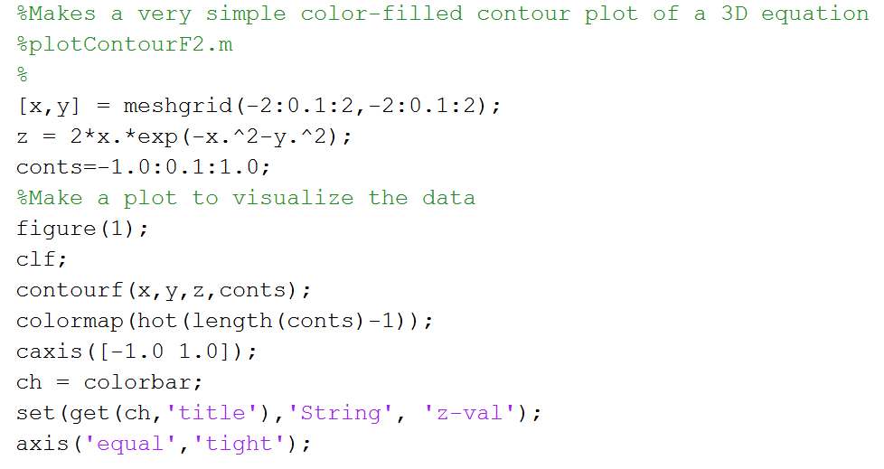
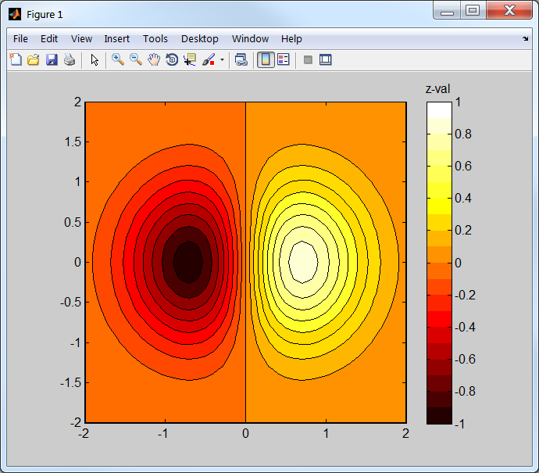
Filled Contour Plots: Some Options
Color-filled contour plots are an excellent way to visualize 3D data in a 2D format
If color is not an option, use colormap(gray)

Slide 20
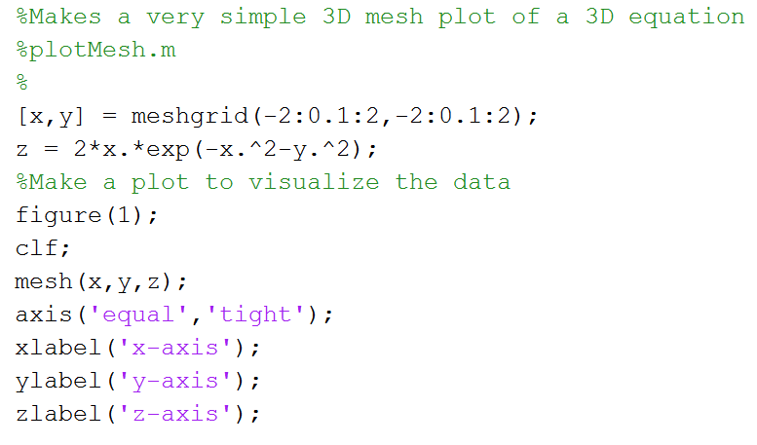
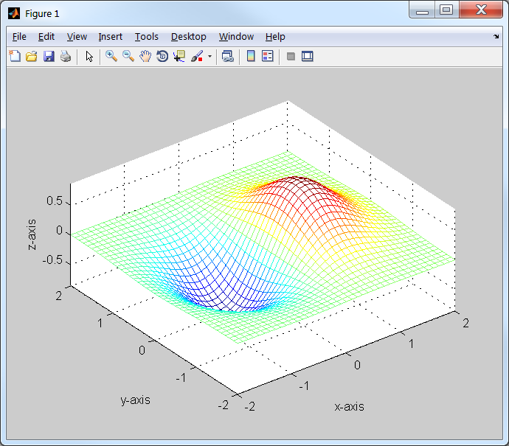
3D Mesh Plot
Makes a rectangular mesh of 3D data
Unless color is specified, mesh is colored by a colormap

Slide 21
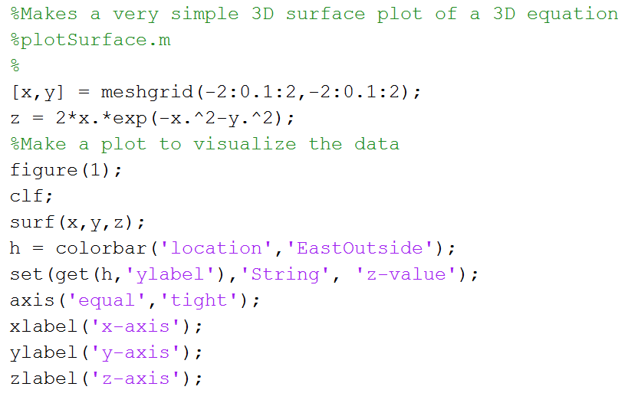
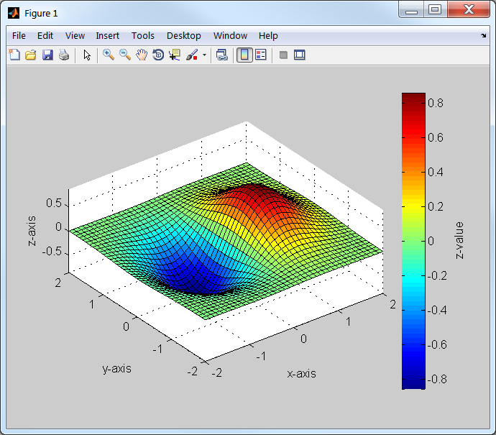
3D Surface Plots
Surface plots use solid colored quadrilaterals to make a 3D surface
Num of elements depends on [x,y] spacing

Slide 22
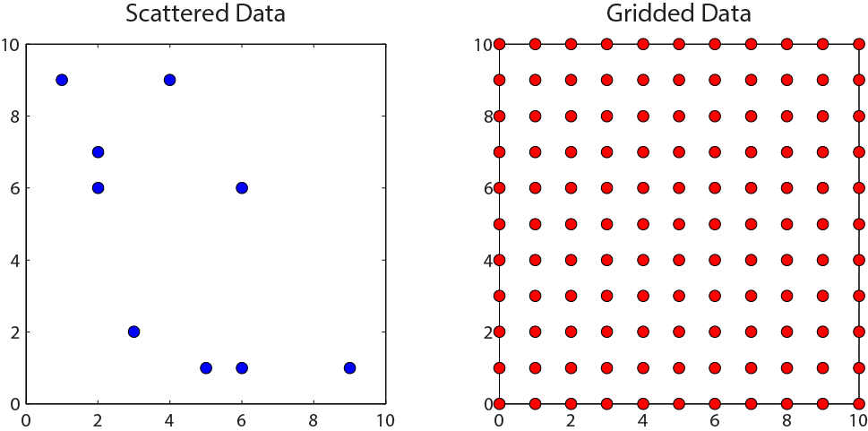
Gridding/Interpolating 3D Data
All of the previously discussed, 3D data visualization commands require data on a regular grid
What if your data is unevenly spaced or scattered?
You must first grid the data (interpolate it)
MATLAB provides a few really nice tools for this task
I will only cover: griddata & scatteredinterpolant

Slide 23
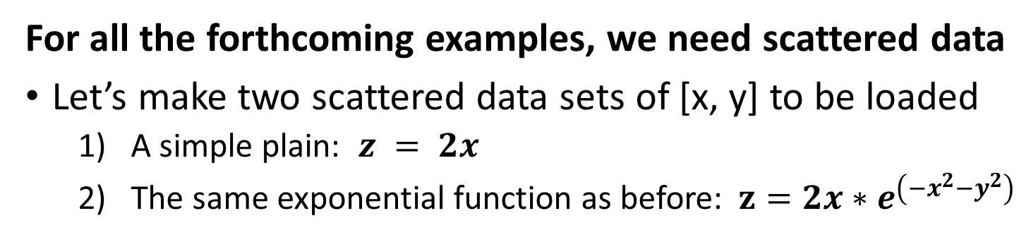
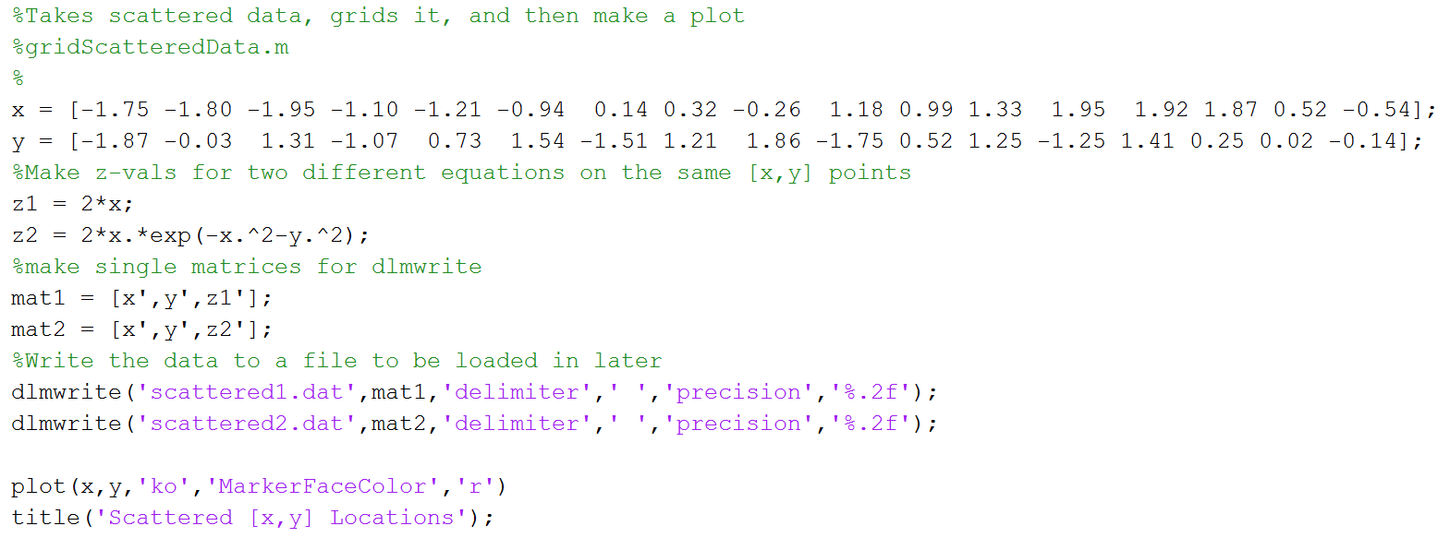
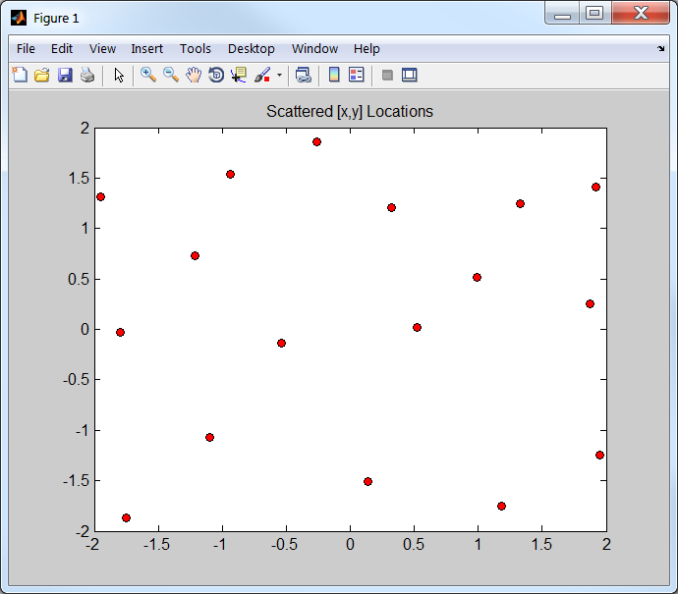
Let’s Make a Scattered Data Set

Slide 24
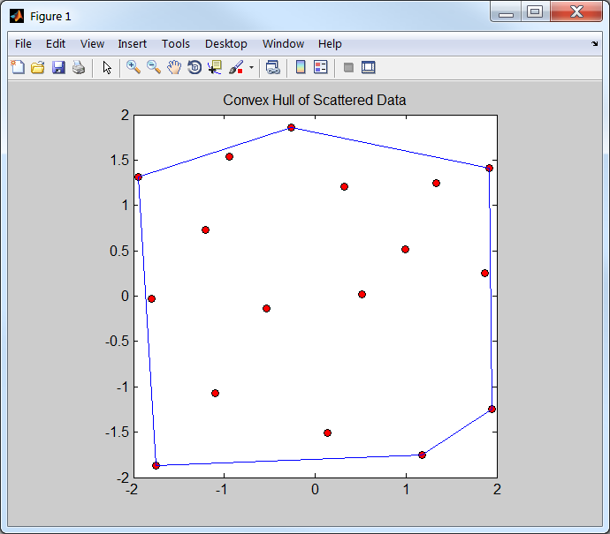

Convex Hulls & Extrapolation
When calling some gridding/interpolating functions in MATLAB, extrapolation is not performed by default
What is extrapolation in 2D/3D?
Any point that falls outside of the convex hull is typically considered to be extrapolated
Convex hull: An outline of your data’s limits
convhull: returns the indices of the input [x,y] values that are at the outer edges of the data range

Slide 25

Gridding Non-Uniform Data: griddata
griddata
interpolates z-values from non-uniform (or uniform) data
Requires:
scattered [x,y,z] *(can also interpolate gridded [x,y,z] data)
new grid data points [x,y] (from meshgrid)

Slide 26




griddata Example 1

Slide 27






griddata Example 2

Slide 28

griddata: Interpolation Methods
griddata offers several interpolation methods
Which is best?
No straightforward answer
Depends on your data and sampling
If you don’t know, stick with linear (default)

Slide 29
Other Ways to Interpolate 2D/3D Data
interp2 / interp3: will also interpolate a 2D/3D dataset, but the scattered data must be monotonically increasing.
I.e. the data must follow a constant and predictable direction
Doesn’t do anything that griddata or scatteredInterpolant doesn’t already do
While griddata works fine for most applications, it is not highly optimized
So, if your data set is huge, consider using scatteredInterpolant
scatteredInterpolant: Accepts [x, y, z] data and returns a function that can be used to interpolate/extrapolate the data at any user-specified value
Advantages: Faster than griddata. More reliable interpolation algorithm
Disadvantages: Requires a bit more coding than griddata. Will extrapolate by default. Only in MATLAB 2013a or newer

Slide 30




scatteredInterpolant Example 1
Interpolate the scattered planar data
Warning!!
scatteredInterpolant extrapolates by default!

Slide 31




scatteredInterpolant Example 2
Interpolate the scattered exponential data
What interpolation options are there for scatteredInterpolant?

Slide 32

scatteredInterpolant: Interpolation Methods
scatteredInterpolant has three interpolation methods
See documentation for usage
Also has two extrapolation methods
Or you can turn extrapolation off
Now that you know how to grid/interpolate scattered data you can make any of the 3D plots shown earlier!

Slide 33


Triangulation
What if you have scattered data that you do not want to interpolate?
Typically, you will triangulate the data and make the data into a triangulated surface
Determining the optimal triangulation is non-trivial, but MATLAB has a built-in function that calculates the optimal triangulation, delaunay
Called a Delaunay triangulation

Slide 34

Delaunay Triangulation of Scattered Data

Slide 35




3D Triangulated Surfaces: trisurf
'FaceColor','interp'

Slide 36







Comparison: surf vs. trisurf
'FaceColor','interp'
'FaceColor','interp'

Slide 37

Final Thoughts
MATLAB is a powerful tool for processing quantitative data
MATLAB is not the only tool for data analysis
Is not ideal for all analyses, but is very good for most
Not all Earth scientists know how to code…but they should!
Knowing how to write your own code gives you the freedom to create customized tools
Tools that save time
Reduce errors from repetitive tasks
Avoid re-doing data analyses multiple times
Coding allows you to develop new research methods
Don’t need to wait for a program to have a button. You can be the one that makes the buttons
Although you now know that buttons are inefficient

