Slide 1
Project Presentation

Slide 2
POLICE FEEDBACK SYSTEM

Slide 3
TABLE OF CONTENTS
01
02
03
04
05
06
Project Profile
Proposed System
Environment Specification
Here, you will find details about the project.
Here, you will find the proposed details of the system
Here, you will find information about hardware, software, and the development description.
System Planning
System Analysis
System Flow
Here, you can find information about software engineering models
Here you find detail SRS and flowchart of the project
Here you will understand the flow of the project

Slide 4
“Technology is anything that makes our life easier, solves problems and helps us achieve our goals.”
— UNKNOWN

Slide 5
MISSION STATEMENT
Empowering communities through our Police Feedback System for transparent, accountable, and collaborative policing. Share experiences, build trust, and shape safer neighborhoods together.

Slide 6
01
PROJECT PROFILE

Slide 7
PROJECT DESCRIPTION
Project Title | Police Feedback System
Project Category | Website
Technology Used | PHP , Express.js
Back-End | MY SQL
Team Strength | Four Member
Project Programmers | Kapadiya Meet A. Tamboli Pratham J. Joshi Kavya K. Jain Vidhi N.

Slide 8
02
PROPOSED SYSTEM

Slide 9
PROPOSED SYSTEM
SCOPE
The Police comments System will allow law enforcement agencies to handle and react to comments, as well as allow civilians to provide feedback A variety of user roles, including administrators, police officers, and civilians, will be supported by the system.

Slide 10
PROPOSED SYSTEM
OBJECTIVE
The primary objective of this website is to facilitate the submission of thoughts and feedback to the police by enabling anyone to participate

Slide 11
PROPOSED SYSTEM
H/W Constraints
S/W Constraints
Minimum Microsoft Windows 7 Required
Google Chrome, Mozilla Firefox or any other browser required
MYSQL Database
Band with 10 MBPS minimum required
Processor 2 GB RAM and 100 GB HDD minimum required

Slide 12
03
ENVIRONMENT SPECIFICATION

Slide 13
HARDWARE REQUIREMENT
Web Requirement | Band with – 10 Mbps(Minimum)
Development | Processor – Intel(R)Core ™ 2 Duo
Environment | Processor RAM – 1 GB HDD – 100GB Operation System: Window XP
Client Configuration | Internet – 512 Kbps(Minimum) Internet explorer 6.0 and above.
Web Hosting | Windows Server 2003 and above

Slide 14
SOFTWARE REQUIREMENT
Front-end | HTML , CSS
Back-end | Node.js, Express.js
Scripting Language | JavaScript
Other Technology | xampp
Browser | Mozilla Firefox, Google Chrome

Slide 15
DEVELOPMENT DESCRIPTION
EXPRESS.JS
PHP
Lightweight Node.js web framework for building efficient web applications and APIs with simplicity, flexibility, and scalability in mind
Widely-used open-source scripting language, designed for web development, executing on the server, and embedding within HTML code for dynamic content
MYSQL
XAMPP SERVER
Popular open-source relational database management system, known for reliability, speed, and versatility in managing structured data for applications
Cross-platform, free, open-source server solution, bundling Apache, MySQL, PHP, and Perl for simplified web development and testing environments.

Slide 16
04
SYSTEM PLANNING

Slide 17
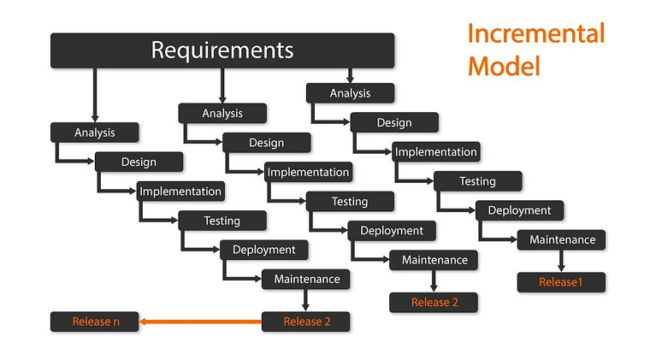
SYSTEM PLANNING
SOFTWARE ENGINERRING MODEL
INCREMENTAL MODEL
The incremental model in software engineering is a modern approach to project management that involves dividing a complex project into smaller, self-contained modules known as increments.

Slide 18
INCREMENTAL MODEL
Each increment represents a partial system with added functionality, allowing for the project's gradual development. The key feature of this model is its iterative process, where increments are developed, tested, and integrated one after another into the evolving system. This iterative approach facilitates frequent testing, quick feedback, and early defect detection.
By breaking the project into increments, teams can prioritize features and address changes efficiently. This process promotes collaboration and adaptability, making it essential for effectively managing intricate projects in today's dynamic digital landscape. Continuous assessment, feedback, and adjustments are integral to this model, enabling prompt identification and correction of errors. To ensure the smooth integration of increments, careful planning and coherent design are crucial. This approach harnesses the power of the incremental model, allowing organizations to efficiently address evolving requirements while effectively managing the complexity of modern projects.

Slide 19
05
SYSTEM ANALYSIS

Slide 20
ADMIN
Give Feedback
Add New User
Manage Website
Manage Post
Manage data / Report
View Feedback
Manage Comment
Manage Status
POLICE
Give Feedback
View Data / Report
View Feedback
View Post
View Comment
Update / Manage Status
CIVILIANS
Give Feedback
View Post
Add Comment
View Status

Slide 21
06
SYSTEM FLOW

Slide 22
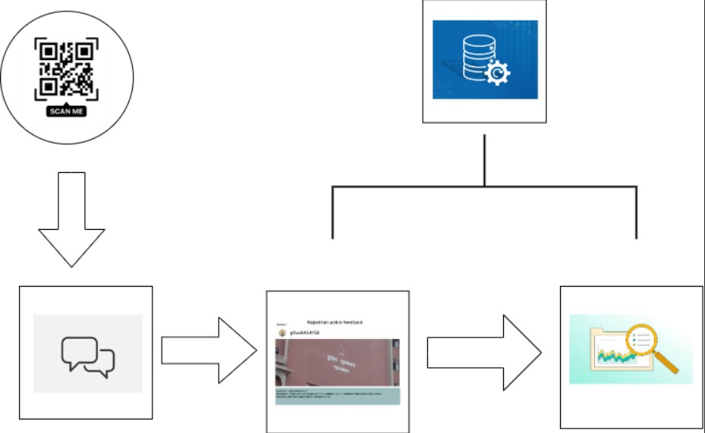

Slide 23
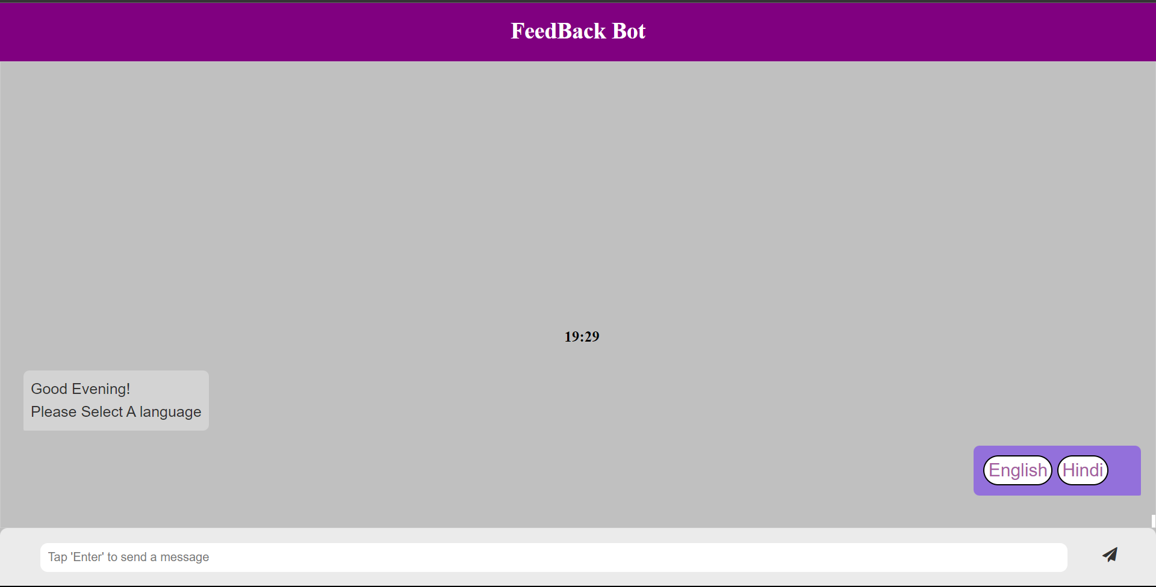
Chatbot Interface

Slide 24
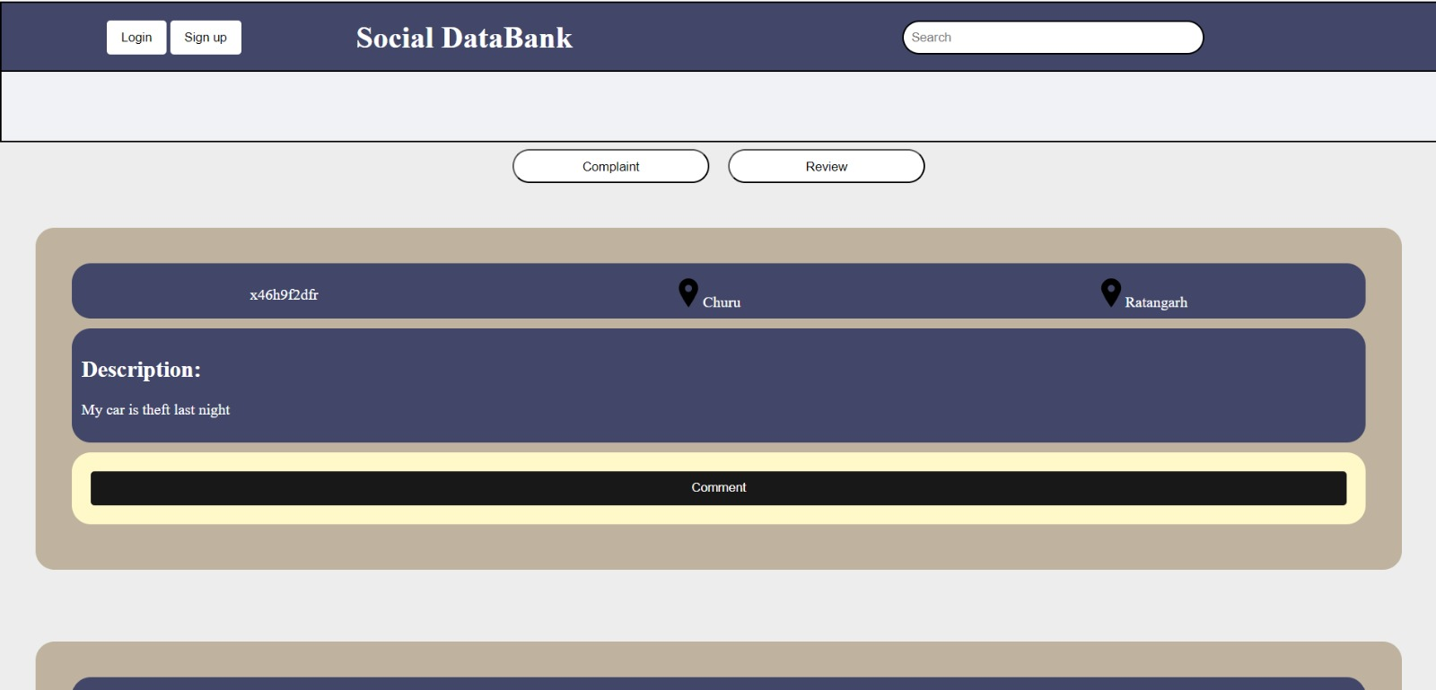
Civilians POV Interface

Slide 25
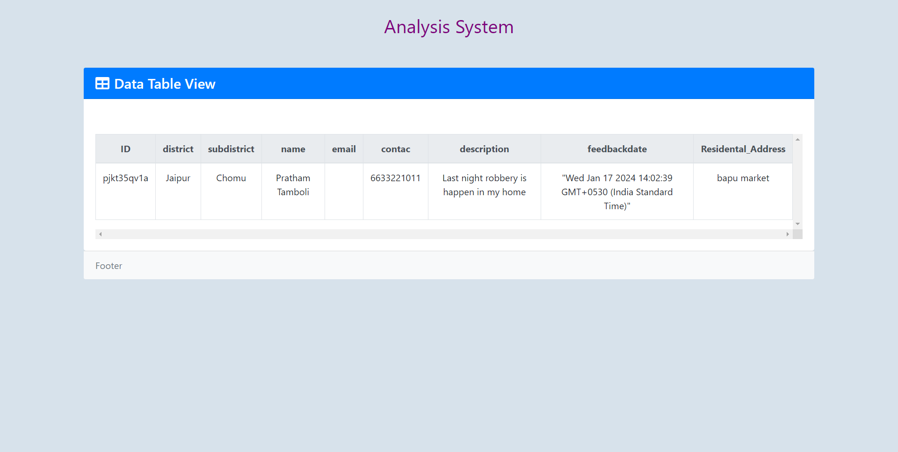
Civilians POV Interface

Slide 26
THANK YOU
Do you have any questions?
meetkapadiya143@gmail.com
prathamtambolipt1@gmail.com

