Slide 1




Kharagpur Open Source Society
presents
GIT AND GITHUB CONCEPTS
Always code as if the guy ends up maintaining your code will be a violent psychopath who knows where you live.
– Martin Golding

Slide 2

Table of Contents :
Basic commands :
# git add
# git commit
# git status
Special commands :
# git diff
# git switch
# git rebase
# git reflog
# git cherry-pick
# git stash
# git bisect

Slide 3

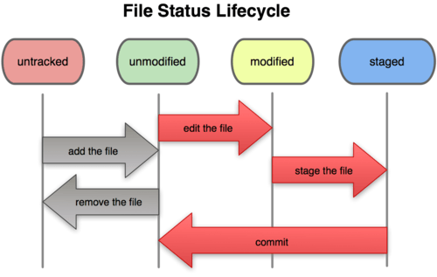

Slide 4

BASIC GIT COMMANDS :
QUICK QUIZ ?
What tab do you use to request that someone reviews and approves your changes to a project before they become final?
Which git command allows you to see the state of your working directory and the staged snapshot of your changes?
Under which tab on GitHub will you find all the source files for a repository?
Which Git command transfers changes from your local repository to the remote repository?
Helper Notes

Slide 5
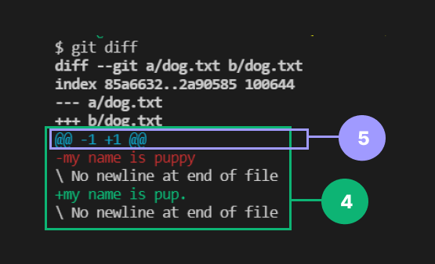
ADVANCED GIT CONCEPTS :
1)GIT DIFF
Synopsis
Diffing is a function that takes two input data sets and outputs the changes between them.The data sources can be commits,branches,working tree,etc.
Example
Suppose we have created a file “dog.txt”. We added it to the staging
area with content ‘my name is puppy’ in it. Now we apply git diff
command but it shows nothing.That is because the command
compares the working directory with the staging area file.But now we
modify ‘puppy’ with ‘pup’ .If we run command git diff, the outcome
is weird.
In the first line, Git has named old version of file as ‘A’ & newer as ‘B’.
In third line,git assigned a minus sign ‘-’ to ‘A’ & ‘+’ to ‘B’. In 4th line,Git
shows chunk of lines with red being modified to green lines.
The fifth corresponds to a chunk header.
What does the second line signify???
Can you see -1 & +1 ??? \ No newline at end of file ???

Slide 6
Other Comparisons
git diff HEAD – Command to compare the both staged and unstaged changes
with your last commit.
git diff <branch_name1> <branch_name2> – Command to compare the changes
from the first branch with changes from the second branch.Order does matter when
you're comparing branches. So diff's outcome will change depending on the order.
Branch comparison considers the commits only. It doesn't look for staged and
unstaged changes.
git diff <commit_hash> <commit_hash> – Command to compare the
changes between two commits.
git diff --staged <file_name> – Command to compare the staging area file with
committed file.
git diff --cached <file_name> – Can you guess?
How can you display a list of files added or modified in a specific commit?
git diff-tree <commit_hash>

Slide 7
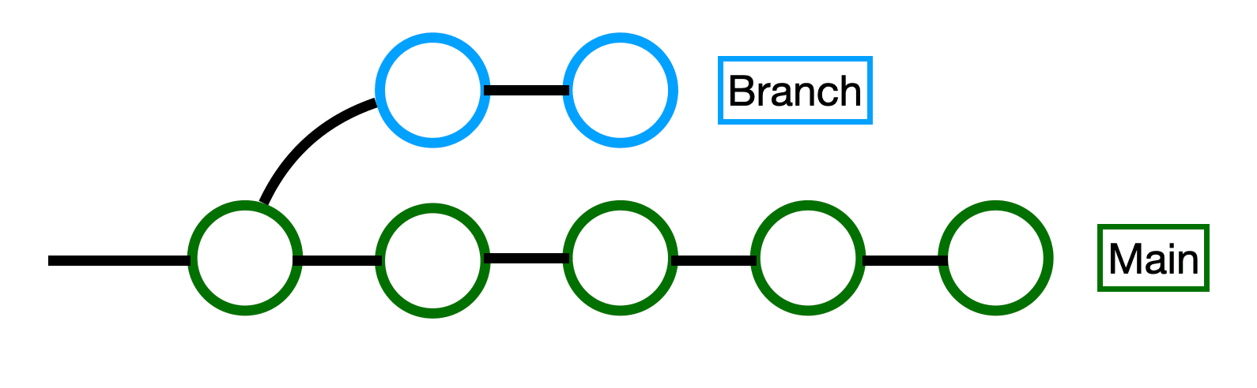
2)GIT SWITCH
Synopsis & Options
git switch <branch_name> – It simply specifies the local branch you want to switch.This will make given branch the new HEAD branch.
git switch -c <branch_name> – You can create and switch to a new branch in one go.
git switch – – Using it ,you can switch back to the previously checkout branch.
git switch remote branch – If you want to check out a remote branch (that doesn't yet exist as a local branch in your local repository), you can simply provide the remote branch's name. When Git cannot find the specified name as a local branch, it will assume you want to check out the respective remote branch of that name.This will not only create a local branch, but also set up a "tracking relationship" between the two branches, making sure that pulling and pushing will be as easy as "git pull" and "git push".
What is a remote branch ? How is it different from a local branch?

Slide 8
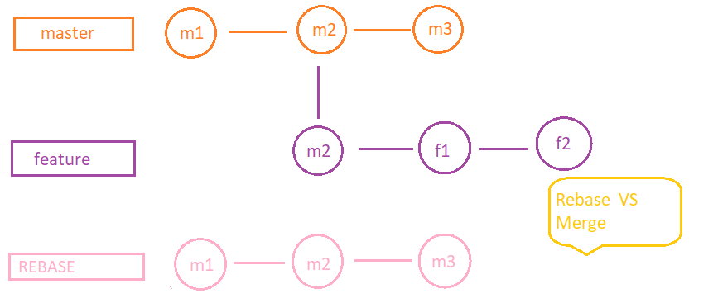
3)GIT REBASE
Synopsis & Examples
Rebase is another way to integrate changes from one branch to another. Rebase compresses all the changes into
a single “patch”. Then it integrates the patch onto the target branch.
Suppose there is a file in working directory .It is already committed once with message ‘m1’ on master branch. Now it is committed second time as ‘m2’. Now we checkout a branch ‘feature’ on initial base commit ‘m2’ which is common in both branches.

Slide 9
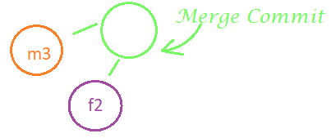

Now we are working in ‘feature’ branch and file is added and committed once with message ‘f1’. In meantime,our colleagues are working in the master branch and have committed it third time as ‘m3’.And we have again committed the file in feature as ‘f2’.
Now we want to integrate the changes made in both the branches. There are two ways :
git merge – The command simply merges the branch to the master along with all commits being merged .It may be beneficial but we have an additional commit just for merge with HEAD pointing to master. Moreover ,it is tedious to understand and locate a commit.
2. git rebase – We apply command ‘git rebase feature’.Now git compares the last commit of
both branches.Here the last commit is ‘m3’.So git rebase command changes the base of
feature branch with the last commit , here,i.e., ‘m2’ to ‘m3’.Thus ’f1’ is based on ‘m3’
And git proceeds feature branch ahead with this base and aligns feature branch with
master branch putting every next commit of feature branch on top of ‘m3’ commit.

Slide 10

Now if we rebase the master branch ,then git checks changes in feature branch and apply it to master branch and
also update the master branch to latest commit.
Rebases are how changes should pass from the top of the hierarchy downwards, and merges are how they flow
back upwards.
To have a clear and simple branching, git rebase <branch_name> is advisable to use due to traceability and
understandable history commit.
What is purpose of command ‘git rebase -i’ ?
What does the command ‘git rebase -i HEAD~10’ do?
What is ‘merge conflict’?
How many ways are present in Git to integrate changes from one branch into another?
What is the main issue with using git rebase when working with multiple developers?
.

Slide 11
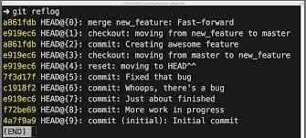
4)GIT REFLOG
Synopsis & Example
‘Reflogs’ are short form of reference logs.Git keeps a record of tips of branches and other references that were updated in the repository.
The git reflog accepts subcommands like show,expire,delete and exists.
Git can show logs history of at most last 90 days.
The ‘git reflog show’ command will show the log of a specific reference (it defaults to HEAD).To view logs of tips of a particular branch,we can apply ‘git reflog show <branch_name>’.
Let us clear concept using image beside.The last line in image corresponds to the initial commit.The characters shown in yellow text together are called as a hash of commit and checkout.The hashes and HEAD@{ } are references and are helpful to move from one place to another.The hash and head@ are not fixed.As we apply commands further,they change. But the recent command is always allocated as HEAD@{0}.Since particular branch is not specified, it follows the head pointer.

Slide 12
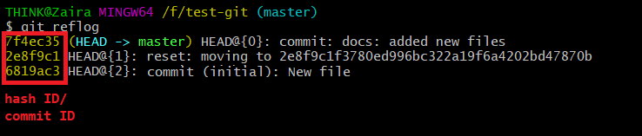
Thus,reflog is a logging mechanism and keeps a track of all the changes against their unique hash-id.
Picking the commit ID using ‘git reflog <hash-id>’ helps us to revert a commit.
What information do Git reflogs (reference logs) store?
After accidentally deleting a branch in your local repository, how can you recover it? Find the hash of the branch with the reflog command, then execute git checkout -b <branchname> <hash>.

Slide 13
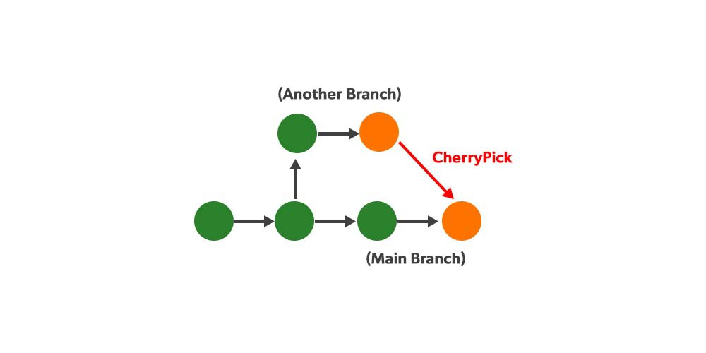
5)GIT CHERRY–PICK
Synopsis
Cherry-picking in git means choosing a commit from one branch and applying it to another branch. This is in contrast with other ways such as merge and rebases which normally apply many commits into another branch.
Cherry-picking is just like rebasing It is mainly used if you don’t want to merge the whole branch and you want some of the commits.It is mainly used for bug fixes where you want to place that bug fix commit in all the version branches.It is also used when we accidentally made a commit in wrong branch.
But it can cause lot of duplicate commits.
Example as a DEMO VIDEO & QUIZ
We use command git cherry-pick <commit_id>
for selective commits.
Practical Implication by me
What does the following command describe?
git checkout feature-user-location
git cherry-pick kj2342134sdf090093f0sdgasdf99sdfo992mmmf9921231
git cherry-pick kj2342134sdf090093f0sdgasdf99sdfo992mmmf9921231
.

Slide 14
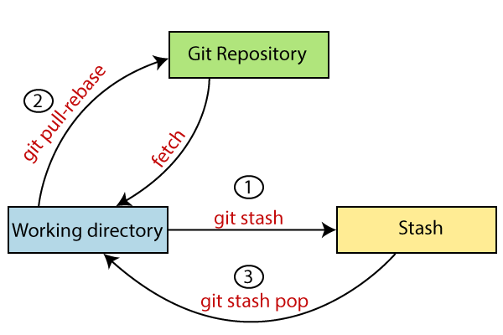
6)GIT STASH
Synopsis
git stash command saves the previously written code and then returns to the last commit for a fresh start. Now you can add the new feature without disturbing the old one as it is saved locally. After committing to the new feature you can go on with working on the old feature which was incomplete and uncommitted.It allows us to switch branches without committing the current branch. It helps us to store them in hidden files.
Example as a DEMO VIDEO
Normally before switching branch,we first commit our work.But
suppose we don’t wish to commit our undone work.
If we switch without committing, two things may happen:
Switches to branch carrying the changes
Git will not allow to switch the branch and asks to commit or stash the changes.
Git stash command demo video

Slide 15
Some of the git stash commands to know :
Git stash save “message”
Git stash list
Git stash apply
Git stash changes
Git stash pop
Git stash drop
Git stash clear
Git stash branch
While modifying a file, you're unexpectedly assigned an urgent bug fix on another branch. How
can you temporarily save your local work without committing?
What do the git stash drop and git stash branch <branch_name> command do?

Slide 16
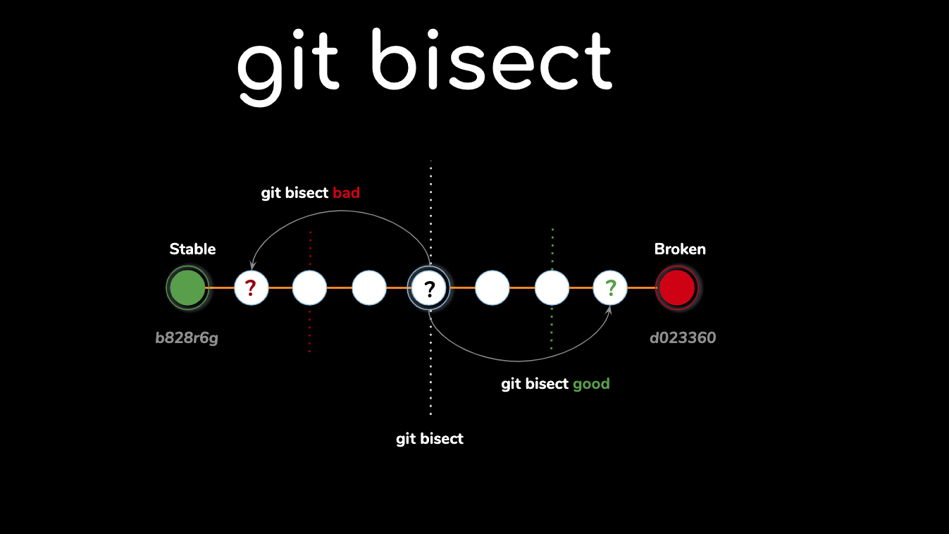
7)GIT BISECT
Synopsis
This command uses the binary search algorithm to find out the commit that introduced a bug.
How it works?
Git bisect start : It starts up a git bisect wizard.
Git bisect bad “version” : It lets the git bisect wizard of a bad commit.
Git bisect good “version” : It lets the git bisect wizard of a bad commit.
Git bisect reset : It ends git bisect wizard.
Quick quiz ???
What is the operation doing given the Git
commands below?
git bisect start
git bisect
bad5d41402abc4b2a76b9719d911017c592
git bisect good
69faab6268350295550de7d587bc323d

Slide 17

Row
Example
Suppose we have created a file ‘text.txt’ which spells out a poem .We have written a verse ‘Row your boat gently down the stream’.But by mistake,we have introduced a bug since word boat is replaced with car in further commits.The following given snapboxes are commits in master branch.The file is committed after every single word.So we will use git bisect to find the commit which introduced the bug.
After starting wizard, we will declare a good commit using git log and checking our output.Then we may use the most recent commit as a bad commit as our final result is not satisfying.
When we typed git bisect bad in this step, git bisect checked out an old commit for us – the commit halfway between the latest bad commit and the known good commit. This is how bisect works – it cuts the commit history down in halves until it finds the original bad commit.
Based on our result for the half ,we will declare the commit pointed as good or bad. Here,on dividing,the word car has appeared. Declaring bad commit,
git bisects the half again.
Finally, we are able to find that particular commit .
The command git bisect reset is used to exit the wizard.
your
boat
Good commit
gently
car
down
the
stream
Bad commit

Slide 18

CONCLUSION :
Git is a very powerful tool and helps to collaborate professionally,save our code,presentation and learn from others’ coding related projects.
Take a tiny second to celebrate our cognitive effort.Because we have already gotten our hands dirty with git commands’ outcome.
THANKS
FOR THE
OPPORTUNITY
MODI MEET -9913239263
modimeet20@gmail.com

