Slide 1


Slide 2
DEPARTMENT:
INDUSTRIES AND MINES
CHALLENGE TITLE:
ELECTRONIC DOCUMENT MANAGEMENT
SYSTEM

Slide 3
TEAM:
TEAM LEADER: Abhishek Shingadiya
TEAM MEMBERS:
Ravi Vaniya
Bhagyesh Radiya
Sanat Dhobi
Komal Tankariya
Nirzari Gupta
Shailly Rajput
TEAM MENTOR: Prof. Mayur Vegad

Slide 4
BARCODE

Slide 5
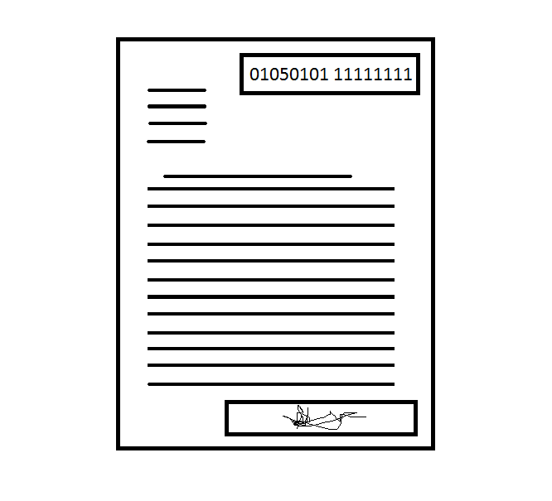
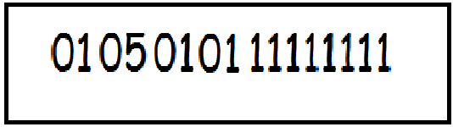

Slide 6
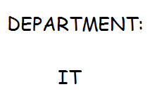

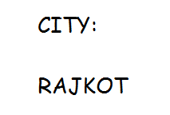

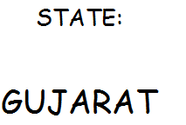
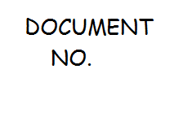





Slide 7
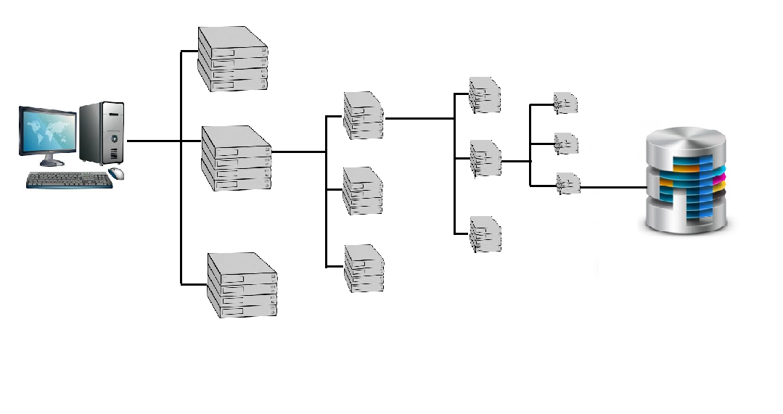


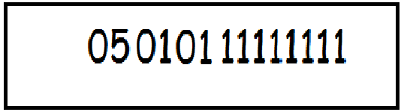


Slide 8
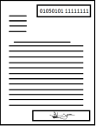

Slide 9

THE VERIFICATION
PROCESS

Slide 10









DATA
BASE

Slide 11
THANK YOU…

