Slide 1

Semantic Search and Retrieval-Augmented Generation (RAG)
Shraddha Sharma

Slide 2
Agenda
Encoder-only Transformers for Dense Embeddings
Sentence Embeddings over Word Embeddings
Semantic Search with Transformers
Sentence Embeddings using Cosine Similarity
Semantic Search in RAG
RAG Workflow
Benefits & Limitations of RAG
RAG Evaluation Mechanisms
Advanced RAG Methods

Slide 3
Traditional Language Models
Integer encoding
One-hot encoding
Bag-of-Words
Term Frequency-Inverse Document Frequency (TF-IDF)
Word embeddings
Word based models (Word2Vec, GloVe)
Character based models (ElMo, BERT)
ELMo (Embedding from Language Model)
BERT (Bidirectional Encoder Representations from Transformers)

Slide 4


Transformer model
The Transformer
Input
Output
First transformer model was introduced in 2017 by Google researchers in the paper "Attention is All You Need".
For sequence-to-sequence tasks in NLP.
Self-Attention: Allowed the model to process all words in a sentence simultaneously, rather than sequentially like RNNs.
Replaced RNNs with Self-Attention mechanism

Slide 5

Transformer model
The Transformer
Input
Output
Encoder
Decoder
Encoder-Only
Decoder-Only
Only concerned with the input sequence
Does not generate any output sequence
Applies self-attention mechanism to the input tokens
Takes in a fixed-size vector representation of the context.
Generates a sequence of words one at a time
Each word being conditioned on the previously generated words.

Slide 6
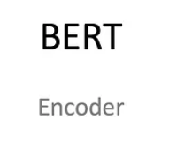
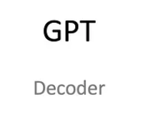
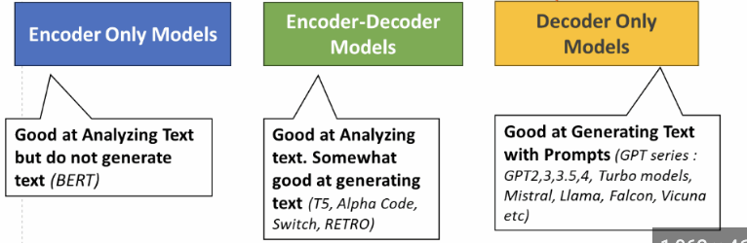
Transformer model
The Transformer
Encoder
Decoder
Input
Output

Slide 7
Encoder-only Transformers for Dense Embeddings
Examples: BERT, RoBERTa
Only encoder part is used to generate embeddings
Outputs fixed-size dense vectors for input texts
Ideal for downstream similarity tasks
Example:
Transformers
Encoder
are
Fixed-size dense vectors
amazing
for
Transformers are amazing for NLP tasks
NLP
Input Text
tasks

Slide 8
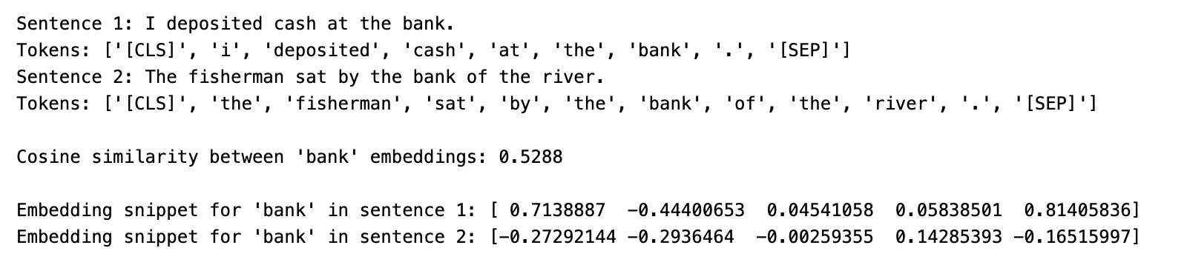
Word Embeddings example

Slide 9
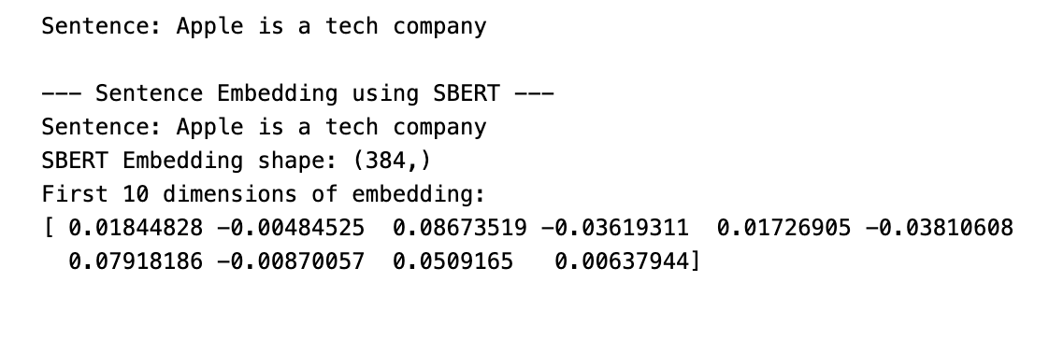
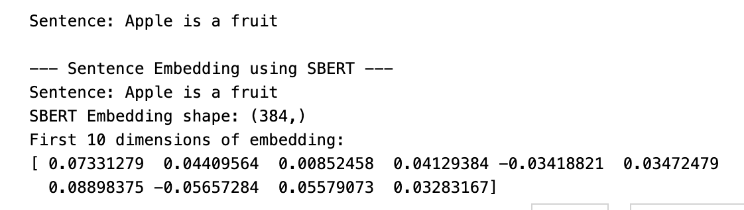
Sentence Embeddings over Word Embeddings
Sentence-BERT (SBERT) uses BERT architecture to create semantically meaningful sentence embeddings
Use pooling (e.g., CLS token, mean pooling) over encoder outputs
Example:
Compare
"Apple is a fruit"
vs.
"Apple is a tech company”
Transformers
Encoder
are
amazing
Pooling
for
Transformers are amazing for NLP tasks
NLP
Input Text
Sentence Embedding
tasks
Word Embeddings

Slide 10
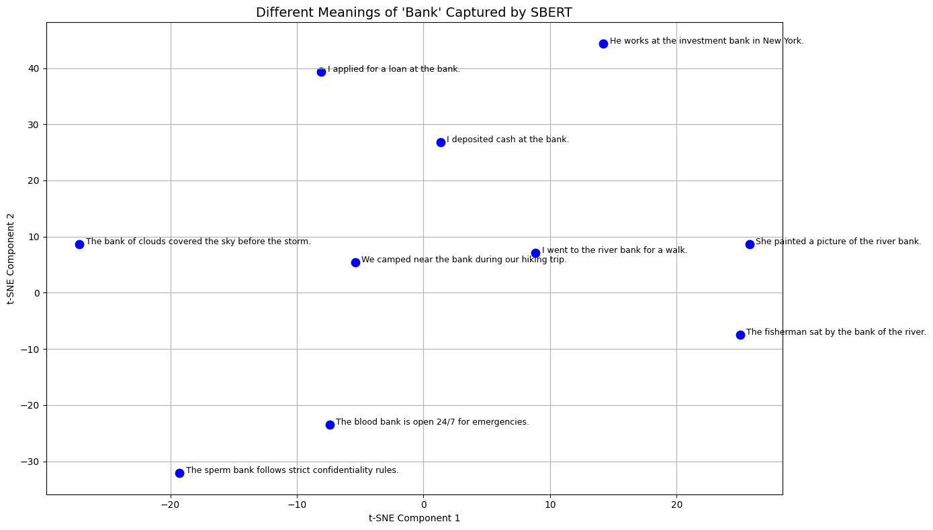
Sentence Embeddings example

Slide 11
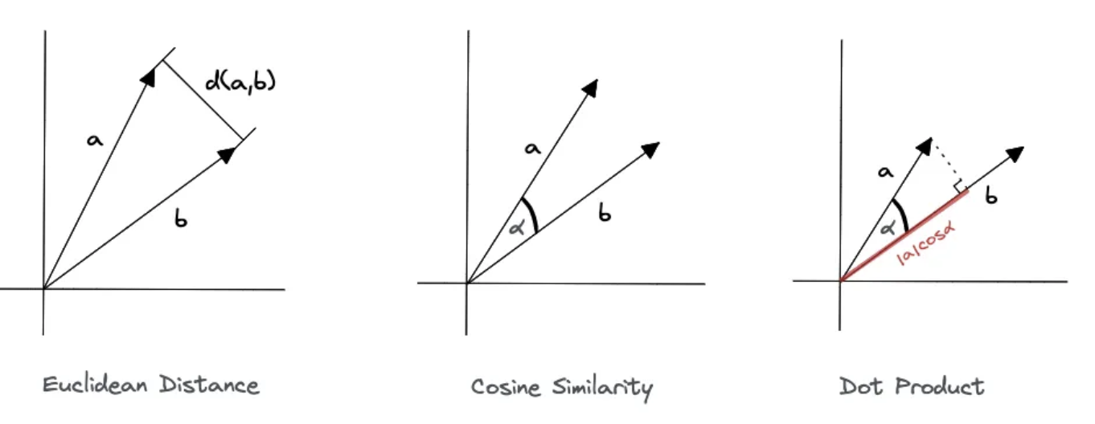
Semantic Search with Transformers
Encode corpus and query using the same model
Use vector similarity (e.g., cosine) for retrieval
Outperforms lexical search (e.g., BM25)
Enables fuzzy matching & contextual understanding

Slide 12
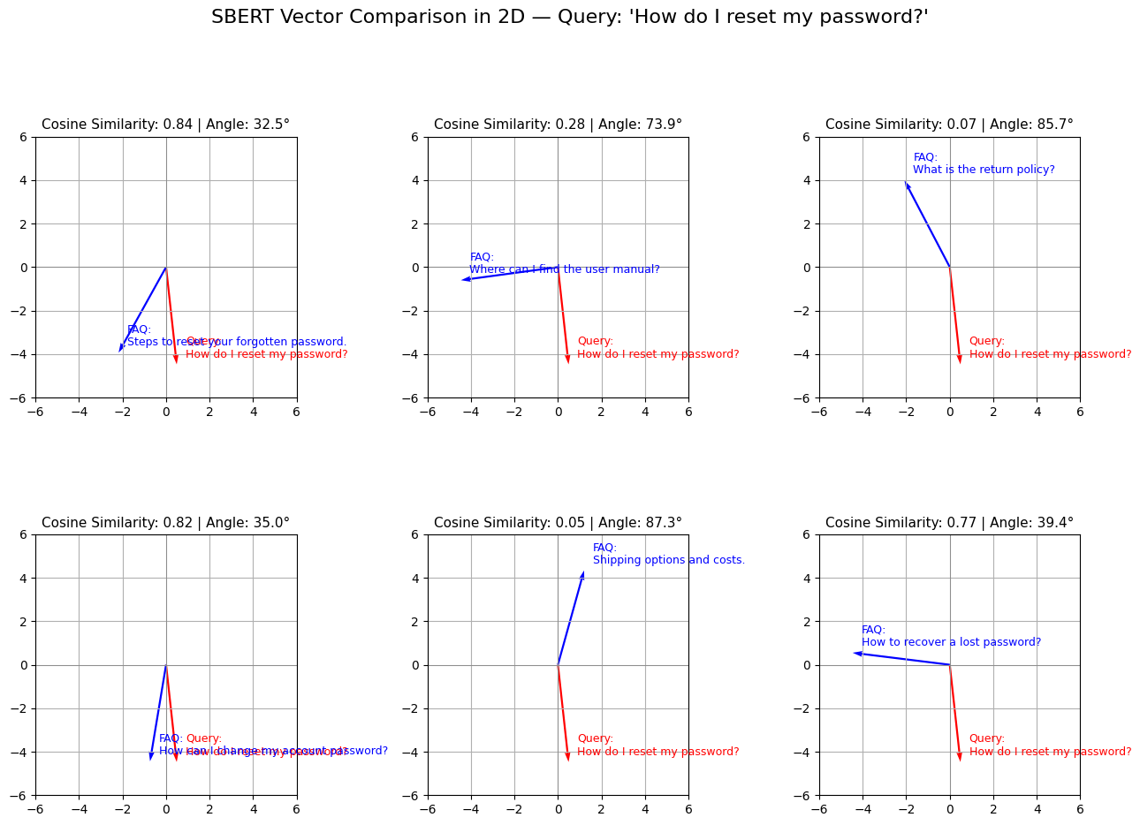
Semantic Search using Cosine Similarity
1
2
3
Cosine similarity measures angle between vectors
Effective in high-dimensional semantic space
Used to find nearest neighbors in vector DBs
Example: Find top 5 similar product descriptions or FAQs to a user query using cosine similarity on SBERT vectors
Query: How do I reset my password?
Product FAQs
Steps to reset your forgotten password.
Where can I find the user manual?
"What is the return policy?
"How can I change my account password?
Shipping options and costs.
How to recover a lost password?
4
5
6

Slide 13
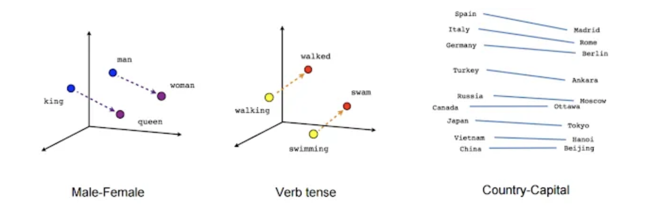
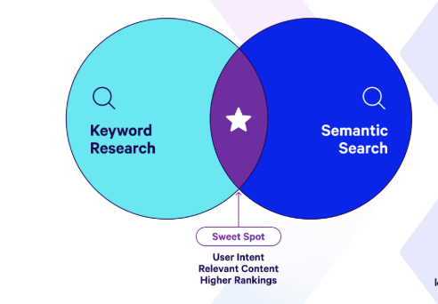
Semantic Search in RAG
Retrieve relevant context from a document corpus
Context passed along with query to LLM
Improves relevance and factual accuracy of answers
Example: Query: "What is the shelf life of COVID vaccines?" — retrieves CDC guidelines as context for LLM

Slide 14
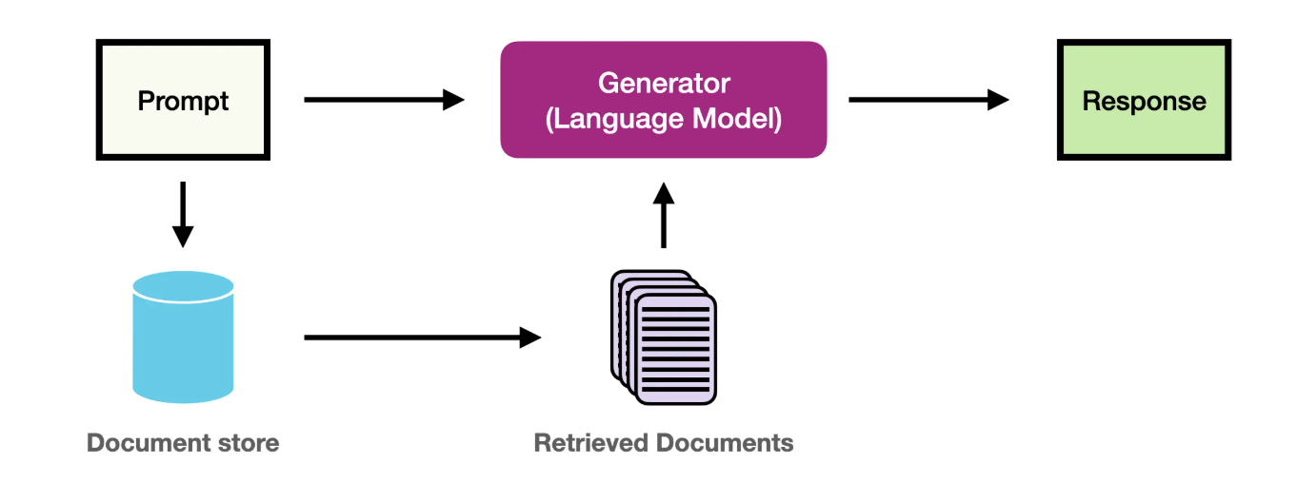
RAG Workflow
Embed Question (same embedding model used)
Final LLM Response Generation (e.g., OpenAI GPT-4 or Cohere command R)
Data Loading (e.g., load knowledge base documents from PDFs or CSVs)
Chunking (split into manageable pieces, e.g., 500 tokens each)
Embedding (via sentence transformer like all-MiniLM-L6-v2)
Store in Vector Database (e.g., FAISS, Pinecone, Weaviate)
Semantic Search & Retrieve Top-k Documents

Slide 15
Benefits of RAG
Reduces hallucination by grounding in real data
Provides references for fact-checking
Avoids fine-tuning large models
Supports dynamic databases (no retraining)
Improves privacy by minimizing prompt leaks
Example: Customer support bot uses RAG to answer from internal support docs instead of relying on pre-trained data

Slide 16
Limitations of RAG
Retrieval quality affects response quality
Context length limits in LLM
Requires well-maintained Vector DB
May still need post-retrieval re-ranking
If irrelevant documents are retrieved due to poor embedding, answer quality drops significantly

Slide 17
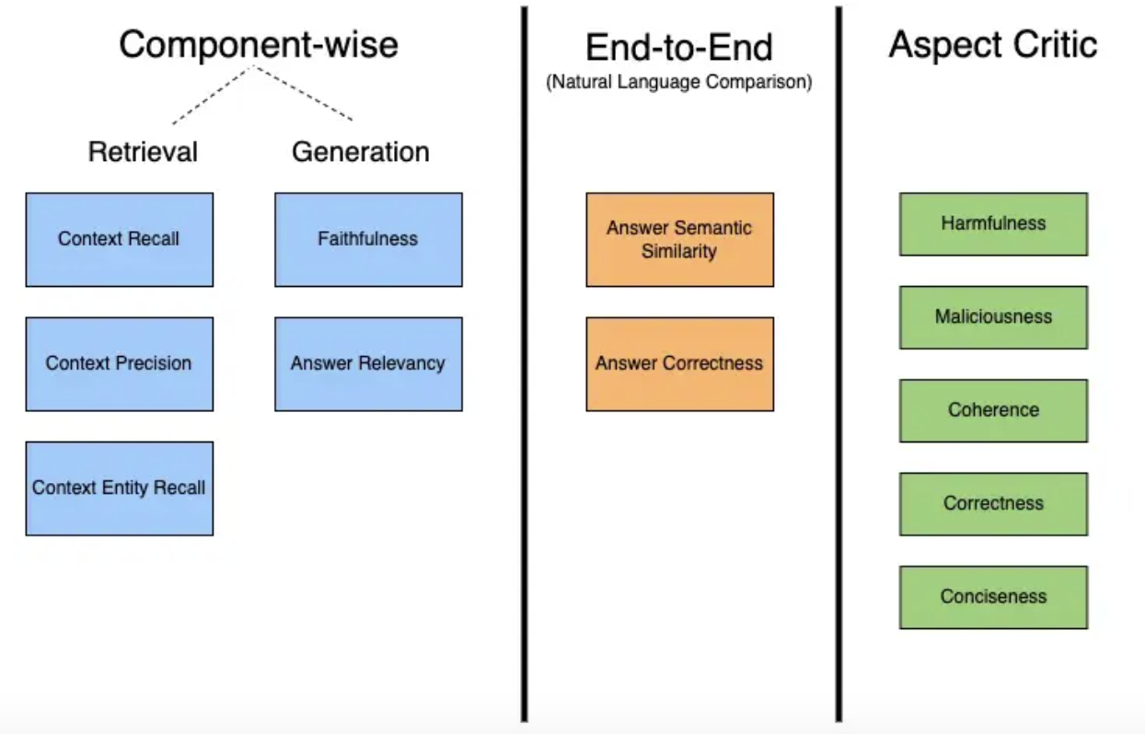
RAG Evaluation Mechanism
The RAG Triad: Context Quality, Answer Quality, Grounding
RAGAS Framework: Standard metrics for RAG evaluation
Context Recall, Precision
Answer Relevance, Factuality
Factuality Scores: Human/automated fact-checking
Example: Evaluate chatbot answers for "accuracy" by checking if supporting document was correctly retrieved

Slide 18
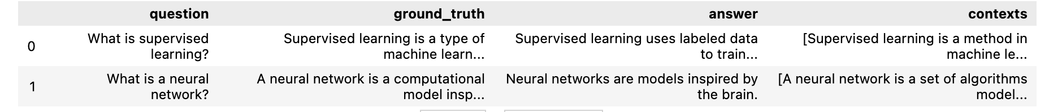
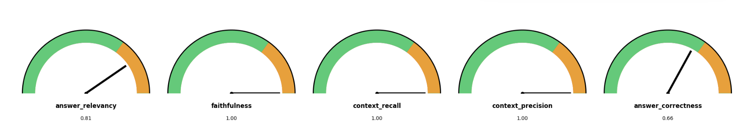
RAGAS Evaluation

Slide 19
Basic Rag has limitations.
Here is how we can improve it…

Slide 20
Advanced RAG Methods
Reranking: Reorder retrieved documents with scoring model
HyDE (Hypothetical Document Embeddings):
Generate hypothetical answer
Use it as a query to retrieve better documents
Example: Query: "How does quantum computing work?" → LLM generates an explanation → used as search query

Slide 21
Summary
Semantic Search is foundational to RAG
RAG combines IR with LLMs for improved response quality
Benefits include factuality, adaptability, and reduced hallucinations
Evaluation and improvement methods are evolving rapidly

Slide 22

Q&A
Questions?
Discussion

