Slide 1

STRESS DETECTION USING MACHINE LEARNING
PARAMETERS PATROL
GROUP DETAILS:
Pruthviraj Dodiya (AU2040175)
Manan Vadaliya (AU2040264)
Mitsu Sojitra (AU2040157)
Mohsinali Vijapura (AU204080)

Slide 2
INTRODUCTION
Our project uses machine learning to detect stress in social media data, with a focus on Reddit posts.
We aim to provide a tool for identifying and supporting people who may be experiencing stress.
Our project involves data preprocessing, feature extraction, algorithm selection, and evaluation.
We experimented with several machine learning algorithms, such as SVM, KNN, Gradient Boost, XGBoost, and Bernoulli Naive Bayes.

Slide 3
PROBLEM STATEMENT
With the increasing prevalence of stress, there is a growing need for effective and efficient stress detection methods.
Social media platforms provide a rich source of data on stress, but the volume and diversity of data make analysis difficult.
Our project aims to develop a machine learning-based system to efficiently detect stress in social media data.
Our system will contribute to the field of mental health research by providing a new tool for tracking stress levels in the population.

Slide 4
THE EXISTING BODY OF WORK
Social media data is being used to track mental health indicators like stress levels.
Researchers have tried different approaches to detect stress in social media, including sentiment analysis and machine learning.
Challenges in stress detection include language complexity and privacy concerns.
Existing studies show some promising results, but there's a need for more accurate and efficient methods.
Our project uses machine learning to detect stress in social media while considering additional features like confidence and social upvote ratio.

Slide 5
OUR APPROACH
Collect data: Measure self-reported stress levels using data from the Perceived Stress Scale (PSS) questionnaire.
This dataset will serve as the foundation for the stress detection model.
After implementing several PREPROCESSING procedures, such as cleaning up text data and verifying existing dependencies, a word cloud will be created to help identify the words that are most affected by stress.
Manual Feature Selection: As we had 116 features in our dataset, we performed exploratory data analysis on our dataset and then based on that we selected 5 features for training which are , "text", "label", "social_upvote_ratio", "confidence", "syntax_ari", "sentiment" , and then we have further cleaned up our text data.

Slide 6
OUR APPROACH
Data Exploration and Preprocessing: Model Selection and Training: Train four different machine learning algorithms, SVM, KNN, Gradient Boost, and XG Boost, using the selected features from the previous step.
MODEL EVALUATION AND COMPARISON: COMPARE THE PERFORMANCE OF THE FOUR MODELS USING THE ACCURACY SCORE
ALSO, VISUALIZING THE RESULTS USING CONFUSION MATRIX OTHER BAR PLOTS TO UNDERSTAND THE MODEL'S BEHAVIOR.
BASED ON THE EVALUATION METRICS, SELECTING THE BEST PERFORMING MODEL(S) AND TUNE THE HYPERPARAMETERS FURTHER IF REQUIRED.

Slide 7
OUR APPROACH
Deployment and Monitoring: Once the best model is selected, you can deploy it in a production environment and monitor its performance using real-time data.
retrain the model periodically to keep up with the changing data patterns and avoid model degradation.

Slide 8
FINAL RESULTS
Our analysis showed that the Gradient Boosting and XGBoost algorithms achieved higher accuracy in detecting stress than the SVM and KNN algorithms.
Specifically, the Gradient Boosting algorithm achieved an accuracy of 73%, and the XGBoost algorithm achieved an accuracy of 72%.
On the other hand, the SVM algorithm achieved an accuracy of 68%, and the KNN algorithm achieved an accuracy of 55%
Gradient Boosting and XGBoost are both ensemble methods that combine weak learners, such as decision trees, to create a more robust predictor.
The decision trees were trained sequentially to correct the errors of the previous tree, resulting in a highly accurate final predictor.

Slide 9
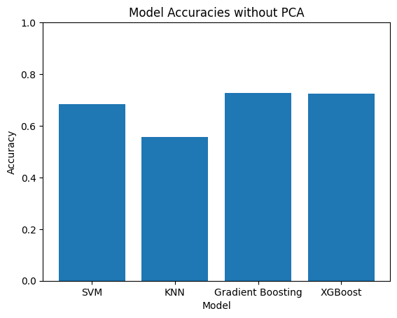
FINAL RESULTS

Slide 10
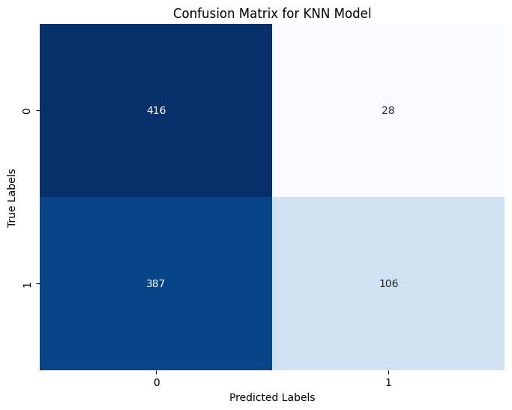
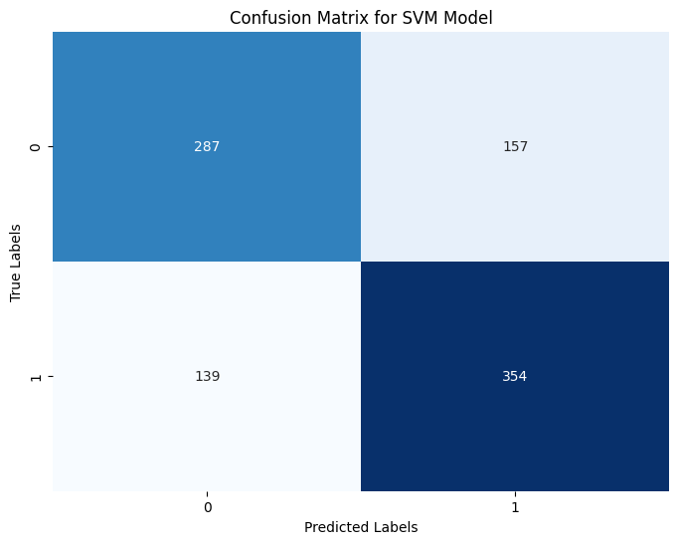
FINAL RESULTS

Slide 11
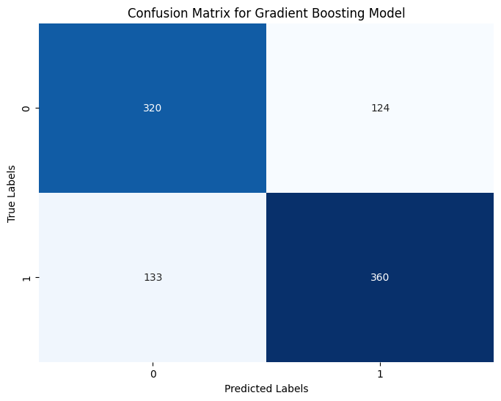

FINAL RESULTS

Slide 12
CONCLUSIONS
Incorporating additional features like confidence and social upvote ratio can improve the accuracy of stress detection models.
Our work builds on existing research in mental health monitoring using social media data.
Our methods could be adapted to identify other mental health concerns like anxiety or depression.
Limitations include the use of a single dataset and the need for further validation of our results.
This work represents an important step forward in the development of automated mental health monitoring tools.
INTERSECTION
DATASET

Slide 13
ROLE OF EACH GROUP MEMBER IN THE PROJECT
1
Manan: Running different algorithms ,checking for multiple feature combinations ,Data preprocessing
Pruthviraj: Understanding maths of algorithms and understanding their intuition, Data visualization, Feature selection
2
Mitsu: Applying different algorithms on code & Pre-processing the data ,report
3
4
Mohsinali: Checking accuracies for different algorithms , Report and presentation

Slide 14
REFERENCES
Panicker, S. S., & Gayathri, P. (2019). A survey of machine learning techniques in physiology based mental stress detection systems. Biocybernetics and Biomedical Engineering, 39(2), 444-469.
Ahuja, R., & Banga, A. (2019). Mental stress detection in university students using machine learning algorithms. Procedia Computer Science, 152, 349-353.
Keshan, N., Parimi, P. V., & Bichindaritz, I. (2015, October). Machine learning for stress detection from ECG signals in automobile drivers. In 2015 IEEE International conference on big data (Big Data) (pp. 2net], 9, 381-386.661-2669). IEEE.
Bijalwan, V., Kumar, V., Kumari, P., & Pascual, J. (2014). KNN based machine learning approach for text and document mining. International Journal of Database Theory and Application, 7(1), 61-70.
Mahesh, B. (2020). Machine learning algorithms-a review. International Journal of Science and Research (IJSR).[Internet], 9, 381-386.

