Slide 1
MeetYourCosmos
A User-Friendly Astronomical Database
SPACEAPPS 2020
STAGO. CHILE

Slide 2

Objective.
With the objective of creating a functional, consistent and accessible interface for the largest possible audience without losing professionalism. We took material from different sources to create a data analyzer and a modern, User-Friendly astronomical database. Using programs like HTML, CSS and python.
Meet Your Cosmos corresponds to a project carried out to participate in Spaceapps 2020, Stago. Chile. Our work is produced under the category "Observe/Hey! What Are You Looking At?".

Slide 3


First big step.
The first step was obtaining material, for this we used a program (code in perl) to automatically download big volumes of data from HEASARC.

Slide 4
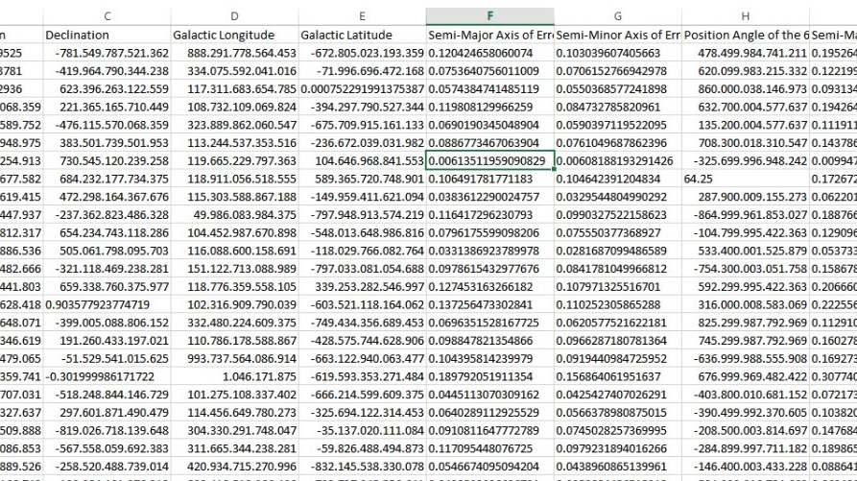
Second step.
By taking data from sources like NASA´s Archive of Data on Energetic Phenomena (HEASARC), and the Canadian Astronomy Data Centre (CADC) we preapare our data with high legibility in a way it's easy to manipulate.

Slide 5
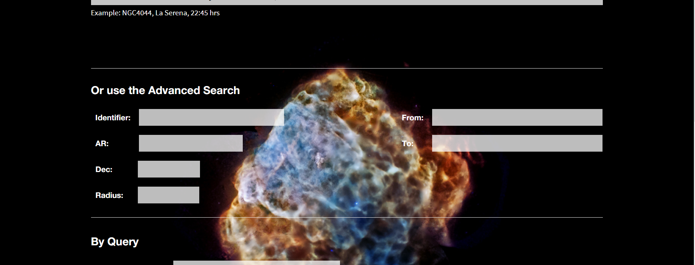
Third step.
The main part our Project is creating the User-friendly interface, for this, we create a desing using html and css knowledge.
Full version here

Slide 6
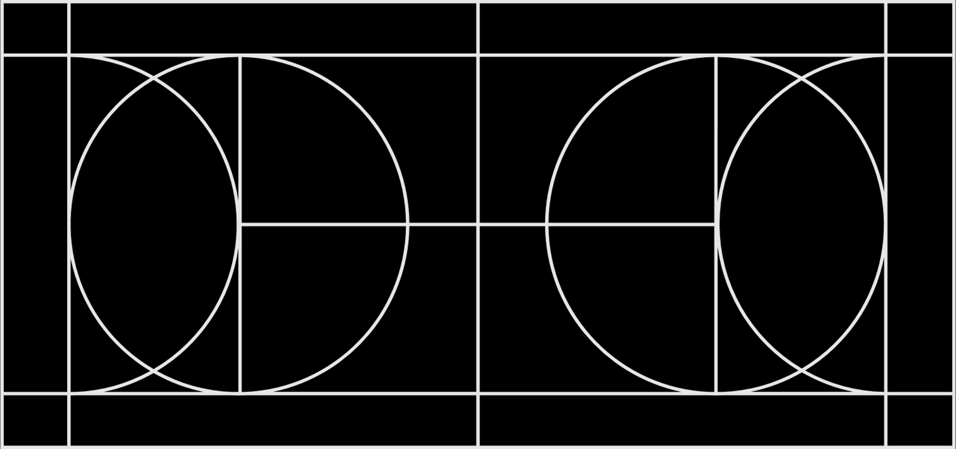
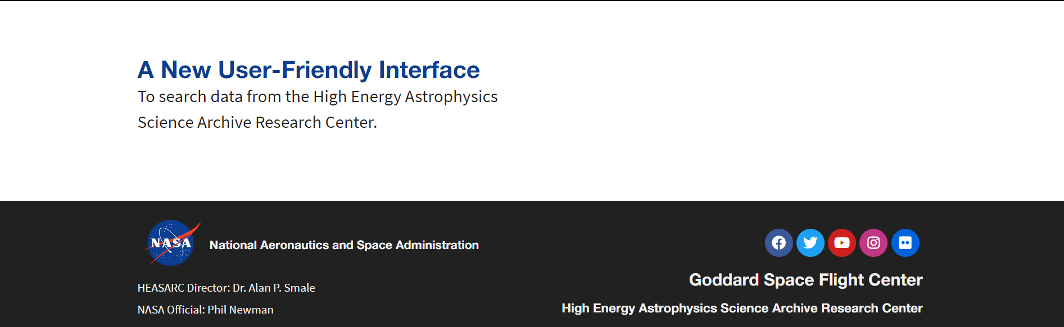
Final steps.
Finally all of our prepared data must be incorporated into the designed webpage, lastly the only step left is testing and small corrections.

Slide 7

Team and resources.
Team
Manu Antonio Pardo Rivas.
Matilde Andrea Gaete Tapia.
Emmanuel Ángel Blue Norambuena Sepúlveda.
Agustín Iñaki Joshua Salomón Monsalvéz.
Tomás Alberto Meier Aparicio.
Alberto Benjamín Osorio Muñoz.
Resorces
Git - Version control software.
WordPress - content management system.
Phpmyadmin - Tool written in PHP with the intention of handling the administration of MySQL.
Our GitHub.
Our WebPage.

