Slide 1
Multiplexer
A multiplexer (or mux) is a device that selects one of several analog or digital input signals and forwards the selected input into a single line.

Slide 2
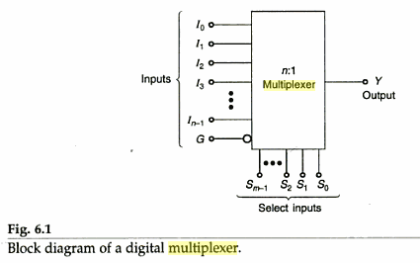

Slide 4
Applications of Mux
Boolean function implementation circuit
Pulse train generator.
Encoders

Slide 5
Demultiplexer
Demultiplex (DEMUX) is the reverse of the multiplex (MUX) process – combining multiple unrelated analog or digital signal streams into one signal over a single shared medium, such as a single conductor of copper wire or fiber optic cable. Thus, demultiplex is reconverting a signal containing multiple analog or digital signal streams back into the original separate and unrelated signals.

Slide 6
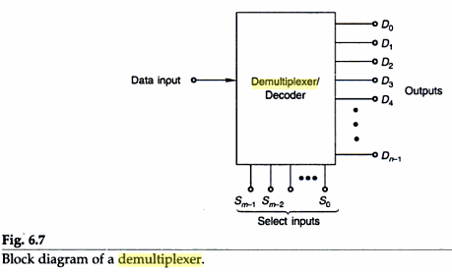

Slide 7
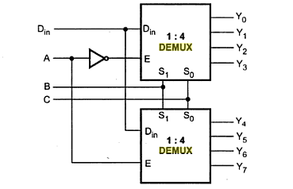
1:8 demux using two 1:4 demux

