Slide 1
Analysis of a NoSQL Graph DBMS for a Hospital Social Network
-Antonio Celesti; Alina Buzachis; Antonino Galletta; Giacomo Fiumara; Maria Fazio.
Department of MIFT, University of Messina, Italy
Meet Gajra
1911011
SY COMPS A

Slide 2
Index
Introduction
Why use NoSQL?
Graph-Database
Neo4j Graph-Database
Graph-Based model design for a HSN
Performance Analysis
Conclusion
Bibliography

Slide 3
INTRODUCTION
Nowadays, there is an increasing interest of clinical operators in social media, big data analytics.
In this panorama, social media represent a tempting opportunity for healthcare operators for improving the patients’ wellbeing.
Many Healthcare Social Network (HSN) platforms have emerged with the purpose to enhance patient care and education.
However, Clinical operators are reluctant to use public HSNs.

Slide 4
INTRODUCTION
Therefore, clinical operators are looking at customized HSNs solutions.
In this context, a RDBMS presents two main issues: i) Scalability ii) Big data analytics.
The objective of this preliminary scientific work is to prove the suitability of a NoSQL graph DBMS for the management of the Big Data coming from an HSN.
Data scalability tests carried out on one of the major NoSQL graph database managemement systems, that is Neo4j.

Slide 5
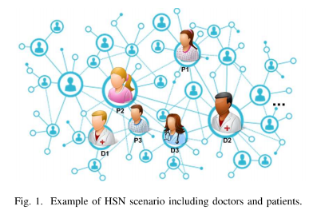
Why use NoSQL?
One of the major issues that has to be overcome is the management of big data with a high number of relations among the involved entities. Such entities include, for example, patients, their families, clinical reports, doctors, nurses and any kind of clinical personnel.
High heterogenous data.
In this context, a RDBMS presents two main issues
i) It does not scale up very well with the size of the dataset
ii) it is not adequate for big data analytics.
In the reminder of this paper we focus on the first issue
considering a NoSQL graph DBMS solution

Slide 6
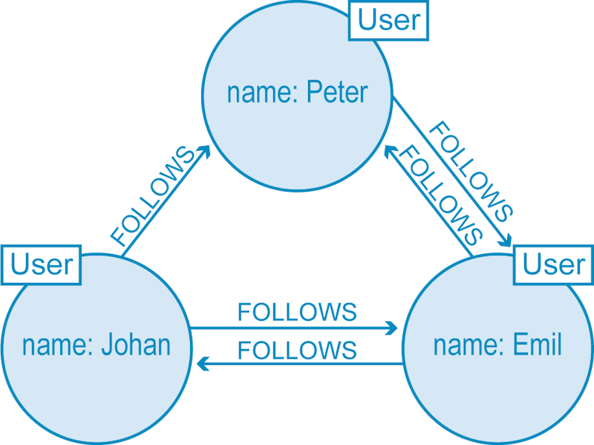
Graph-Databases
A graph is composed of two elements: a node and an edge(relationship).
Each node represents an entity (a person, place, thing, category or other piece of data)
They can hold any number of attributes (key-value pairs) called properties. Nodes are tagged with labels
Relationship represents how two nodes are associated.
A relationship always has a direction, a type, a start node,
and an end node. Like nodes, relationships can also have
properties

Slide 7
Graph-Databases
Advantages of Graph-Database:
Unlike other database management systems (DBMS), relationships take first priority in graph
Since Neo4j doesn’t have tables, there are no JOINs to worry about.
The relationships allow data in the store to be linked together directly and, in many
cases, retrieved with one operation. Querying relationships is fast because they are
perpetually stored in the database.
Flexibility
Useful for understanding heavily inter-connected data.

Slide 8
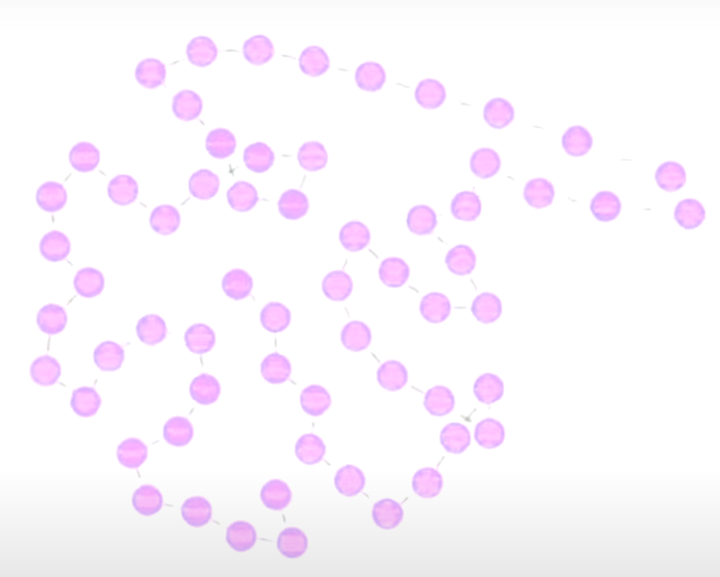

NEO4j Graph-Database
Neo4j is an open-source, NoSQL, native graph database that provides an ACID-compliant transactional backend for your applications.
Neo4j is implemented in Java and accessible from software written in other languages using the Cypher query language

Slide 9
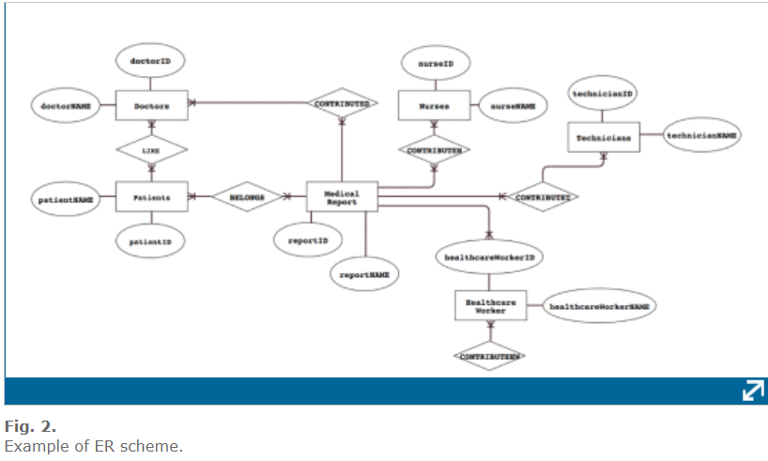
Graph-Based model design for a HSN
First of all, starting from the Entity-Relationship (ER) model of the RDBMS illustrated in Figure 2, we present the conversion procedure which translates the RDBMS ER model into a graph data model illustrated in Figure 3.

Slide 10
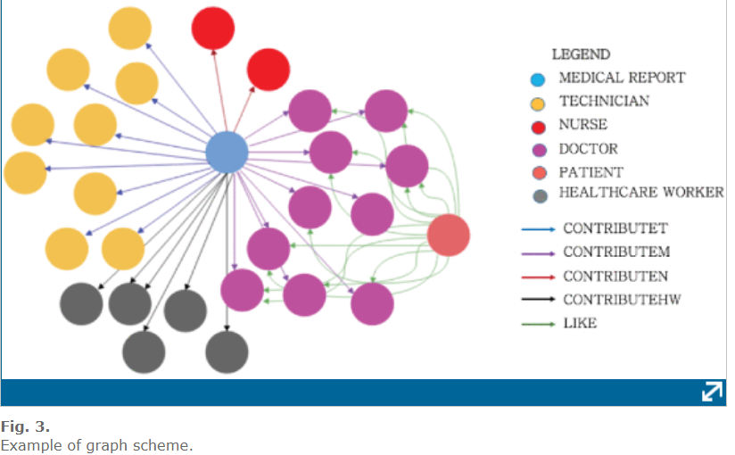
Graph-Based model design for a HSM

Slide 11
Performance Analysis
Data scalability tests considering one of the major NoSQL graph DBMS, that is Neo4j.
Test Setup :
Neo4j server was equipped with: CPU Intel(R) Core(TM) Xeon E7-8860V3 CPU @ 3.20GHz, RAM 32GB, OS: Ubuntu server 16.04 LTS 64 BIT. Each experiment has been repeated 30 times considering increasing datasets. In particular we considered 5 different datasets composed respectively of: 100, 1000, 10000, 100000 and 1000000 nodes.

Slide 12
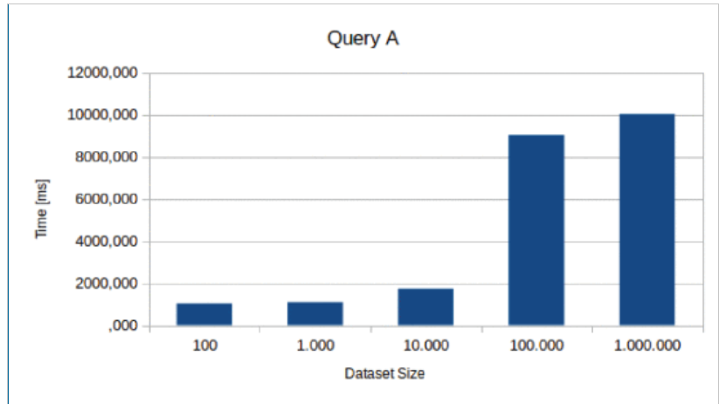
Performance Analysis
In order to carry out experimental tests we considered 4 different queries:
A: MATCH (r:Records) RETURN r.RecordsName
returns all medical records. In order to accomplish
this task we performed a “MATCH” on Neo4j nodes:
Execution times vs dataset size are shown
They increase as the dataset size increases, but the
overall performances are somewhat acceptable for
every size

Slide 13
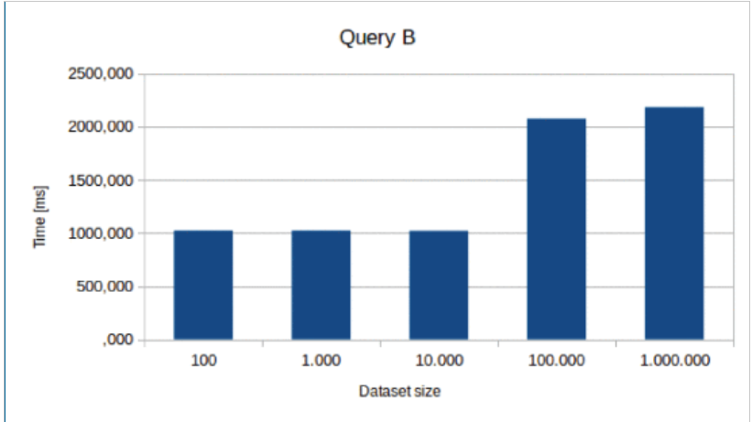
Performance Analysis
B: MATCH (p:patient)-[:belongs]-(r:records)WHERE p.patientName = ’Patient1’RETURN r.medicalRecordName
returns all medical records of a specific patient. In order to accomplish this task we performed a MATCH on the edge “BELONGS” that connects medical reports and patients nodes: Also in this case time the execution time grows up as the dataset size increases;

Slide 14

Performance Analysis
C: MATCH (p:patients)-[:belongs]- (r:records)-[:contributed]- (d:doctors)WHERE p.patientName = ’Patient1’RETURN DISTINCT d.doctorName
retrieves the name of doctors who has treated a particular patient. In order to accomplish this task we performed two different “MATCH” operations, one on the edge “BELONGS” that connects medical reports and patients nodes, another one on the edge “CONTRIBUTED” that connects doctors and medical reports. Furthermore in order to avoid any duplication we used the “DISTINCT”clause: Execution times vs dataset size, shown in the figure, exhibit a behavior similar to query B;

Slide 15
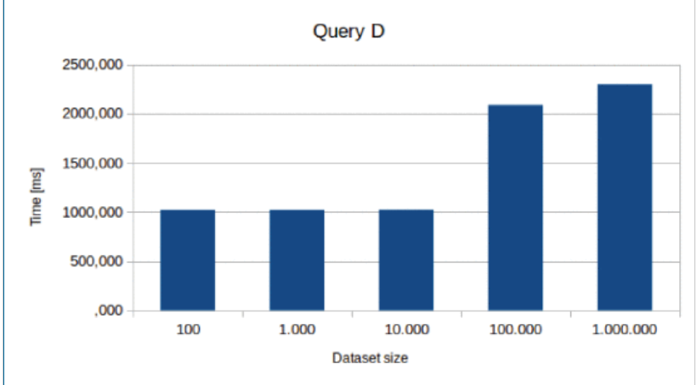
Performance Analysis
D: MATCH (:patients)-[:like]-(d:doctors)WHERE d.doctorName = ’Doctor1’RETURN count(d.doctorName)
amount of likes attributed to a specific doctor. In order to accomplish this task we performed a “MATCH” on the edge “LIKE” that connects doctors and patients nodes: As observed for queries B and C, execution times vs dataset size shown in figure are approximately the same.
Times needed to execute simple queries such as those presented in this Section are quite acceptable. They scale in a very promising way up to 1 million elements large datasets, which suggests the possibility of using a graph database management system even for Big Data.

Slide 16
CONCLUSION
Recently, many HSN platforms are emerging aiming at enhancing patient care and information. However, many clinical operators are reluctant to use them because they do not fulfil their requirements and are looking at the possibility to develop their own HSN platforms in order to perform social science studies involving innovative techniques such as data science and machine learning in order to better understand hidden relations .
In this context, NoSQL graph DBMS can overcome the limits of RDBMS.

Slide 17
CONCLUSION
Experimental results showed that Neo4j, one of the major NoSQL graph DBMS, simplifies the management of HSN data also guaranteeing acceptable performances in the perspective of future social science studies.
This positive preliminary results are a good starting point. In future works, we plan to exploit the potentialities of the graph data model specifically focusing on social science studies.

Slide 18
BIBLIOGRAPHY
Original paper: http://ieeexplore.ieee.org.library.somaiya.edu/document/8538469
https://neo4j.com/
Thank You!

