Slide 1
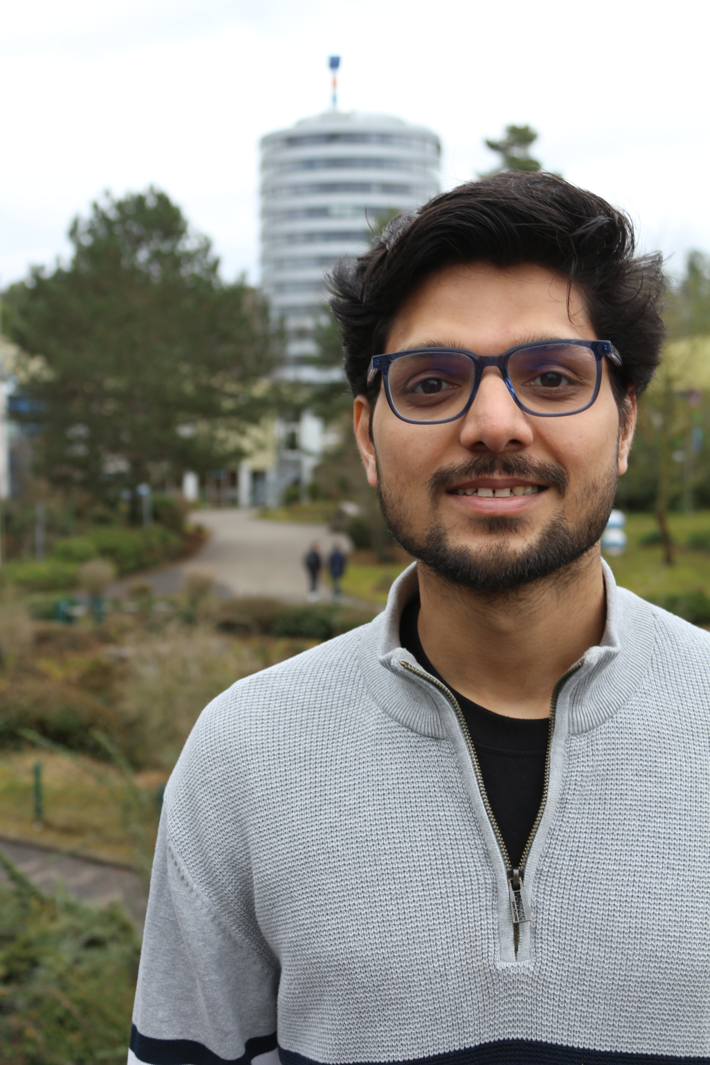
Portfolio
Experience & Projects
Shubham Singh
Masters Automation & Control - RPTU

Slide 2
I wish to ..
Design Motors, simulate on tools like MotorCAD, Maxwell etc.
Design Motor Controller and simulate on eg. Matlab etc.

Slide 3
Path planning using Deep Reinforcement Learning – RRLAB (RPTU)
Applied discretization to set control point paths for AutoBus navigation using Markov Decision Process (MDP)
Simulated in Unreal, with bus guidance via PID controller
Used PPO-trained policy for direct path generation, improved with curriculum training on dynamic/static obstacles
GITHUB link to photos

Slide 4
RADAR CAN controller
Optimized High-Speed CAN-BUS Design by reducing redundancy at Safe-lock and Daisy chain on PCB
Performed MathCad worst-case analysis & DFMEA/FMEDA
Improved EMC on PCB by reducing trace lengths, vias and shielded HF signals
Performed ESD and Electrical Test and prepared test reports
Optimized HF component placement, which reduced emission radiation

Slide 5
Autonomous Vehicle
Designed Battery management System including over-discharge & short circuit protection
Performed power budget calculation and designed On-board power distribution for motors and controllers
Feasibility study of DC motor and controllers for the project
Test code on Arduino to ensure basic maneuverability of vehicles
Link to GitHub for photos

Slide 6
Phase Shifted Full Bridge Converter
Designed AC-DC converter with power factor correction (PFC), followed by an isolated DC-DC converter.
Designed two-stage charger includes an interleaved boost PFC and a PWM zero-voltage-switching (ZVS) full-bridge DC-DC converter.
Logic signals via H-bridge, gate driver ckt using Arduino coding
Tools Used : Matlab/Simulink, Altium Designer
Skills : AC/DC/DC Converter Design
Link to Github files

Slide 7
USB-HUB Controller
Prototyped a USB HUB controller using TUSB4041I
Used Filters like Low-pass & decoupling caps to reduce noise
Used Current Limiter at the battery terminal connection
USB shields & In-rush limiters in the design
Tools Used : Matlab/Simulink, Altium Designer
Skills : PCB layout avoiding crosstalk and ensuring EMC
Link to Github Files

Slide 8
Mini- Projects
Obstacle Avoider CAR
Used 4 DC motors and controllers, with Ultrasound sensor, detected distance and changed position
Smart Fan
Used PIR sensor and run a DC motor using Arduino, which detects human and rotate
Gesture Controlled CAR
Used IMU and controlled the motion of a car running on DC motor via ESP32 wifi module
Github link to photos

Slide 9
Thank you
Contact me : ifoundsingh@gmail.com / shubham.singh@edu.rptu.de
Phone : +49 015510349952

