Slide 1
Velocity Aware Risk Assessment on Scout
Include Velocity into existing perception-risk-feedback pipeline
Service Robots and Assistance Systems
RPTU Kaiserslautern-Landau | Adaptive Autonomy and Off-Road Robotics Lab
Supervisor: Catharina Helten | Prof. Dr. Patrick Wolf
- Shubham Singh
29th July 2026

Slide 2
Recap of previous work
&
Challenges

Slide 3
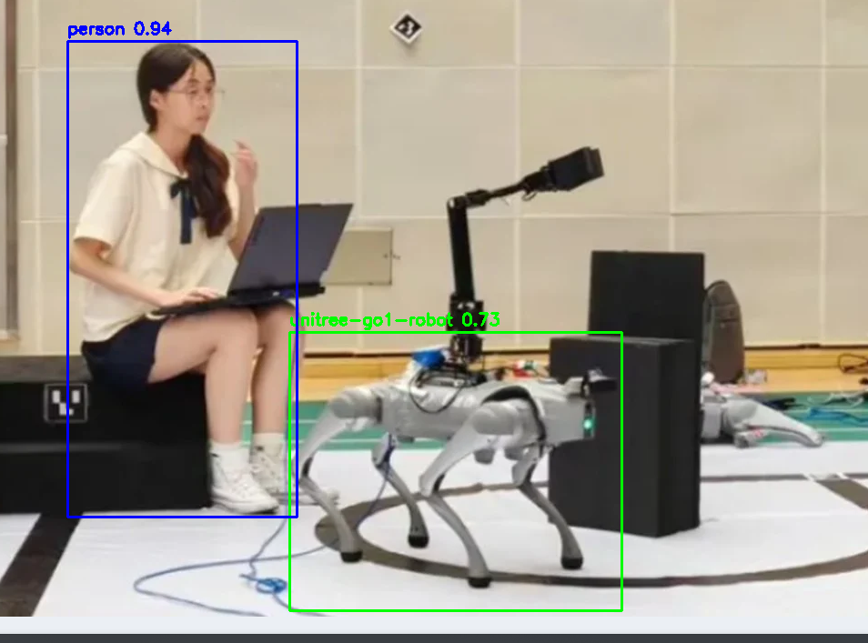
Perception Layer: Object Detection + Depth Estimation
Object Detection
• Two YOLO models run in parallel on each frame from camera
– YOLOv8n (COCO pretrained) — detects humans (class 0)
– best.pt (trained on YOLOv8n, fine-tuned on unitree Go1
• Output per detection:
- eg. HazardObject(category='HUMAN', distance_m=1.2, box=(340, 150, 120, 280), confidence=0.87),
Dataset from Roboflow : detects Unitree Go2 robot
Challenges:
It uses very old model - yolo v4 model, currently existing version include yolo v26, yolo v11
Existing Yolo v3/v4 for “human” from rrlib is available but threshold 0.15 only
How to train robot?
Train in python and then run ONNX in c++ → but can’t use higher yolo version as OpenCV version in finroc is lower compared to expected
Train in Darknet → Needs CUDA toolkit but can’t install due to access limit, here it takes 40hours in CPU while just 1 hour in GPU

Slide 4
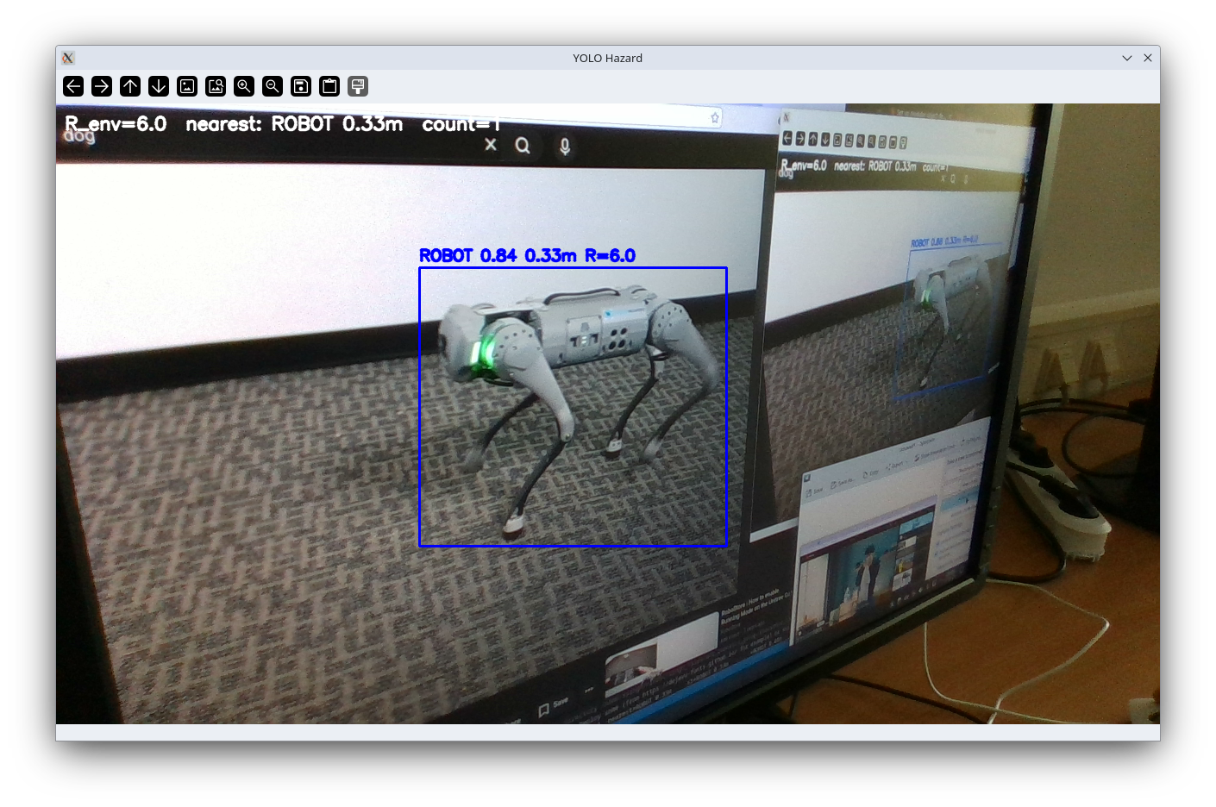
Hazard Identification & Risk Calculation – NOT implemented
HazardObject — what each detected entity carries
Three Hazard Categories
• category — semantic class (HUMAN or ROBOT)
• distance_m — closest separation from the robot body
• box — bounding box (x, y, w, h)
• confidence — YOLO detection score
• LIVING — humans, animals weight w = 3.0
• DYNAMIC — robots, vehicles weight w = 2.0
• STATIC — walls, furniture, obstacles, others weight w = 1.0
• Ordering enforced: w_living > w_dynamic > w_static
• Groups many YOLO classes into three safety-relevant distinctions
R_i = w(c_i) · g(d_i) · ( 1 + α · ṽ )
• w(c_i) — category weight
• g(d_i) — inverse-distance risk: g(d) = 1 / d
• ṽ = v_robot / v_max — normalised robot velocity (α = 0.5)
R_env = max_i ( R_i )
Aggregation across all detected objects
It check multiple hazard in the frame and score them on the screen
BB, and highest risk holder is designated

Slide 5
Discrete State Mapping + Visual Feedback
Continuous R_env mapped to five discrete states — now implemented in Finroc (mRiskAssessment →
mRiskToLampIndicator, front + rear)
Percept into a discrete risk level 0–4
Code : hardware/ — gHardwareInterface: RealSense cameras, CH341 tower lights, BPearl 3D lidar
Future Implementation : Replace distance to velocity based risk identification
Challenges :
1. Camera velocity is difficult to find based on IMU data alone, it drifts a lot, need odometry / GPS data or other data for stable velocity
2. Object velocity based on only camera depth sensor limits distance - 3m
3. Realsense gives 0 output at depth > 3m and <0.3 m, hence its challenging to find if object has already hit the robot or is not visible to it

Slide 6
Update: Pipeline Ported into Finroc
Python prototype (yolo_detector.py / run_yolo_hazard.py) reimplemented as Finroc C++ modules on the Scout
What changed since the last update
• Standalone Python loop → Finroc project scout, application ScoutControl
• Code lives → safety_demo/ — gSafetyDemo, mPercept, mRiskAssessment, mRiskToLampIndicator, mRiskVisualization

Slide 7
Thank You

