Slide 1
Identify a “WHOIS” Solution
Priyank Shah
Meetika Sharma
Shubham Kothari
Parth Shirolawala

Slide 2
Environment
Controller: POX Controller
Topology: Linear Topology
Tool: Mininet
Language: Python
Requirements: Python2.7

Slide 3
“WHOIS” Lookup Features
WHOIS database - listing of registered domains
WHOIS data – to identify and fix problems
To combat spam or fraud
To hold accountable and for legal purposes

Slide 4
GRE Tunnel
Generic Routing Encapsulation (GRE) is a tunneling protocol developed by Cisco Systems.
Encapsulates packets to route other protocols over IP networks.
To create point to point connections between two networks.

Slide 5
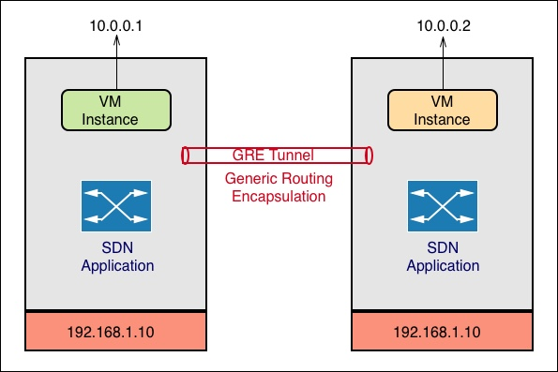
Architecture

Slide 6
Our topology
VM1
VM2
hH1
H!
H3
SS1
S2
GRE TUNNEL
H2
H4

Slide 7
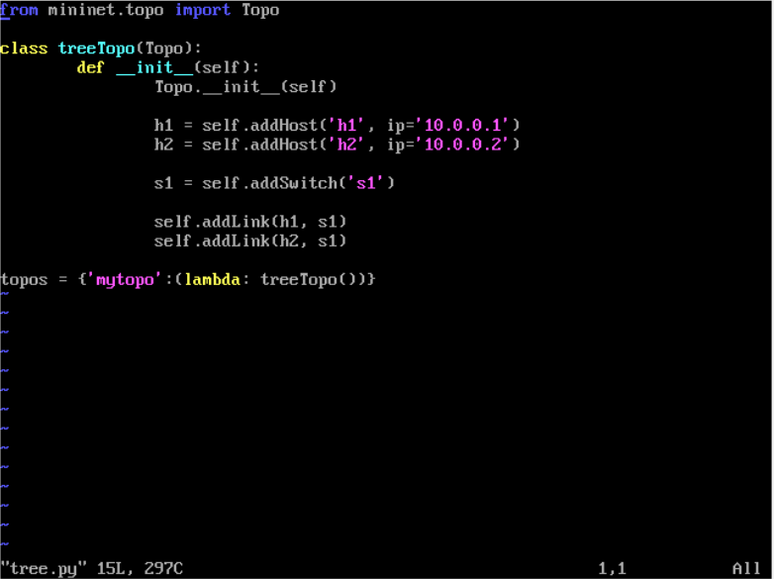
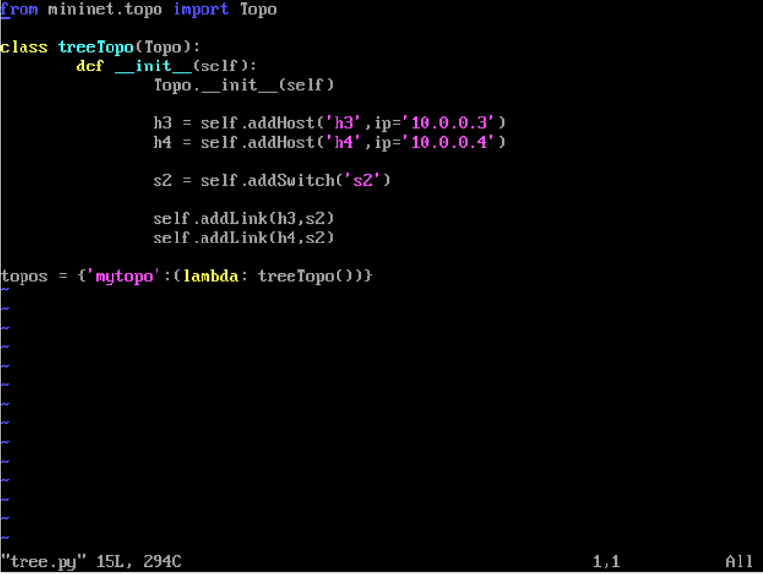
1) Run the Mininet VM instance
2) cd mininet
3) Create Tree.py with the following code
Mininet VM 1 - Tree.py
Mininet VM 2 - Tree.py

Slide 8

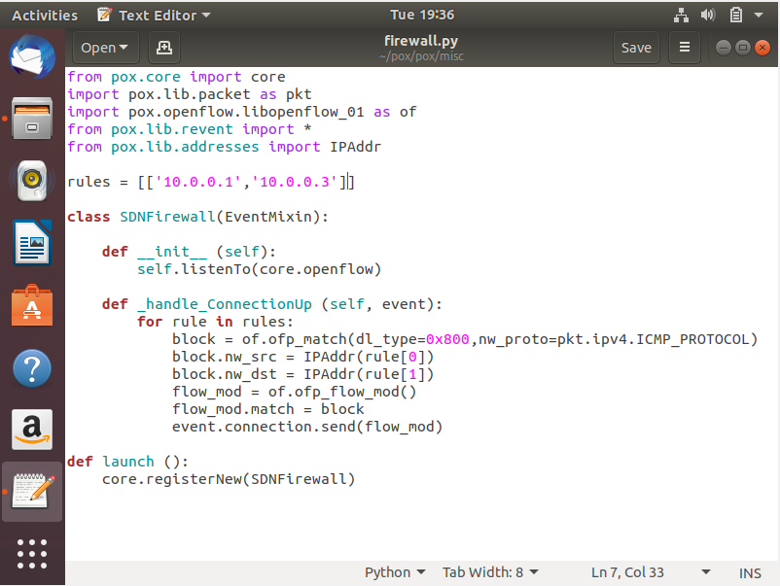
Steps to install POX controller with custom Firewall
Clone the git repository - git clone https://github.com/noxrepo/pox
cd into the POX directory – cd pox/pox/misc
Create/Update firewall.py with the following code
Rules is a list of list which contains the IP addresses of the hosts to be blocked.
We can add multiple rules to block multiple flows.

Slide 9

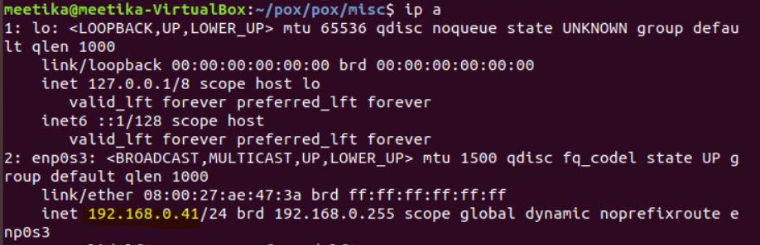

Steps to run the POX controller on Ubuntu
Get the IP address of the machine where POX controller will run using following command – ip a
E.g. 192.168.0.41
cd pox
./pox.py openflow.of_01 forwarding.l2_learning misc.firewall

Slide 10
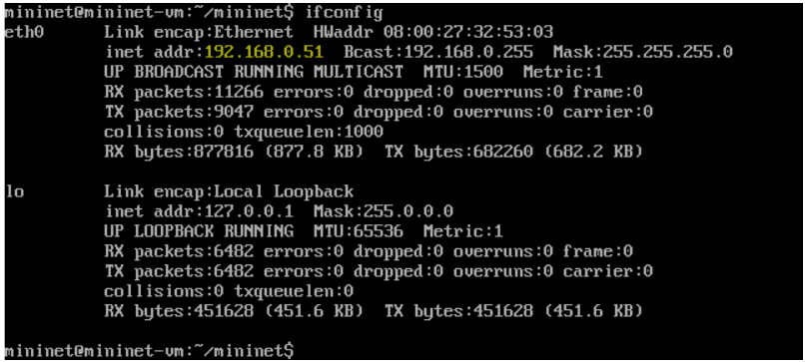
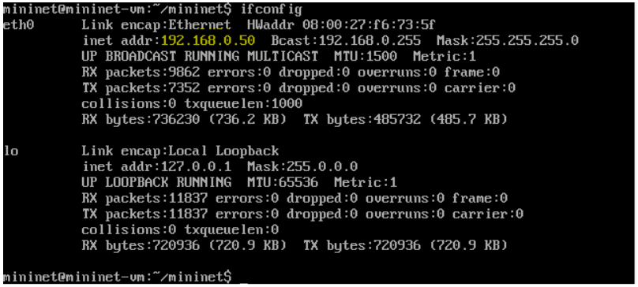
Mininet VM 1 - ifconfig
Mininet VM 2 - ifconfig

Slide 11
Connect both Mininet VM to remote POX controller using the following command
cd mininet
sudo mn --custom Tree.py --topo mytopo --mac --controller=remote,ip=192.168.0.41,port=6633
Tree.py – filename of your topology
192.168.0.41 – IP address of the machine where POX controller is running

Slide 12
Create a GRE tunnel between mininets using the following command
On VM 1
sh ovs-vsctl add-port s1 hello -- set interface hello type=gre options:remote_ip=192.168.0.50
On VM 2
sh ovs-vsctl add-port s2 hello -- set interface hello type=gre options:remote_ip=192.168.0.51
s1, s2 – Name of the switch used in the topology
192.168.0.XX – IP address of the other mininet

Slide 13
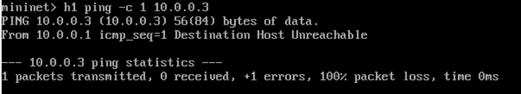
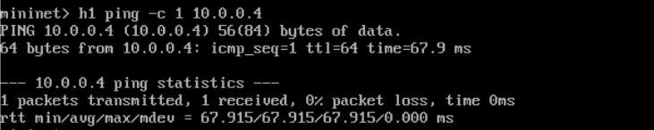
VM1 contains
1 Switch (s1)
2 Hosts (H1 (IP = 10.0.0.1),
H2 (IP = 10.0.0.2))
VM2 contains
1 Switch (s2)
2 Hosts (H3 (IP = 10.0.0.3),
H4 (IP = 10.0.0.4))
Flow from Host1 to Host3 is blocked.
This is mentioned in the rules in firewall.py
H1 cannot ping H3
H1 can ping H4

Slide 14
Challenges Faced
Accessing mininet, controller on UTD network.
Configuring the GRE Tunnel.
We blacklisted the IP, but we faced issues while doing reverse job i.e. Whitelisting the IP for certain hosts.

Slide 15
Thank You

