Slide 1
CS5330 · FINAL PROJECT
3DGS Outdoor Reconstruction
from webcam video to a photorealistic browser scene
650k
30k
28.11 dB
15 MB
splats
iters
PSNR
ksplat
Meet Jain
github.com/Meetjain-0201/3dgs-outdoor-reconstruction

Slide 2
01 · PROBLEM
Photoreal 3D from a phone-grade camera
How good can a reconstruction be with just a handheld walkthrough and a laptop GPU?
traditional scanning
NeRF (2020)
3D Gaussian Splatting (2023)
LiDAR rigs
seconds / frame
real-time
Specialised hardware, slow capture, large files, not for a walkthrough-style demo.
Photoreal view synthesis, but rendering is too slow for a real-time viewer.
Comparable quality to NeRF, tile-based rasterizer runs in real time on commodity GPUs.
goal → raw video · ~17 min of compute · scene you can fly through in a browser tab
CS5330 · Meet Jain · April 2026
2 / 8

Slide 3
02 · RELATED WORK
Standing on three sets of shoulders
2016
2020
2023
COLMAP
NeRF
3DGS
Schonberger & Frahm, CVPR
Mildenhall et al., ECCV
Kerbl et al., SIGGRAPH
Incremental SfM: SIFT features, bundle adjustment, a sparse point cloud. Still the standard for camera pose recovery.
Neural radiance fields. Photoreal view synthesis from a set of posed images, but slow to query per pixel.
Explicit 3D Gaussians + tile-based differentiable rasterizer. Real-time rendering at NeRF-class quality.
open-source glue used:
graphdeco-inria/gaussian-splatting · mkkellogg/GaussianSplats3D · three.js · vite
CS5330 · Meet Jain · April 2026
3 / 8

Slide 4
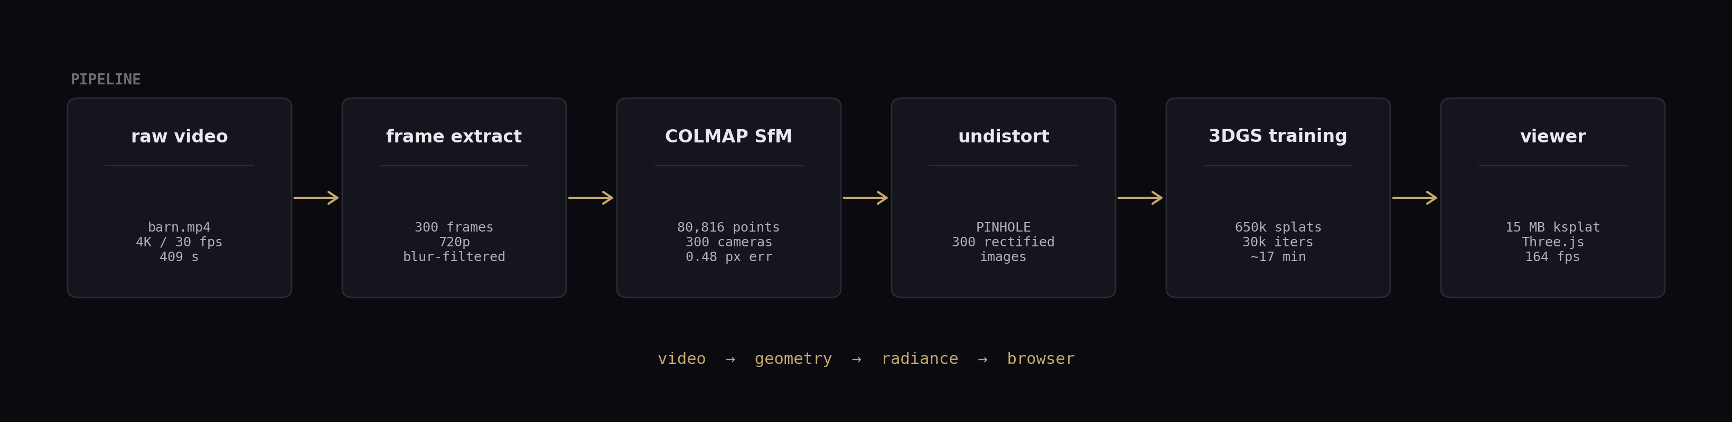
03 · METHODS & THEORY
Pipeline and the theory behind each block
Why 3DGS is fast
explicit scene
no MLP query per pixel; colour comes from 650k Gaussians
tile rasterizer
splats binned into 16x16 tiles, sorted by depth, α-blended
adaptive density
split / clone / prune during training reshapes the cloud
differentiable
L1 + SSIM gradients flow back into position, Σ, colour, α
CS5330 · Meet Jain · April 2026
4 / 8

Slide 5
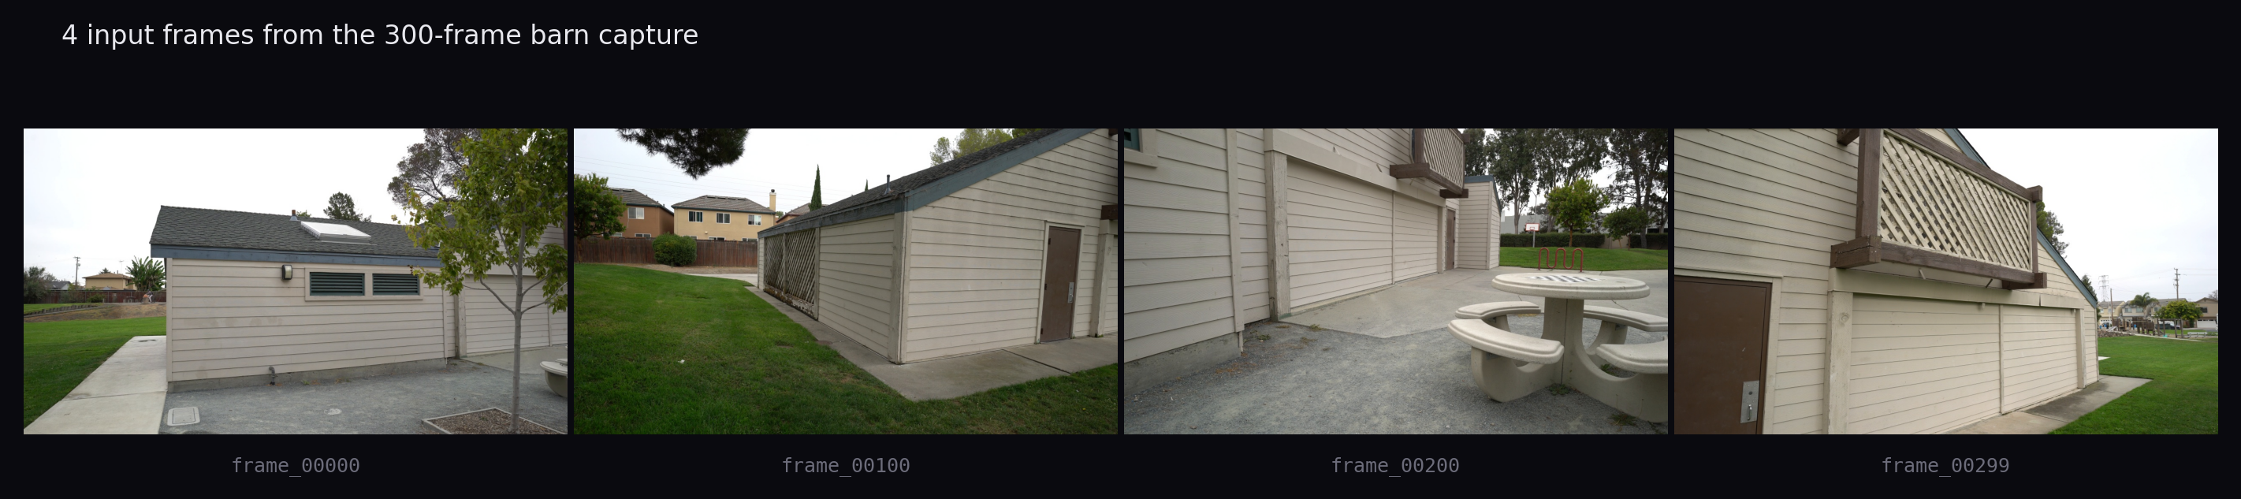
04 · DATA & EXPERIMENTS
One barn, one laptop, one walkthrough
capture
hardware & training
source
4K / 30 fps handheld walkthrough
GPU
RTX 5060 · Blackwell sm_120 · 8 GB VRAM
length
409 s · 12,270 raw frames
stack
PyTorch 2.11 + CUDA 12.8 · Python 3.11
sampled
1 fps + blur filter → 300 sharp 720p frames
budget
30k iterations · ~17 min wallclock
cameras
300 registered · 0.48 px reproj. err
eval
LLFF hold-out · 38 test views
CS5330 · Meet Jain · April 2026
5 / 8

Slide 6
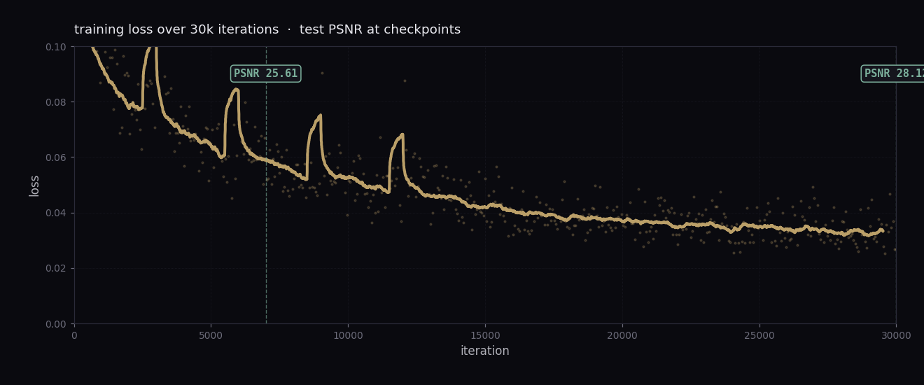
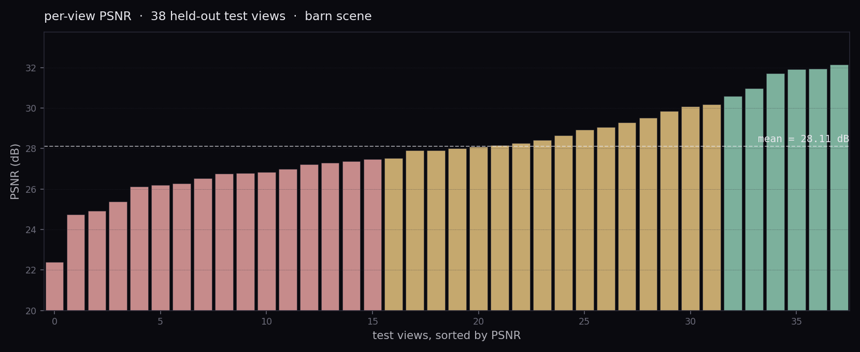
05 · RESULTS
barn · 30k iterations · 38 held-out views
PSNR
SSIM
LPIPS
28.11
0.879
0.120
dB
(higher better)
(lower better)
per-view range 22.4 → 32.1 dB · worst views are blank-sky and specular; best are textured frontal wall
CS5330 · Meet Jain · April 2026
6 / 8

Slide 7
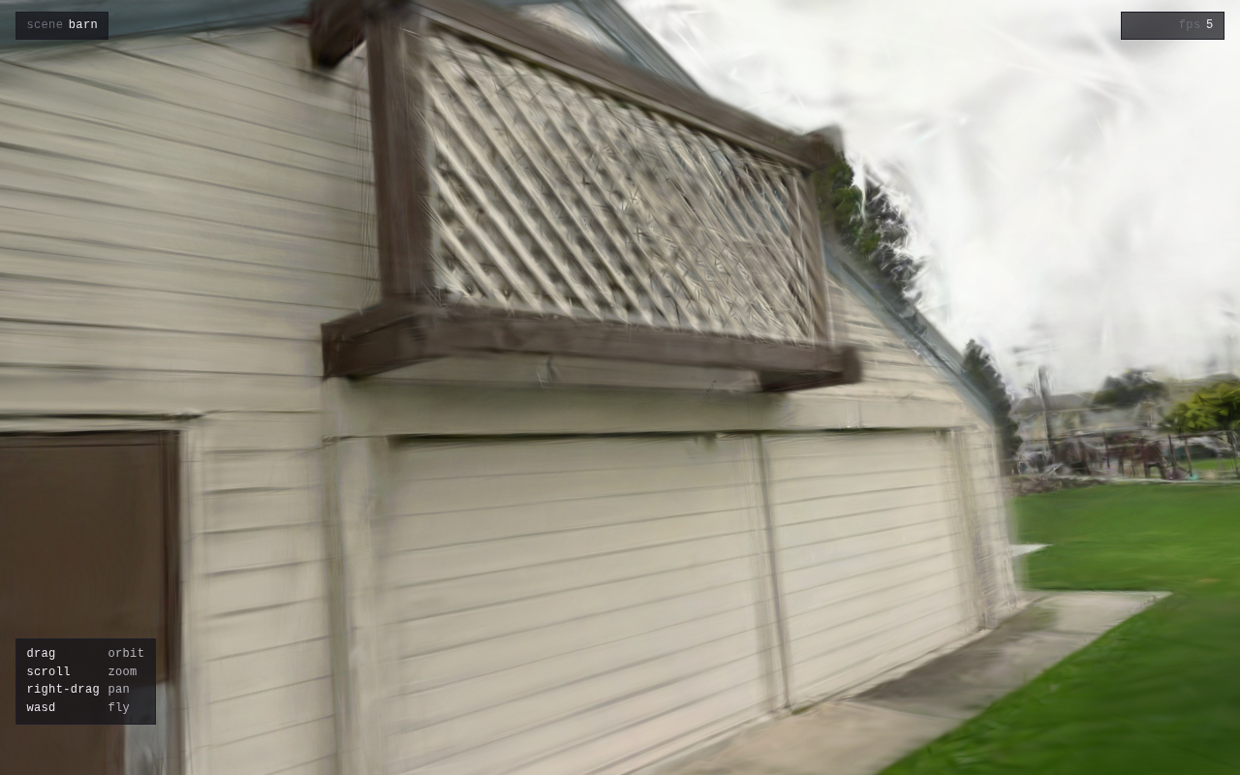
06 · DEMO
Running in your browser
localhost:5173 → landing page → scene picker → viewer.html
controls
drag
orbit
scroll
zoom
right-drag
pan
WASD
fly
stack
three.js 0.184
gaussian-splats-3d 0.4.7
vite 8 + ksplat (15 MB)
CS5330 · Meet Jain · April 2026
7 / 8

Slide 8
07 · TAKEAWAYS
shipped, bit, next
1 / 3
2 / 3
3 / 3
shipped
learned
next
· end-to-end pipeline in one repo
· new GPUs need new toolchains
· train at full 720p on a 12 GB card
· Blackwell-ready env (sm_120)
· camera conventions break silently
· actual indoor scenes
· COLMAP to 3DGS camera handoff
· one config flag = silent black screen
· LOD / mesh fallback for mobile
· live training monitor (rich TUI)
· instrument every layer before guessing
· pose init from first COLMAP view
· eval: PSNR / SSIM / LPIPS
· coordinate systems silently bite
· CI smoke test on a short clip
· three.js browser viewer
repo → github.com/Meetjain-0201/3dgs-outdoor-reconstruction
CS5330 · Meet Jain · April 2026
8 / 8

