Slide 1
Egocentric Lab Demo → Unitree G1 + Inspire in Simulation
Recovering hand + arm motion from smart-glasses RGB + head IMU, retargeting onto a five-finger G1, replayed in MuJoCo — motion translation only.
Dimenso Hackathon

Slide 2
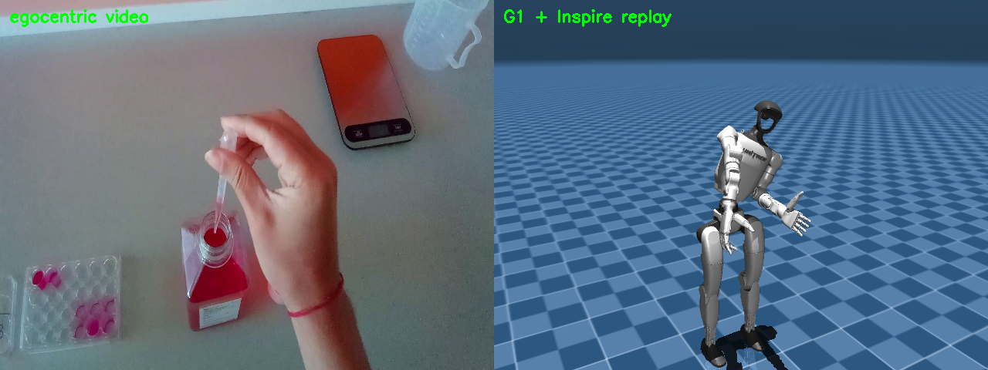
Problem & the reframe
A forward head-cam sees hands, not the body
• Egocentric forward camera CANNOT recover full body
– Only 29% of frames return any MediaPipe Pose; lower body collapses (knees 0.46, ankles 0.22)
• So: legs FROZEN, torso/waist ← head IMU, arms + hands ← hand tracking
– G1 has no neck joint → head orientation drives the 3 waist joints only
• Task chosen: task_04 Pasteur-pipette
– 77% frames with a hand (vs 34–49%), highest confidence 0.976, shortest dropout ~3.4 s
egocentric source ∥ G1+Inspire replay

Slide 3
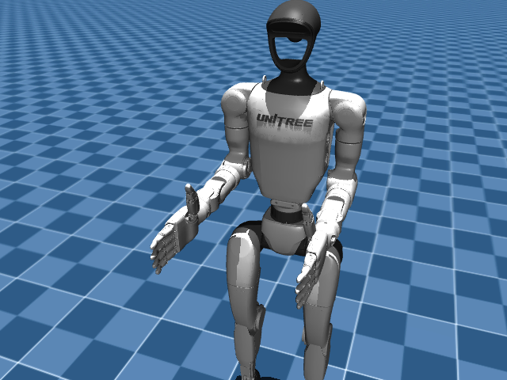
The robot: G1 + five-finger Inspire
One MuJoCo model, 53 actuated DoF
• Base: mujoco_menagerie Unitree G1 (arms + wrists, no hand)
• Hands: Inspire DFQ five-finger, grafted from unitree_ros
– Both chiralities sourced directly — no manual mirroring
• 53 actuated DoF = 29 G1 (12 leg + 3 waist + 14 arm) + 24 fingers (12 × 2)
– Fingers modeled as independent joints (real hand ~6-motor underactuated — documented simplification)
open / fist verified, symmetric inward curl

Slide 4
Data pipeline (the centerpiece)
video + IMU → documented per-frame dataset
• 1. Perception — MediaPipe Hands (21 lm), One Euro filter, confidence gate, finger curl + pinch
• 2. IMU sync — resampled onto VIDEO frame times (jittery dt, not a 10 ms grid)
– accel-gravity (roll/pitch) + gyro → waist lean, clamped ±30°
• 3. Stabilize — 2D wrist → 3D target on a table plane (RGB-only: depth APPROXIMATED, stated plainly)
• 4. Retarget — DLS IK → full G1+Inspire qpos
• 5. Dataset — outputs/task04_dataset.npz + schema.json (timestamps, 3D targets, fingers, lean, qpos)

Slide 5
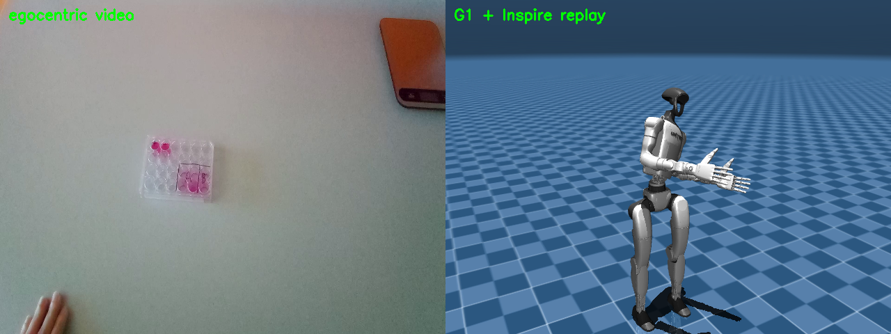
Method: retargeting
Damped-least-squares IK on the MuJoCo model
• Each detected wrist driven to its 3D target via DLS IK (MuJoCo Jacobians)
• 3 waist joints = shared IK DoF, soft-biased to the IMU lean → torso assists reach
– Both arms solved jointly (they share the waist)
• Finger curl → Inspire finger joints; thumb opposition from pinch
• Per-arm STOW when a hand isn't visible (hold-last-valid, then ease)
• Velocity-clamped targets → smooth, no snapping

Slide 6
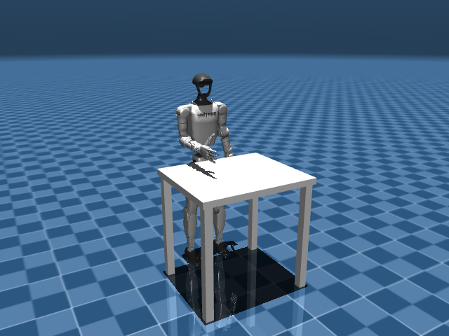
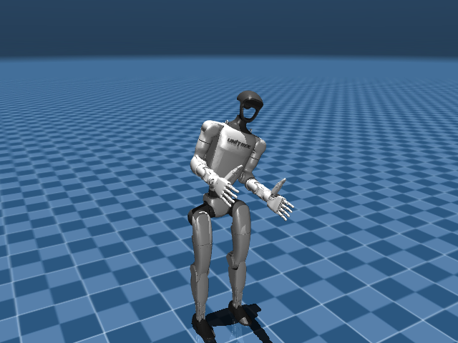
Scene & replay
White table at hand height; mp4 + live native viewer
table top at 0.75 m = pipeline PLANE_HEIGHT
retargeted trajectory replayed on G1+Inspire

Slide 7
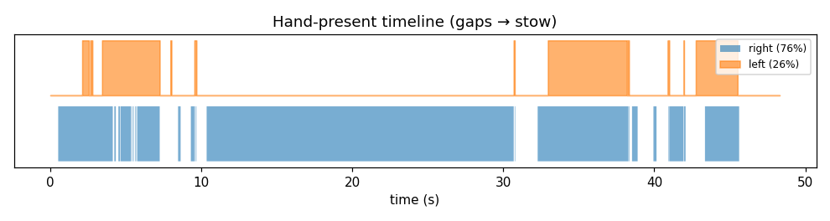
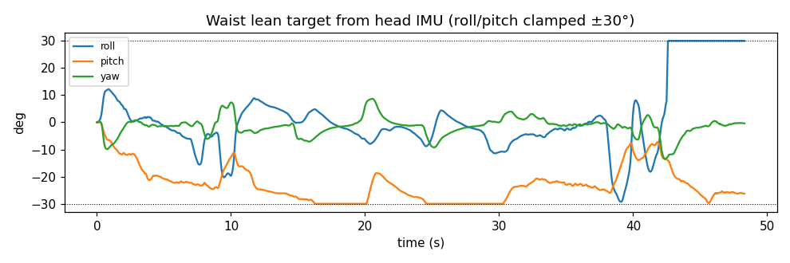
Validation
task_04 — 1431 frames @ 29.6 fps
• 79.6% of frames use REAL tracking, 20.4% stow
– right hand 76.5% · left hand 26.5% (bimanual often one-handed)
• IMU vs video duration: 48.42 s vs 48.30 s (~0.12 s slack)
• Tracking accuracy / rollout = TODO (post-IK-tuning)

Slide 8
Imitation learning — a credible plan (not run)
Honest: this data alone can't train a task policy
• Why not yet: no depth, no object/scene state, no reward, open-loop
• But it IS legitimate demonstration data for imitation learning
• Plan:
– Add object perception (depth / wrist RGB-D), collect many demos
– Convert to LeRobot v2 (proprioception + vision + action)
– Train behavior-cloning / diffusion-policy baseline
– Validate on held-out demos + sim rollout success rate
• A tiny overfit demo was out of scope in the time

Slide 9
Feasibility & cost
Proposal estimates, stated assumptions
• BOM ≈ $25–35k: G1 (~$16k) + 2 Inspire hands (~$3–5k ea) + depth glasses/wrist RGB-D + 1 GPU workstation
• Data: ~50–200 demos/task ≈ 1–4 h capture (data collection is the cost driver)
• Compute: BC/diffusion baseline ≈ a few GPU-hours to ~1 GPU-day
• Timeline: P0 offline engine (done) → P1 add depth → P2 collect+convert → P3 train+sim-eval → P4 sim-to-real
• Risks: sim-to-real gap on a dexterous hand, object occlusion, data scale

Slide 10
Limitations & live system
What's approximate, and what's designed-not-built
• Depth approximated (no sensor) — reach direction right, absolute depth a guess
• IMU yaw drifts (no magnetometer); no shared IMU↔video clock (~2–3 frame offset)
• Left-hand coverage low (26.5%); full-body pose unrecoverable; Inspire underactuation simplified
• Live web panel: DESIGNED, not built — docs/live_architecture.md
– Native MuJoCo viewer + solver thread + uvicorn + MJPEG of annotated video; drop frames to stay on clock
– Verdict: live feasible = YES; biggest risk = Python GIL/CPU contention (mitigate: solver in a separate process)

Slide 11
Status & next steps
• Done: diagnostics → G1+Inspire model → offline engine → dataset → mp4 + live replay → report
• Delivered as reviewable PRs; report as PDF + this deck
• Next: tune DLS IK (accuracy), add depth prior, pin IMU/video sync, build the live panel
• Honest framing throughout: measured numbers vs clearly-marked approximations

