Slide 1
Egocentric Lab Demo → Unitree G1 + Inspire in Simulation
Hand + arm motion from smart-glasses RGB + head IMU → retargeted onto a five-finger G1, replayed in MuJoCo. Motion translation only.
Dimenso Hackathon — final

Slide 2
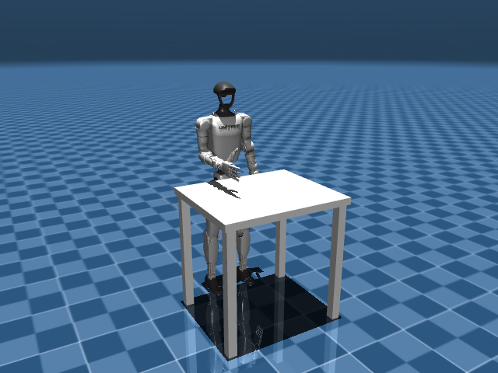
Task choice & the egocentric reframe
A forward head-cam sees hands, not the body
• Task = task_04 Pasteur-pipette: 77% frames with a hand (vs 34–49%), conf 0.976, shortest dropout
• Full body NOT recoverable: only 29% of frames return any Pose; lower body collapses
• → legs FROZEN, torso turns with head-IMU yaw (upright), arms+hands from hand tracking
• Five-finger Inspire DFQ grafted on the menagerie G1 — 53 actuated DoF
work table top at 0.75 m = pipeline plane height

Slide 3
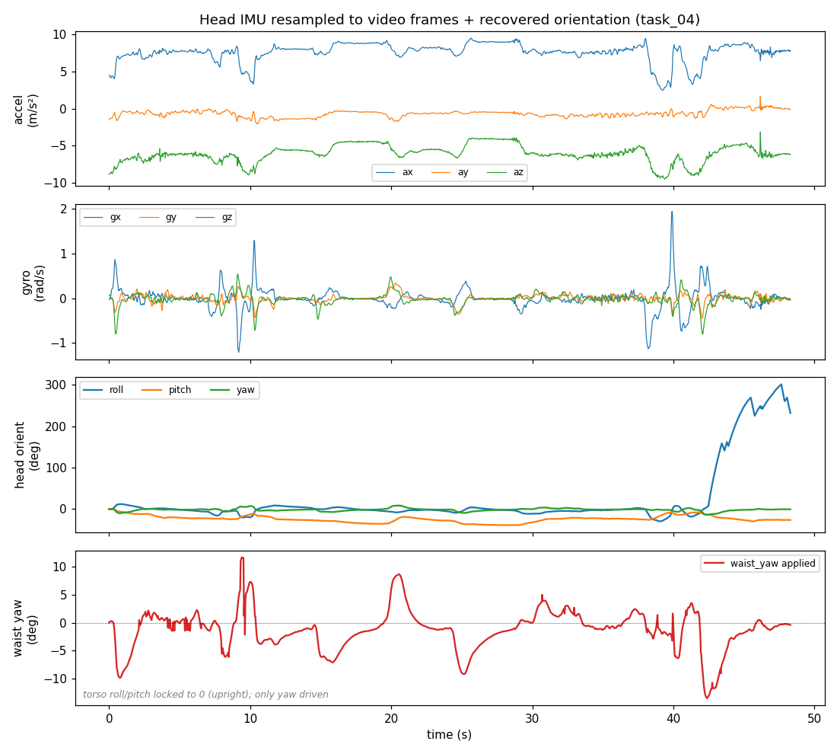
Data pipeline (the centerpiece)
run_offline.py — 5 stages, names read from the model
• 1 MediaPipe Hands → One-Euro filter → curl / pinch / thumb-fingertip distances
• 2 IMU resampled onto VIDEO frame times → complementary filter → head orientation
• 3 2D wrist → approx 3D target (table plane + scale depth; lateral Y from real wrist sep)
• 4 DLS IK (waist yaw shared) + distance-based finger/thumb + arm-down stow
• 5 Dataset: outputs/task04_dataset.npz + documented schema.json
IMU layer: accel / gyro / recovered head orientation / applied waist-yaw

Slide 4
What the dataset records (per frame, time-aligned)
• RAW MediaPipe landmarks — both hands, 21×3 (the clean perception layer)
• handedness + confidence + present/stow flag per arm
• derived: per-finger curl + thumb↔fingertip distances
• resampled IMU (accel, gyro) + head roll/pitch/yaw + applied waist-yaw
• approximate 3D wrist targets (both hands)
• FULL 53-joint G1+Inspire trajectory — every column named (self-describing)
– schema.json documents name / shape / units / frame / derivation for all 22 array groups

Slide 5
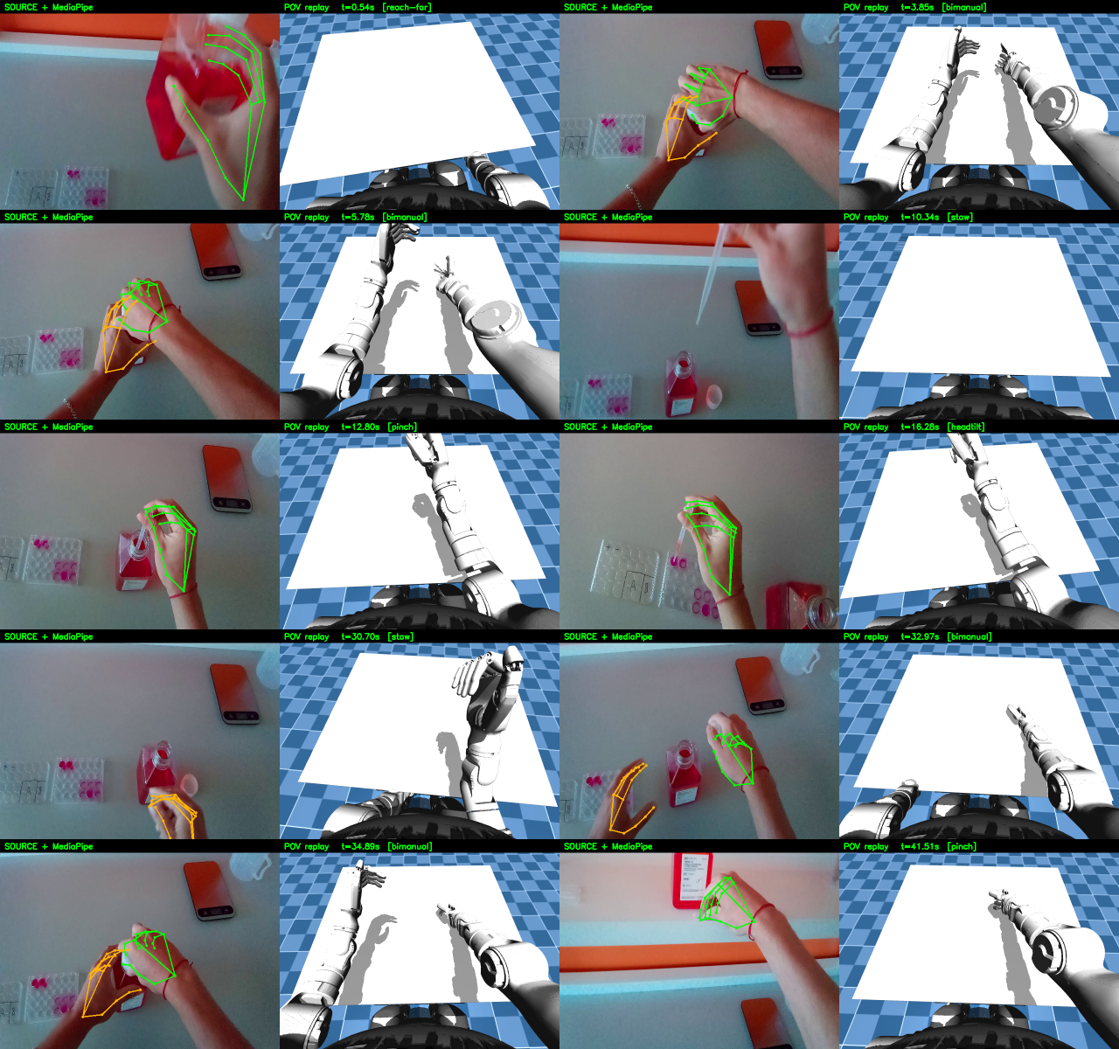
Tuned result: source ∥ POV replay
250-frame clip (frames 307–556, 100% right-hand coverage) plays live
egocentric source + MediaPipe ∥ G1+Inspire from the head POV camera

Slide 6
Retargeting method (tuned)
DLS IK on the MuJoCo model
• Each wrist driven to its 3D target via damped-least-squares IK, both arms jointly
• Torso UPRIGHT: waist roll/pitch locked 0; only waist_yaw turns (from head yaw)
• Distance-based fingers: thumb FLEXES into pinches (was opposing only)
• Hand separation tracks the real detected wrist spacing
• Lost hand → stows hanging straight down, out of frame; velocity-clamped eases
– Before→after numbers verified frame-by-frame with the POV diagnosis harness

Slide 7
Imitation-learning sketch (not built — honest gap)
• Dataset = DEMONSTRATION data (state→action). NOT closed-loop: no depth/object/reward, open-loop
• Models: BC baseline · Diffusion Policy (Chi 2023) · ACT/ALOHA · VLA (OpenVLA / π-0)
– Inputs: proprioception (53 joints) + vision (ego + wrist cam) + optional language
– Outputs: joint / end-effector target sequences (what the dataset already stores)
• Scale: 50–200 demos/task (more for diffusion), add depth/wrist-cam, multi-operator, LeRobot v2
• Validate: held-out tracking error → sim rollout success → sim-to-real
– A tiny overfit demo was out of scope in the time — stated, not hidden

Slide 8
Feasibility & cost (proposal)
• BOM ≈ $25–35k: G1 (~$16k) + 2 Inspire hands (~$3–5k ea) + depth glasses/wrist RGB-D + 1 GPU box
• Data: ~50–200 demos/task ≈ 1–4 h capture — data collection is the cost driver
• Compute: BC/diffusion baseline ≈ few GPU-hours to ~1 GPU-day
• Timeline: P0 engine (done) → P1 depth → P2 collect+convert → P3 train+sim-eval → P4 sim-to-real
• Tradeoff: RGB-only is fast but open-loop; depth + data unlocks a closed-loop policy

Slide 9
Limitations & honest gaps
• Reach DEPTH still RGB-approximated — direction right, absolute distance a guess
• Left-hand coverage 26.5% → bimanual moments render one-handed
• Thumb-distance retarget reliable only when the hand is fully in frame
• No shared IMU↔video clock (~2–3 frame offset); IMU yaw drift-leaked
• Inspire underactuation modeled as independent joints (deliberate simplification)
• Live web panel DESIGNED, not built → docs/live_architecture.md (feasible; risk = GIL)

Slide 10
Next steps
• Add a depth / wrist-cam prior to fix reach depth
• Improve left-hand re-acquisition; pin the IMU/video sync via a shared motion event
• Collect demos + train the BC/diffusion baseline (per the IL sketch)
• Build the live MuJoCo + web panel per docs/live_architecture.md
• Everything reproducible from the repo: dataset, replay, live viewer, 250-frame clip, notebook

