Slide 1



Spellchecker
Welcome to the Data Structure Project presentation!
In this informative session, we will explore the importance of choosing the right data structures, their implementation, and real-world applications.

Slide 2

Introduction
Introduction to Spell Checkers
Underlying Data Structures - Trie and Hash Map
Spell Checking Process
Key Advantages of Trie and Hash Map
Real-world Applications and Customization

Slide 3

Overview of Data Structures
Speed and Efficiency
Low Memory Footprint
Customization
High Accuracy & Scalability

Slide 4
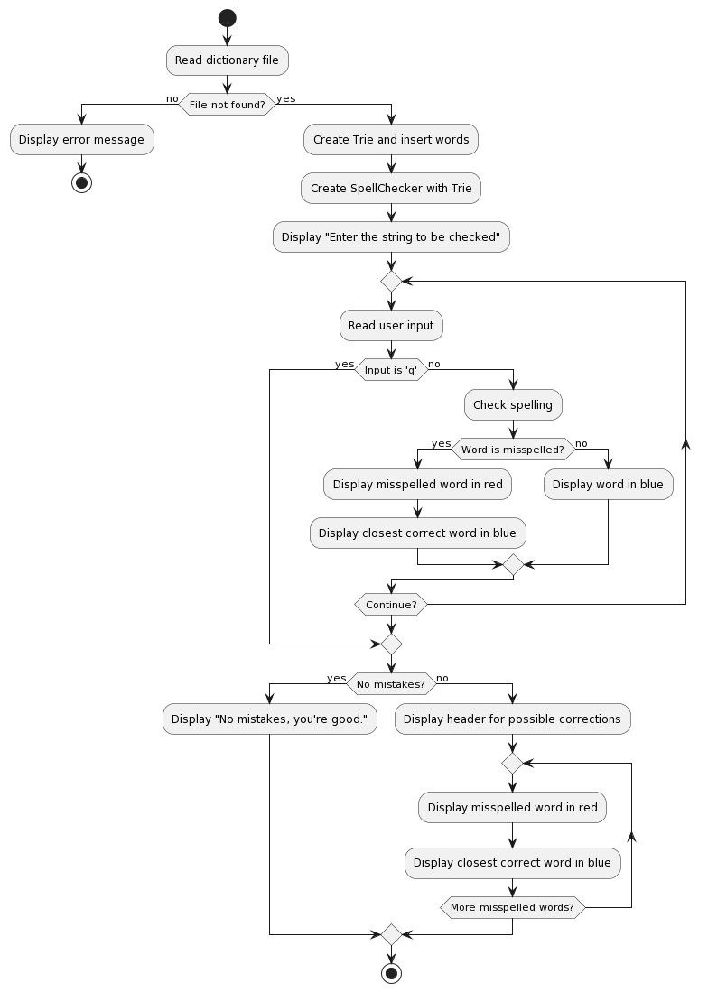

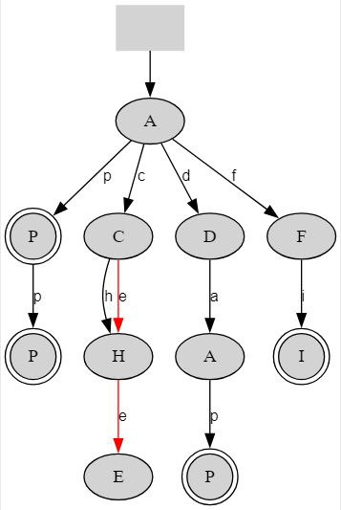
Flow Chart

Slide 5

Benefits
Speed and Efficiency
Low Memory Footprint
Customization
High Accuracy & Scalability

Slide 6

Disadvantage & Mitigation
Memory Usage
Speed of Suggestion Generation
Scalability Challenges
Limited Contextual Understanding

Slide 7
Future Scope
Contextual Understanding and Contextual Suggestions
Integration with AI and Language Models
Multimodal Spell Checking

Slide 8
Thank You

