Slide 1

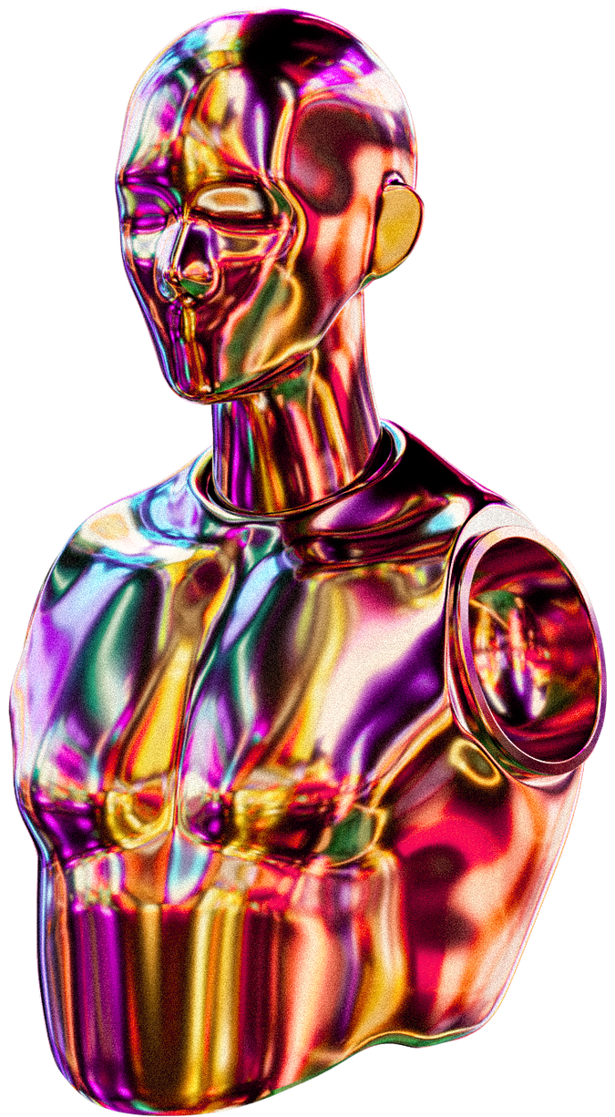



EMNLP 2023
EOJIN JEON
MINGYU LEE
JUHYEONG PARK
IMPROVING BIAS MITIGATION
YEACHAN KIM
WING-LAM MOK
NATURAL
LANGUAGE
UNDERSTANDING
THROUGH
BIAS
EXPERTS IN
SANGKEUN LEE
Fixing a Hidden Flaw in Debiasing: Why Softmax is the Problem
START PRESENTATION NOW

Slide 2
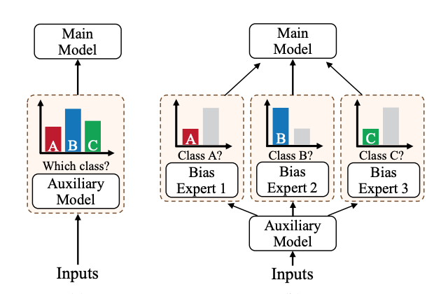

PROBLEM DESCRIPTION
DATASET BIAS IN NLP
Models exploit spurious correlations
High In-Distribution accuracy
Poor Out-of-Distribution (OOD) generalization
EXAMPLE FROM PAPER (SECTION 1)
Existing Debiasing
Proposed Bias Experts
Multi-class auxiliary model
(Problem)
Bias experts
(Solution)
Negation → predicts contradiction
Lexical overlap → predicts entailment
The paradox:
Auxiliary models meant to detect bias are trained with objectives that prevent overfitting — but bias detection requires overfitting to bias.

Slide 3
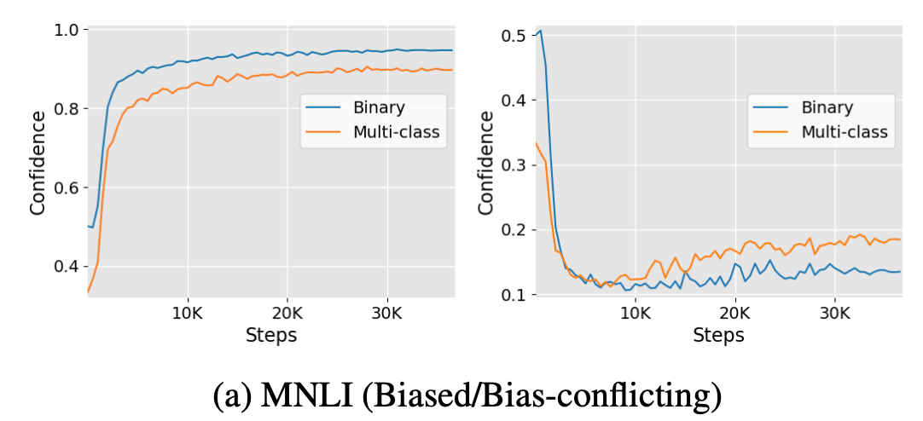
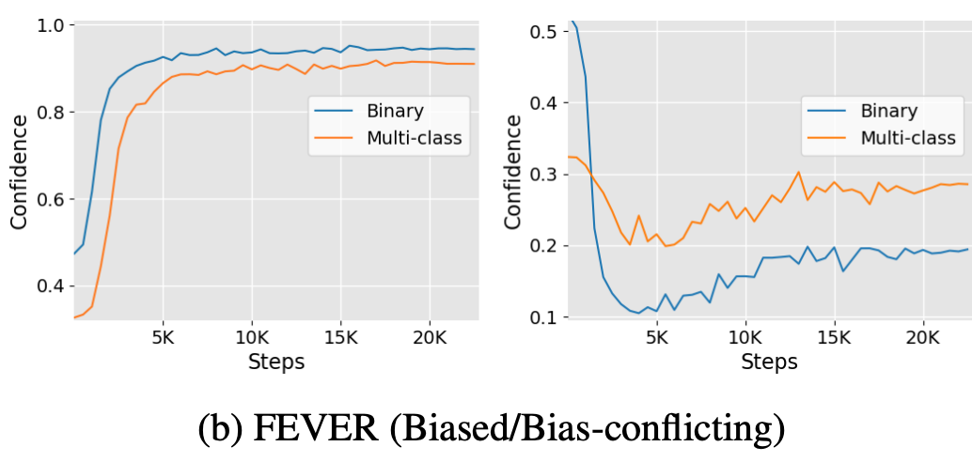
WHY MULTI-CLASS OBJECTIVE IS SUB-OPTIMAL
BINARY LEARNS BIAS FASTER
MULTI-CLASS CONFIDENCE LOWER
EMPIRICAL OBSERVATIONS:
MULTI-CLASS OBJECTIVE LEARNS BIAS ATTRIBUTES SLOWER
LEARNS TARGET ATTRIBUTES FASTER
POOR BIAS IDENTIFICATION
MULTI-CLASS LEARNING OBJECTIVE IS SUB-OPTIMAL

Slide 4
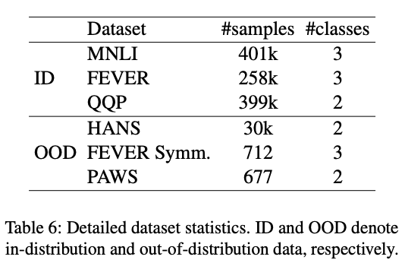
MNLI
401k SAMPLES
3 CLASSES
OOD: HANS (30K)
PUBLIC DATASET
DATASET DESCRIPTION
FEVER
258k SAMPLES
3 CLASSES
OOD: FEVER SYMMETRIC
QQP
399k SAMPLES
2 CLASSES
OOD: PAWS
MODELS: BERT-BASE (110M PARAMS)
AUXILIARY + BIAS EXPERTS: BERT-TINY (4M PARAMS)
3 EPOCHS TRAINING
ADAMW OPTIMIZER

Slide 5
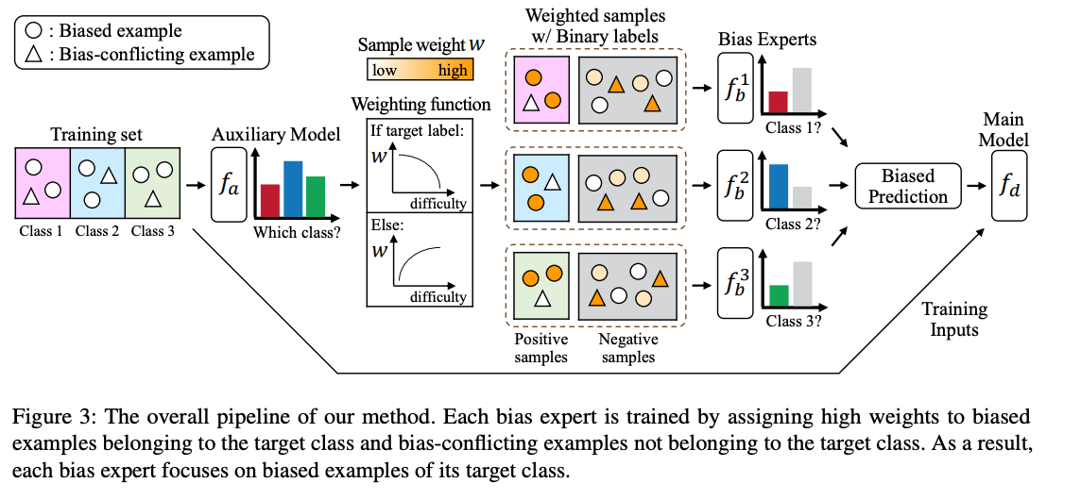
METHOD OVERVIEW
STEP 1 → OVR
STEP 2 → TRAIN BIAS EXPERTS
STEP 3 → PRODUCT-OF-EXPERTS (POE)

Slide 6
ONE-VS-REST
FOR K CLASSES → CREATE K BINARY DATASETS:
EXAMPLE MNLI:
CONTRADICTION VS REST
ENTAILMENT VS REST
NEUTRAL VS REST
REMOVES SOFTMAX COMPETITION
ALLOWS INDEPENDENT BIAS LEARNING
Bi = {(x, 1y=i)}

Slide 7
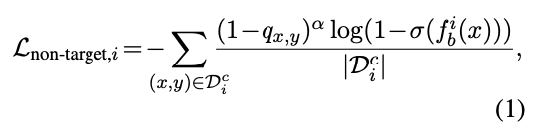
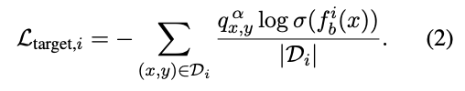
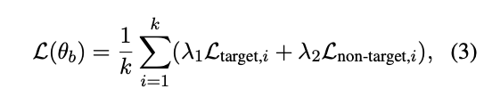
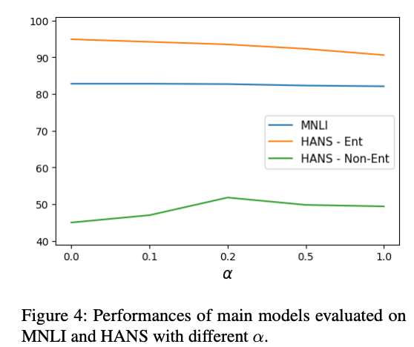
BIAS AMPLIFICATION MECHANISM
LOSS FUNCTIONS:
L_TARGET
L_NON-TARGET
HYPERPARAMETER Α CONTROLS AMPLIFICATION
01
α ↑ → stronger bias learning
Too high → performance drops
Performance drop after α > 0.2
02

Slide 8

PRODUCT OF EXPERTS (POE)
IF BIAS EXPERT CONFIDENT → REDUCES MAIN MODEL WEIGHT
BIAS EXPERTS FROZEN DURING MAIN TRAINING.

Slide 9
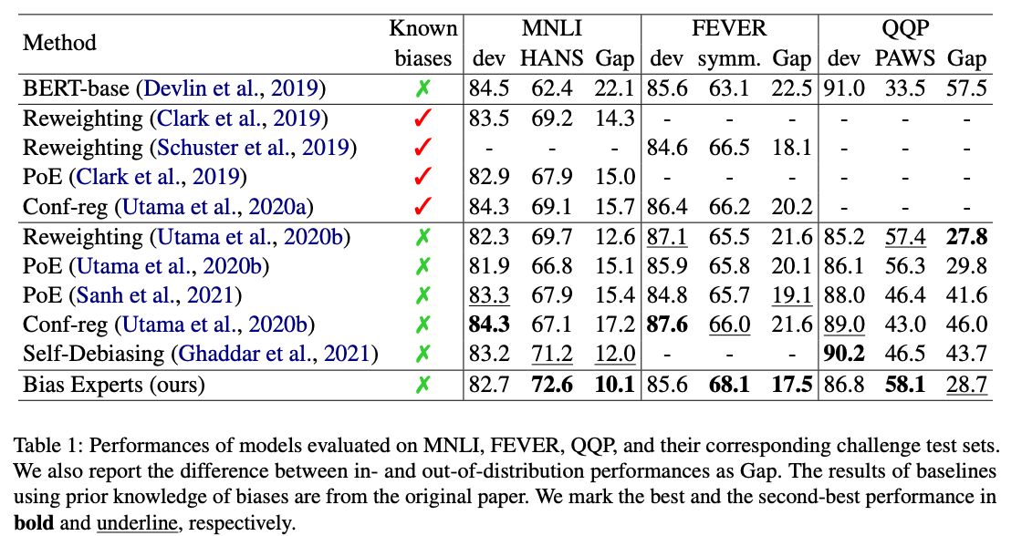
MAIN RESULTS
HANS: 72.6
FEVER SYMMETRIC: 68.1
PAWS: 58.1
Consistent OOD improvement
Smaller ID-OOD gap

Slide 10
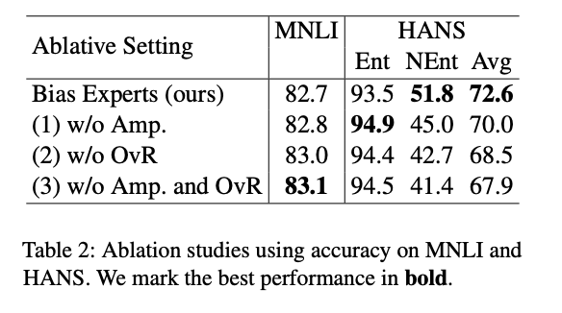
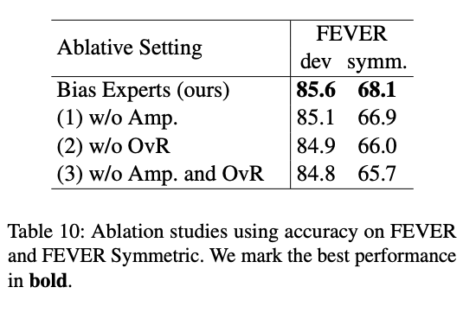
ABLATION STUDY
REMOVE OvR → DROP
REMOVE AMPLIFICATION → DROP
REMOVE BOTH → WORST
CONCLUSION:
BOTH COMPONENTS NECESSARY

Slide 11
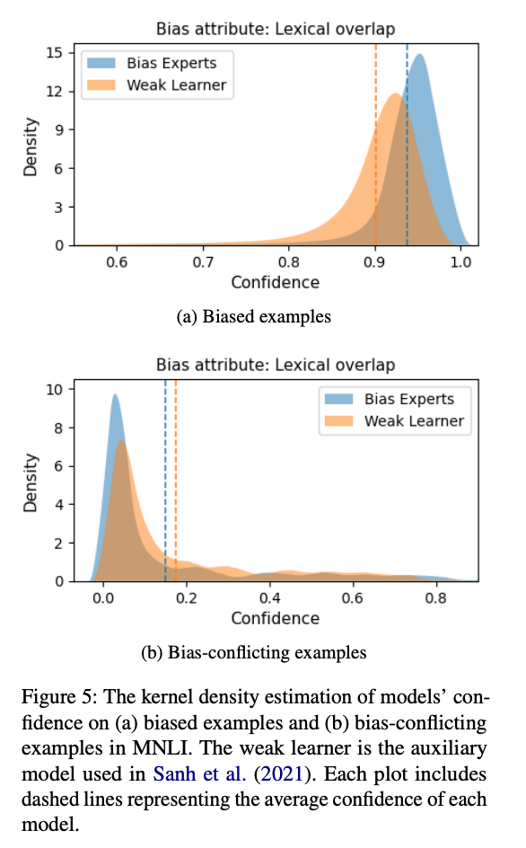
CONFIDENCE ANALYSIS
BIAS EXPERTS SHOW:
HIGHER CONFIDENCE ON BIASED EXAMPLES
LOWER CONFIDENCE ON BIAS-CONFLICTING EXAMPLES
THIS PROVES BETTER BIAS IDENTIFICATION.

Slide 12
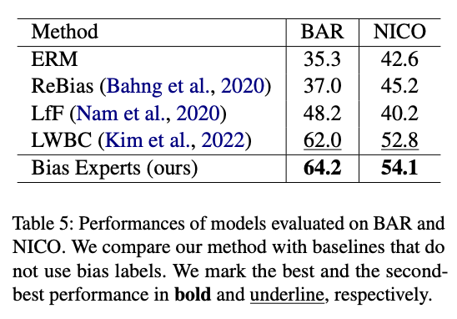
GENERALIZATION TO VISION
TESTED ON BAR AND NICO (IMAGE DATASETS)
SHOWS MODEL-AGNOSTIC PROPERTY

Slide 13
CRITICAL EVALUATION
STRENGTHS
IDENTIFIES STRUCTURAL FLAW IN MULTI-CLASS TRAINING
MODULAR ARCHITECTURE
WORKS WITHOUT EXPLICIT BIAS LABELS
MODEL-AGNOSTIC
WEAKNESSES (FROM LIMITATIONS SECTION) IMPROVING BIAS MITIGATION THROU…
MEMORY SCALES WITH NUMBER OF CLASSES
HYPERPARAMETER Α TUNING NEEDED
SLIGHT ID PERFORMANCE TRADE-OFF
ETHICS
TRADE-OFF BETWEEN MINORITY ROBUSTNESS AND MAJORITY PERFORMANCE

Slide 14
THANK YOU

