Slide 1
project:NLP Project for Disaster Tweet Classification
Name: Meet Patel
Date : 23/04/2025

Slide 2
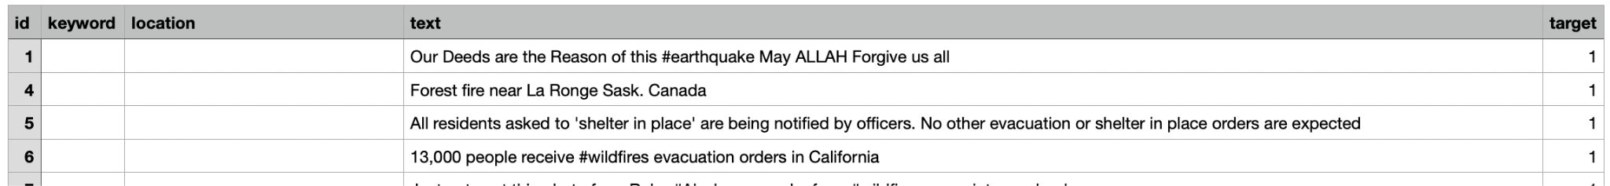
Problem statement : Classify disaster vs. non-disaster tweets
Dataset Overview:
It has alsmost 7600 rows and 6 columns
Sample features:

Slide 3
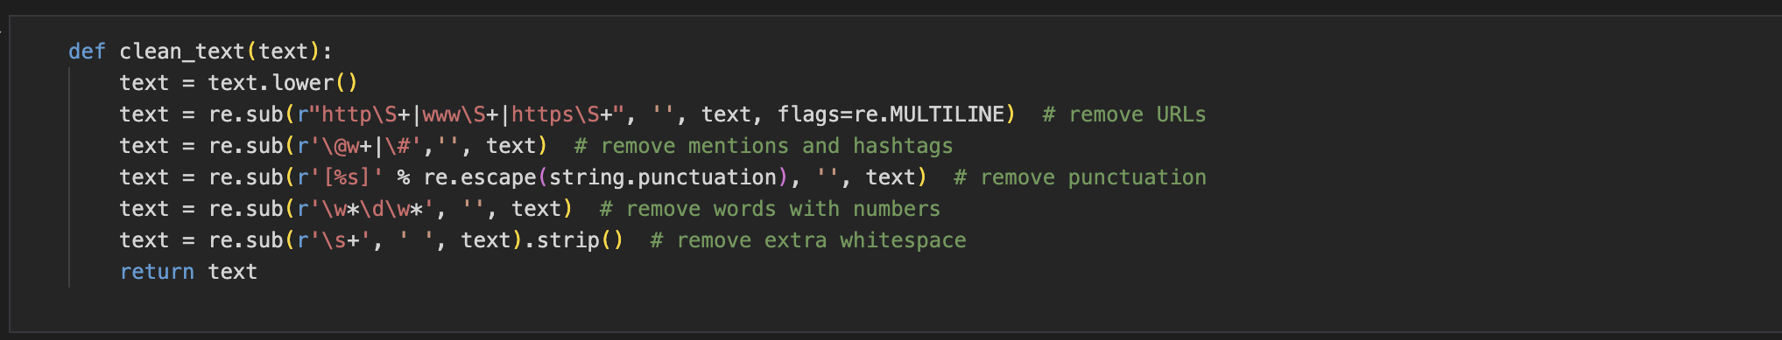
Data Preprocessing:
Cleaning text like remove stop words,#,@,url with help of “Re” function
Then i do tokenization using “word tkenize”
Then i complete Tf-IDF Vectorizer

Slide 4
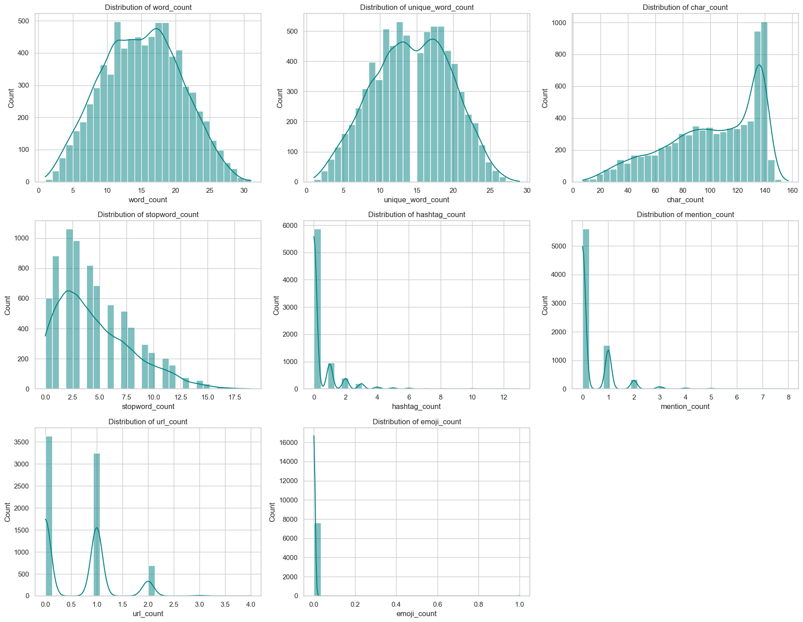

Slide 5
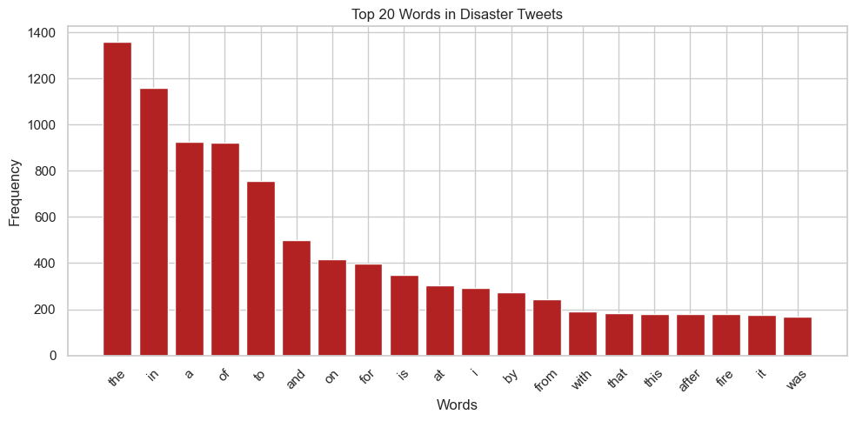
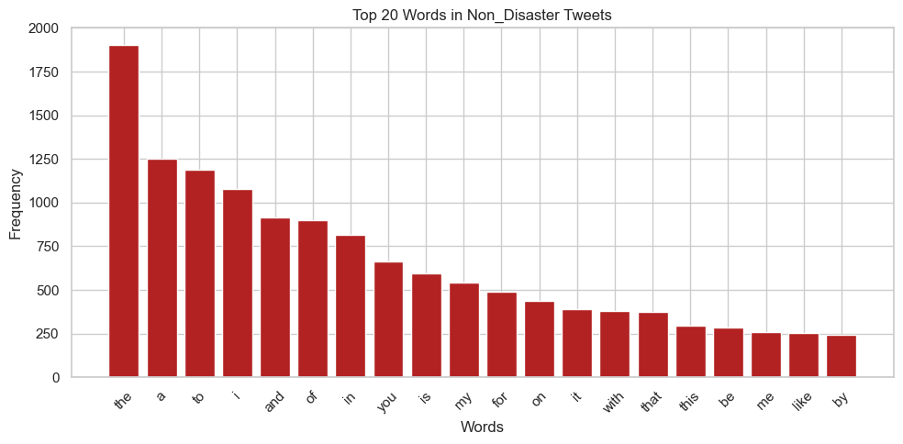
TOP 20
Words
Uses
Disaster tweet
And
Non Disaster
tweet

Slide 6
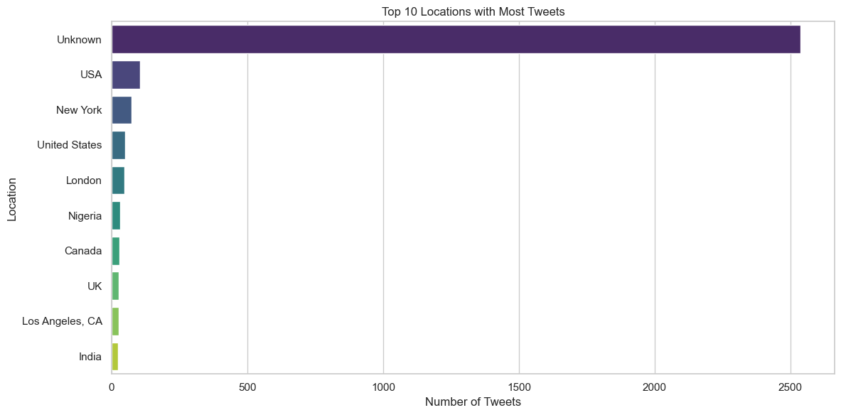

Slide 7
Feature Engeneering:
Add:
word_count
hashtags_count
stop_word_count
Uniqe_word_count
Char_count
Mention_count
Url_count
emoji_count

Slide 8
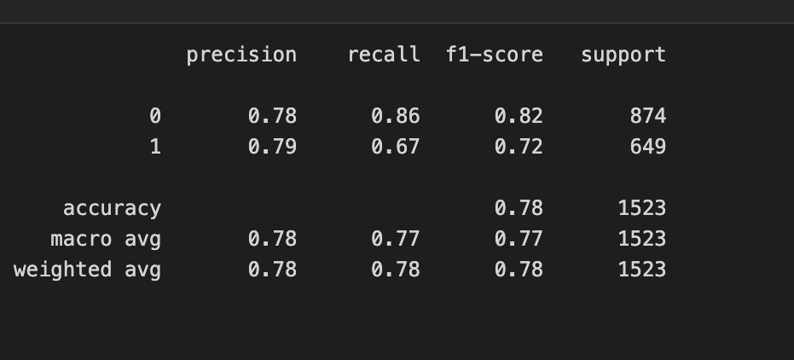
Model Bulding :
Using RandomForestclassifier
Accuracy is : 0.77003939
Then i do for hyperperameter tuning using
RandomizedSearchCV
Accuracy RandomizedSearchCV :0.7805678

Slide 9
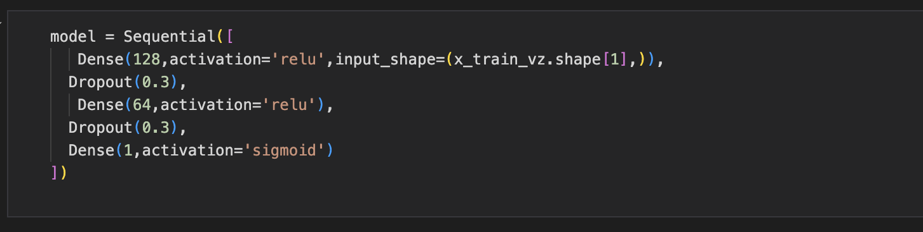
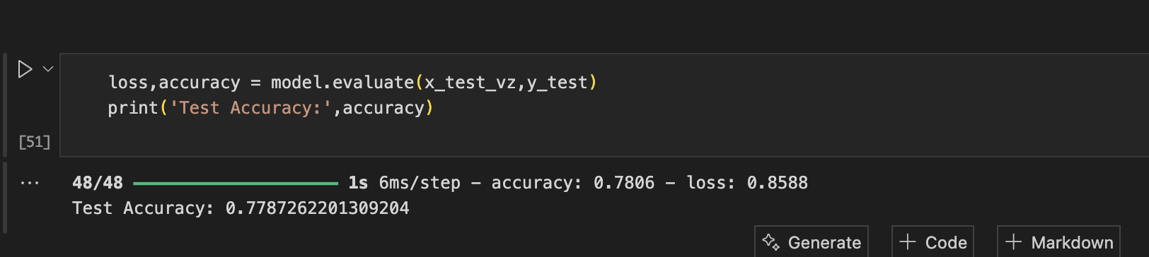
Deep Learning using tensorflow and keras

Slide 10
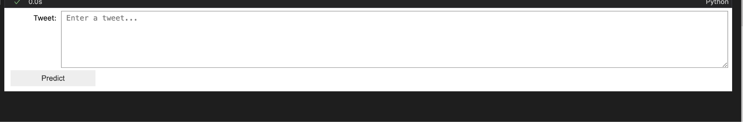
Model deployment:
Enter the tweet and click predict button then result appear in under the tweet box.
This model work for when we wright tweet then it model give this tweet is disaster or non disaster

Slide 11
In this project i learn something new
I learn how to preprocess sentence based data
I learn how work NLP ,TF-IDF,
Thank you

