Slide 1
WEEK 3
ADVANCED CYBERSECURITY PRACTICAL
Network Discovery • Wireshark • Vulnerability Assessment • Hardening
Prajapati Meet Ghanshyam
DG Interns Hub | Week 3 Task

Slide 2
1. Lab Setup & Objectives
• Authorized VirtualBox Host-Only lab.
• Kali: 192.168.56.101/24 on eth1.
• Windows: 192.168.56.1/24 on Ethernet 2.
• Tasks 7–14: discovery, traffic analysis, vulnerability checks and hardening.
• Scope was limited to the isolated lab network.
• No public or third-party systems were targeted.
Prajapati Meet Ghanshyam | DG Interns Hub | Week 3

Slide 3
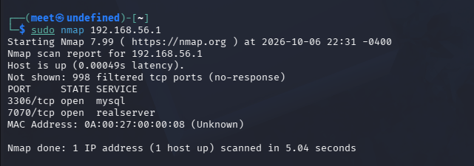
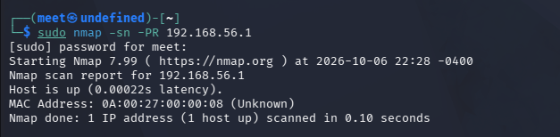
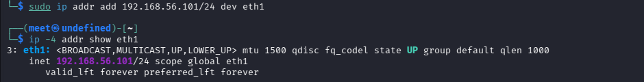
2. Task 7 — Network Discovery
Lab network
Host discovery
Initial TCP scan
• 192.168.56.1 discovered as the lab Windows host.
• Initial scan: 3306/tcp and 7070/tcp open.
Prajapati Meet Ghanshyam | DG Interns Hub | Week 3

Slide 4
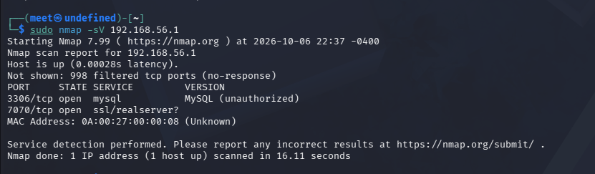
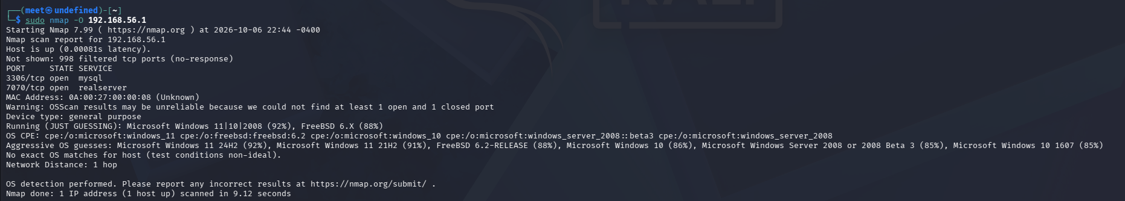
3. Task 8 — Service & OS Detection
Service detection
OS detection
• 3306 identified as MySQL; exact version not disclosed.
• OS estimate: Microsoft Windows family; exact match not confirmed.
Prajapati Meet Ghanshyam | DG Interns Hub | Week 3

Slide 5
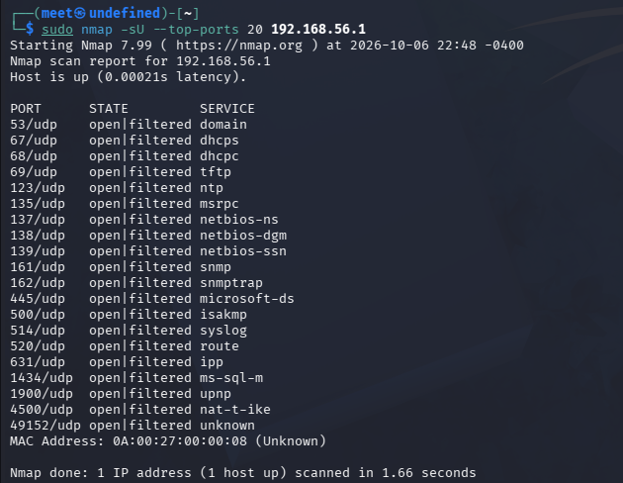
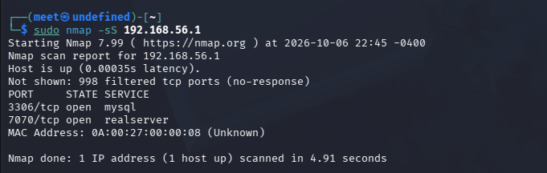
4. Task 8 — SYN & UDP Scans
SYN scan
UDP scan
• SYN scan reproduced the two open TCP services.
• UDP top ports were reported as open|filtered.
Prajapati Meet Ghanshyam | DG Interns Hub | Week 3

Slide 6
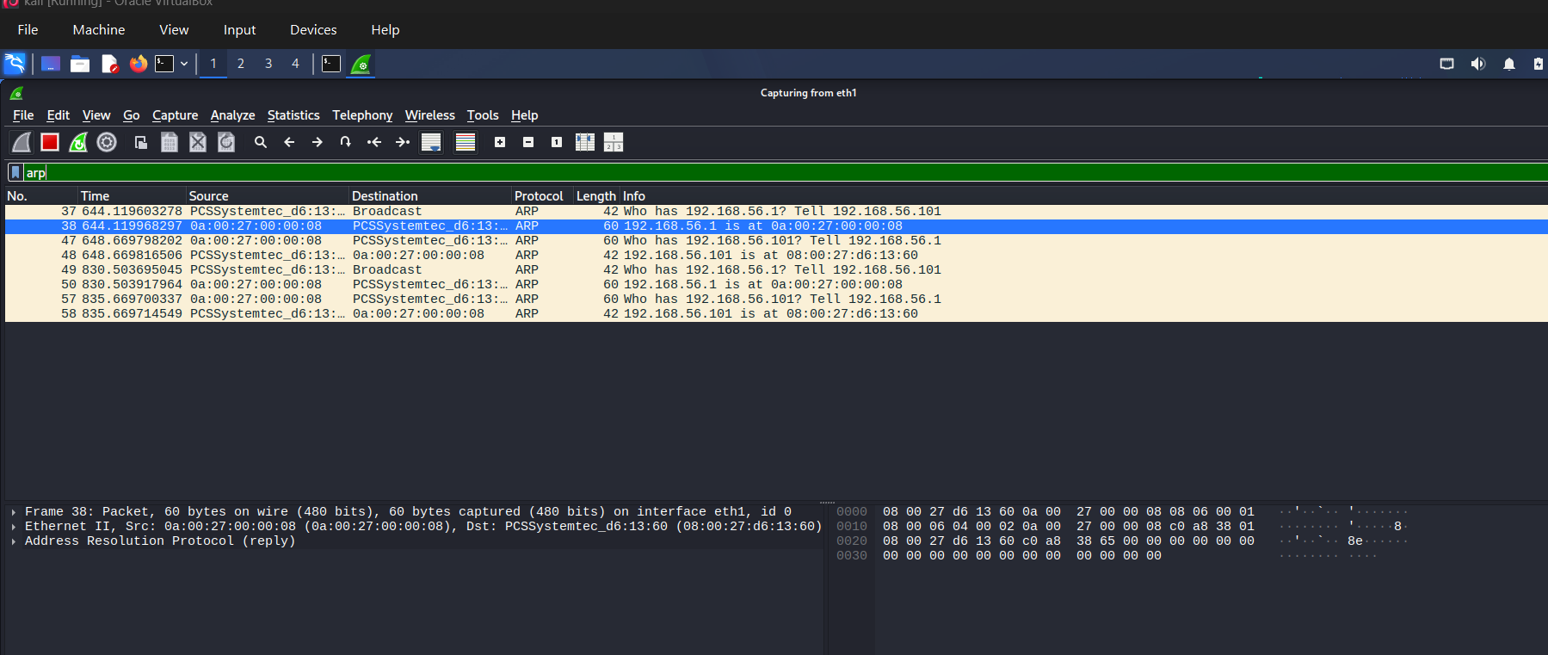
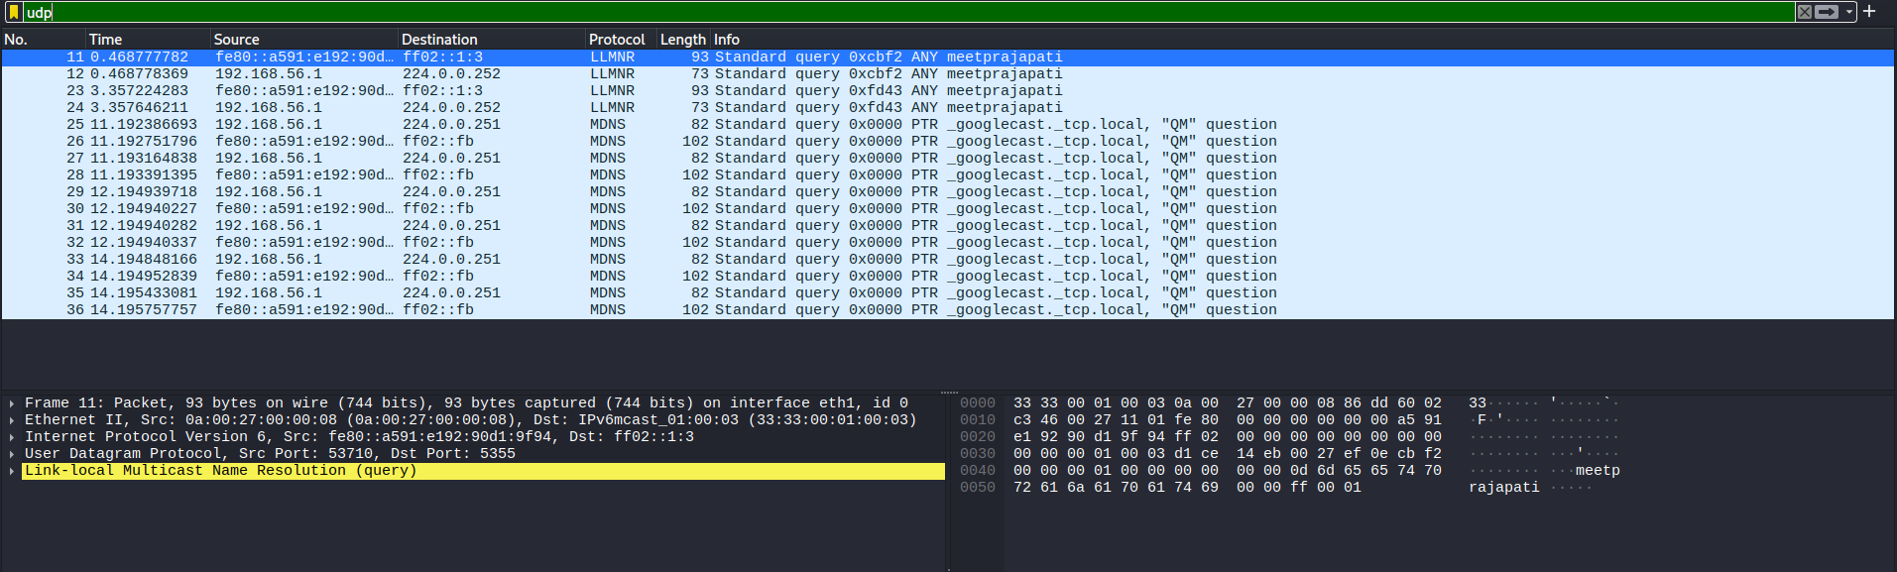
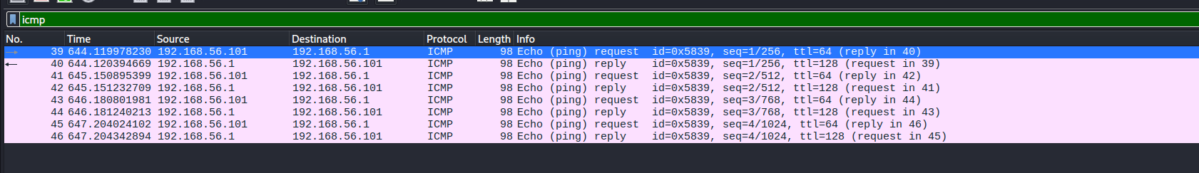
5. Task 9 — Wireshark: UDP, ICMP & ARP
UDP / LLMNR-mDNS
ICMP
ARP
• Observed local discovery traffic, successful ICMP, and ARP resolution.
Prajapati Meet Ghanshyam | DG Interns Hub | Week 3

Slide 7
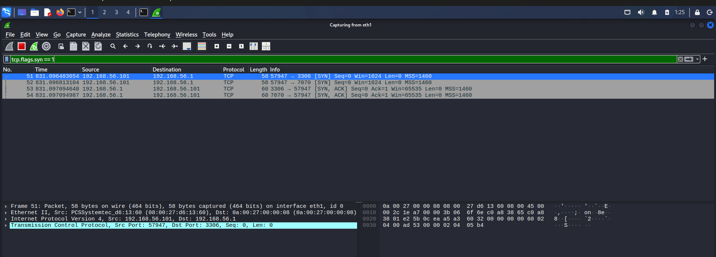
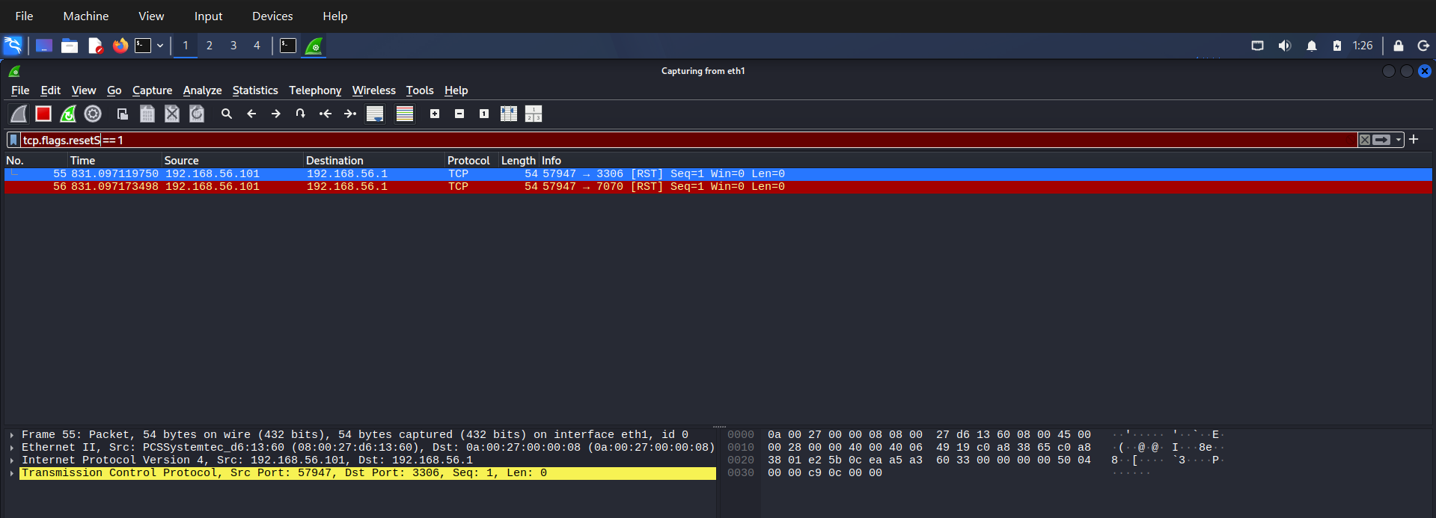
6. Task 9 — Wireshark: TCP
TCP SYN/SYN-ACK
TCP RST
• SYN/SYN-ACK packets show connection establishment attempts.
• RST packets terminate the half-open SYN scan.
Prajapati Meet Ghanshyam | DG Interns Hub | Week 3

Slide 8
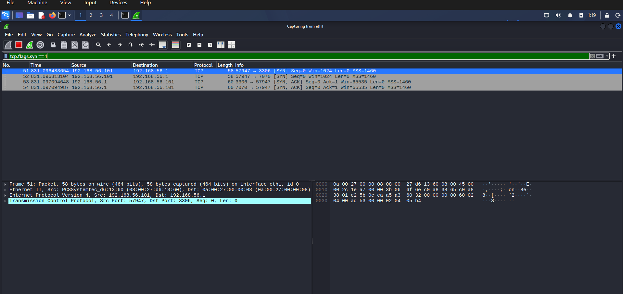
7. Task 10 — Nmap + Wireshark Correlation
• SYN → 3306 → SYN/ACK.
• SYN → 7070 → SYN/ACK.
• RST packets terminate the half-open scan.
Packet-level evidence
Prajapati Meet Ghanshyam | DG Interns Hub | Week 3

Slide 9
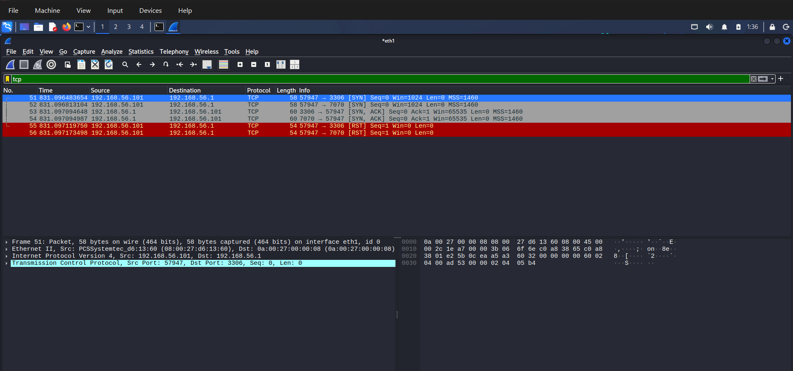
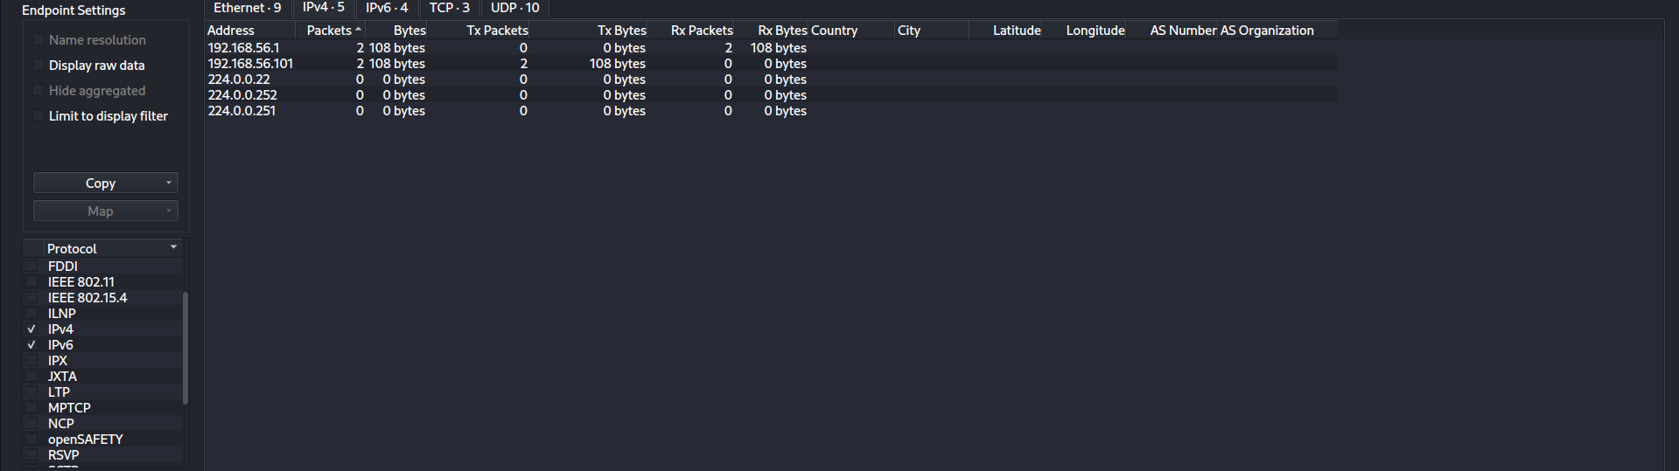
8. Task 11 — Endpoints & DNS
IPv4 Endpoints
DNS filter
• Primary endpoints: 192.168.56.1 and 192.168.56.101.
• DNS filter displayed 0 packets in the selected capture.
Prajapati Meet Ghanshyam | DG Interns Hub | Week 3

Slide 10
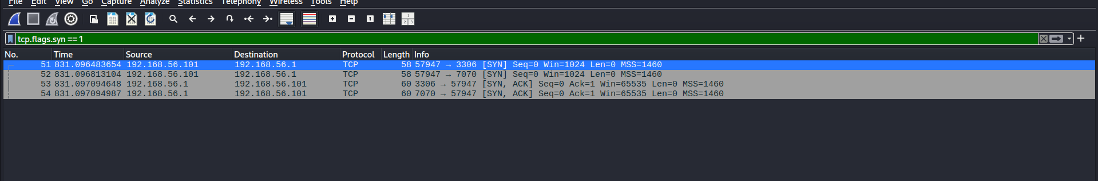
9. Task 11 — TCP & Suspicious Activity
TCP investigation
TCP SYN filter
• 3306 and 7070 received SYN/ACK responses.
• Traffic was generated intentionally by the authorized Nmap scan.
Prajapati Meet Ghanshyam | DG Interns Hub | Week 3

Slide 11
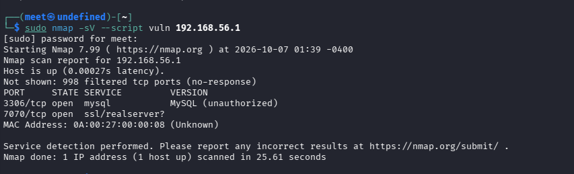
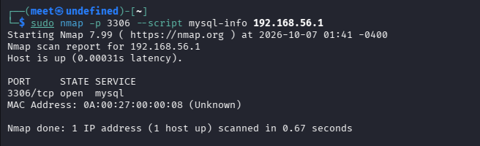
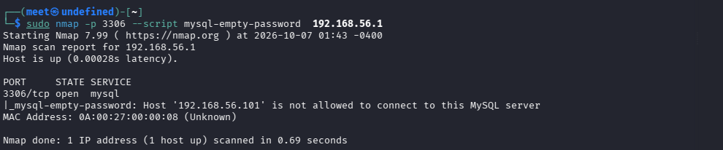
10. Task 12 — Vulnerability & MySQL Checks
Vulnerability NSE
MySQL info
Empty-password check
• No specific vulnerability reported by general NSE scan.
• Empty-password issue was not confirmed.
Prajapati Meet Ghanshyam | DG Interns Hub | Week 3

Slide 12
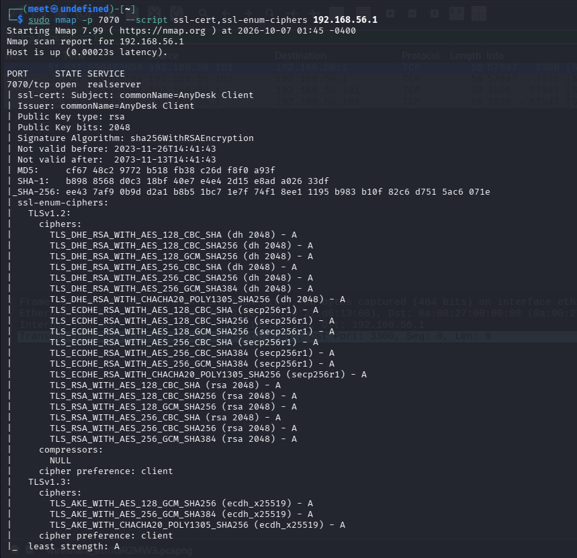
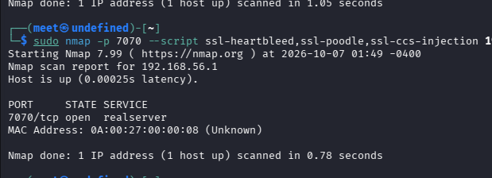
11. Task 12 — TLS Assessment
TLS ciphers
TLS checks
• 7070 exposed a TLS service with legacy CBC/SHA-1 suites.
• TLS 1.3 was also supported; targeted vulnerability checks gave no specific finding.
Prajapati Meet Ghanshyam | DG Interns Hub | Week 3

Slide 13
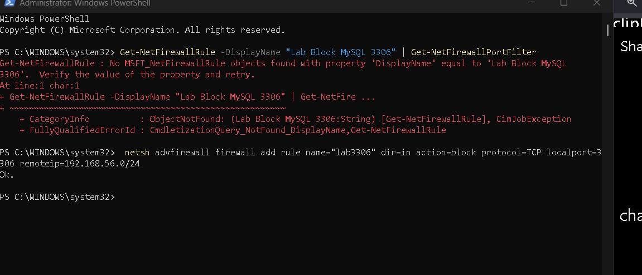
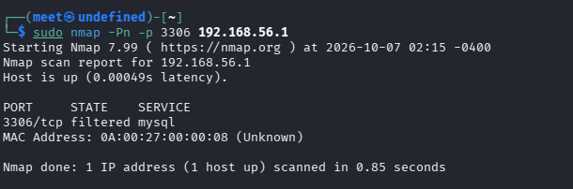
12. Task 13 — Hardening: MySQL 3306
Firewall rule
3306 filtered
• Firewall rule blocked TCP/3306 from 192.168.56.0/24.
• Verification changed 3306 from open to filtered.
Prajapati Meet Ghanshyam | DG Interns Hub | Week 3

Slide 14
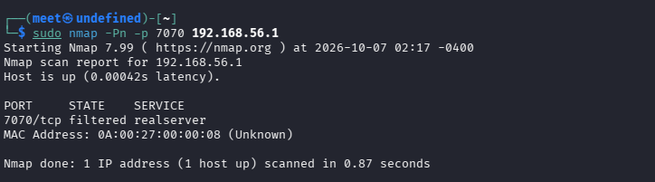
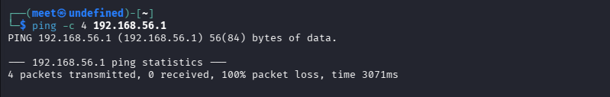
13. Task 13 — Hardening: 7070 & ICMP
7070 filtered
ICMP blocked
• 7070 changed from open to filtered.
• ICMP Echo was blocked: 100% packet loss.
Prajapati Meet Ghanshyam | DG Interns Hub | Week 3

Slide 15
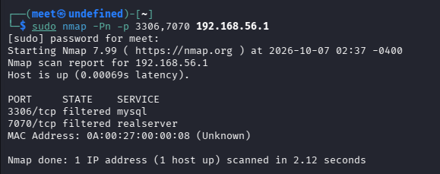
14. Task 14 — Final Assessment
• 3306/tcp → filtered.
• 7070/tcp → filtered.
• Network attack surface was reduced.
• Tasks 7–14 completed in the authorized lab.
• Recommendation: retain firewall restrictions and review legacy TLS/local discovery settings.
Final Nmap verification
Prajapati Meet Ghanshyam | DG Interns Hub | Week 3

