Slide 1
DG INTERN HUB
WEEK 4
CYBER SECURITY INTERNSHIP TASK
Basic Network Setup • IIS / Apache • Nmap • Wireshark
Submitted by: Prajapati Meet Ghanshyam
Organization: DG Intern Hub
Date: 14 October 2026
Practical evidence presentation

Slide 2
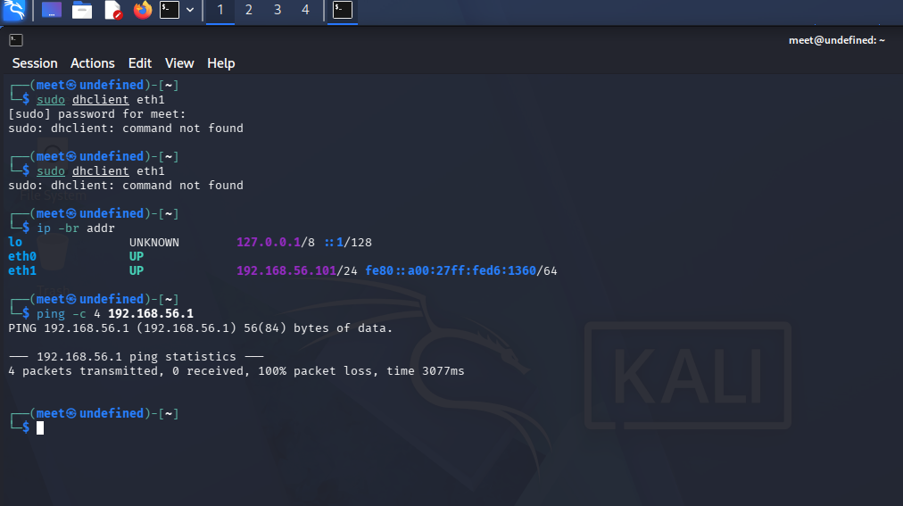
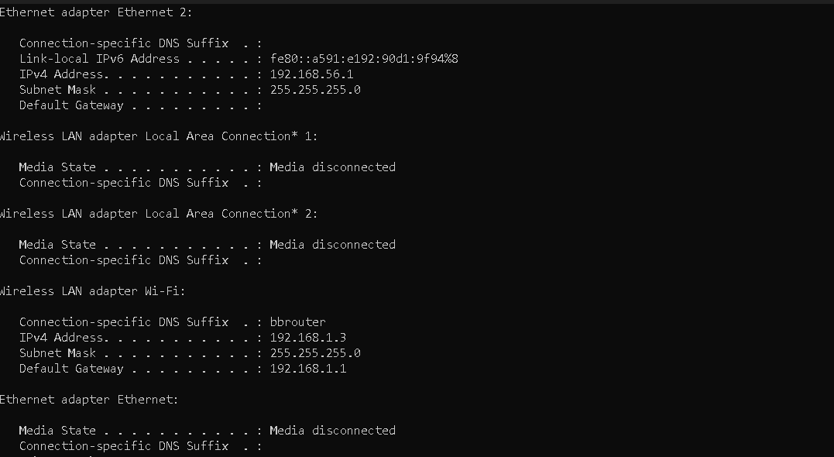
1. Lab Setup & Network
Authorized Host-Only lab segment
KALI LINUX VM
WINDOWS HOST
Test client / Wireshark
eth1: 192.168.56.101/24
Target web server (IIS)
Ethernet 2: 192.168.56.1/24
VirtualBox Host-Only
192.168.56.0/24
Kali interface evidence
Windows Host-Only adapter evidence
DG INTERN HUB | WEEK 4 | PRAJAPATI MEET GHANSHYAM 02

Slide 3
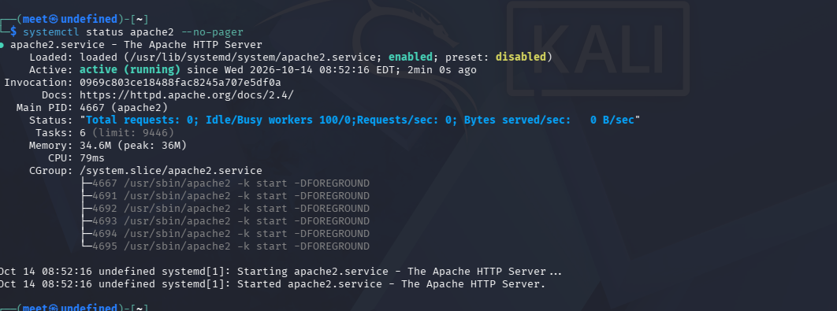
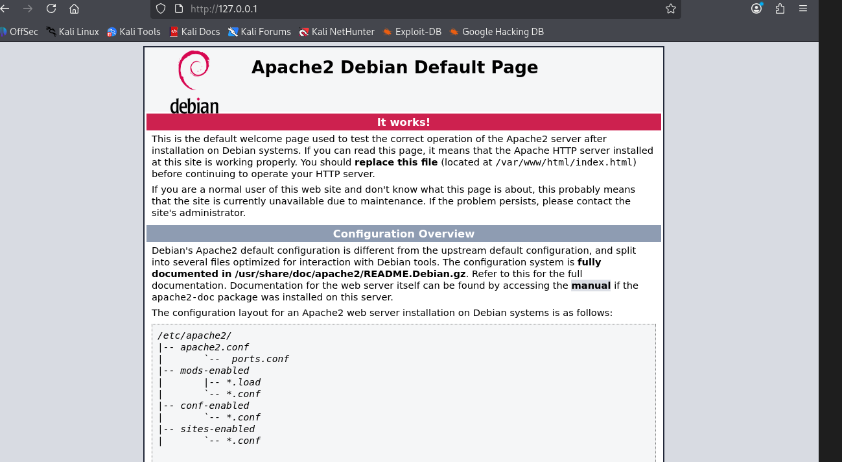
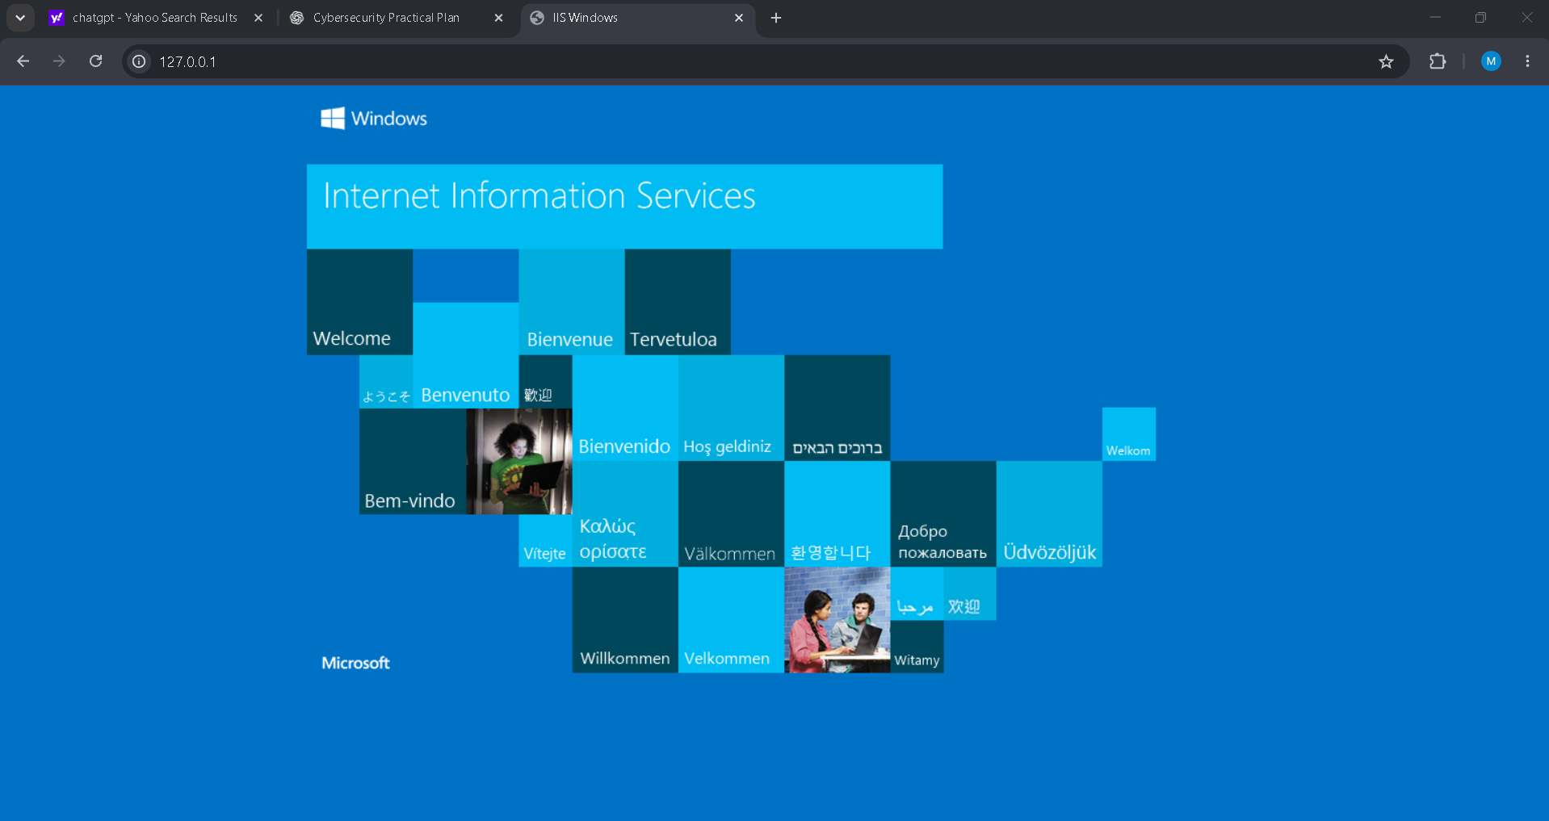
2. Web Server Setup
Apache on Kali was verified locally; IIS was enabled on the Windows target.
Apache2 service: active (running)
Apache default page at http://127.0.0.1
Windows IIS welcome page
Target: 192.168.56.1
DG INTERN HUB | WEEK 4 | PRAJAPATI MEET GHANSHYAM 03

Slide 4
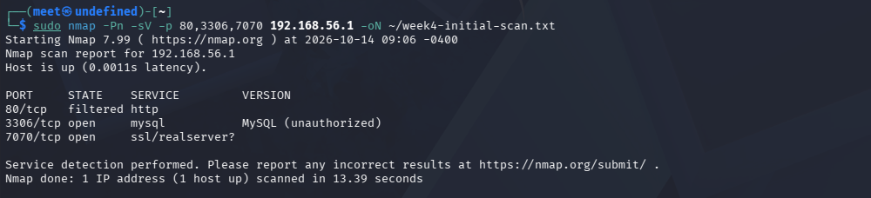
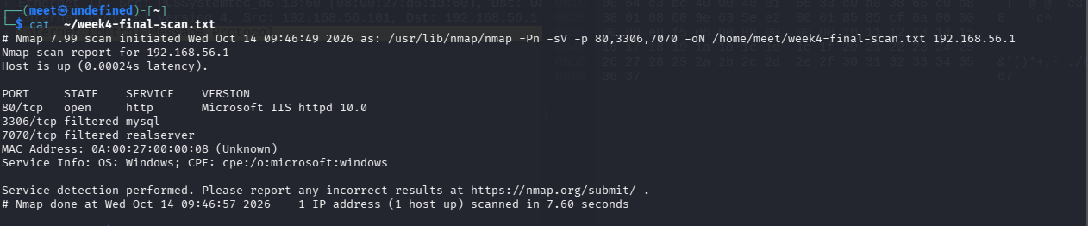
3. Nmap Scanning Results
Initial scan: port 80 was filtered. After enabling IIS, port 80 became open.
Initial scan — 80 filtered; 3306 and 7070 open
Final scan — 80 open (Microsoft IIS HTTPD 10.0)
Port | Final state | Notes
80/tcp | Open | Microsoft IIS HTTPD 10.0
3306/tcp | Filtered | MySQL was open in the initial scan
7070/tcp | Filtered | Initial scan identified ssl/realserver?
DG INTERN HUB | WEEK 4 | PRAJAPATI MEET GHANSHYAM 04

Slide 5
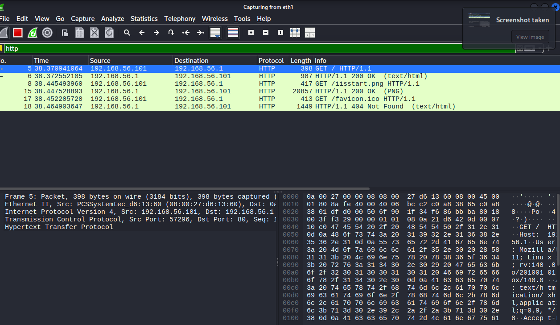
4. Wireshark — HTTP Traffic
Capture interface: eth1 | Display filter: http
Observed: GET / from 192.168.56.101 to 192.168.56.1 and HTTP/1.1 200 OK in response. Additional resource requests were also visible.
DG INTERN HUB | WEEK 4 | PRAJAPATI MEET GHANSHYAM 05

Slide 6
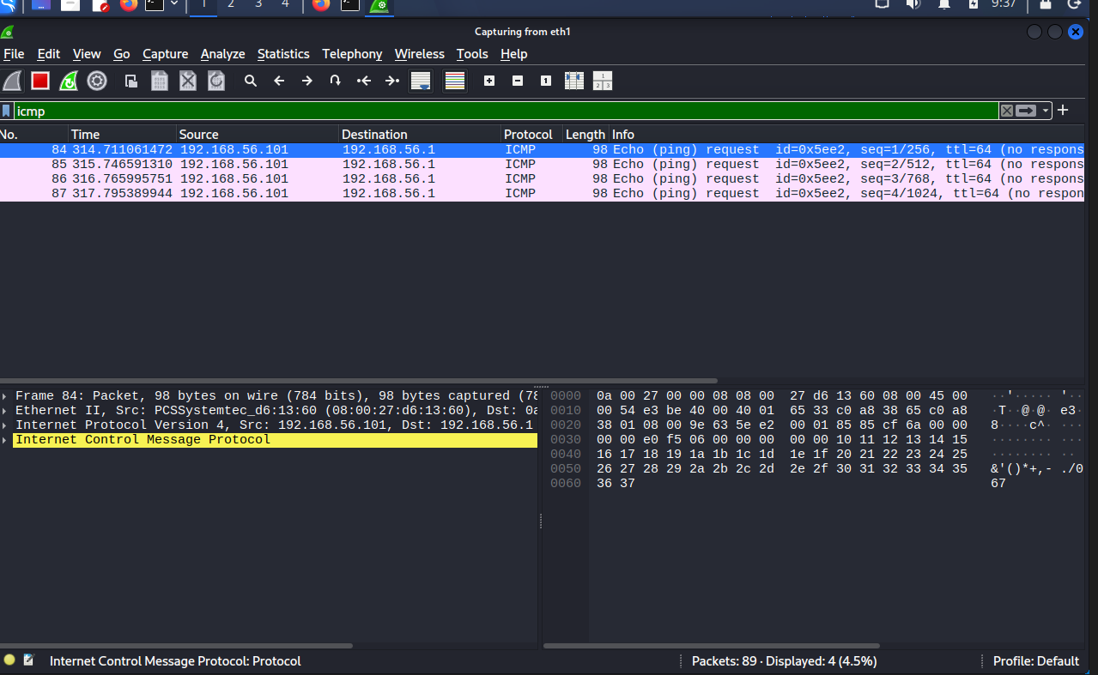
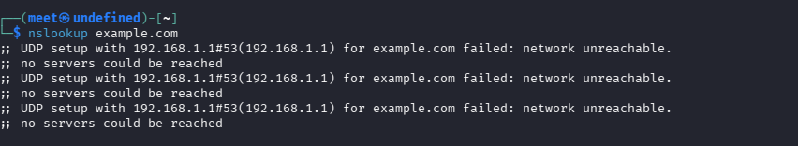
5. Wireshark — ICMP & DNS
DNS lookup failed: resolver unreachable
DNS limitation
nslookup example.com failed with “network unreachable” while trying 192.168.1.1. Successful DNS query/response traffic was not captured, so this is reported as an incomplete item—not a successful finding.
Four ICMP Echo Requests; no replies visible
DG INTERN HUB | WEEK 4 | PRAJAPATI MEET GHANSHYAM 06

Slide 7
6. Key Findings & Conclusion
NETWORK
Kali 192.168.56.101/24 ↔ Windows 192.168.56.1/24
WEB SERVER
Windows IIS reachable on TCP/80; identified as Microsoft IIS HTTPD 10.0
NMAP
Final scan: 80 open; 3306 and 7070 filtered
WIRESHARK
HTTP GET and 200 OK observed; ICMP requests captured without replies
LIMITATION
DNS resolution failed because the configured resolver was unreachable
Conclusion: the lab demonstrated network setup, web-service verification, port scanning and HTTP packet analysis. DNS capture should be repeated after fixing resolver connectivity.
DG INTERN HUB | WEEK 4 | PRAJAPATI MEET GHANSHYAM 07

