Slide 1
WEEK 6 TASK • DG INTERNS HUB
Web Security & VAPT\nPractical
DVWA • SQL Injection • XSS • Burp Suite • OWASP ZAP
Prajapati Meet Ghanshyam\n28 October 2026

Slide 2
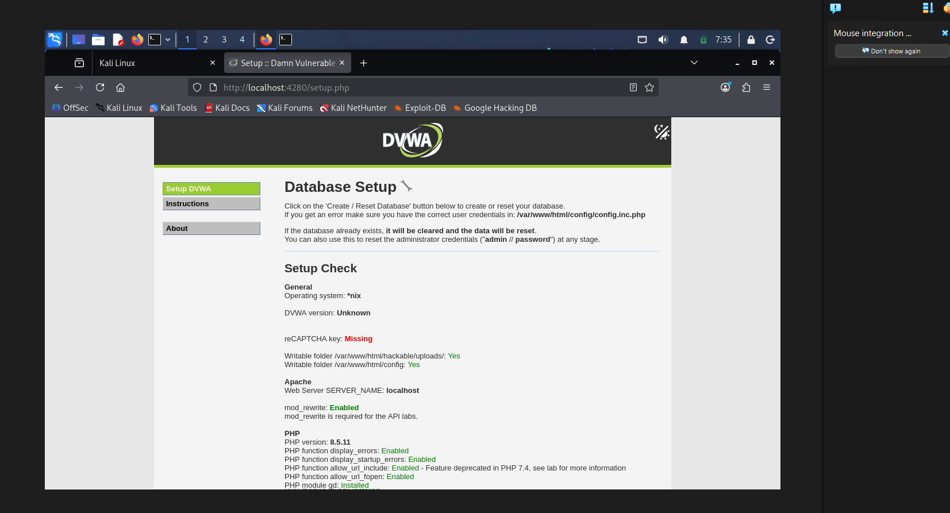
1. Objectives & Lab Scope
Local intentionally vulnerable DVWA environment
OBJECTIVES\n• Learn SQL Injection and XSS\n• Inspect HTTP traffic in Burp Suite\n• Run OWASP ZAP automated scan\n• Record evidence and mitigations\n\nSCOPE\n• http://localhost:4280\n• Kali Linux + Docker\n• Local lab only
Prajapati Meet Ghanshyam | DG Interns Hub | Week 6 | 28 Oct 2026 • 2

Slide 3
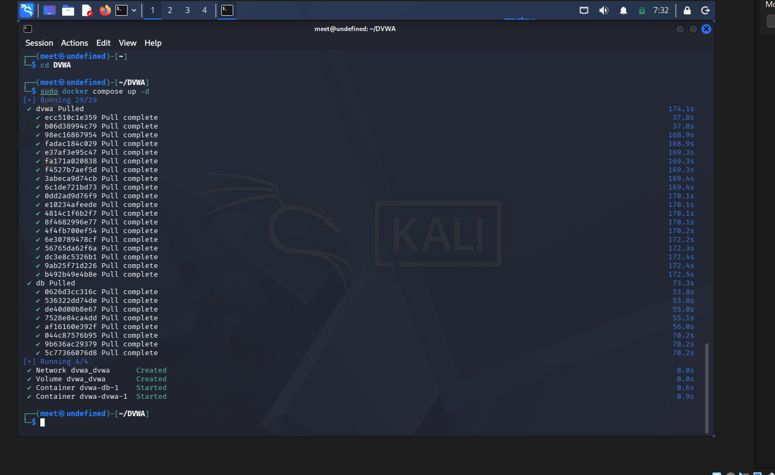
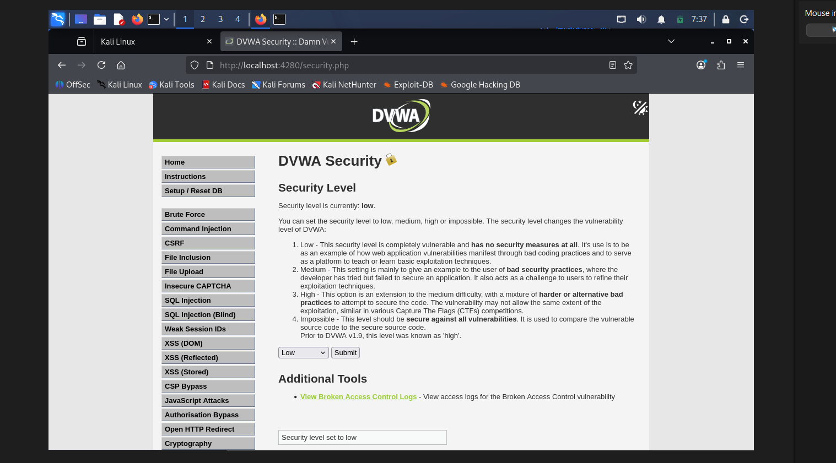
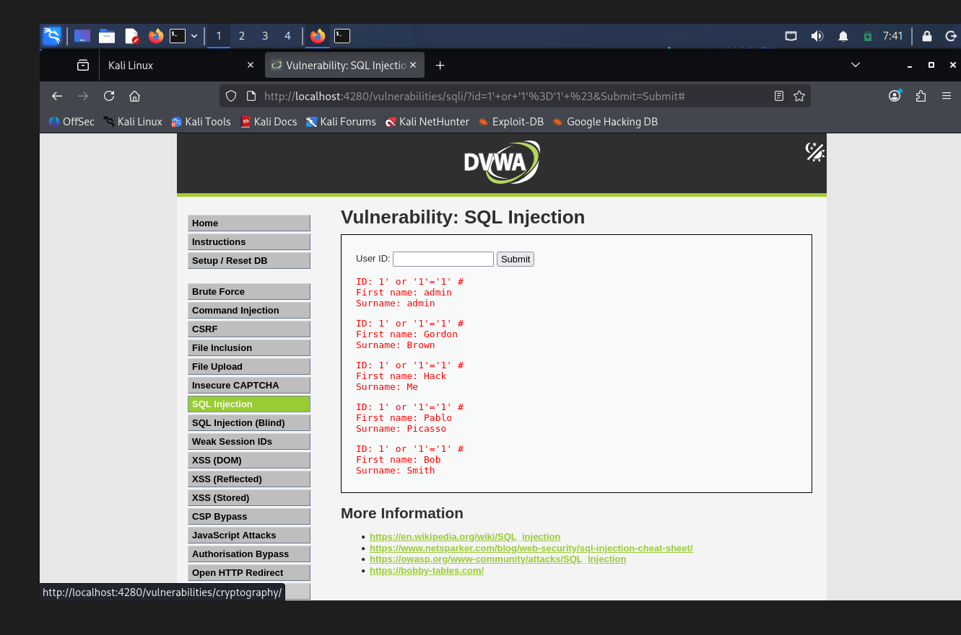
2. Lab Setup & SQL Injection
Docker and DVWA evidence
Docker Compose started the DVWA containers. Security level was set to Low for the training exercise.
Crafted input returned multiple records: SQLi behaviour observed.
Prajapati Meet Ghanshyam | DG Interns Hub | Week 6 | 28 Oct 2026 • 3

Slide 4
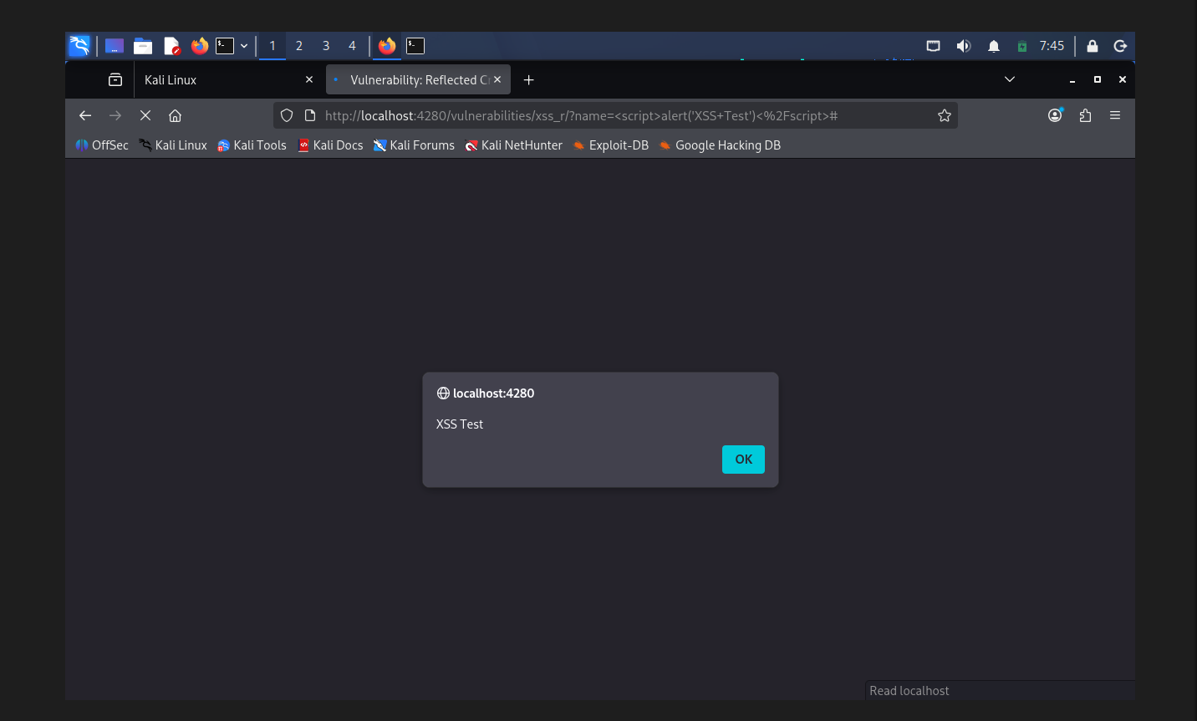
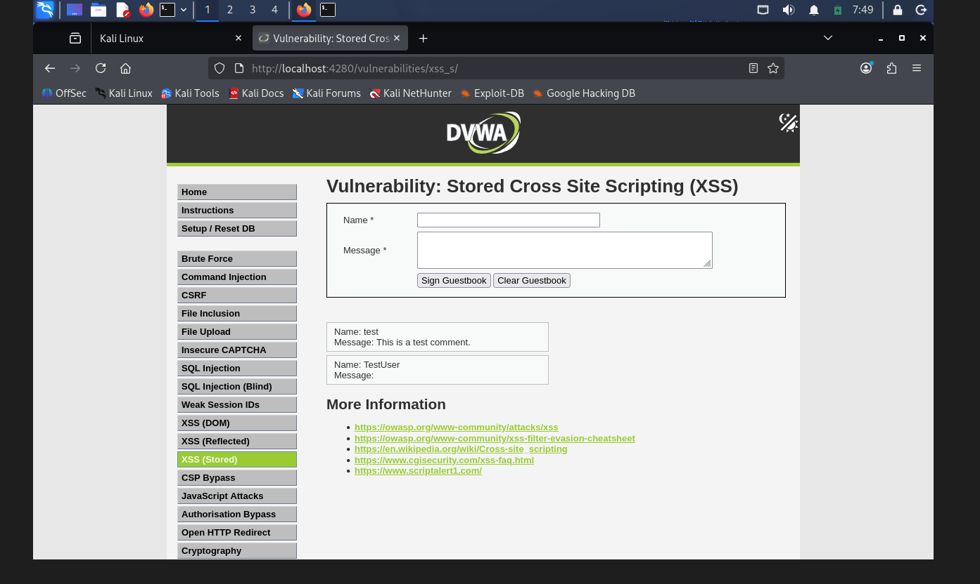
3. XSS Demonstrations
Reflected and Stored XSS in the local lab
Reflected XSS: “XSS Test” alert appeared.
Stored XSS: “stored XSS Test” alert appeared.
Prajapati Meet Ghanshyam | DG Interns Hub | Week 6 | 28 Oct 2026 • 4

Slide 5
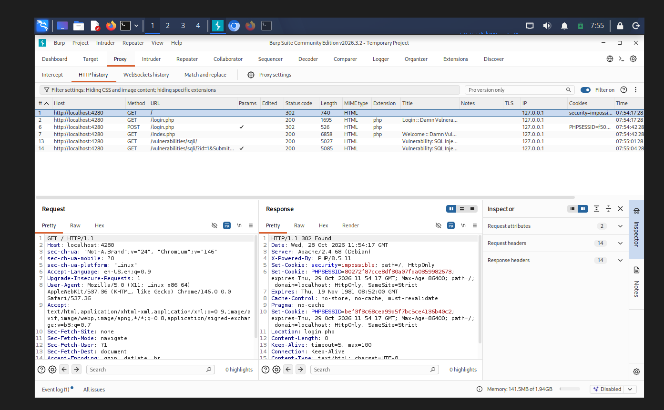
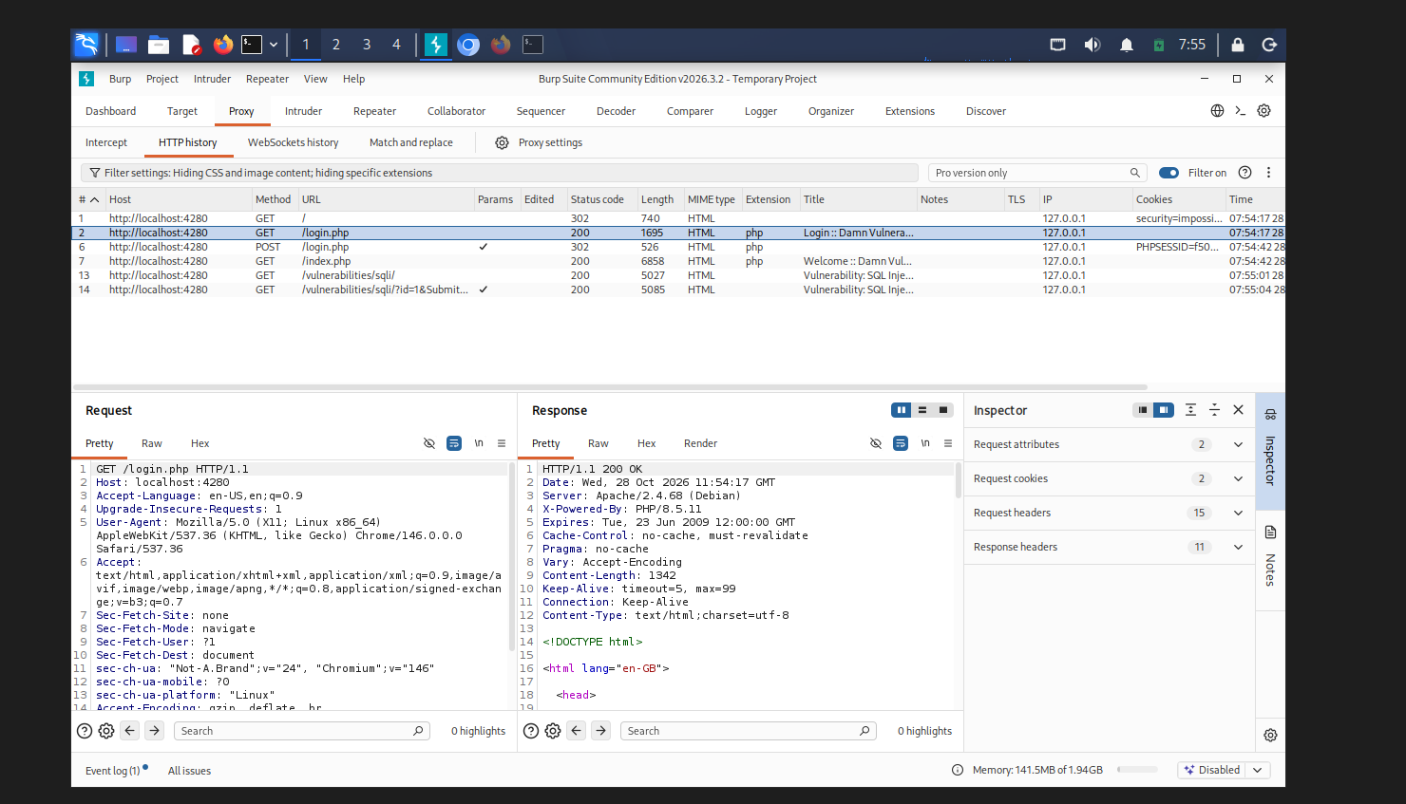
4. Burp Suite HTTP Inspection
Captured local DVWA requests and responses
HTTP history included 200 OK and 302 Found responses. Redact session cookies before sharing.
Prajapati Meet Ghanshyam | DG Interns Hub | Week 6 | 28 Oct 2026 • 5

Slide 6
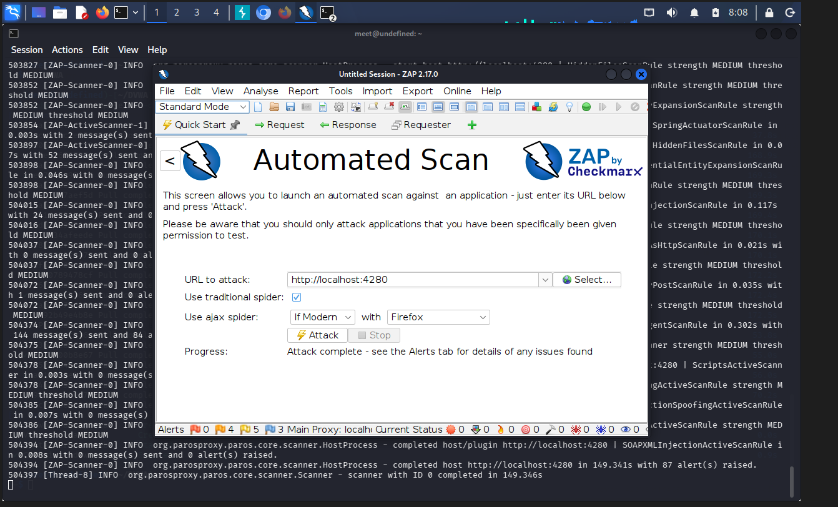
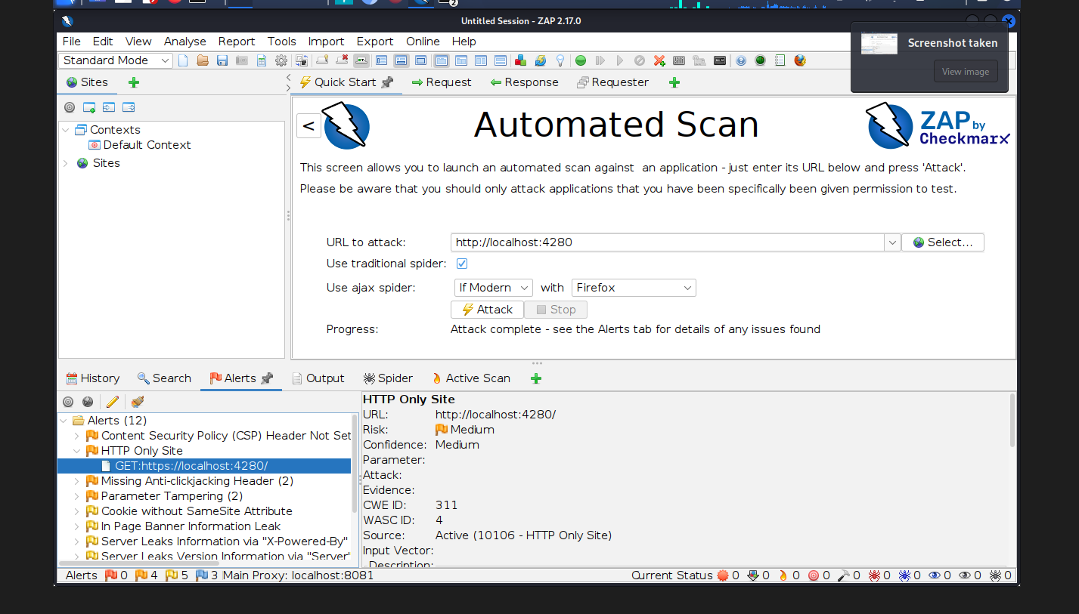
5. OWASP ZAP Automated Scan
Target: http://localhost:4280
Scan completed with 87 alerts reported; 12 alert groups were visible. Validate each alert before calling it exploitable.
Prajapati Meet Ghanshyam | DG Interns Hub | Week 6 | 28 Oct 2026 • 6

Slide 7
6. Findings, Mitigation & Conclusion
OBSERVED\n• SQL Injection behaviour\n• Reflected XSS\n• Stored XSS\n• Burp HTTP traffic\n• ZAP scan completed\n\nMITIGATION\n• Prepared SQL statements\n• Context-aware output encoding\n• Secure headers and cookies
KEY LEARNING\nScanner alerts are leads for investigation, not proof that every issue is exploitable. Validate evidence, remediate confirmed issues and retest.\n\nPrajapati Meet Ghanshyam\nDG Interns Hub
Prajapati Meet Ghanshyam | DG Interns Hub | Week 6 | 28 Oct 2026 • 7

