Slide 1
DG INTERNS HUB • CYBER SECURITY INTERNSHIP
WEEK 5 TASK
Vulnerability Assessment & Penetration Testing (VAPT)
Submitted by: Prajapati Meet Ghanshyam
Date: 21 October 2026
Tools: Nmap • Nikto • Burp Suite Community Edition
Authorized training-target testing • Practical evidence and limitations
Prajapati Meet Ghanshyam | DG Interns Hub
1

Slide 2
Project Overview
WEEK 5 • VAPT
Objective
NMAP
3 scan modes executed
Learn a basic VAPT workflow: scan a training host, attempt web checks, and inspect HTTP requests through a local proxy.
NIKTO
Connection to TCP/80 failed
Tools used
Nmap — host/port/service reconnaissance
Nikto — web-server checks
Burp Suite — HTTP request inspection
curl / getent / ping — connectivity troubleshooting
BURP
Listener active; GET history visible
Prajapati Meet Ghanshyam | DG Interns Hub
2

Slide 3
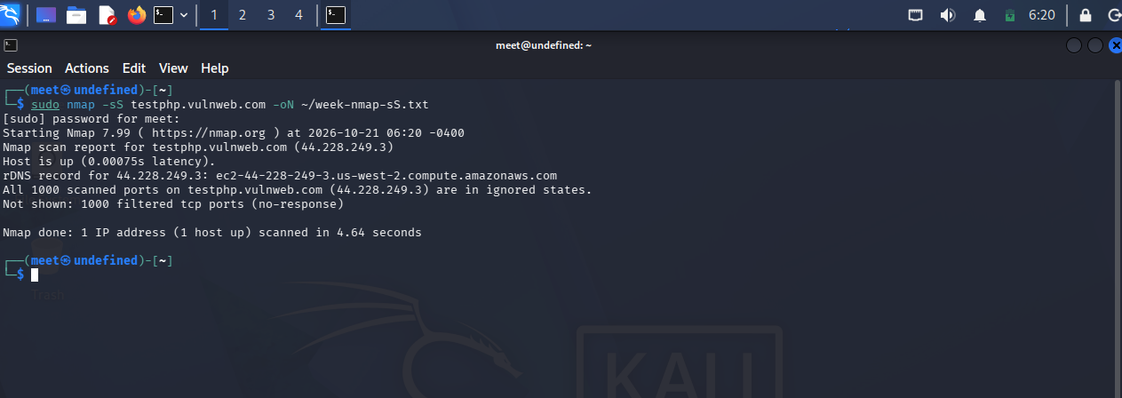
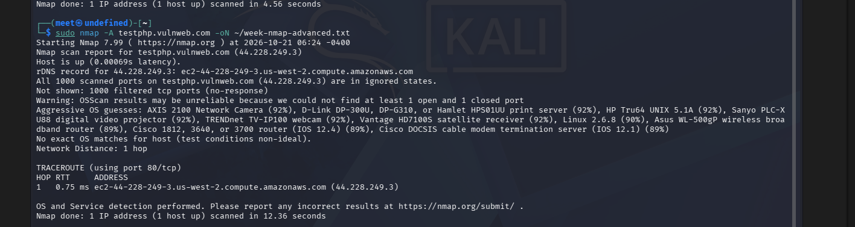
Nmap Reconnaissance
WEEK 5 • VAPT
Commands run
sudo nmap -sS testphp.vulnweb.com
sudo nmap -sV testphp.vulnweb.com
sudo nmap -A testphp.vulnweb.com
Key result
SYN scan evidence
• Host reported up at 44.228.249.3
• All 1,000 default TCP ports filtered/no-response
• No open port or service version confirmed
• OS guesses from -A were explicitly unreliable
Advanced scan: no exact OS match
Prajapati Meet Ghanshyam | DG Interns Hub
3

Slide 4

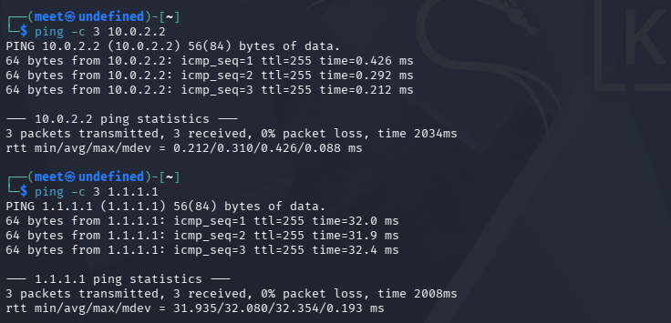
Nikto Scan & Connectivity
WEEK 5 • VAPT
Nikto outcome
Nikto v2.6.0 could not connect to testphp.vulnweb.com:80. No usable vulnerability findings were produced.
Troubleshooting
Nikto connection failure
• NAT gateway 10.0.2.2 reachable
• 1.1.1.1 ping: 0% packet loss
• Target DNS resolved to 44.228.249.3 in some checks
• HTTP/HTTPS connection timed out
Gateway and IP reachability
Prajapati Meet Ghanshyam | DG Interns Hub
4

Slide 5
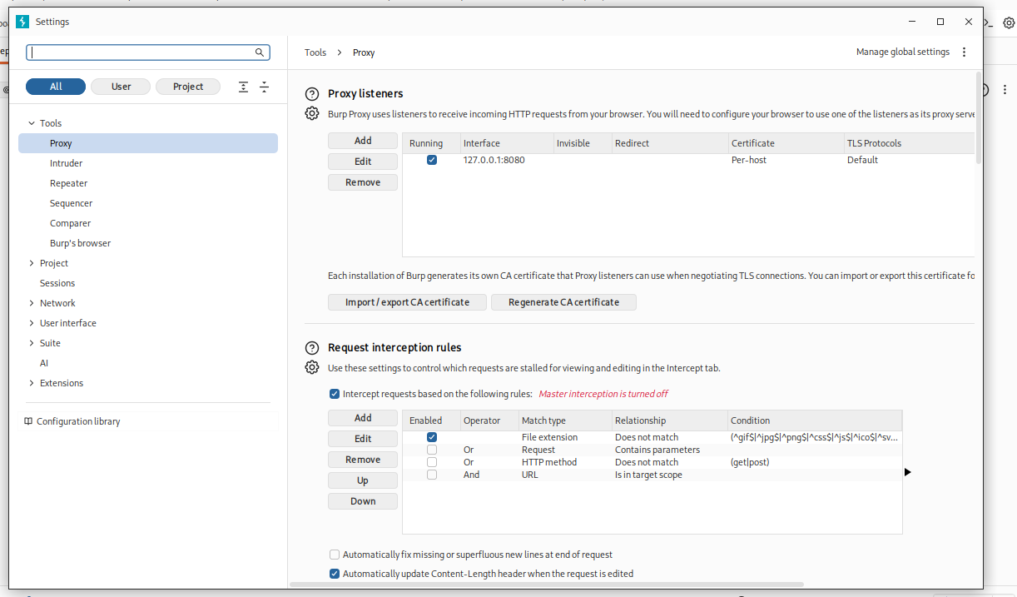
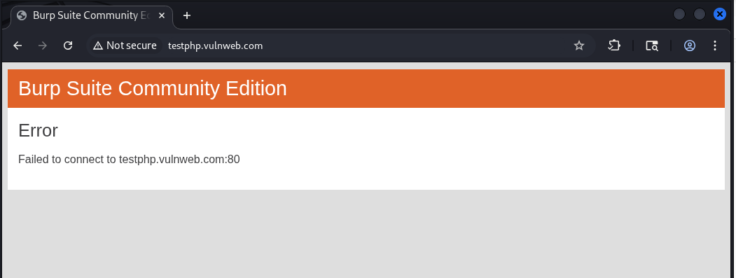
Burp Suite Setup
WEEK 5 • VAPT
Configuration
• Burp Suite Community Edition
• Temporary project in memory
• Proxy listener: 127.0.0.1:8080
• Built-in browser used for testing
Observed limitation
Proxy listener active on 127.0.0.1:8080
The browser showed a Burp connection error for the remote training target. This is a reachability limitation, not a confirmed vulnerability.
Target connection error
Prajapati Meet Ghanshyam | DG Interns Hub
5

Slide 6
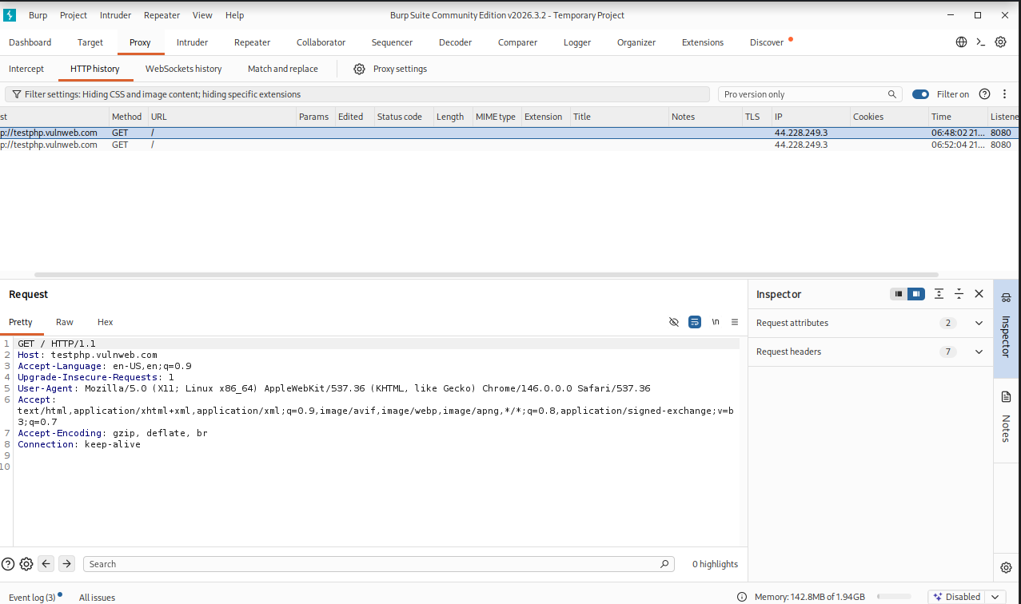
Burp HTTP History
WEEK 5 • VAPT
What was captured
• Two GET / entries visible in HTTP history
• Selected request showed HTTP/1.1 and Host header
• Browser User-Agent and Accept headers visible
• No successful target response confirmed
Learning
A request in history proves the proxy saw a request; it does not prove the remote server returned a response.
Actual Burp HTTP history and request headers
Prajapati Meet Ghanshyam | DG Interns Hub
6

Slide 7
Findings & Conclusion
WEEK 5 • VAPT
Evidence-based findings
Conclusion
Nmap: 1,000 TCP ports filtered
The workflow demonstrated Nmap scanning, Burp proxy setup, HTTP request inspection, and connectivity troubleshooting. No exploitable vulnerabilities were confirmed.
F-01
Informational
F-02
OS detection: no exact match
Informational
Next steps
F-03
Nikto: target TCP/80 unreachable
Limitation
• Retry when the target is reachable
• Re-run Nikto and save actual output
• Capture a successful Burp response
• Keep scan text files with screenshot evidence
F-04
Burp: proxy works; target response unavailable
Partial
Only verified results are reported; connection failures are not vulnerabilities.
Prajapati Meet Ghanshyam | DG Interns Hub
7

