Slide 1
Visualization / Analysis of E-Commerce Shipping Data
Meet Trivedi (N01520331)
Raghavender Chakilam (N01533573)
ITE 5201 Humber College

Slide 2
Problem statement:
  Visualization / Analysis of eCommerce shipping data.
Dataset description:
  The E-commerce shipping dataset contains daily shipping logs of good which was delivered from different warehouse to customers.
  Dependent variables such as warehouse_block, mode_of_shipment, customer_care_calls, customer_rating, cost_of_the_product, prior_purchases, product_importance, discount_offered, gender and weight_of_goods, which we have used to predict if goods received by customer were on time or not.

Slide 3
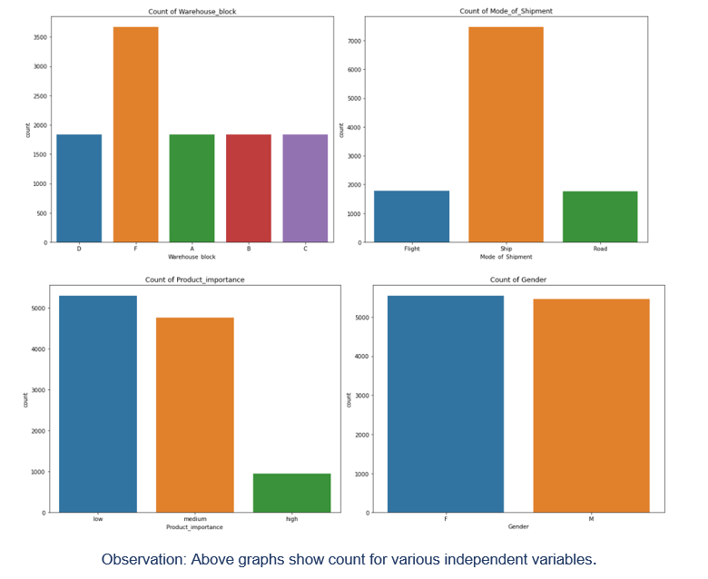

Slide 4
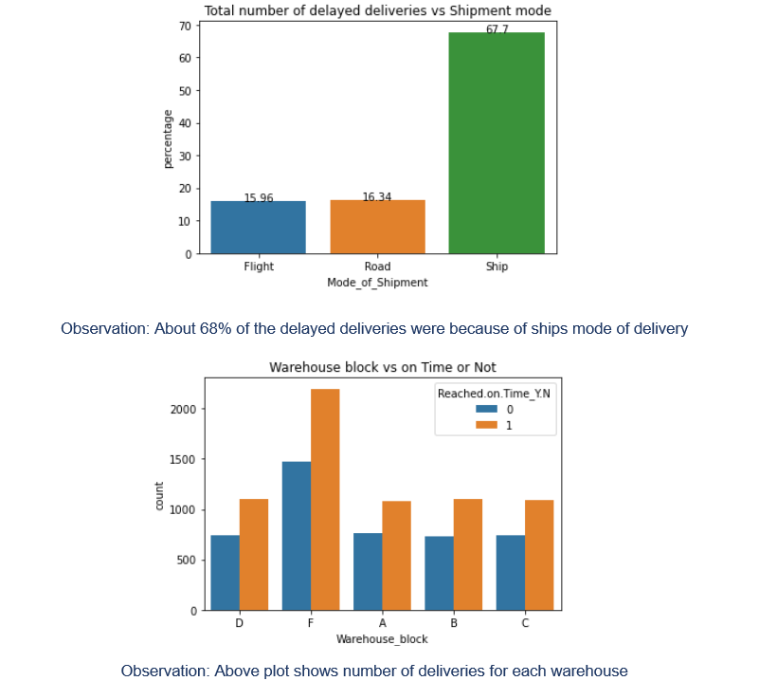

Slide 5
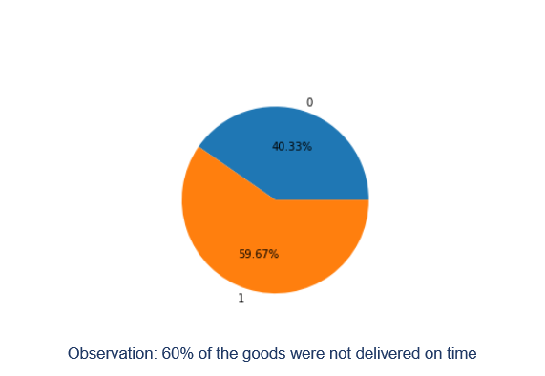

Slide 6
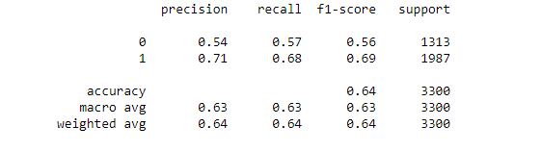
Results and Discussion
From the below classification report, the model has a precision of 54% and recall of 57%, and accuracy of 64% to predict the goods delivered on time.

