Slide 1

VOCO – Native Language Learning Platform
MERN Stack Web Application | IMCA Semester 8 Project
Developed By: Meet Patel, Yash Shah, Krishna Radhani | Guide: Prof. Harsh Shah

Slide 2

Project Overview
VOCO is a modern web-based language learning platform designed to provide an interactive and flexible learning experience. The platform enables users to improve reading, listening, and speaking skills through structured lessons and real-life practice scenarios.
Built using the MERN stack architecture, VOCO combines responsive design with RESTful API architecture to deliver a seamless learning experience accessible anytime, anywhere.

Slide 3
Problem Statement
Traditional Methods Are Expensive
Limited Flexibility
Classroom-based language courses require significant financial investment, making them inaccessible to many learners seeking to acquire new language skills.
Fixed schedules and location requirements prevent learners from studying at their own pace and convenience, creating barriers to consistent practice.
Lack of Personalization
Insufficient Practice
One-size-fits-all approaches fail to address individual learning needs, skill levels, and progress tracking requirements.
Traditional methods offer limited opportunities for continuous, interactive practice and immediate feedback on performance.

Slide 4
Project Objectives
User-Friendly Platform
Affordable Education
Develop an intuitive interface that provides seamless navigation and accessible learning experiences for all users.
Deliver high-quality language learning at a fraction of traditional costs, making education accessible to everyone.
Universal Support
Self-Paced Learning
Design comprehensive content that accommodates learners of all proficiency levels, from beginner to advanced.
Enable users to control their learning journey with flexible schedules and progress at their own speed.
Interactive Content
Progress Tracking
Provide engaging lessons, exercises, and assessments that keep learners motivated and involved throughout their journey.
Implement comprehensive analytics to monitor user performance, identify strengths, and address areas needing improvement.

Slide 5
Existing System Analysis
Current Approach
Key Limitations
Classroom-based instruction with physical presence required
Reliance on printed textbooks and workbooks
Manual assessment and grading by instructors
Fixed class schedules throughout the week
Limited accessibility outside classroom hours
Not flexible for working professionals or students with conflicting schedules
Difficult to scale for large numbers of learners simultaneously
High operational costs make education expensive
Limited practice opportunities beyond classroom time

Slide 6





Proposed Solution: VOCO Platform
Online Learning Modules
Structured vocabulary and grammar lessons accessible 24/7
Audio Support
Pronunciation practice with native speaker audio samples
Interactive Exercises
Engaging activities that reinforce learning concepts
Certificate Generation
Recognition of achievement upon course completion

Slide 7
Core Platform Features
Secure Authentication
Learning Modules
User registration and login with OTP verification and JWT-based token management for secure access control.
Comprehensive vocabulary and grammar sections organized into structured chapters for systematic learning.
Audio Integration
Assessment System
Native speaker audio support for pronunciation practice and listening comprehension exercises.
Chapter-wise and final examinations with multiple-choice questions to evaluate knowledge retention.
Progress Tracking
Certificate Generation
Real-time analytics dashboard displaying user performance metrics and learning milestones achieved.
Automated certificate creation upon successful completion of course requirements.

Slide 8
Technology Stack
Frontend Layer
Backend Layer
React.js
Node.js + Express.js
Component-based UI framework for building responsive user interfaces with state management and dynamic rendering capabilities.
Server-side runtime with lightweight framework for handling API requests, middleware, and business logic implementation.
Database Layer
Security Layer
MongoDB
JWT Authentication
NoSQL document database for flexible schema design, storing user data, course content, and assessment records efficiently.
JSON Web Tokens for secure user authentication, session management, and API endpoint protection against unauthorized access.
The platform utilizes REST API-based communication between frontend and backend components, ensuring clean separation of concerns and maintainable code architecture.

Slide 9
Development Methodology
Week 1-2: Planning
1
Requirement analysis, system design, and technology stack selection
2
Week 3-4: Backend
API development, database schema design, and JWT implementation
Week 5-6: Frontend
3
UI components, React hooks, and state management integration
4
Week 7: Integration
Frontend-backend connection, API testing, and data flow validation
Week 8: Testing
5
User acceptance testing, bug fixing, and final deployment preparation

Slide 10

Future Enhancements & Conclusion
Planned Improvements
Mobile Application: iOS and Android apps for on-the-go learning
AI-Powered Tutor: Intelligent chatbot for instant feedback and guidance
Speech Recognition: Automated pronunciation assessment technology
Community Features: Peer interaction through discussion forums
Expanded Languages: Additional language courses beyond initial offerings
Project Impact
VOCO successfully addresses the need for affordable, accessible, and flexible language learning. The platform demonstrates effective implementation of modern web technologies while solving real-world educational challenges.

Slide 11
Problem Statement & Objectives
Problem
Objective 1
Existing language platforms lack native language support, structured chapter-based learning, and comprehensive progress tracking systems for diverse learners.
Develop a scalable multilingual platform with chapter-based content organization and native language learning paths.
Objective 2
Objective 3
Implement secure user authentication, exam systems, and real-time progress tracking with certificate generation.
Create an intuitive admin dashboard for managing users, languages, content, and assessments efficiently.

Slide 12

System Architecture
MERN Stack Implementation
MongoDB
NoSQL database storing user data, learning content, progress tracking, and exam results efficiently.
Express.js
Backend framework handling API routing, middleware authentication, and request processing.
React
Frontend library creating dynamic, responsive user interfaces with component-based architecture.
Node.js
Server runtime enabling asynchronous processing and handling concurrent user connections effectively.

Slide 13


System Modules
User Module
Admin Module
User account management and monitoring
Language and chapter configuration
Learning content creation and updates
MCQ bank management and organization
System analytics and reporting
Secure registration and login with OTP verification
Language selection and profile management
Interactive learning content access
Multiple-choice question exams
Real-time progress tracking dashboard

Slide 14






Database Design
Efficient Data Management Structure
Users
Learning Languages
User profiles, credentials, preferences, and authentication data
Supported languages, levels, and native language configurations
Progress Tracking
Chapters
Exam attempts, scores, completion status, and certificate generation
Structured content organization by topics and learning progression
MCQs
Learning Words
Assessment questions, answers, difficulty levels, and scoring systems
Vocabulary database with translations, pronunciations, and usage examples

Slide 15

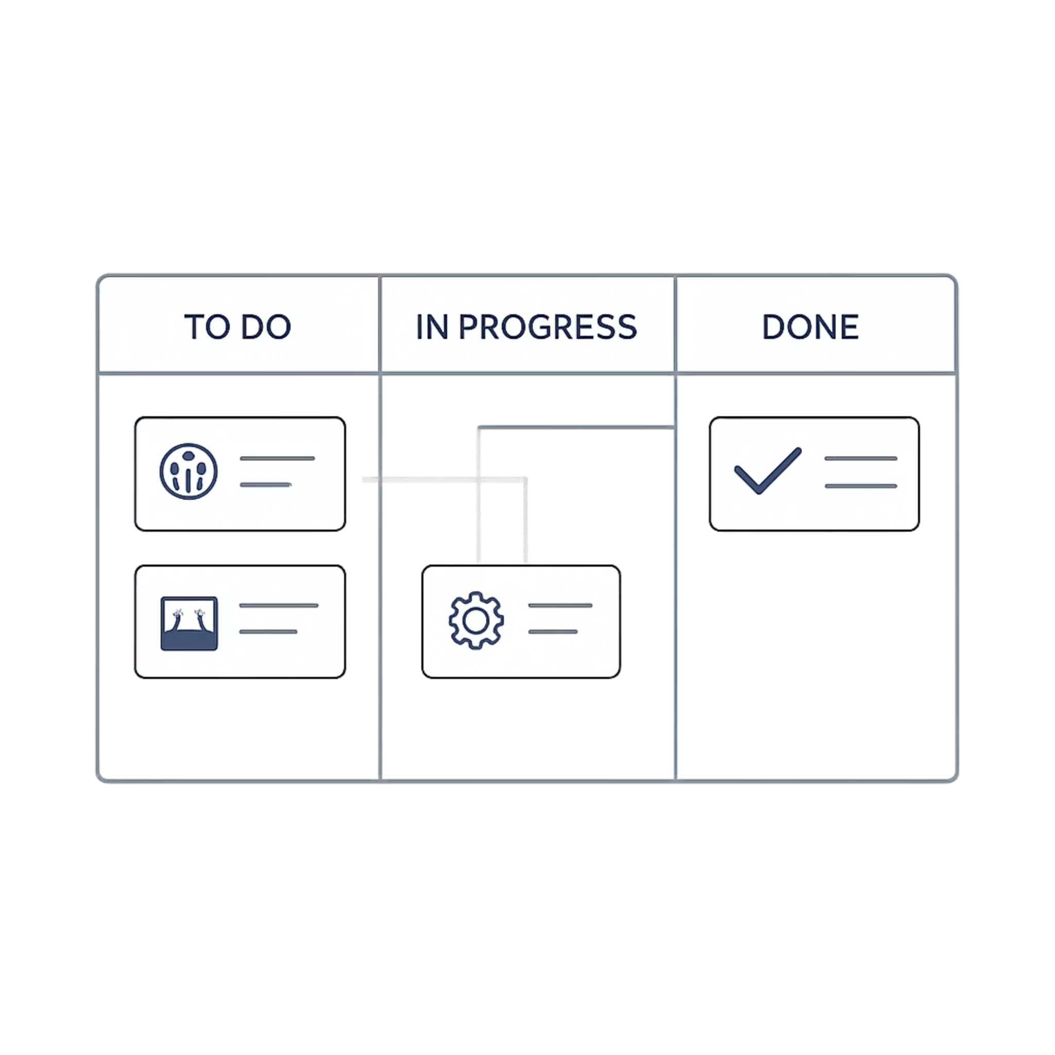



Agile Development Methodology
Sprint Planning
Feature prioritization and task breakdown into 2-week cycles
Development
Incremental feature implementation with continuous integration
Testing
Regular quality assurance and bug fixing throughout development
Feedback
User testing and stakeholder input for iterative improvements
Faster Development
Better Quality
Rapid feature delivery through parallel sprint execution
Continuous testing ensures stable and reliable system performance
Easy Adaptability
Flexible architecture allows quick response to changing requirements

Slide 16
Key Functionalities
Secure Authentication
Chapter-Based Learning
OTP-based verification combined with JWT token management ensures robust user security and session protection.
Structured content delivery organized by chapters with progressive difficulty levels and native language support.
Exam Evaluation
Progress Tracking
Comprehensive final exam system with automated scoring, instant results, and detailed performance analysis.
Real-time monitoring of learning milestones, completion percentages, and skill development metrics.
Certificate Generation
Responsive Design
Automated certificate creation upon course completion with customizable templates and verification codes.
Optimized interface adapting seamlessly across desktop, tablet, and mobile devices for flexible learning.

Slide 17
Future Enhancements
AI-Powered Personalization
Voice Recognition
Gamification Features
Machine learning algorithms to analyze user behavior and recommend customized learning paths based on individual strengths and weaknesses.
Advanced speech processing for pronunciation assessment, enabling users to practice speaking and receive instant feedback on accuracy.
Badges, leaderboards, and achievement systems to increase engagement and motivation through competitive learning experiences.
Mobile Application
Offline Learning Support
Cross-platform mobile apps for iOS and Android providing offline access to learning materials and sync capabilities.
Downloadable content enabling users to access lessons and practice exercises without internet connectivity, syncing progress later.

Slide 18
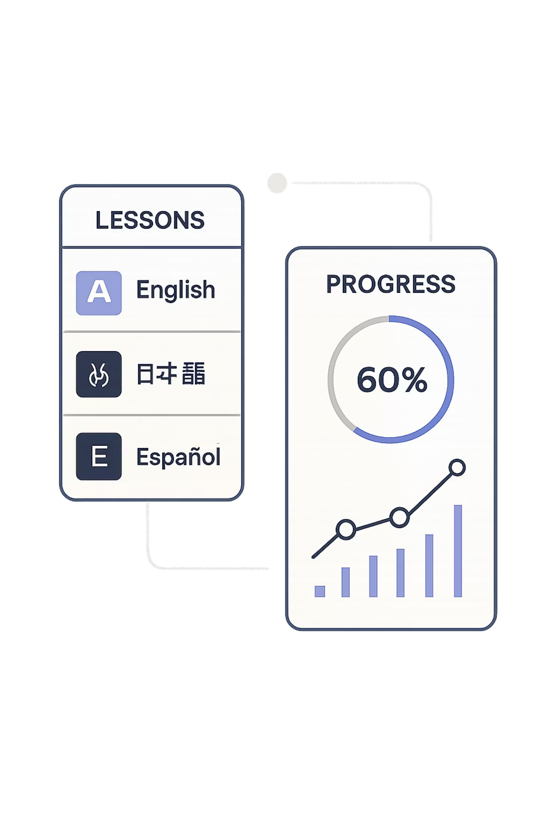

Conclusion
VOCO represents a modern, scalable language learning platform that addresses contemporary educational needs through innovative technology implementation.
Technical Excellence
User-Centric Design
Built with industry-standard MERN stack architecture ensuring maintainability and performance
Intuitive interfaces and interactive learning experiences tailored for diverse learners
Future-Ready Platform
Extensible architecture ready for AI integration, mobile expansion, and advanced features

Slide 19

Thank You
Thank you for your attention and support throughout this presentation.
For questions, feedback, or collaboration opportunities, please feel free to get in touch.
Contact: Learnvoco@gmail.com
LET'S CONTINUE THE CONVERSATION

