Slide 1

Cold Calling
Mindset
The Iceberg Model: What Drives Your Behavior on the Phone
"Business opportunities are never missed — they're just taken by someone else."
Meevo Sales Enablement | Confidential

Slide 2
THE HUMAN ICEBERG
WHAT PEOPLE SEE VS. WHAT DRIVES YOU
Your behavior on the phone is just the tip. Below the waterline: your emotions, beliefs, and mindset drive everything.
Above the Waterline — What People See
Below the Waterline — What Drives You
Your tone, words, confidence, pace, and professionalism. This is the 10% the prospect experiences.
Your emotions, anxiety, confidence, beliefs about rejection, self-worth, and purpose. This is the 90% that controls everything.
WHAT THEY SEE (10%)
WHAT DRIVES IT ALL (90%)
Tone of Voice
Word Choice
Pace & Energy
Professionalism
Anxiety & Fear
Self-Worth
Beliefs About Rejection
Motivation & Purpose
Confidence
Past Experiences
PROPRIETARY AND CONFIDENTIAL
2

Slide 3
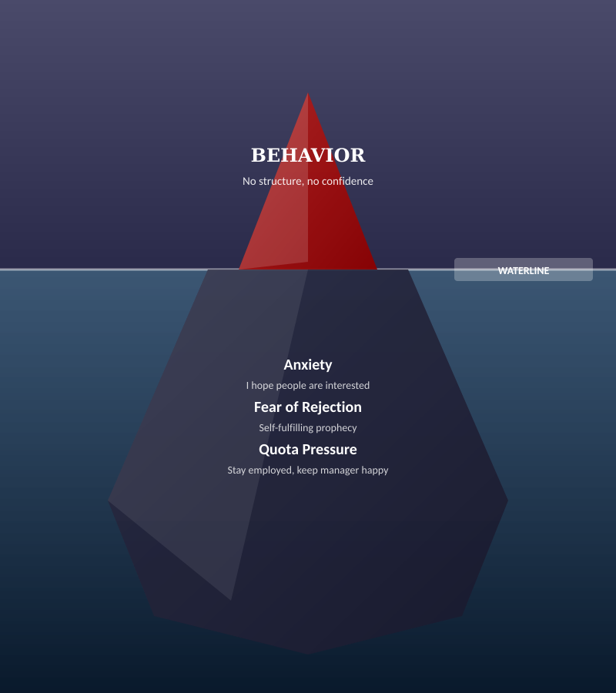

THE WRONG MINDSET — ANXIETY-DRIVEN ICEBERG
FRAMING THE TASK WRONG
"My task is to book meetings. Result = more demos booked."
My goals become:
Hit quota
Keep my manager happy
Stay employed
I start thinking:
"I hope people are interested"
Result: No structure, no confidence. Your own self-fulfilling prophecy.
PROPRIETARY AND CONFIDENTIAL
3

Slide 4
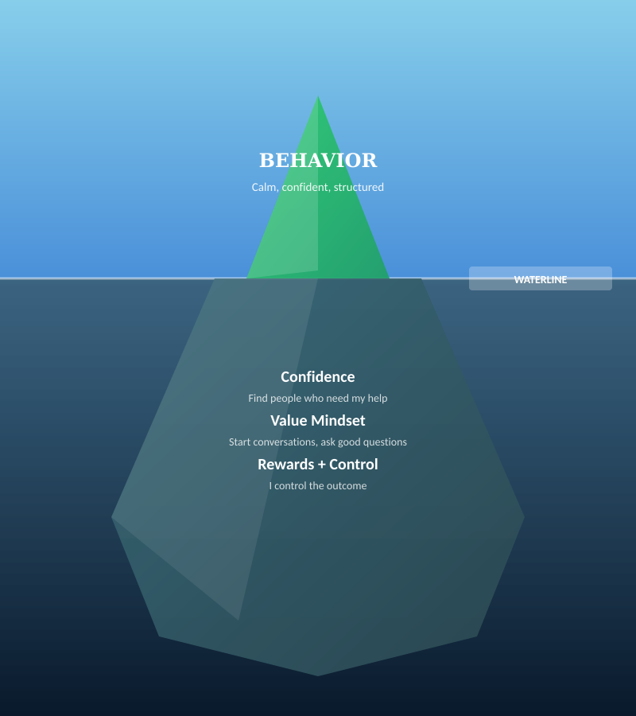

THE RIGHT MINDSET — CONFIDENCE-DRIVEN ICEBERG
REFRAMING THE TASK
"My task is NOT to convince anyone. The task is to have conversations."
My goals become:
Start relevant conversations
Ask good questions
Find problems worth solving
I start thinking:
"I need to find people who might need my help"
Result: You sound calm and confident. Conversations happen naturally.
PROPRIETARY AND CONFIDENTIAL
4

Slide 5





YOUR DAILY SET-UP — PRIME YOUR MINDSET
Walk / Exercise
Reflect on Yesterday
Time Management
Reward Yourself
Start the day with movement. Clear your head before you pick up the phone.
What worked well? What can you change? Learn from every session.
Schedule stretch breaks. Structure your day around energy peaks.
Set personal rewards for hitting milestones. Celebrate small wins.
Re-structure your daily habits. The way you start your morning directly shapes how you perform on the phone.
PROPRIETARY AND CONFIDENTIAL
5

Slide 6
KEY TAKEAWAYS
Your mindset controls your behavior. Fix what's below the waterline first.
Reframe the task: your job is to have conversations, not convince anyone.
Daily habits matter: walk, reflect, structure your time, reward yourself.
PROPRIETARY AND CONFIDENTIAL
8

Slide 7


Q&A
Remember
Your behavior is the tip of the iceberg — fix what's underneath
The task is to have conversations, not close deals on the phone
Control what you can: your prep, your mindset, your structure
Now go kill it!
Meevo Sales Enablement | Confidential

