Slide 1

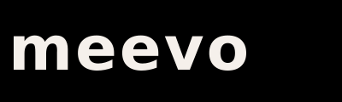
Social Selling
LinkedIn & Research Techniques
How to Warm Up Cold Prospects Before You Ever Pick Up the Phone
Profile Optimization • Engagement Strategy • Connection Requests • Content Plays • DM Scripts
Commit to the process. Control the controllables.

Slide 2


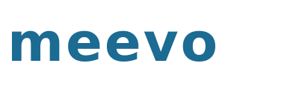
Why Social Selling Matters in Our World
Salon and spa owners live on Instagram and LinkedIn. Social selling isn’t a nice-to-have — it’s a channel that warms up cold prospects before you ever dial.
78%
3x
45%
5 min
of social sellers
outperform peers
who don’t
higher connection
rate when you engage
before calling
more opportunities
created through
social touches
daily investment
that compounds
over months
THE BEAUTY INDUSTRY ADVANTAGE
Salon and spa owners are highly active on social media — it’s how they market their business. They check their DMs. They notice who likes their posts. They see who views their profile. You have a direct line to decision makers that most B2B reps would kill for.
Cold call with no context
Warm call after social engagement
Generic connection request
Personalized request with trigger
Commit to the process. Control the controllables.
2

Slide 3



Your LinkedIn Profile — Your Digital First Impression
Before you send a single connection request, your profile must position you as a trusted advisor — not a salesperson.
Headline
Helping salon & spa owners grow with technology that works | Meevo
Owners want a partner, not a pitch. Lead with value, not your title.
SDR at Millennium Systems International
Banner Image
Meevo-branded banner with tagline or value prop
First visual impression. Shows you represent a real brand, not a cold caller.
Default LinkedIn blue gradient
About Section
3–4 sentences: who you help, what you’ve seen work, and an invitation to connect. Write in first person.
Prospects read this when deciding whether to accept your request. Make it about THEM.
Copy/paste of Meevo’s boilerplate or a resume-style list of responsibilities
Activity / Posts
Engage with 3–5 posts weekly. Share industry insights. Comment on owner posts.
Active profiles get 5x more profile views. Engagement builds familiarity before the call.
Zero activity. Last post was 2019. Profile looks abandoned.
Featured Section
Pin a case study, a useful industry stat, or a Meevo blog post that helps owners
Gives prospects something to learn from. Positions you as someone who adds value, not just sells.
Empty or a link to meevo.com homepage
Commit to the process. Control the controllables.
3

Slide 4


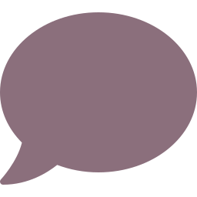
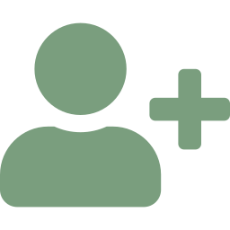

The Daily 5-Minute Social Selling Routine
MIN 1
View 10 Prospect Profiles
Pro tip: Do this every morning before you start dialing. By week 2, they’ve seen your name 5–10 times.
Open your target list. View 10 profiles. That’s it. They get a notification. Name recognition starts building.
MIN 2
Like 5 Prospect Posts
Pro tip: Likes are low-effort for you, high-visibility for them. They see you showing up consistently.
Scroll your feed. Find 5 posts from salon/spa owners or managers. Like them. Takes 30 seconds.
MIN 3
Comment on 2–3 Posts
Pro tip: Comments > Likes. A thoughtful comment puts your name in front of their entire network.
Leave a genuine comment on 2–3 posts. Congratulate a new hire. Ask a question about their business. Reference something specific.
MIN 4
Send 2–3 Connection Requests
Pro tip: Never send the default “I’d like to connect.” Always personalize with a trigger or observation.
Send personalized connection requests to prospects you’re about to call or have recently engaged with.
MIN 5
Send 1–2 DMs
Pro tip: DMs convert at 3–5x the rate of cold calls when the prospect has already seen your name.
Send a low-pressure DM to a warm connection. Not a pitch — a value-add or question.
Commit to the process. Control the controllables.
4

Slide 5
Connection Request Scripts — Never Send the Default
Every connection request must be personalized. The default “I’d like to connect” gets ignored 90% of the time.
Trigger: They posted about growth / new hire
“Hey Nicole! Congrats on the new addition to the team — love seeing salons grow like this. I work with a lot of salon owners in [city] and would love to connect. No pitch, just think we run in similar circles. – Terry”
Trigger: They’re in a beauty industry group
“Hi Jason — saw we’re both in the Salon Business Owners group. I work with salons and spas on the tech side and always enjoy connecting with owners who are serious about growth. Would love to be in your network. – Terry”
Trigger: You’re about to cold call them
“Hi Sarah — I was doing some research on spas in [city] and came across your business. Really impressive what you’ve built. I’d love to connect — I share a lot of content around spa growth and technology. – Terry”
Trigger: They recently launched memberships
“Hey Maria! Saw you launched a membership program — that’s a huge move. I work with salon owners who’ve made memberships their #1 revenue driver. Happy to share what’s been working if you’re ever curious. – Terry”
Trigger: Post-call / post-demo follow-up
“Hi Nicole — great chatting earlier! Wanted to connect here so you can put a face to the name. Looking forward to staying in touch either way. – Terry”
Commit to the process. Control the controllables.
5

Slide 6
ADVANCED PLAYS
DM Scripts, Content
Strategy & Multi-Channel
The plays that turn LinkedIn connections into booked meetings

Slide 7
LinkedIn DM Scripts — Value First, Ask Second
THE VALUE-ADD DM
“Hey Nicole, thanks for connecting! I noticed you recently launched a membership program — congrats. I actually just helped a 15-chair salon in [city] grow their membership revenue 35% in 90 days. Happy to share what worked if you’re curious. No pitch — just thought it might be relevant.”
Timing: After they accept your connection
THE CONTENT SHARE DM
“Hey Jason — loved your post about rebooking. We actually just put out some data on how salons are using automation to hit 85%+ rebook rates. Thought of you immediately. Want me to send it over?”
Timing: After engaging with their content 2–3 times
THE WARM BRIDGE DM
“Hi Sarah — I’ve been doing some research on growing spas in [city] and your business keeps coming up. Impressive growth! I work with a lot of spa owners on the technology side and had a quick thought I wanted to share. Mind if I give you a call this week?”
Timing: Before you cold call
THE BREAKUP DM
“Hey Nicole — I know you’re busy running a business, so I’ll keep it short. I sent a note a while back about some membership growth strategies. If the timing isn’t right, totally get it. But if you’re ever curious, I’m a quick message away. All the best! – Terry”
Timing: After 2 DMs with no response
Commit to the process. Control the controllables.
7

Slide 8
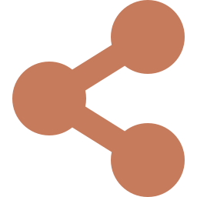
The Multi-Channel Sequence — Social + Phone + Email
Social selling doesn’t replace cold calling — it supercharges it. The best reps layer social touches into their outreach sequence.
Day 1
LinkedIn
View their LinkedIn profile + like a recent post
Day 2
Phone
Cold call attempt #1 → leave trigger-based voicemail
Day 2
LinkedIn
Send personalized connection request (reference the trigger)
Day 3
Email
Send cold email with trigger + curiosity gap
Day 4
LinkedIn
Comment on one of their posts (genuine, specific)
Day 5
Phone
Cold call attempt #2 → social proof voicemail
Day 6
LinkedIn
Send value-add DM (if connected) or InMail
Day 7
Email
Follow-up email with case study or helpful content
Day 8
Phone
Cold call attempt #3 → breakup voicemail
By Day 9, they’ve seen your name 8–10 times across 3 channels. You’re no longer a stranger — you’re that person who keeps showing up.
Day 9
LinkedIn
Breakup DM if no response on LinkedIn
Commit to the process. Control the controllables.
8

Slide 9

Practice & Self-Assessment
HOMEWORK & PRACTICE
SELF-ASSESSMENT (1–5 SCALE)
My LinkedIn profile is optimized: headline, banner, about, and featured section all position me as a trusted advisor
Update your LinkedIn profile using the optimization checklist on slide 3. Screenshot before/after and share with the team.
Start the 5-minute daily routine tomorrow. Track it for 2 weeks. Log profile views, connection accepts, and DM responses.
Write 5 personalized connection requests for accounts you’re about to call. Use a different trigger for each one.
Write 3 DM scripts: value-add, content share, and warm bridge. Practice delivering them out loud.
Build a 10-day multi-channel sequence for your top 5 accounts. Map every touch across LinkedIn, phone, and email.
Find and join 2 beauty/wellness LinkedIn groups. Comment on 3 posts in each group this week.
I execute the 5-minute daily routine consistently (view, like, comment, connect, DM)
I never send the default connection request — every one is personalized with a trigger
I layer social touches into my outreach sequence alongside phone and email
I’ve booked at least one meeting through LinkedIn engagement in the last 30 days
I engage with prospect content genuinely — not just “great post!” but specific, thoughtful comments
Score yourself 1–5. Below 3 = your coaching focus for next 2 weeks.
Commit to the process. Control the controllables.
9

Slide 10
Key Takeaways
01
Social selling doesn’t replace cold calling — it supercharges it. The best reps use both.
02
Your LinkedIn profile is your digital first impression. Optimize it before you send a single request.
03
The 5-minute daily routine: View 10 profiles, like 5 posts, comment on 2–3, send 2–3 connections, send 1–2 DMs.
04
Never send the default connection request. Personalize every one with a trigger or observation.
05
DM scripts follow the same principle as voicemails: value first, ask second. Create curiosity, not pressure.
06
The multi-channel sequence layers social + phone + email across 9–10 days. By the end, you’re not a stranger.
07
Salon and spa owners are active on social — they check DMs, notice likes, and see profile views. Use that.
08
5 minutes a day. Compounded over months, that’s hundreds of warm touches. This is the controllable that compounds.
Commit to the process. Control the controllables.

