Slide 1
CSS2266- Theory of Computation
[L-T-P-C: 3-0-0-3]
Module 1: Introduction to Automata Theory.

Slide 2
Introduction to Automata Theory.

Slide 3
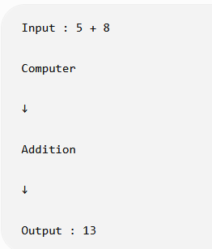
What is Computation?
Computation is the process of solving a problem by executing a sequence of well-defined steps (an algorithm).
Every computation has
Input
Processing
Output

Slide 4
What is Theory of Computation?
Theory of Computation is the branch of computer science that studies the mathematical models of computation and determines what problems a computer can and cannot solve.
Simple explanation
It answers questions like:
Can a computer solve this problem?
How can it solve it?
How much memory is required?
How much time is required?

Slide 5
What is Theory of Computation?
Think of it like this:
A civil engineer studies models of bridges before constructing a real bridge.
Similarly,
Computer scientists study models of computers before designing algorithms, programming languages, compilers, and AI systems.

Slide 6
Why not study only real computers?
Real computers are different.
  Intel processors
  AMD processors
  ARM processors (mobile phones)
  Apple Silicon
Each has different hardware. Instead of studying every hardware architecture, computer scientists created an abstract mathematical computer.
This makes analysis much easier.

Slide 7
Evolution of Computation Models
The history of computation developed through increasingly powerful models.
Finite Automata (FA)
↓
Pushdown Automata (PDA)
↓
Turing Machine (TM)

Slide 8
Abstract Machine
An abstract machine is a theoretical or mathematical model of a computer used to study how computation works. It is not a physical machine like a laptop or smartphone; instead, it is an imaginary model that helps us understand how a computer processes input and solves problems.

Slide 9
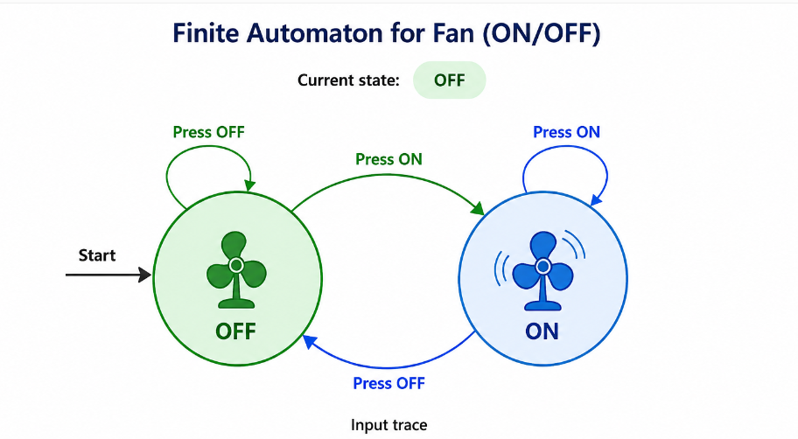
Automata Theory
Automata Theory is studies abstract computing machines (automata). The computational problems can be solved using them. It explains how machines process input strings, change between different states, and determine whether the input is accepted or rejected.

Slide 10
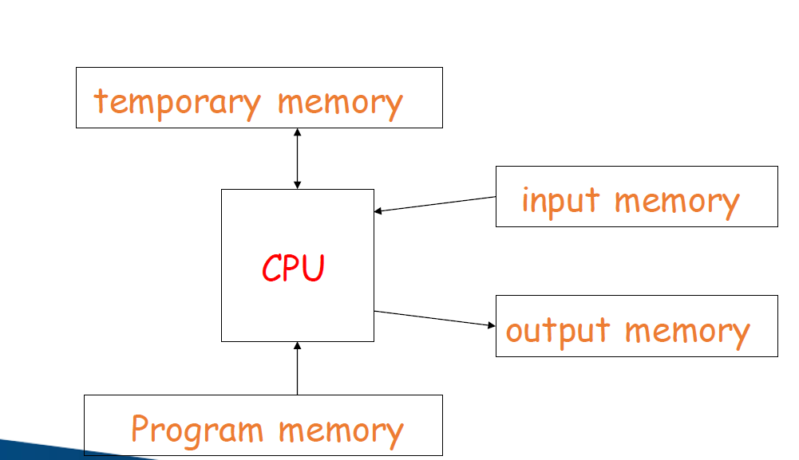
Computation

Slide 11
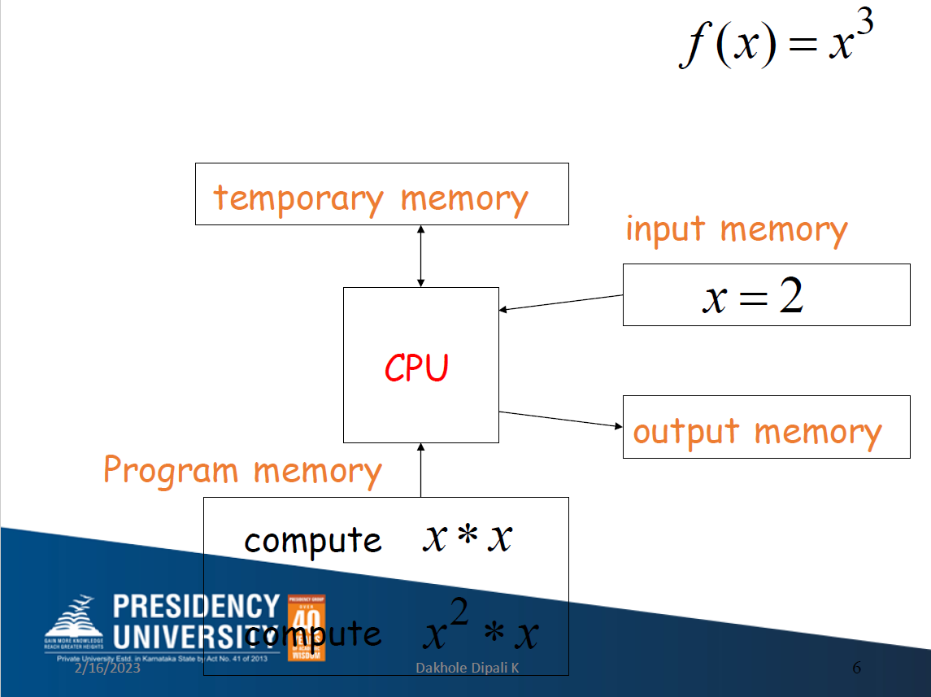
Computation

Slide 12
Computation

Slide 13
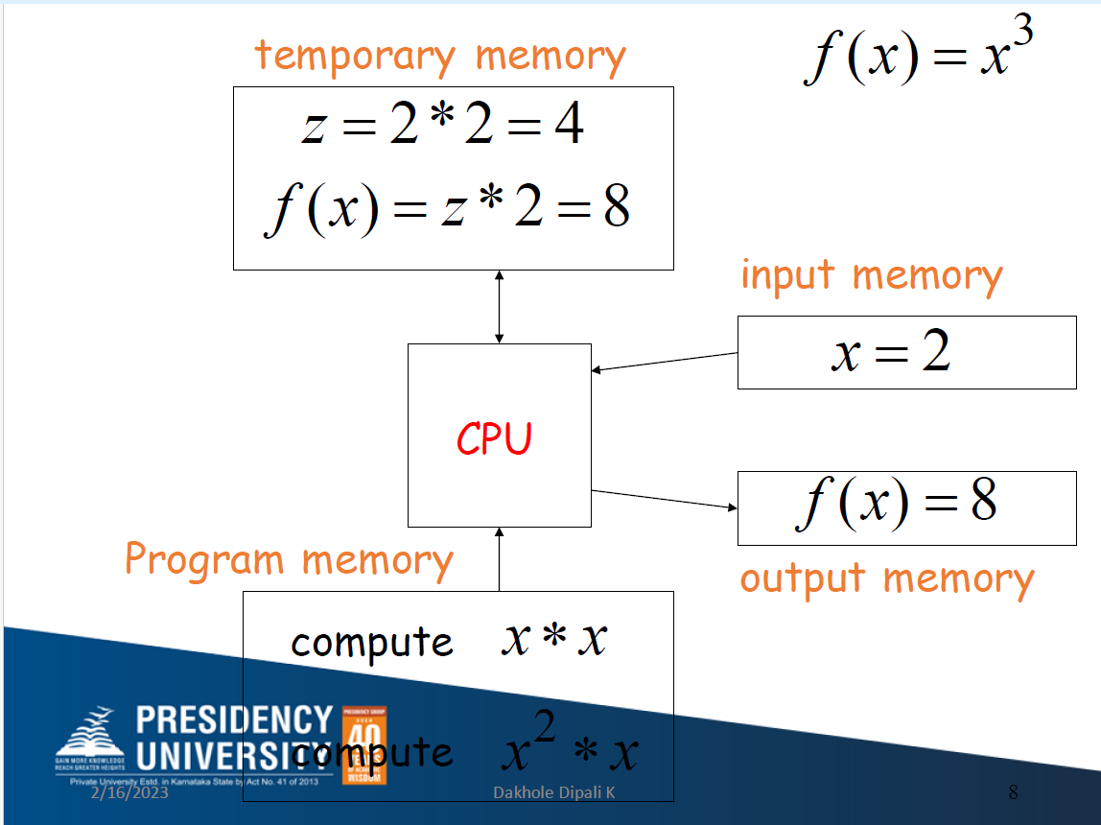
Computation

Slide 14
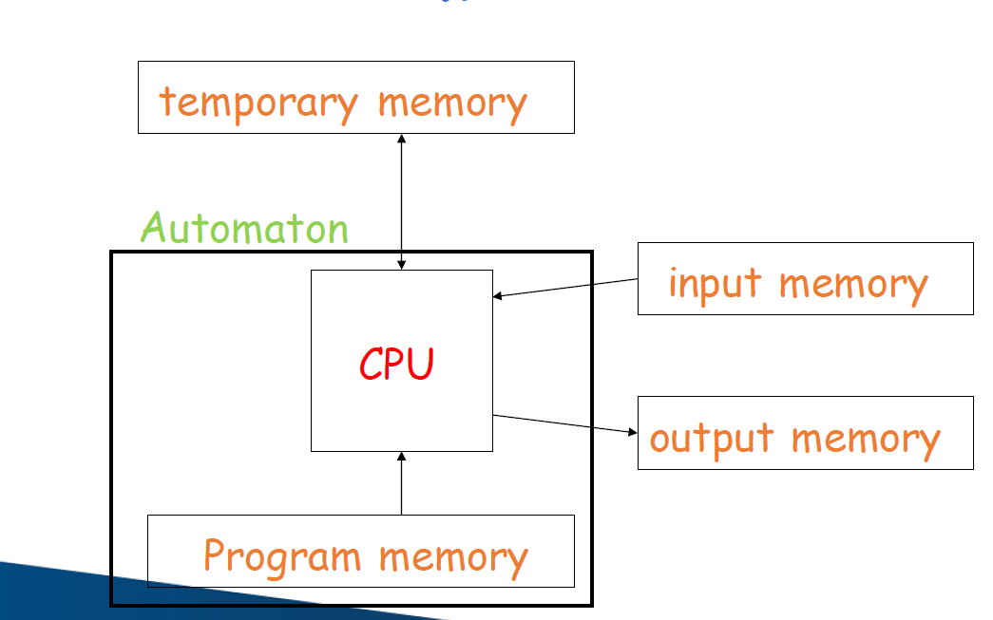
Automata

Slide 15
Abstract model of digital computer
Mechanism of reading input
Assumes input as a string written on o input file
Which automata can read but can't change.
And input file is dived into cells
Each cell can hold one symbol at a time
Read input from left to right
The automaton can produce output in any form which have temporary storage device.
Consist of unlimited cells
Each capable of holding one symbol at a time from an alphabet
The automata can read the input and can make changes in storage part
Finally, the control unit which can be in any of the finite number of states.
Which can change states in any manner.

Slide 16
Different Kinds of Automata
Automata are distinguished by the temporary memory
•Finite Automata no temporary memory
•Pushdown Automata stack
•Turing Machines random access memory

Slide 17
Finite Automata
Finite Automata is the simplest computational machine.
It has:
states
transitions
input symbols
accepting states
No memory.

Slide 18
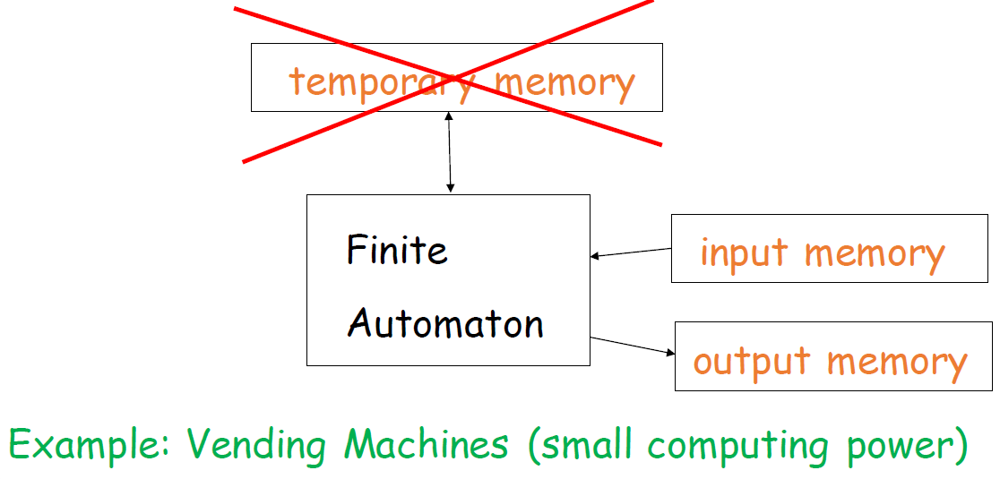
Finite Automata

Slide 19
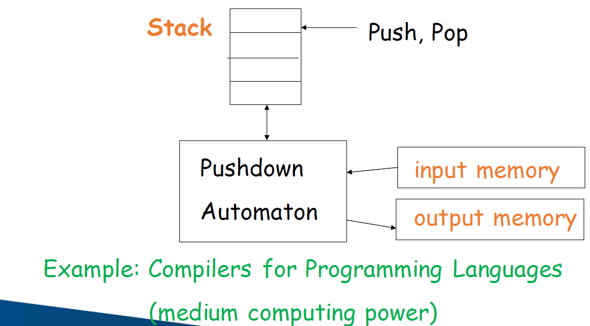
Push Down Automata

Slide 20
Turing Machine
The Turing Machine provides an idealized model with unlimited tape and is considered the most powerful classical model of computation.
Modern computers are not literally Turing Machines, but they are Turing-complete, meaning they can simulate a Turing Machine given enough time and memory.
Modern computers and smartphones are more complex than finite automata, but they are built on principles explained by computational models

Slide 21
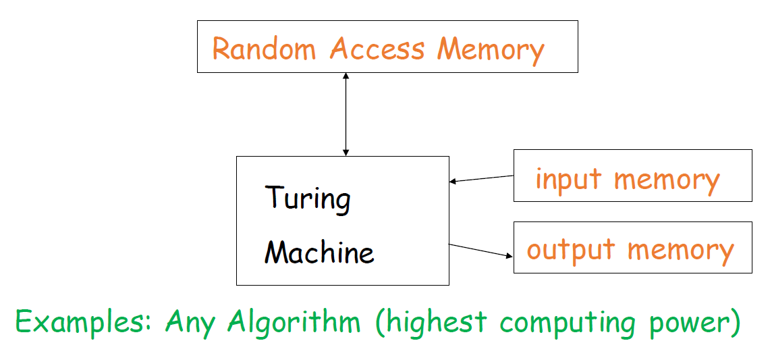
Turing Machine

Slide 22
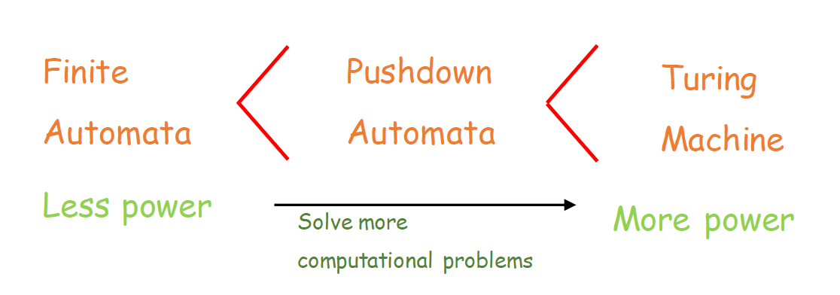
Power of Automata

Slide 23
Application of Finite Automata
For the designing of lexical analysis of a compiler which breaks the input text into logical units like identifiers, keywords, etc.
For recognizing the pattern using regular expressions.
For the designing of the combination and sequential circuits.
Software for designing and checking the behavior of digital circuits.
Used in text editors.
For the implementation of spell checkers.

Slide 24
Application of Finite Automata
Software for scanning large bodies of text like web pages to find occurrences of words, phrases, and other patterns.
Software to verify all types that have a finite number of distinct states, such as communication protocols for the secure exchange of information.

Slide 25
Applications of Push Down Automata
For designing the parsing phase of a compiler (Syntax Analysis).
For implementation of stack applications.
For evaluating arithmetic expressions.
For solving the Tower of Hanoi problem.

Slide 26
Applications of Turing Machine
For solving any recursively enumerable problem.
For understanding complexity theory.
For implementation of neural networks.
For implementation of robotics applications.
For implementation of artificial intelligence.

Slide 27
Basic Notation and Definitions
1)Alphabets:
It is a finite set of symbols which is non-empty and is denoted as Σ.
Example:
Σ = {0, 1}
Σ = {a, b, c}

Slide 28
Basic Notation and Definitions
2) String:
It is a finite sequence of alphabets (symbols) chosen from Σ.
Example:
If Σ = {0, 1}, then the strings are:{0, 1, 00, 01, 11, 000, ...}

Slide 29
Basic Notation and Definitions
3) Empty String:
A string with zero symbols is called an empty string and is denoted as ε (epsilon).

Slide 30
Basic Notation and Definitions
4) Length of a String:
The number of symbols in a string is called the length of a string, denoted as |W|.
Example:
If W is a string, then the length of W is denoted as |W|.
Σ={0,1}, the string W is derived from alphabet Σ, W=01100, ∣W∣=5

Slide 31
Basic Notation and Definitions
5) Power of an Alphabet:
If Σ is an alphabet, the set of all strings formed from the alphabet is called the power of the alphabet. It is represented as Σⁿ.
Example:
If Σ = {0, 1}, then:
Σ⁰ = {ε} ≠ ∅
Σ¹ = {0, 1}
Σ² = {00, 01, 10, 11}
Σ³ = {000, 001, 010, ..., 111}

Slide 32
Basic Notation and Definitions
6) Kleene Closure:
The set of all strings over Σ, including the null (empty) string, forms the Kleene closure and is denoted by Σ*.
Σ∗= Σ⁰ ∪ Σ¹ ∪ Σ² ∪ ⋯
Example:
If Σ = {a, b}, then
Σ* ={ε, a, b, aa, ab, ba, bb, aaa, …}

Slide 33
Basic Notation and Definitions
7) Positive Closure:
The set of all strings over Σ, excluding the null (empty) string, forms the positive closure and is denoted by Σ⁺.
Σ⁺ =Σ⁰ ∪ Σ¹ ∪ Σ² ∪ ⋯
Example: If Σ = {a, b}, then
Σ⁺ ={a, b, aa, ab, ba, bb, aaa, …}
Also,
Σ* =Σ+ ∪ {ε} or Σ⁺ = Σ* −{ε}

Slide 34
Basic Notation and Definitions
8) Concatenation of Strings:
Let x and y be two strings. Then the concatenation of the two strings is represented as xy.
Example:
x = ababb
y = aabba
Then,
xy=ababbaabba
Also,
∣xy∣=∣x∣+∣y∣

Slide 35
Basic Notation and Definitions
9) Prefix and Suffix:
Any strings formed using the leading symbols of a given string are called the prefixes of the string.
Any strings formed using the trailing symbols of a given string are called the suffixes of the string.
Example:
If W = "kongu", then
Prefix(W) = {ε, k, ko, kon, kong, kongu}
Suffix(W) = {ε, u, gu, ngu, ongu, kongu}

Slide 36
Basic Notation and Definitions
10) Substring
a substring is obtained by selecting consecutive characters from a given string without changing their order.
W="make"
The substrings of W are:
Length 0: ε (empty string)
Length 1: m, a, k, e
Length 2: ma, ak, ke
Length 3: mak, ake
Length 4: make (Every string is a substring of itself.)
Length | Substrings | Count
0 | ε | 1
1 | m, a, k, e | 4
2 | ma, ak, ke | 3
3 | mak, ake | 2
4 | make | 1

Slide 37
Basic Notation and Definitions
10) Language
a language is any collection of valid strings that are constructed using the symbols of an alphabet.
Σ={0,1}
L={Collection of Strings}
Examples of Languages
L1={ε,0,1}
L2={10,01}
L3={0,1,00,01,10,11,…}
L4={}=∅ L₄ = ∅ is the empty language, which contains no strings.

Slide 38
Operation of Languages
1) Union Operation
The union of two languages L₁ and L₂ is the language containing all strings that belong to either L₁ or L₂ (or both).
L1={a,ab,abc}
L2={ab,b,bc}
Then,
L1∪L2={a,ab,abc,b,bc}
Note: The string ab appears only once because a language is a set, and sets do not contain duplicate elements.

Slide 39
Operation of Languages
2) Concatenation Operation
The concatenation of two languages L₁ and L₂ is the language obtained by concatenating every string of L₁ with every string of L₂.
Let
L1={a,ab}
L2={b,ba}
Then,
L1.L2={ab,aba,abb,abba}

Slide 40
Operation of Languages
3) Intersection Operation
The intersection of two languages L₁ and L₂ is the language consisting of all strings that are common to both L₁ and L₂.
Let
L1={a,ab,abc,b}
L2={ab,b,bc}
Then,
L1∩L2={ab,b}

Slide 41
Operation of Languages
4) Reverse of a Language:
The reverse of a language L is the language obtained by reversing every string in L. It is defined as
L={0,1,10}
Then
Reverse of the Language={0,1,01}

Slide 42
Operation of Languages
4) Difference of a Language:
The difference of two languages L₁ and L₂ is the language containing all strings that belong to L₁ but do not belong to L₂.
L1={a,ab,abc,b}
L2={ab,b,bc}
Then,
L1−L2={a,abc}

Slide 43
Operation of Languages
5) Complement of a Language
The complement of a language L is the set of all strings over the alphabet Σ that are not in L.
L′= Σ* −L​
where:
Σ = Alphabet
Σ∗ = Set of all possible strings (including ε) over Σ
L = Given language

Slide 44
Representation of Automata
An automaton can be represented in several ways to describe its states, inputs, and transitions.
The four common representations are:
Mathematical Representation (5-tuple)
State Diagram (Transition Diagram)
Transition Table
Transition Function

Slide 45
1. Mathematical Representation
A Finite Automaton (FA) is represented mathematically as:
M=(Q,Σ,δ,q0,F)
Where:
Q = Finite set of states
Σ = Input alphabet
δ = Transition function
q₀ = Initial (start) state
F = Set of final (accepting) states

Slide 46
2. State Diagram (Transition Diagram)
A state diagram is a graphical representation of an automaton.
Symbols used:
○ : State
→ : Initial state
◎ : Final (accepting) state
Arrow : Transition between states

Slide 47
3. Transition Table
The transition table lists the next state for every state-input combination.
Present State | Input 0 | Input 1
→ q₀ | q₁ | q₀
*q₁ | q₁ | q₀

Slide 48
4. Transition Function
The transition function specifies how the automaton moves from one state to another.
It is denoted by:
δ:Q×Σ→Q
Example:
δ(q0,0)=q1 ​
δ(q0,1)=q0​
δ(q1,0)=q1
δ(q1,1)=q0
​

Slide 49
Language Recognizers
A Language Recognizer is a computational model (automaton) that determines whether a given input string belongs to a language.
If the input string belongs to the language, the recognizer accepts it.
If the input string does not belong to the language, the recognizer rejects it.
In other words, a language recognizer checks whether a string is a member of a given language.
​

Slide 50
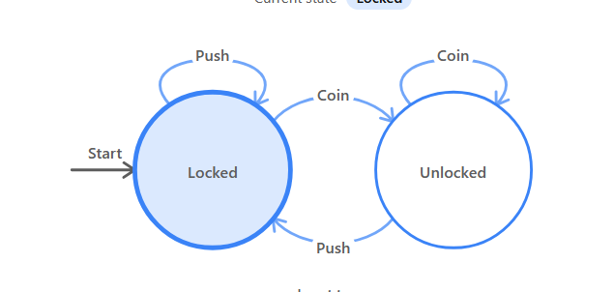
Deterministic Finite Automaton (DFA).
DFA is a finite-state machine used to recognize regular languages. In a DFA, for every state and every input symbol, there is exactly one possible next state.
M=(Q,Σ,δ,q0,F)
where:
Q = Finite set of states
Σ = Finite input alphabet
δ = Transition function, δ:Q×Σ→Q
q₀ = Initial (start) state, where q0∈Q
F = Set of accepting (final) states, where F⊆Q
​

Slide 51
Nondeterministic Finite Automaton (NFA)
NFA is a finite-state machine used to recognize regular languages. In an NFA, for a given state and input symbol, there may be zero, one, or more possible next states. An NFA may also have ε (epsilon) transitions, which allow it to change states without consuming any input symbol.
Formal Definition
An NFA is defined by the 5-tuple:
M=(Q,Σ,δ,q0,F) ​

Slide 52
Nondeterministic Finite Automaton (NFA)
where:
Q = Finite set of states
Σ = Finite input alphabet
δ = Transition function,
δ:Q×(Σ∪{ε})→2Q
q₀ = Initial (start) state, where q0∈Q
F = Set of accepting (final) states, where F⊆Q ​

Slide 53
Regular Languages
A language is called regular if there exists a Deterministic Finite Automaton (DFA) or Nondeterministic Finite Automaton (NFA) that accepts all the strings in the language.
Formal Definition
A language L over an alphabet Σ is called a regular language if there exists a finite automaton
M=(Q,Σ,δ,q0,F)
such that
L=L(M)
where L(M) is the language recognized by the finite automaton M. ​

