Slide 1
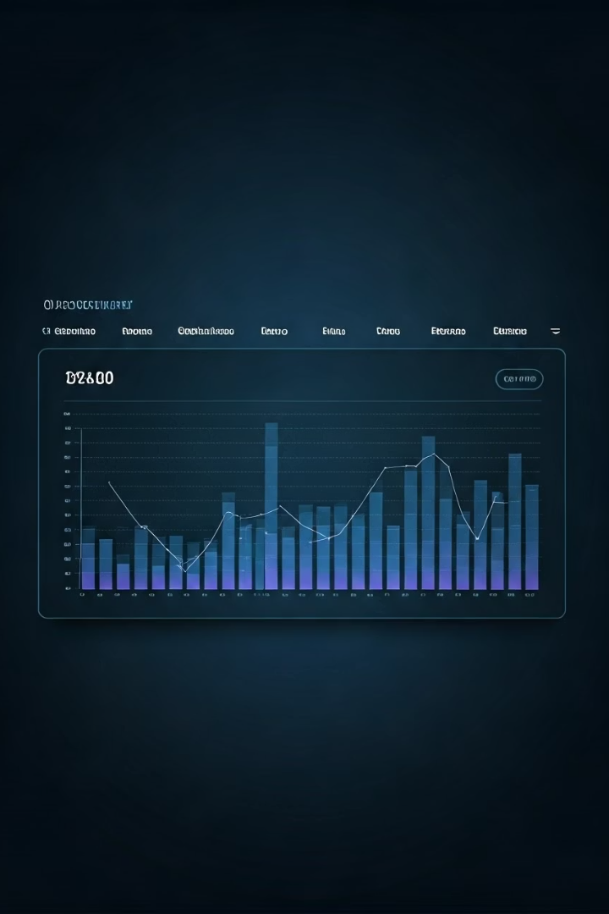
Secure PCAP File Analysis Application
Web-based tool for analyzing network traffic and packet capture (.pcap) files
Allows users to upload .pcap files for threat detection and analysis
Integrates with external APIs like Groq and VxAPI for enhanced threat intelligence
Utilizes Zeek to carve files from .pcap data for deeper inspection
Provides features for managing analysis notes and generating detailed reports
Aims to assist security analysts in automating malware identification in network traffic.
MI
by Meftahul Islam

Slide 2





Core Application Features
File Analysis
Users can upload .pcap files for detailed analysis through external APIs, with results displayed in comprehensive reports.
Note Management
Create, edit, and delete notes related to analysis findings, with built-in protection against XSS attacks.
API Key Management
Securely manage API keys for external integrations with Groq API and VxAPI for file scanning and threat detection.
User Authentication
Secure login and signup with password protection and rate limiting to prevent brute force attacks.

Slide 3
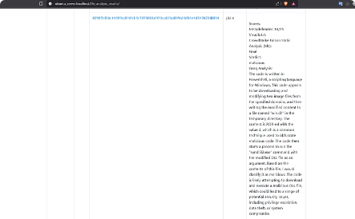
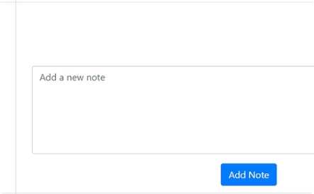
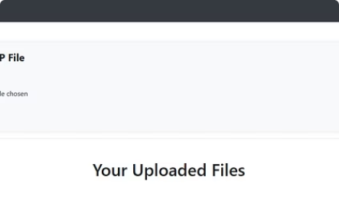
User Interface Overview
File Upload & Analysis
Interface for uploading .pcap files with validation ensuring only proper files are accepted. Analysis results include both summary and detailed reports.
Notes Management
View, add, edit, and delete notes related to analysis findings with inline editing capabilities and input sanitization to prevent XSS attacks.
Dashboard
Overview of uploaded files with timestamps and links to detailed analysis results

Slide 4
Application Architecture
Backend (Flask)
Frontend
The application is built on Flask with key routes for file uploads, note management, API key updates, and user authentication.
Built with HTML, CSS, and JavaScript
AJAX requests used to update notes and API keys without page reloads.
Routes:
/upload: Handles file uploads.
/view_notes: Displays and manages notes.
/update_api_key: Updates the user's API key.
/login and /signup: Handles user authentication.
file_analysis_result: To view the results of the analyzed files
External integrations with Groq API for natural language processing, Hybrid Analysis for file scanning enhance analysis capabilities and Zeek for carving files from uploaded .pcap files.

Slide 5
Security Mechanisms
Authentication
Input Validation
Rate Limiting
CSRF Protection
Handled with Flask-Login to manage user sessions securely.
User inputs are sanitized using bleach to prevent XSS.
Flask-Limiter restricts excessive requests to prevent abuse and DoS attempts.
CSRF tokens are validated for all POST requests using validate_csrf().

Slide 6
OWASP Top 10 Compliance
A09:2021 - Security Logging and Monitoring
A05:2021 - Security Misconfiguration
A03:2021 - Injection
Added logging for critical actions like file uploads, downloads, and API key updates to ensure suspicious activities can be monitored and audited.
A01:2021 - Broken Access Control
Sanitized file names to prevent filename-based injection
Validated file paths to prevent unauthorized access and traversal attacks
Validated file paths to prevent unauthorized file access
Validated user input to block malicious payloads
Ensured only expected and safe files are processed
Restricted access to user-specific data based on session
Used parameterized queries with SQLAlchemy ORM to prevent SQL injection
Implemented error handling to avoid information leaks
Enforced authorization checks for protected operations
Executed shell commands securely to avoid command injection risks
Applied input validation to block malicious or malformed files
Passwords securely stored using SHA256 hashing with salting

Slide 7


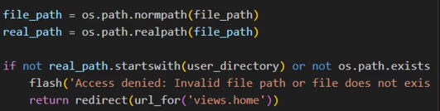
Security Practices
User Authentication
File Upload Validation:
The Flask-Login library is used to manage user sessions and enforce authentication. Ensures that only authenticated users can access protected routes.
Ensured that only files with the .pcap extension are accepted by checking the file extension using the allowed_file function.
Directory Traversal Protection
Normalized and resolved the file path to its absolute path using os.path.normpath and os.path.realpath.
Checked if the resolved path starts with the user's directory and ensured the file exists.
This prevents attackers from accessing files outside the allowed directory using path traversal techniques (e.g., ../../etc/passwd).

Slide 8
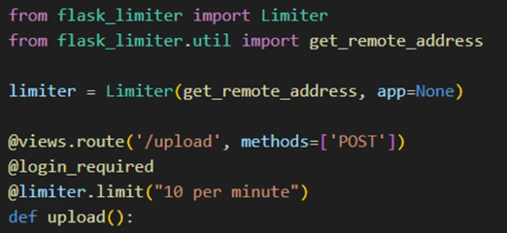
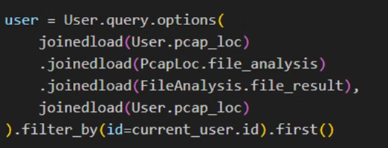

Security Practices
Input Santization
Sanitized inputs from users using bleach
Access Control
Rate Limiting
Ensured that only the logged-in user's file analysis results are fetched from the database.
Added rate limiting to prevent abuse of sensitive routes like login, file uploads and API key updates.
This prevents unauthorized access to other users' data.
This mitigates brute force attacks and denial-of-service (DoS) attacks.

Slide 9

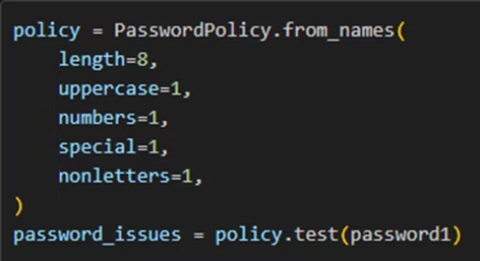
Security Practices
CSRF Tokens
SQL Injection Prevention
CSRF tokens are validated for all POST requests using validate_csrf().
SQLAlchemy ORM is used for database queries, which automatically parameterizes queries to prevent against SQL injections
Password Strength
The PasswordPolicy from the password_strength library is used to enforce strong passwords.

Slide 10
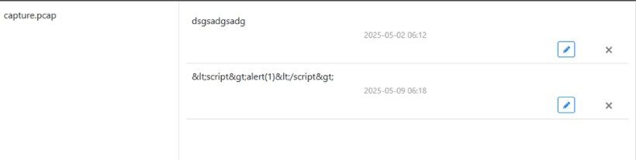
Security Testing: XSS
Tested for Cross-Site Scripting (XSS) by injecting the script <script>alert(1)</script>. Since the application properly sanitized the input and didn’t execute the script, it passed the XSS security test, indicating that the app is protected from this type of attack.

Slide 11
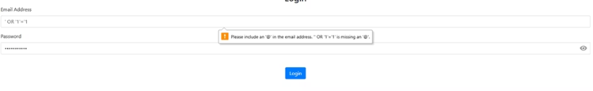

Security Testing: SQL injection
Tested for SQL injection using the payload ' OR '1'='1 on form inputs. The application correctly handled the input without exposing data or bypassing authentication, confirming it's secure against basic SQL injection attacks.

Slide 12
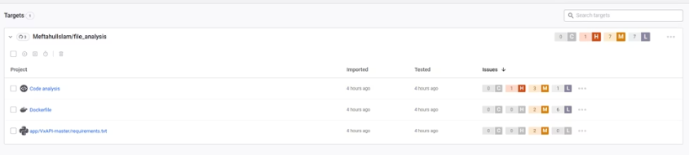
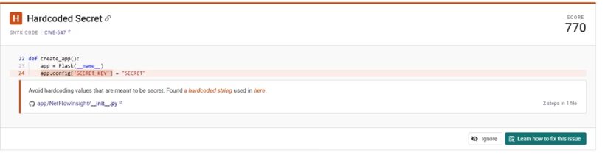
Snyk report
Found one High scored vulnerability. This is left because this is a development environment. For a fix, we could pass it as a secret using an .env file in our docker run process.

Slide 13
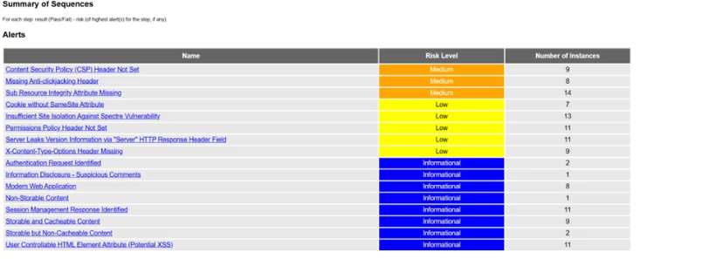
ZAP scanning report:
Summary of Scores
High: None
Medium: 3 issues (CSP, Anti-clickjacking, SRI)
Low: 7 issues (Cookies, Spectre, Permissions, Server info, X-Content-Type)
Informational: 8 findings

Slide 14
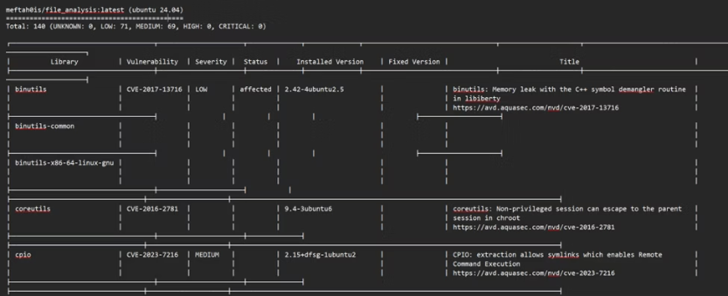
Trivy report
Low: 71
Medium: 69
Notable Vulnerabilities:
cpio (CVE-2023-7216): Allows symlink extraction that can enable remote command execution (MEDIUM severity).
git (CVE-2024-52005): An issue where the sideband payload is passed unfiltered to the terminal, which could lead to code injection or information leakage (MEDIUM severity).
gnupg (CVE-2022-3219): Denial of service via compressed packets in gnupg (LOW severity).
krb5-locales (CVE-2025-3576): Kerberos RC4-HMAC-MD5 checksum vulnerability enabling message spoofing via MD5 collisions (MEDIUM severity).

Slide 15
Thank you

