Slide 1


BS 2 Linz | Class 4bITS
IOT ENVIRONMENTAL MONITORING SYSTEM
Smart Weather Station & Quality Control
Continuous atmospheric sensing, local web server visualization, and live forecasting system.
PROJECT TEAM MEMBERS
Project Assistance
David Sageder
Andrea Roithmeier
Fabian Seelig
Julian Weißböck
Matthias Winklehner
David Steinegger

Slide 2
OVERVIEW
Table of Contents
Key topics and structural agenda for the presentation
01
02
03
04
05
Who We Are
Vision & Goal
Technical Specs
Our Plan
Equipment
Team roles & organizational structure.
IoT station scope & web GUI concept.
Hardware, BME680 & API integration.
CPM network plan & milestones.
Hardware setup & time tracking.
WeatherLab | Class 4bITS - BS 2 Linz
Slide 02

Slide 3





WHO ARE WE
Project Team & Roles
Clear task distribution among the 5 team members
Andrea Roithmeier
David Sageder
Fabian Seelig
Julian Weißböck
Matthias Winklehner
Project Lead
Vice Project Lead & Hardware Engineer
API & Backend Engineer
Documentation
Web Developer
.
Raspberry Pi setup.
OpenWeather API and data logging
OpenWeather API and data logging.
Time tracking and weekly reports.
Project webpage and admin docs.
WeatherLab | Team Organization
Slide 03

Slide 4
VISION & GOAL
What is Our Vision?
Compact environmental monitoring with local touch controls
Live Environmental Data
Continuous tracking of room temperature, humidity, pressure, and air quality.
Primary Goal
Build a self-contained IoT weather station providing live indoor air quality readings and outdoor forecast projections.
Integrated Web Server
Raspberry Pi hosts local Web-GUI accessible directly on the 7-inch touch screen.
BME680 Sensor Integration
Local Touch-Display GUI
OpenWeather API 3-Day Forecast
Documentation Web Portal
Dedicated Virtual Machine hosting admin setup guides and smart home features.
WeatherLab | Project Vision
Slide 04

Slide 5
ARCHITECTURE
System Architecture & Flow
Data pipeline from hardware sensors to touchscreen presentation
BME680 Sensor
Raspberry Pi
OpenWeather API
7" Touch GUI
Temp, Air Quality, Humidity, Pressure
Data Processing & Local Server
External 3-Day Forecast Data
Interactive Live Visualization
Continuous Interval Logging
Documentation Virtual Machine
Sensors read environment at fixed intervals and store values locally for analysis.
Independent VM web server serving administrator setup guides and system manuals.
WeatherLab | System Architecture
Slide 06

Slide 6


OUTLOOK
Smart Home & Future Outlook
Potential expansions and advanced automation integrations
Telegram Bot Warnings
Air Quality LED Feedback
Smart Home Hub
Automated instant notifications for severe weather alerts, storm warnings, or sudden temperature drops.
Physical LED indicator changing color based on BME680 indoor air quality index readings.
Centralized control platform for additional home automation devices and remote web access.
CAN Feature
CAN Feature
Smart Home Integration
WeatherLab | Expansion & Outlook
Slide 11

Slide 7
REQUIREMENTS
Technical Requirements
Breakdown of mandatory core features and optional enhancements
MUST Requirements
MANDATORY
CAN Requirements
OPTIONAL
Sensor Hardware Hookup:
Telegram Alerts:
BME680 wired to Raspberry Pi for continuous reading.
Automated storm and extreme temperature warnings.
Local Web-GUI & Display:
Smartphone Webview
Live presentation on 7-inch touch screen via local server.
A Webview of the Forecast Interface for Smartphones
External API Integration:
Visual LED Indicator:
Fetch 3-day weather forecast using OpenWeather API.
Physical air quality light feedback signal.
VM Project Portal:
Documentation, hardware introduction, and admin guides.
WeatherLab | Technical Specifications
Slide 05

Slide 8
REQUIREMENTS
Cost
Breakdown of mandatory core features and optional enhancements
MUST Requirements
MANDATORY
CAN Requirements
OPTIONAL
Sensor Hardware Hookup:
Telegram Alerts:
BME680 wired to Raspberry Pi for continuous reading.
Automated storm and extreme temperature warnings.
Local Web-GUI & Display:
Smartphone Webview
Live presentation on 7-inch touch screen via local server.
A Webview of the Forecast Interface for Smartphones
External API Integration:
Visual LED Indicator:
Fetch 3-day weather forecast using OpenWeather API.
Physical air quality light feedback signal.
VM Project Portal:
Documentation, hardware introduction, and admin guides.
WeatherLab | Technical Specifications
Slide 05

Slide 9


EQUIPMENT
Hardware & Equipment Specs
Physical components and hardware configuration
Raspberry Pi Unit
BME 680 Sensor
Provided by David Sageder
4-in-1 Environmental Sensor
Main computing controller running local web server and database logging scripts.
Measures temperature, humidity, atmospheric pressure, and indoor air quality.
7-Inch Touch Display
256 GB SD Storage
Interactive Interface
High Capacity Memory
Direct touch display mounting on Raspberry Pi for real-time station monitoring.
Hosts Linux OS, web server files, logs, and historical weather data archives.
WeatherLab | Hardware Components
Slide 09

Slide 10




OUR PLAN
Project Management Standards
Structured execution, quality assurance, and weekly tracking
Organigram
CPM Network Plan
Weekly Protocols
Time Tracking
Formal team structure and clear role descriptions for each member.
ProjectLibre plan identifying critical paths and milestones.
Signed weekly activity reports documenting progress and targets.
Kimai software logging personal workload and hourly effort.
MANDATORY
MANDATORY
MANDATORY
MANDATORY
WeatherLab | Governance & Method
Slide 07

Slide 11
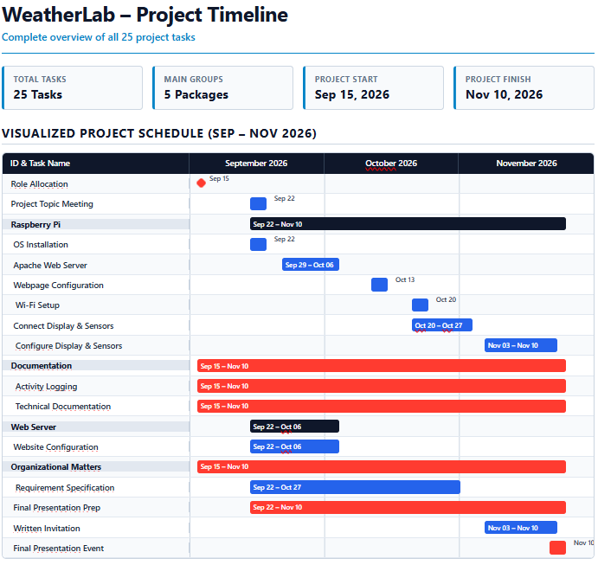
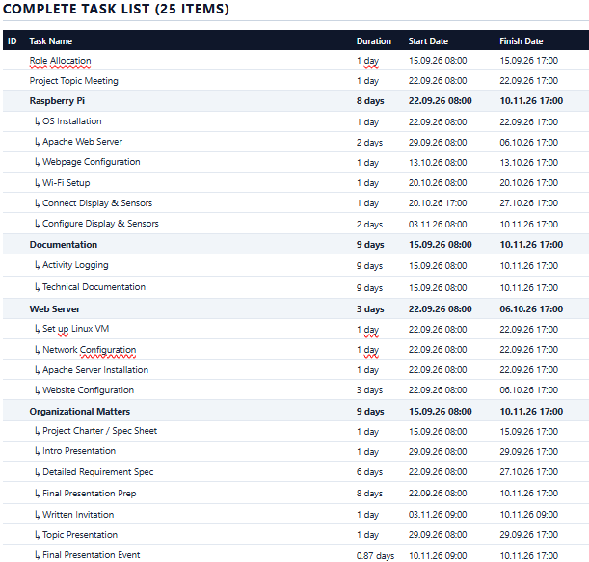
TIMELINE
Project Roadmap & Milestones
Phased progression from initial setup to final presentation
WeatherLab | Project Milestones
Slide 08

Slide 12
Class 4bITS | BS 2 Linz
Thank You for Your Attention!
Questions & Discussion
Project Team
Project Supervision
David S. | Andrea R. | Fabian S. | Julian W. | Matthias W.
BS 2 Linz - Steinegger David

