Slide 1

VELLORE INSTITUTE OF TECHNOLOGY, VELLORE
School of Computer Science and Engineering | BCSE308L Computer Networks Laboratory
Campus Lab Helpdesk
Design and Implementation of an Offline LAN-Based Helpdesk and Communication System for Campus Computer Laboratories
Submitted by
Name: Aarush Sanghi Registration Number: 24BCE2501
Name: Meghant Archit Darji Registration Number: 24BCE2288
Name: Mishank Shah Registration Number: 24BCE2467
Under the guidance of
Kopperundevi N,
Assistant Professor Senior Grade II
September, 2026

Slide 2
Abstract
Problem: students must leave their seat to report lab faults; the assistant has no view of what is waiting, urgent or taken.
Approach: Flask + Flask-SocketIO + SQLite server on one lab PC, used from every other PC through a browser over the LAN.
HTTP over TCP carries pages and the JSON API; a persistent WebSocket pushes tickets, replies and announcements instantly.
Reliability: heartbeats, auto-reconnect with resync, delivery acknowledgements, server-side auth, roles and CSRF.
Outcome: works fully offline; all 81 automated tests pass.
81
automated tests passing
0
internet dependencies
0.0.0.0:5000
LAN bind address
Campus Lab Helpdesk | BCSE308L
2

Slide 3
Introduction: background and problem
1.1 Background
1.2 Problem statement
Labs are shared by many students, so faults are common: a PC will not start, an IDE fails to open, the network drops. Reporting is informal (walk to the desk, phone a friend), urgent and minor faults get mixed up, and nobody can tell a student whether the problem was seen. Internet is often restricted, but the lab LAN always exists.
Build a helpdesk that works entirely on the local network, so that:
a student reports a fault and follows it
the assistant is told instantly and sees priority and status
both exchange messages in real time with delivery confirmation
it stays correct on reconnects and no student can see another's tickets
Campus Lab Helpdesk | BCSE308L
3

Slide 4
Objectives and novelty
Objectives
Novelty
Client-server app: one lab PC serves many browsers, bound to 0.0.0.0
Student portal and lab-assistant console
HTTP for request-response, WebSocket (Socket.IO) for push, no polling
SQLite storage that survives restarts
Heartbeats, auto-reconnect and resync
Server-side auth, roles, ownership, CSRF, validation
Network page showing live connections
Verified by automated tests and scripted runs
Fully offline
Even the Socket.IO client is served locally; no CDN or API.
Lab-specific workflow
Workstation no., lab categories, 4 priorities.
One rule set
HTTP API and Socket.IO call the same service functions.
Visible networking
IP, port and transport shown live.
Campus Lab Helpdesk | BCSE308L
4

Slide 5
Literature survey: existing systems
Approach | Works offline | Setup effort | Live updates | Lab fields
Cloud help desk (Zendesk, Freshdesk) | No | Account + subscription | Yes | No
Self-hosted (osTicket, GLPI) | Yes, once installed | Web server + database | Varies | Customisation needed
Paper register, e-mail, chat group | Mostly | None | Chat only | No
Campus Lab Helpdesk (this project) | Yes, by design | Python + one command | Yes, WebSocket | Yes
Cloud tools need the internet; self-hosted tools need PHP and a separate database; informal methods carry no priority, owner, status or history.
Campus Lab Helpdesk | BCSE308L
5

Slide 6
Literature survey: push techniques
Technique | How it works | Drawback here
Short polling | Repeated HTTP request every few seconds | Wasteful; delayed by up to one interval
Long polling | Request held open until data exists | New request and headers per event
Server-sent events | One-way stream to browser | Chat needs a second channel
WebSocket (RFC 6455) | HTTP Upgrade to full-duplex over TCP | Needs rooms, acks, reconnect: Socket.IO supplies them
WebSocket was chosen: one long-lived TCP connection, both sides can send at any moment. Socket.IO adds named events, rooms, acknowledgements, heartbeats, reconnection and an HTTP long-polling fallback.
Campus Lab Helpdesk | BCSE308L
6

Slide 7
Research gap
Existing options depend on the internet, need a separately maintained web server and database, or lack priority, ownership and real-time notification.
Single small program
Push, not polling
Embedded database, one command, LAN only
Acks and automatic recovery after disconnection
Lab ticket model
Built-in network monitor
Workstation, category, priority, assignee, timeline
Protocols, addresses and connections made visible
Campus Lab Helpdesk | BCSE308L
7

Slide 8
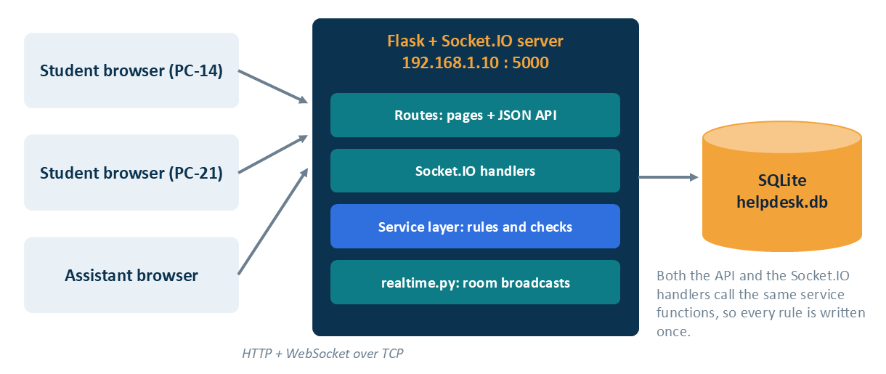
System design: architecture
Client-server: one process owns all data
Two traffic kinds on one TCP port: HTTP and Socket.IO
Broadcasts only after the DB commit
Same service functions behind HTTP and sockets
Figure 3.1: Overall architecture
Layer | Responsibility
Pages / JSON API | Jinja2 pages, thin endpoints
Socket.IO | Auth, rooms, events with acks
Services | Rules, permissions, workflow
Models | SQLAlchemy tables
Campus Lab Helpdesk | BCSE308L
8

Slide 9
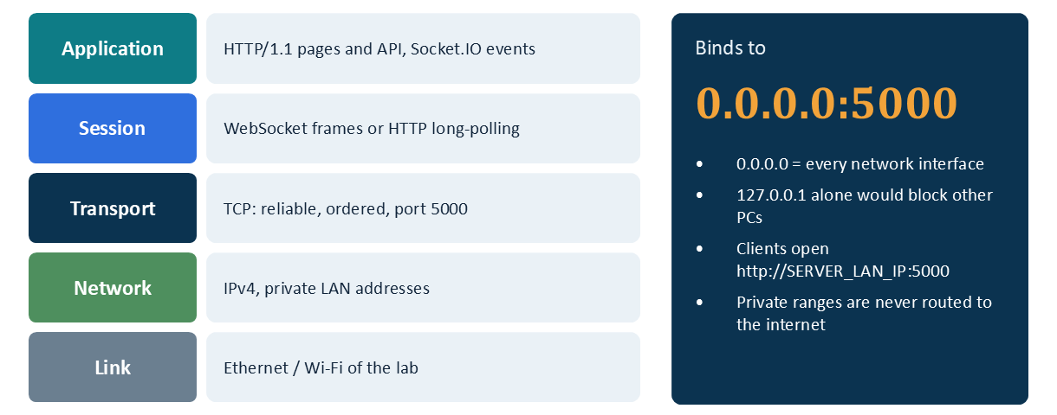
Network addressing and protocol stack
Binding
Server listens on 0.0.0.0:5000, meaning every interface: loopback 127.0.0.1 plus the LAN address. Binding to 127.0.0.1 only would block other PCs. Clients open http://<server LAN IP>:5000. Start-up detects LAN IPs with a UDP connect that sends no packets, so it works offline.
Figure 3.2: Protocol stack and server binding
Private IPv4 ranges (RFC 1918) stay inside the lab
TCP gives ordered, reliable delivery
Campus Lab Helpdesk | BCSE308L
9

Slide 10
Module description
Authentication
Ticket service
Announcements
Hashed passwords, signed sessions, role decorators
LAB-00NN numbers, ownership, filters, workflow, messages
Publish, edit, delete; everyone reads
Statistics
Network service
Socket.IO layer
Dashboard counts per student or whole lab
LAN addresses, bind, heartbeat, stack
Refuses anonymous, rooms, acked events
Real-time broadcasts
Presence
Front end
ticket, notification, stats, announcement events
Thread-safe live connections with IP and transport
main.js, socket.js, student.js, assistant.js, ticket.js
Campus Lab Helpdesk | BCSE308L
10

Slide 11
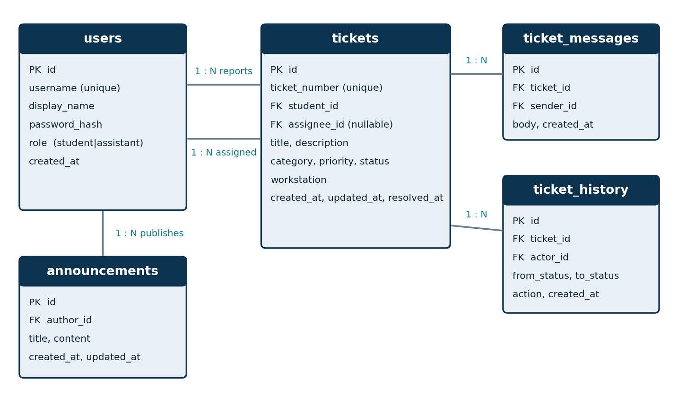
Database design
Table | Purpose
users | Accounts, role student / assistant
tickets | Fault, category, priority, status, workstation
ticket_messages | The conversation
ticket_history | Timeline of every change
announcements | Lab notices
Figure 3.3: Entity-relationship diagram
SQLite in WAL mode, CHECK constraints and indexes. Numbers like LAB-0001 are assigned in the same transaction and never reused. Timestamps stored in UTC.
Campus Lab Helpdesk | BCSE308L
11

Slide 12
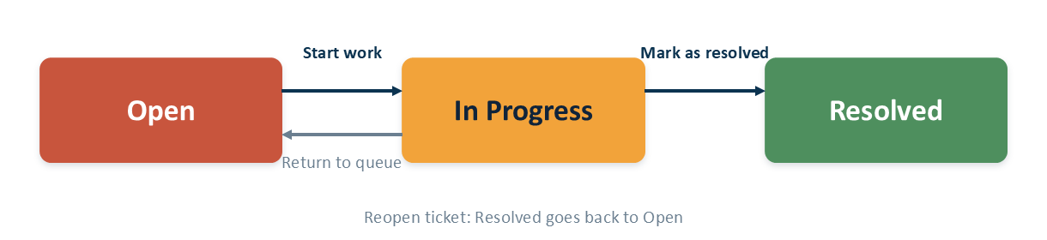
Ticket status workflow
Figure 3.4: Ticket status workflow
Open to Resolved directly, or to the same status, is rejected with HTTP 409
Starting work on an unassigned ticket assigns it to that assistant
Reopen and return-to-queue are allowed; every change is logged in history
Campus Lab Helpdesk | BCSE308L
12

Slide 13
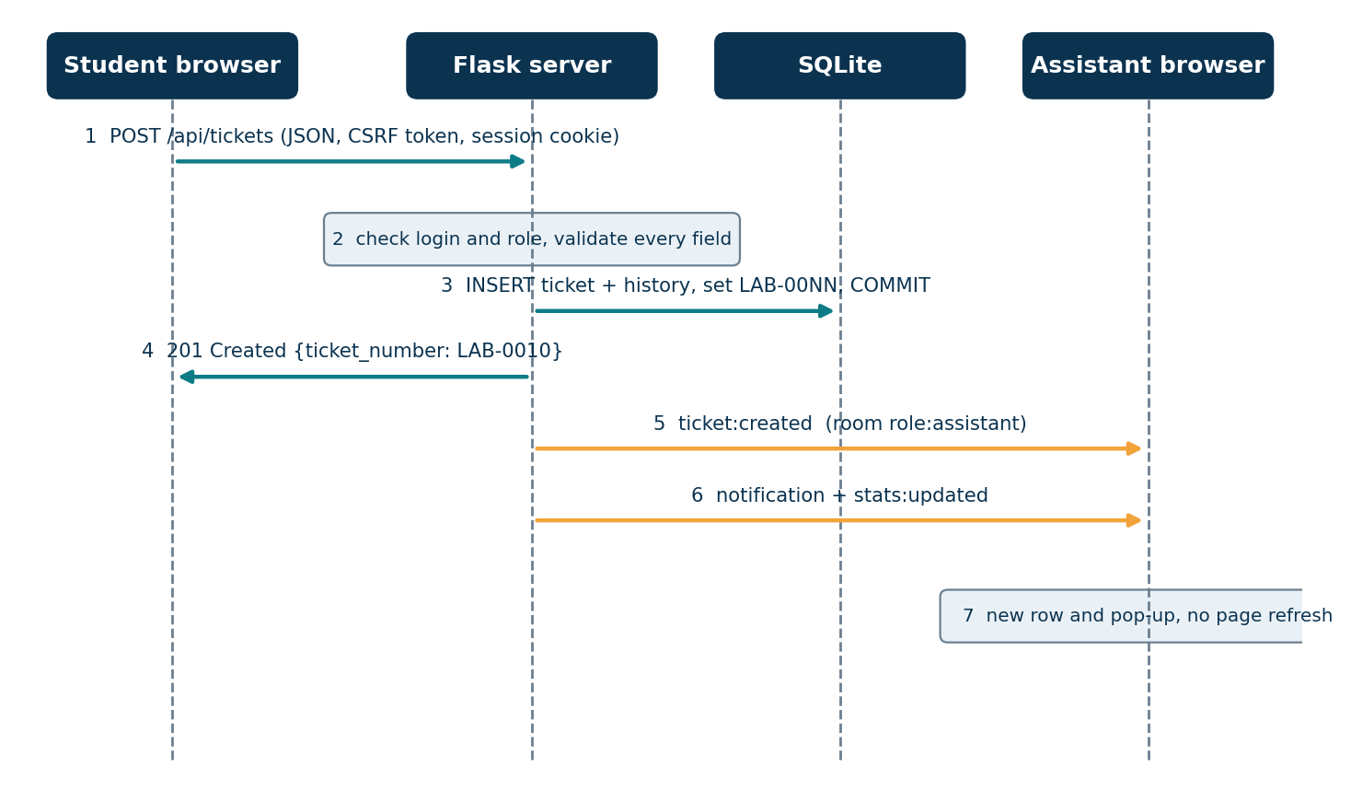
Communication: creating a ticket
Chat with delivery receipt
Bubble shows Sending. Browser emits ticket:send_message; server checks access, validates, saves, commits, broadcasts to the ticket room, then acknowledges. Bubble turns Delivered. If the socket is down, plain HTTP POST is used.
Figure 3.5: Message flow
Campus Lab Helpdesk | BCSE308L
13

Slide 14
Socket.IO rooms and events
Room | Members | Used for
lab | All logged-in connections | Announcements
role:assistant | Assistant connections | New tickets, presence, stats
user:<id> | All tabs of one user | Own ticket updates
ticket:<id> | Viewers after ownership check | Chat and status changes
Server to client: ticket:created, ticket:updated, ticket:message, notification, stats:updated, announcement:*, presence:updated
Client to server: ticket:join / leave, ticket:send_message (acked after commit), net:ping every 10 s
Lifecycle: long-polling, upgrade to WebSocket (101 Switching Protocols), ping 10 s, drop after timeout, reconnect with 1-5 s back-off, then resync from DB
Campus Lab Helpdesk | BCSE308L
14

Slide 15
Security design
Passwords
Sessions
Authorisation
Salted scrypt hashes, never plain text
Signed cookie, HttpOnly, SameSite=Lax; logout closes sockets
Checked on server; other student's ticket returns 404
Socket.IO
CSRF
Input handling
No anonymous connections; same-origin only; ticket rooms need ownership check
Per-session token on every POST, PUT, PATCH, DELETE
Length limits, allowed values, 64 KB cap, bound SQL params, escaped HTML
Campus Lab Helpdesk | BCSE308L
15

Slide 16
Implementation details
Layer | Technology
Front end | HTML5, CSS3, vanilla JS, Jinja2 (no build step)
Real-time | Flask-SocketIO 5, Socket.IO 4 client served locally
Back end | Python 3.10+, Flask 3 blueprints
Database | SQLite via Flask-SQLAlchemy
Auth | Signed-cookie sessions, Werkzeug hashing
Server | Werkzeug threaded server (threading mode)
Run it
pip install -r requirements.txt (once, then offline)
python seed_demo.py creates demo data, repeatable
python run.py starts the server and prints bind and LAN URLs
PORT env var changes the port
Campus Lab Helpdesk | BCSE308L
16

Slide 17
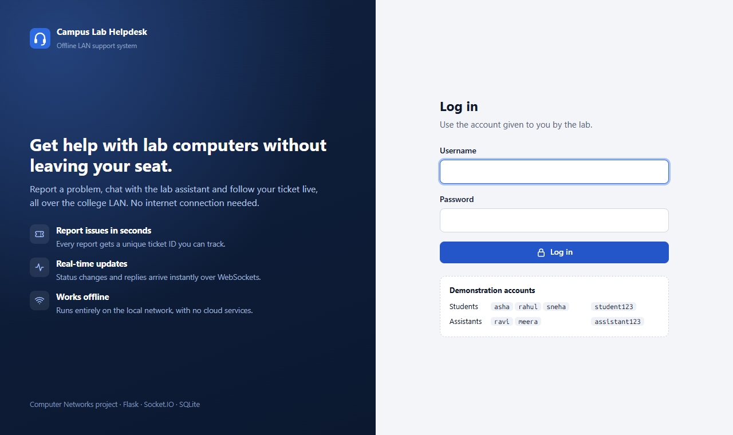
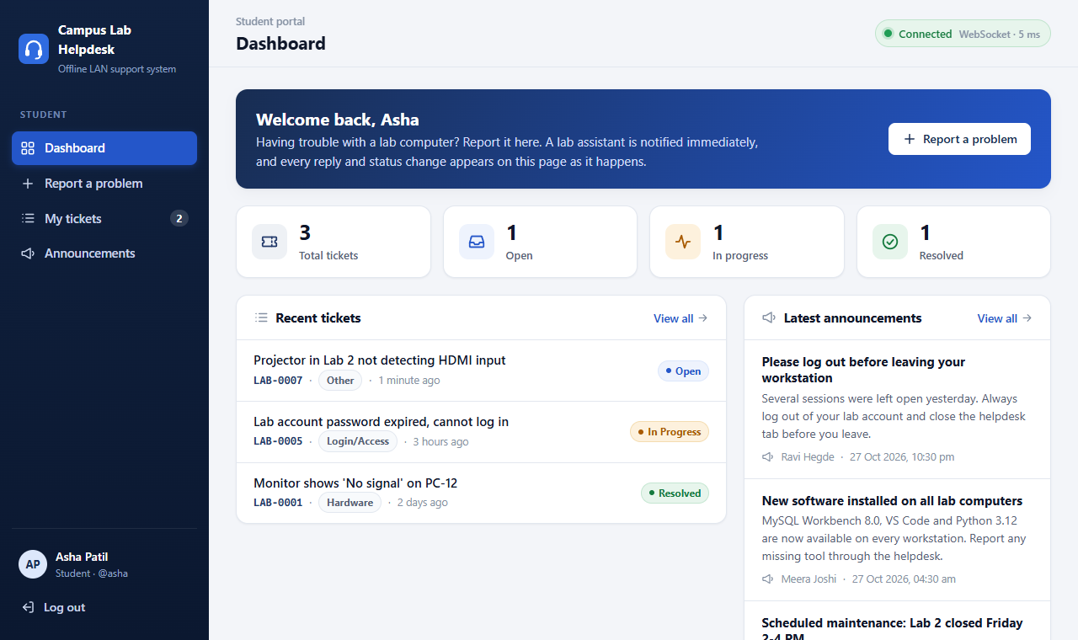
Screenshots 1 of 5
Fig 4.1: Login page
Fig 4.2: Student dashboard, live pill
A student (asha) and an assistant (ravi) were logged in at the same time in separate browsers.
Campus Lab Helpdesk | BCSE308L
17

Slide 18
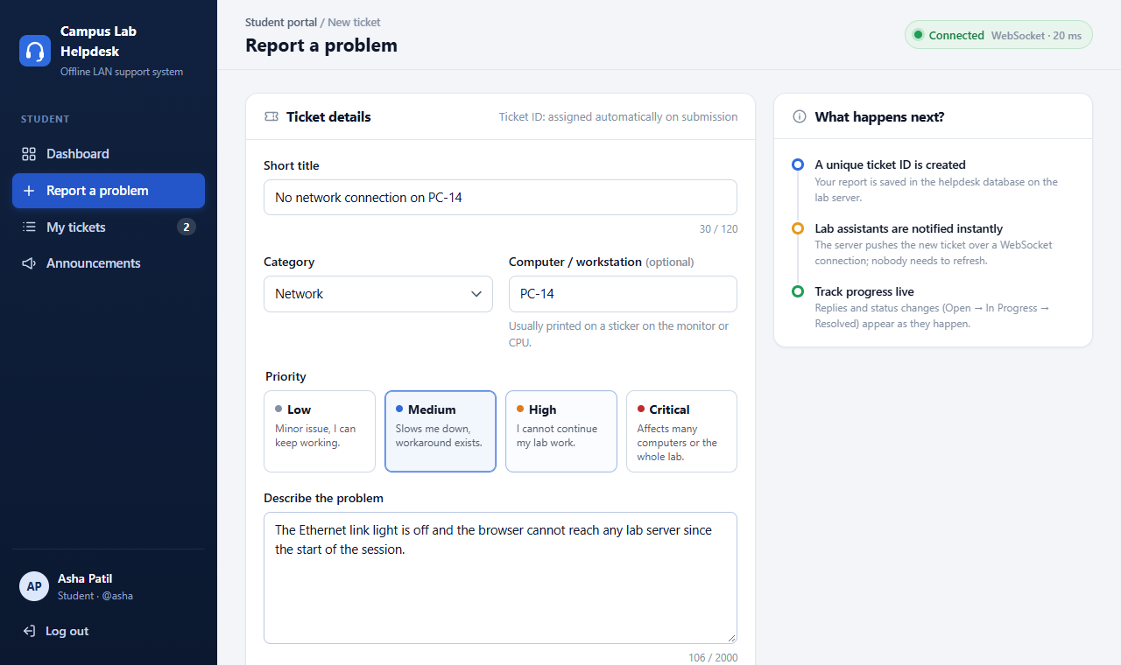
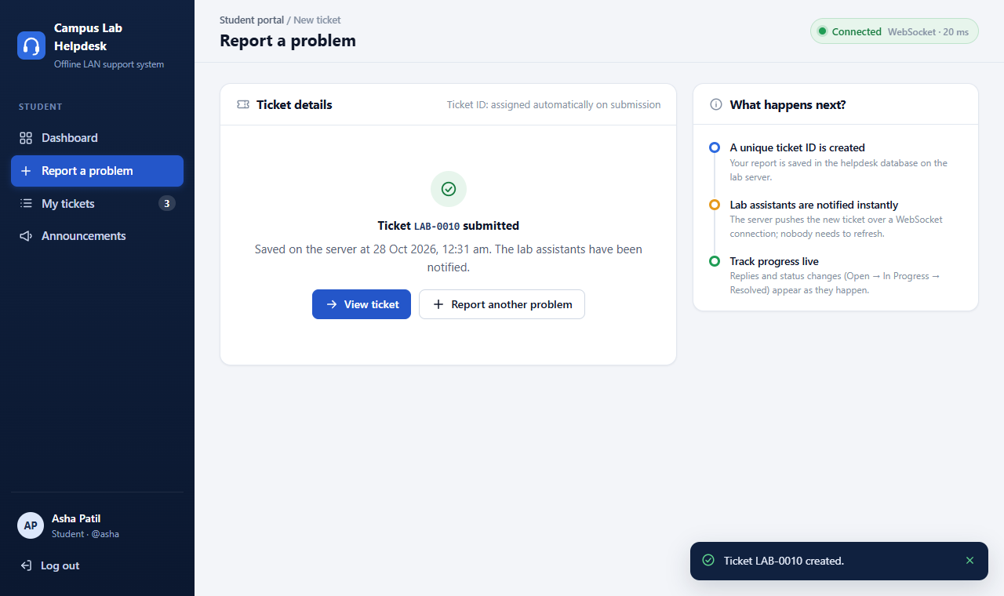
Screenshots 2 of 5
Fig 4.3: Report a problem
Fig 4.4: Ticket number LAB-0010 returned
Campus Lab Helpdesk | BCSE308L
18

Slide 19
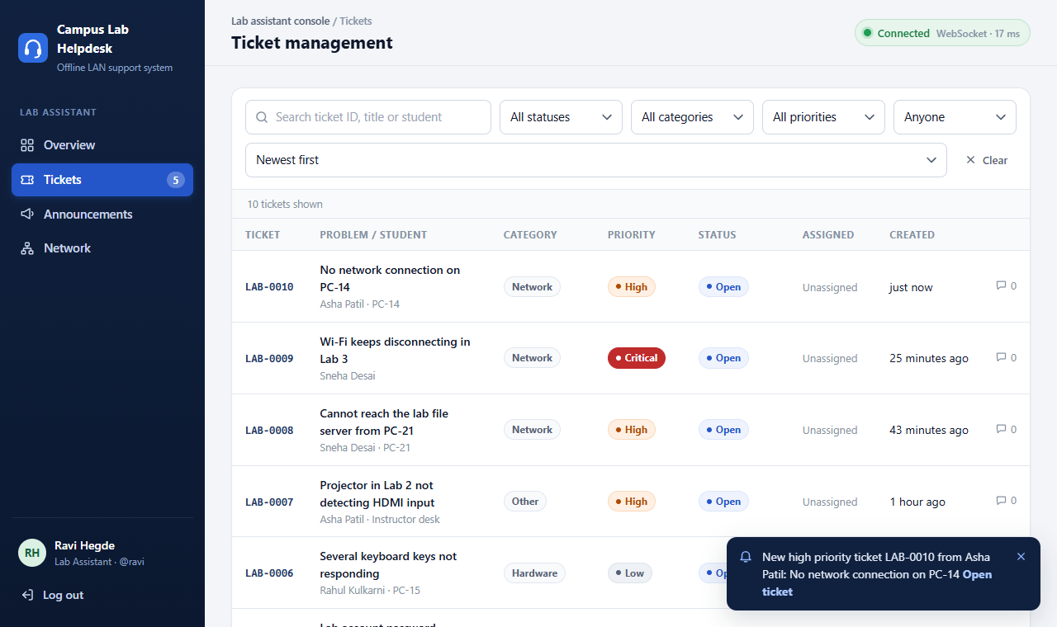
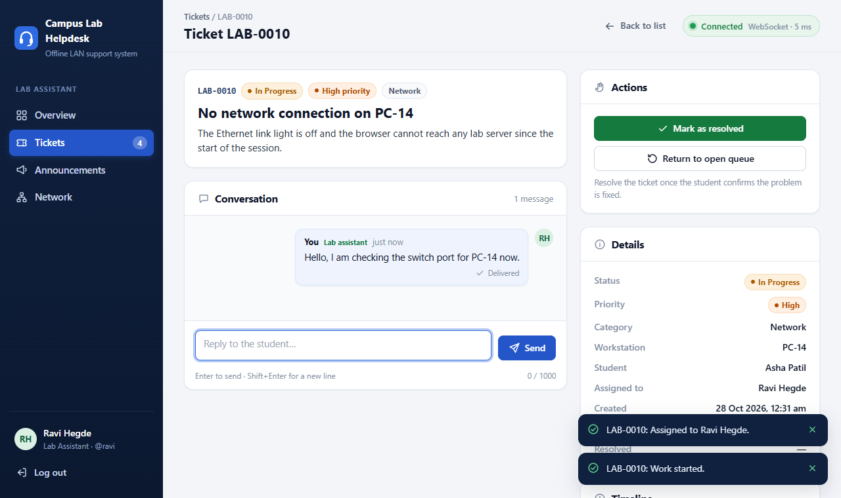
Screenshots 3 of 5
Fig 4.5: Assistant list updates live
Fig 4.6: Assign, start work, reply Delivered
Campus Lab Helpdesk | BCSE308L
19

Slide 20
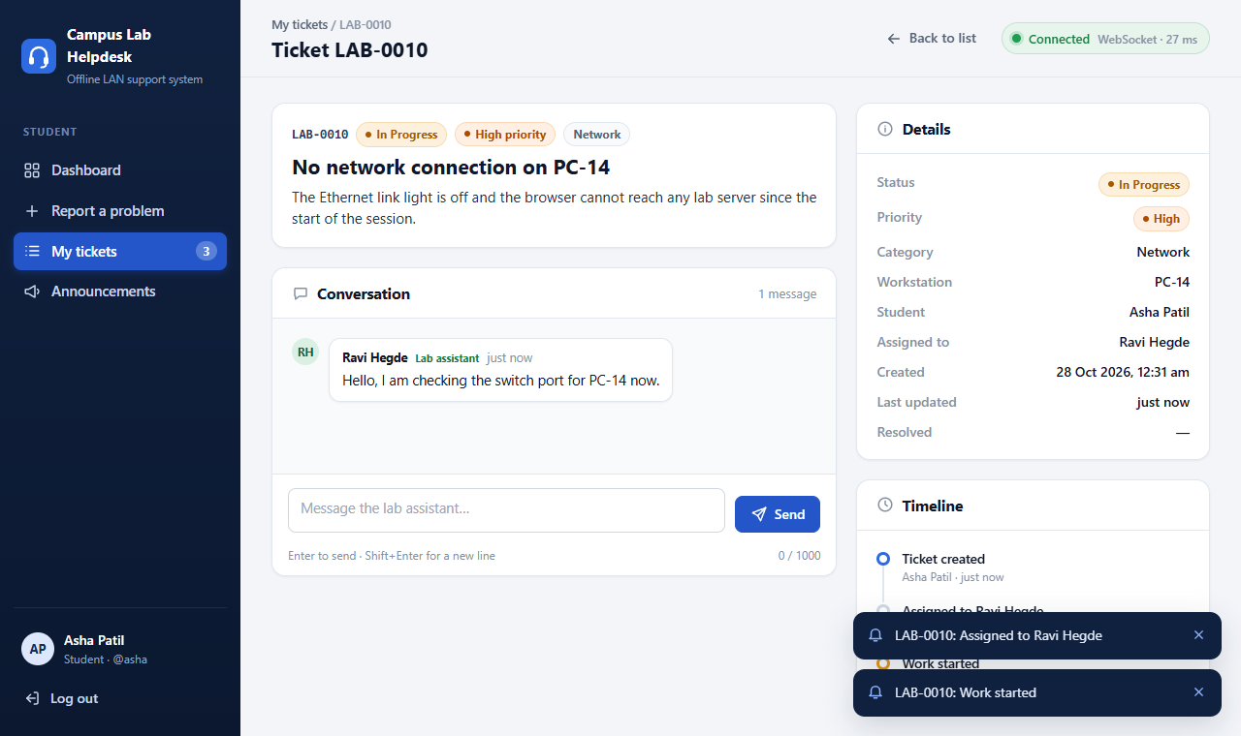
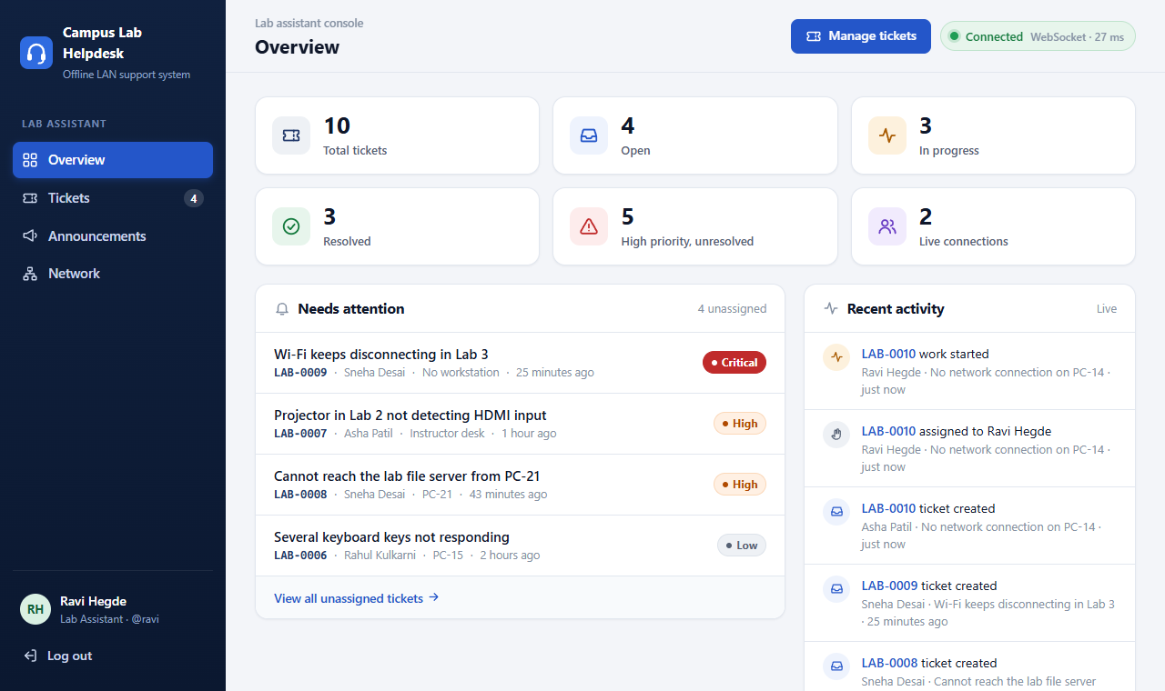
Screenshots 4 of 5
Fig 4.7: Student sees In Progress live
Fig 4.8: Assistant overview and feed
Campus Lab Helpdesk | BCSE308L
20

Slide 21
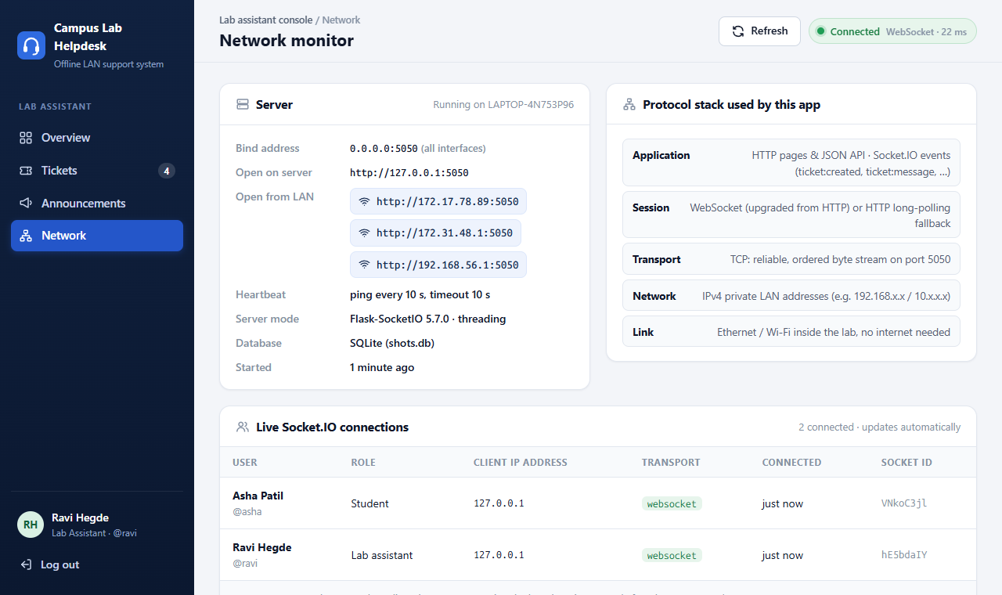
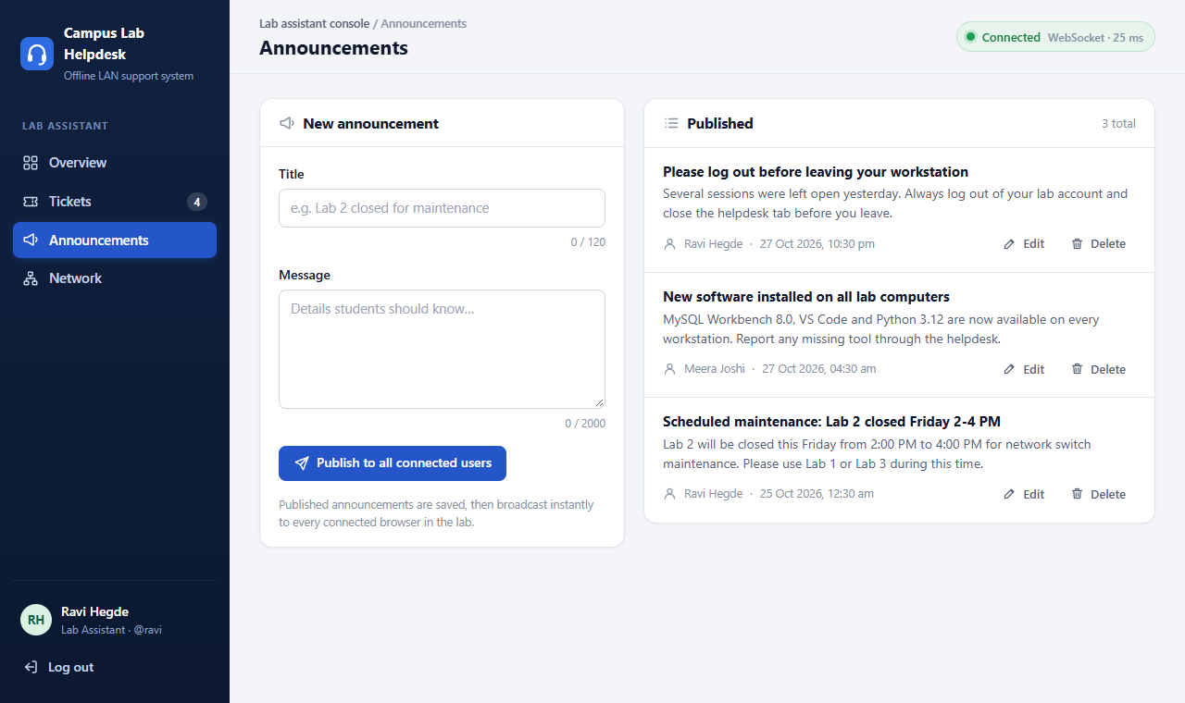
Screenshots 5 of 5
Fig 4.9: Network monitor with client IPs
Fig 4.10: Announcements management
Note: Fig 4.9 was captured with the server on port 5050 (PORT override); the default is 5000.
Campus Lab Helpdesk | BCSE308L
21

Slide 22
Current progress and testing
Module | Status
Auth, sessions, roles, CSRF | Completed, tested
Tickets, search, workflow, chat | Completed, tested
Announcements | Completed, tested
Socket.IO: rooms, acks, presence, resync | Completed, tested
Student portal and assistant console | Completed, checked in browser
Network monitor, seed, CLI tools | Completed
81
pytest tests passing
Auth, tickets, authorisation, announcements, sockets, seed
Scripted WebSocket and headless-browser runs
Pending: test on a second physical PC with the internet disconnected
Campus Lab Helpdesk | BCSE308L
22

Slide 23
Challenges and solutions
Challenge | Solution
Events lost while a client is offline | DB is source of truth; reload over HTTP after reconnect
Duplicate notifications | Unique event_id; browser ignores seen ids
Chat rooms could leak messages | Join only after the same ownership check as HTTP
Handlers missing on later app objects | Import sockets before socketio.init_app()
One stray bracket broke assistant.js | Every JS file now syntax-checked with Node
Second server could start on a used port (Windows) | run.py checks the port first
Campus Lab Helpdesk | BCSE308L
23

Slide 24
Conclusion and future enhancements
Conclusion
Known limitations
A dependable helpdesk on the LAN alone: new tickets and replies reach the other side the moment they are saved, lost clients are detected, pages resync, and rules are enforced on both HTTP and Socket.IO. It covers client-server, private IPs, ports, TCP, HTTP, WebSocket handshake and concurrency.
Dev server (tens of clients); plain HTTP; in-memory presence; no rate limiting or migrations; Retry may duplicate a message.
Future work
HTTPS; gunicorn + Redis; PostgreSQL + Flask-Migrate; rate limiting, password reset, admin page; reports and attachments.
Campus Lab Helpdesk | BCSE308L
24

Slide 25
References
[1] I. Fette, A. Melnikov, "The WebSocket Protocol," RFC 6455, IETF, 2011.
[2] R. Fielding, J. Reschke, "HTTP/1.1: Semantics and Content," RFC 7231, IETF, 2014.
[3] J. Postel, "Transmission Control Protocol," RFC 793, IETF, 1981.
[4] Y. Rekhter et al., "Address Allocation for Private Internets," RFC 1918, IETF, 1996.
[5] Socket.IO documentation (v4), socket.io/docs/v4
[6] Pallets, Flask documentation. [7] M. Grinberg, Flask-SocketIO documentation.
[8] SQLite, "Write-Ahead Logging," sqlite.org/wal.html
[9] Kurose and Ross, Computer Networking: A Top-Down Approach, 8th ed., Pearson, 2021.
[10] OWASP, CSRF Prevention Cheat Sheet. [11] Tanenbaum and Wetherall, Computer Networks, 5th ed., 2011.
[12-14] Zendesk / Freshdesk, osTicket, GLPI product documentation.
Campus Lab Helpdesk | BCSE308L
25

Slide 26
Thank you

