Slide 1
Lecture 4 CMS 165
Competitive Optimization
Spectral Methods

Slide 2
Generative Adversarial Networks (GAN)

Slide 3



Min-max game or Saddle point dynamics
Conditions for local Nash:

Slide 4
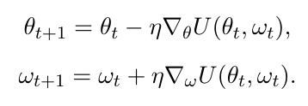
Optimization for Min-Max Game
Simultaneous Gradient Ascent (to avoid confusion to SGD)
What happens in Strongly convex-concave case?
Failure cases?

Slide 5
Optimization for Min-Max Game
Predictive Methods
Optimistic Mirror Descent
Consensus Optimization
Performance for bilinear games and beyond.

Slide 6
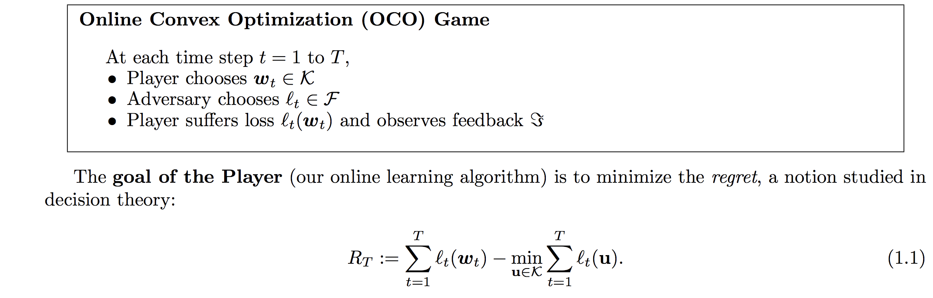

Aside: Online Learning and FTRL
Follow the regularized leader: yields GD in special case.

Slide 7
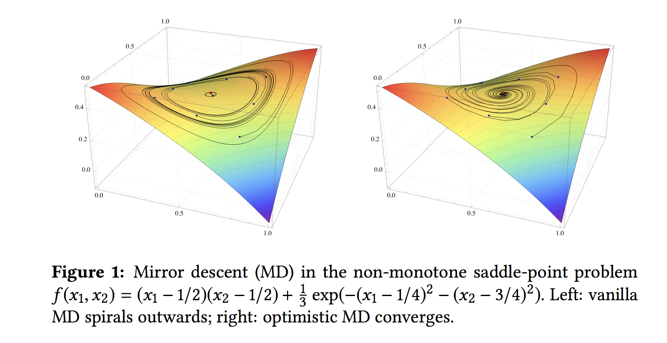
Online Learning vs. Saddlepoint problems
Online learning assumes an adversarial environment: worst case.
Saddlepoint problem is a special case: inner maximization loop is far from worst case
Hence, the term optimistic mirror descent: not assuming the worst case
Source: Optimistic mirror descent in saddle-point problems: Going the extra (gradient) mile

Slide 8
References
Unified analysis of competitive optimization (especially or bilinear games)
https://arxiv.org/pdf/1802.06132.pdf
Empirical paper on GAN (one that recently got a lot of attention in being able to train high resolution images) https://arxiv.org/pdf/1809.11096.pdf
Online learning: http://www.mit.edu/~rakhlin/papers/online_learning.pdf

Slide 9
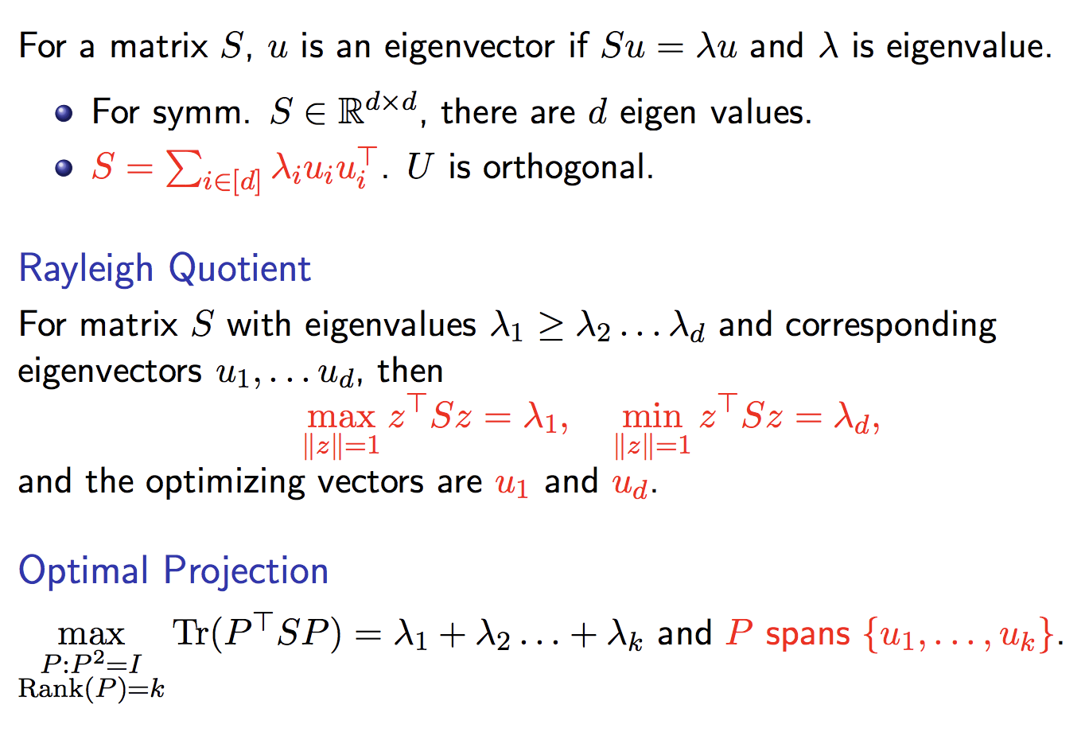
Spectral Methods
Utilize spectral decomposition of matrices (and tensors)
Review of Eigen Decomposition

Slide 10
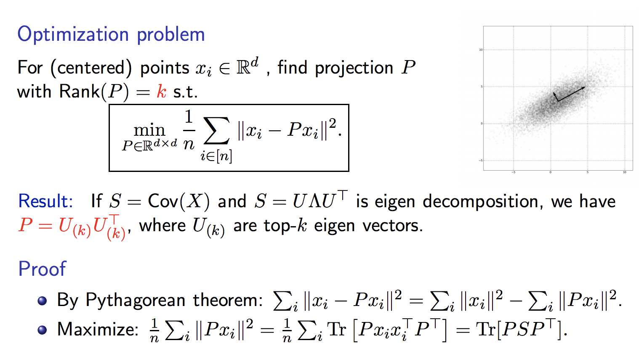
Simplest Spectral Method: PCA

Slide 11
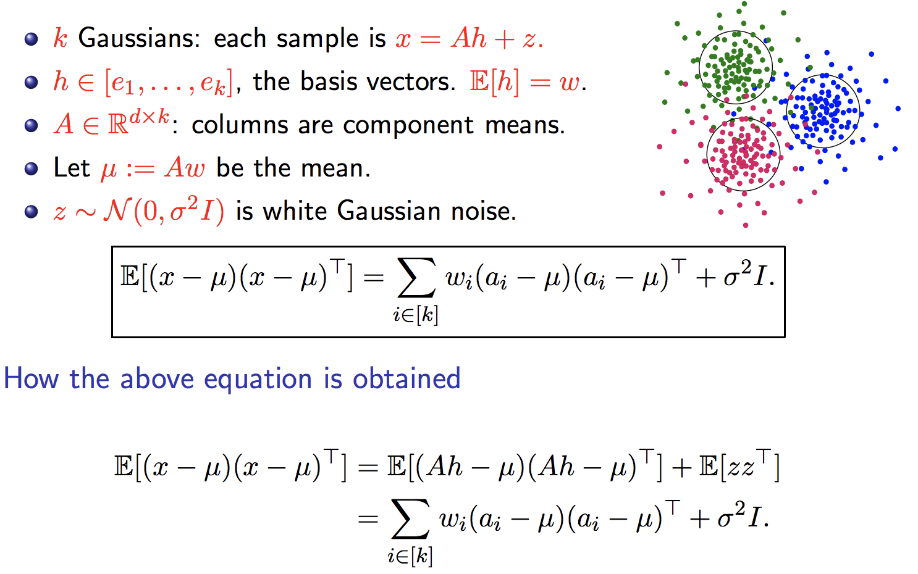
PCA on Gaussian Mixtures

Slide 12
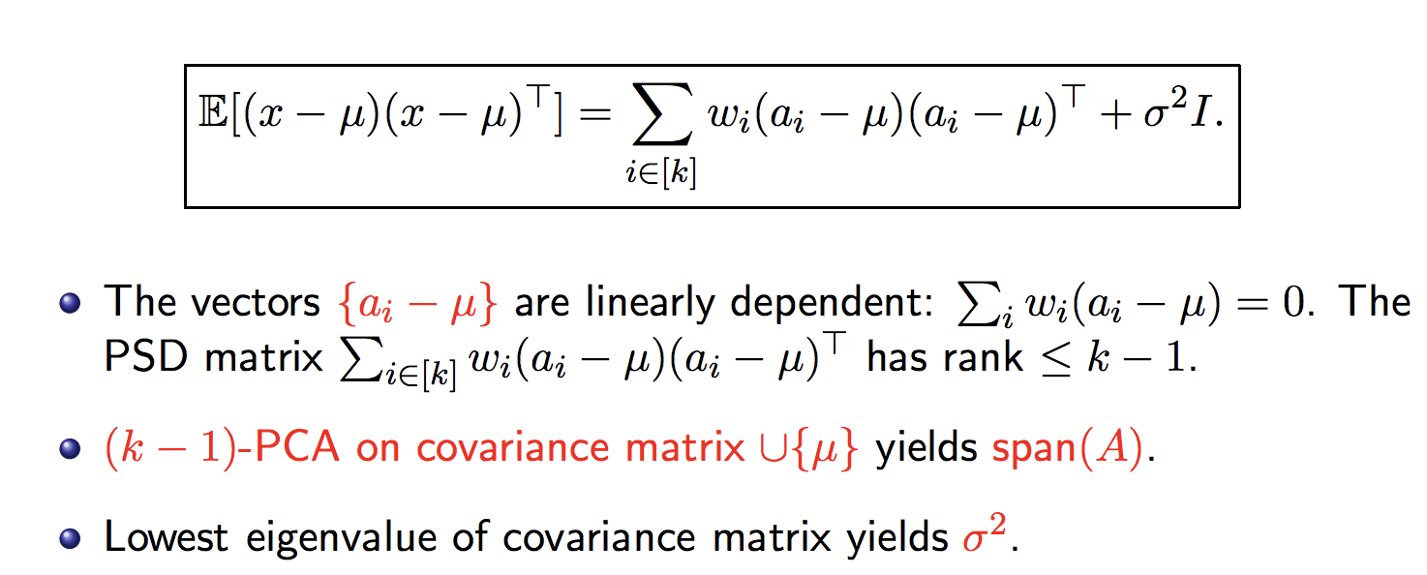
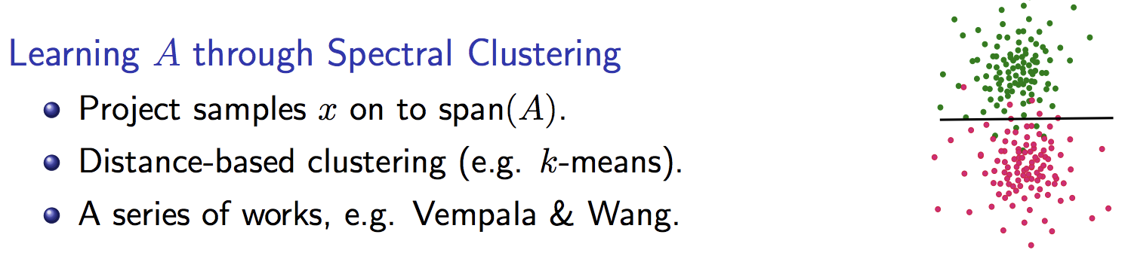
PCA on Gaussian Mixtures Cont.

Slide 13
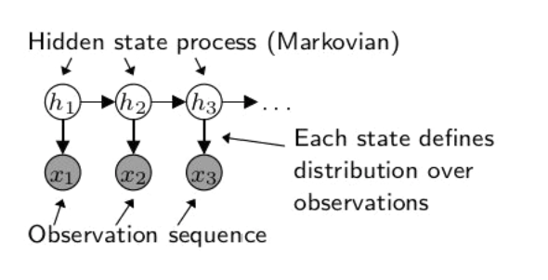
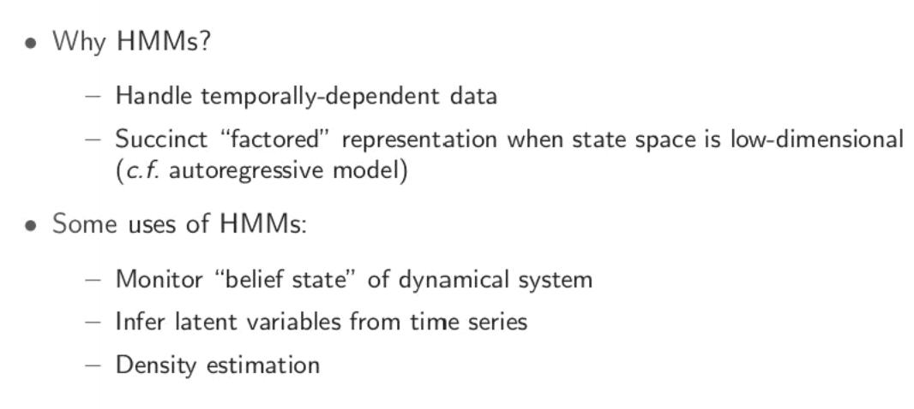
Hidden Markov Models
Source: slides from Daniel Hsu

Slide 14
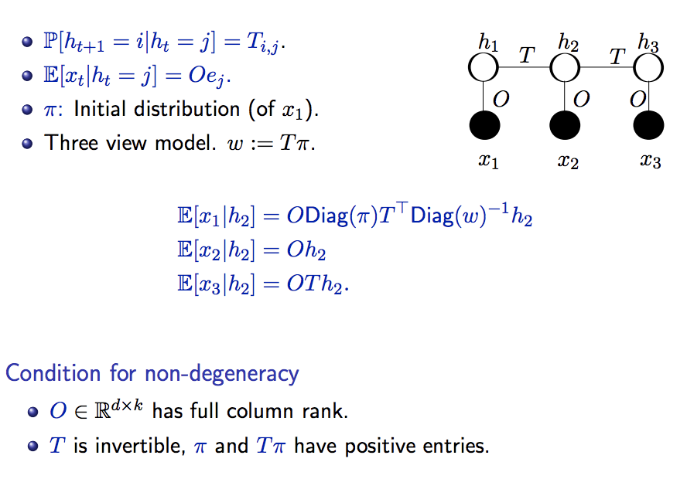
Discrete Hidden Markov Models

Slide 15
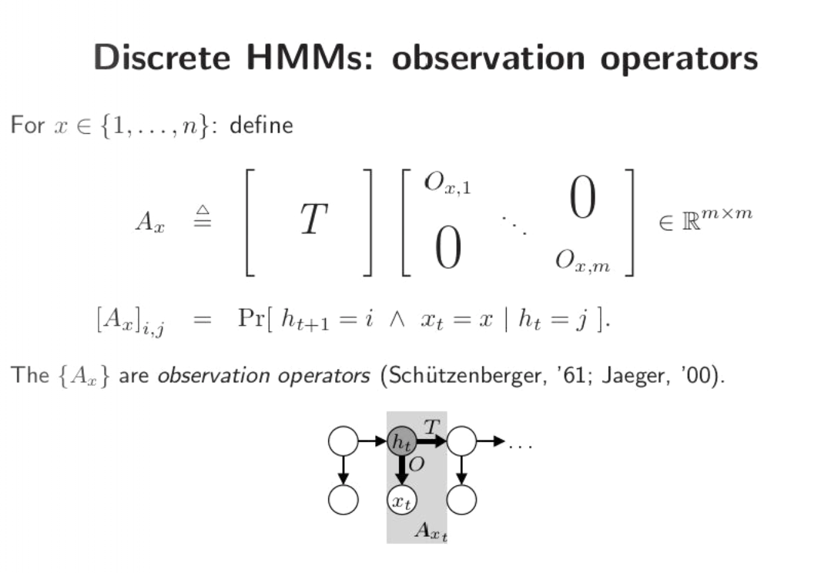
Observable operator in HMM
Source: slides from Daniel Hsu

Slide 16
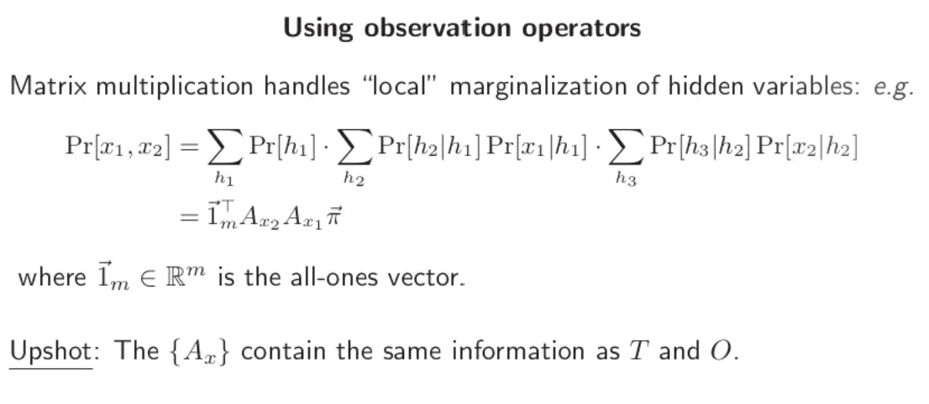
Observable operator in HMM contd.
Source: slides from Daniel Hsu

Slide 17
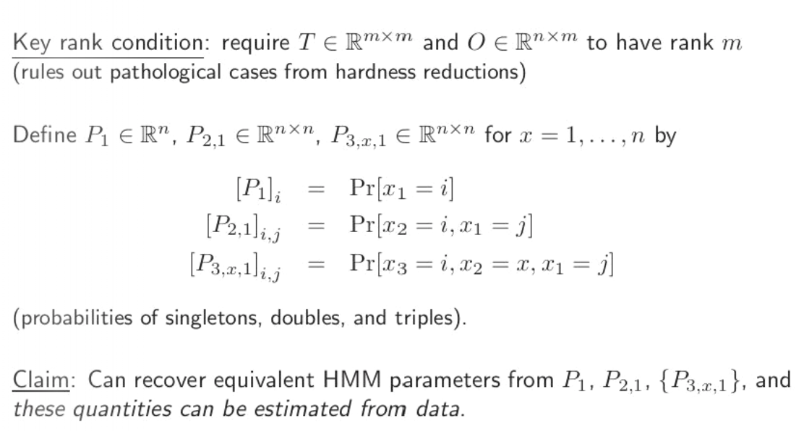
Learning Observable Operators in HMM
Source: slides from Daniel Hsu

Slide 18
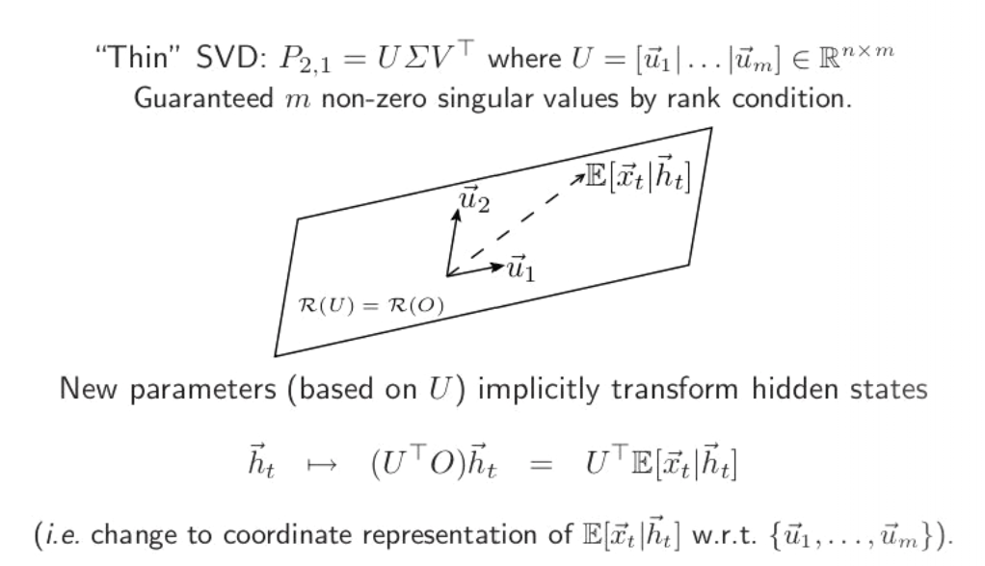
Learning Observable Operators in HMM cont.
Source: slides from Daniel Hsu

Slide 19
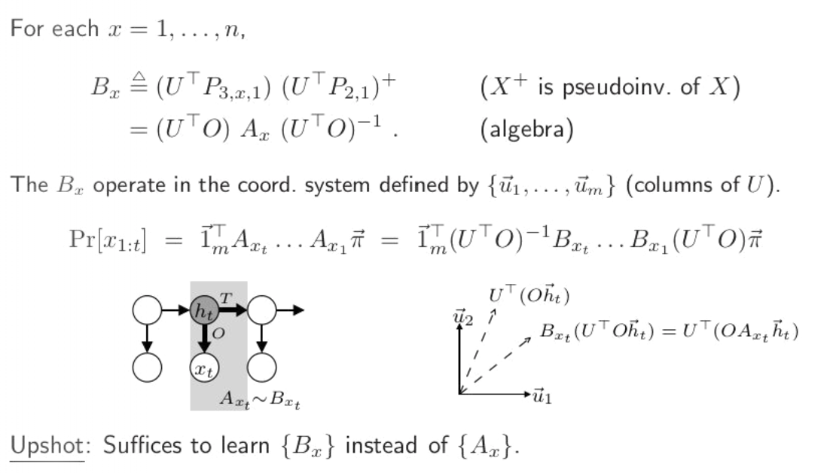
Learning Observable Operators in HMM cont.
Source: slides from Daniel Hsu

Slide 20
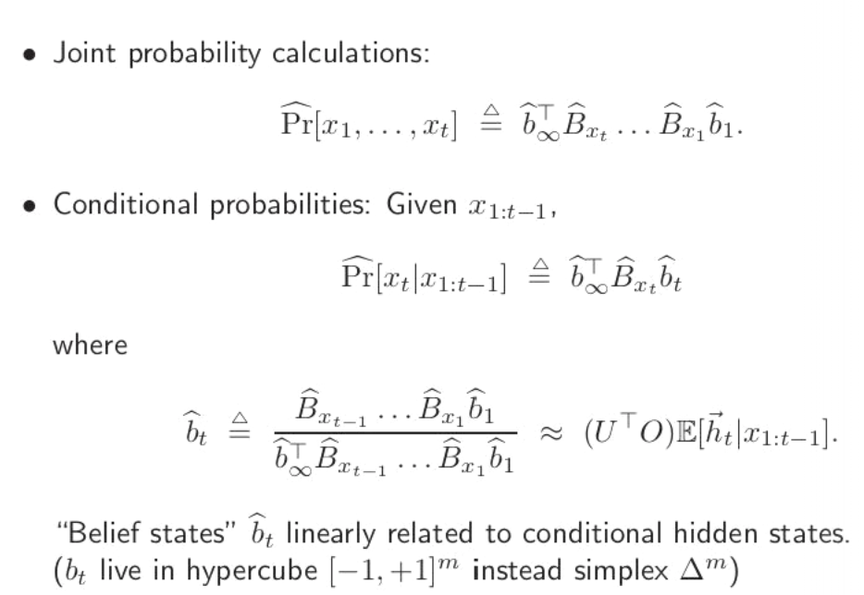
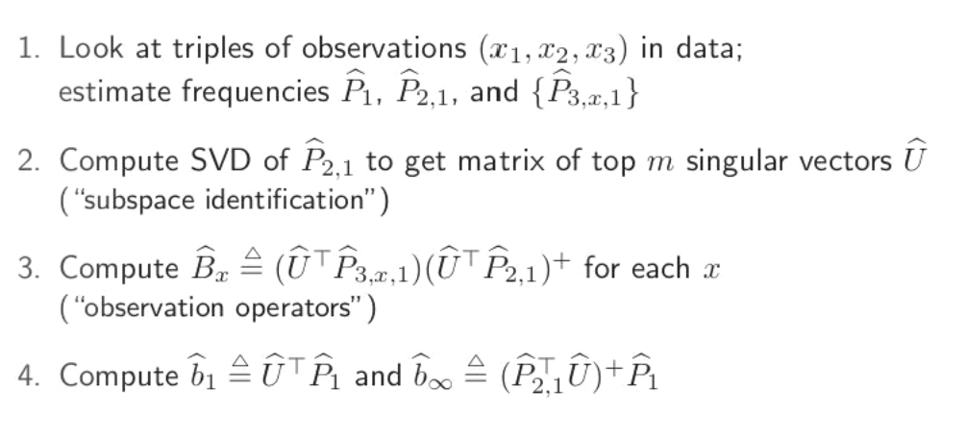
Learning Algorithm for HMM
Source: slides from Daniel Hsu

Slide 21
Lots of other applications of spectral methods
Extending HMMs to Partially observed Markov decision processes (POMDP) and Predictive state representations (PSR): passive vs active.
POMDP: Action based on each observation and can influence Markovian evolution of hidden state
PSR: No explicit Markovian assumption on hidden state. Directly predicts future (tests) based on past observations and actions (For linear PSR, similar to spectral updates in HMM)
Stochastic bandits in a low rank subspace (ask TA Sahin about it)

Slide 22
References
Matrix computations (textbook) by Golub and Van Loan
A spectral algorithm for learning hidden Markov models by Hsu, Kakade and Zhang.
Spectral Approaches to Learning Predictive Representations by Byron Boots (PhD thesis) https://apps.dtic.mil/dtic/tr/fulltext/u2/a566112.pdf

