Slide 1
Lecture 5 CMS 165
Spectral Methods

Slide 2
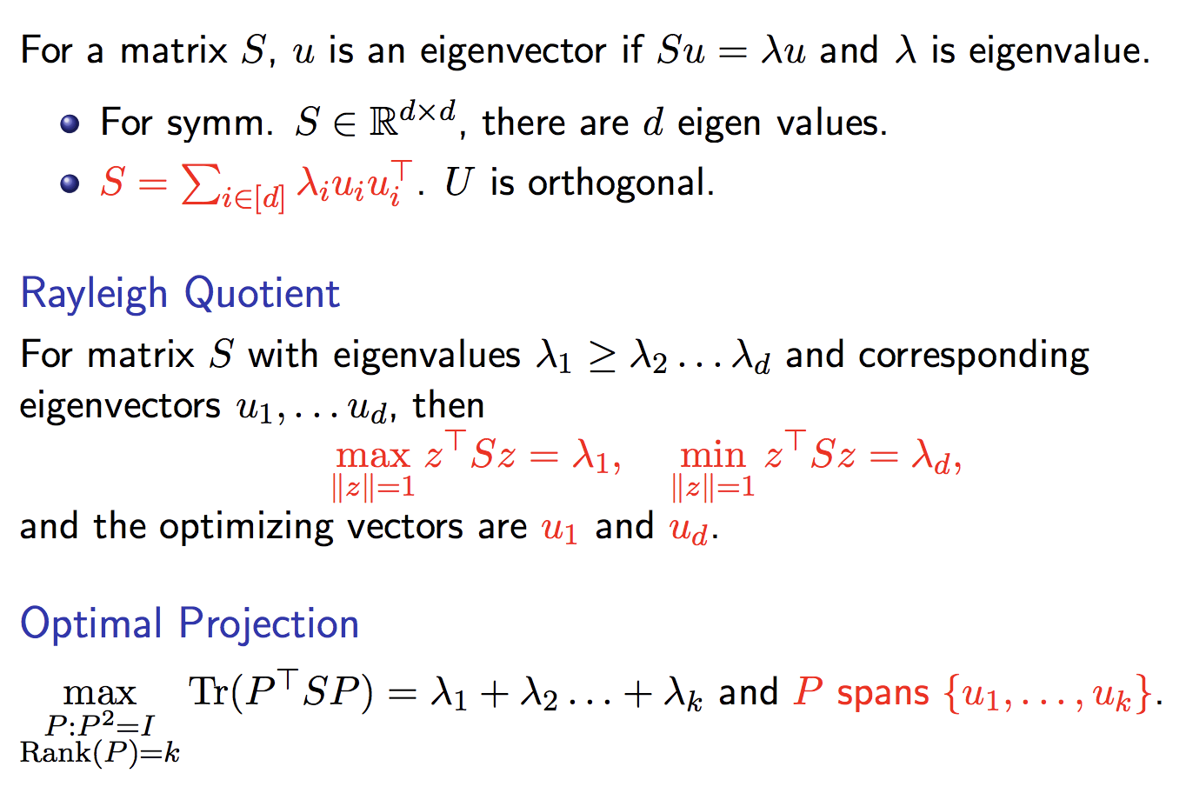
Spectral Methods
Utilize spectral decomposition of matrices (and tensors)
Review of Eigen Decomposition

Slide 3
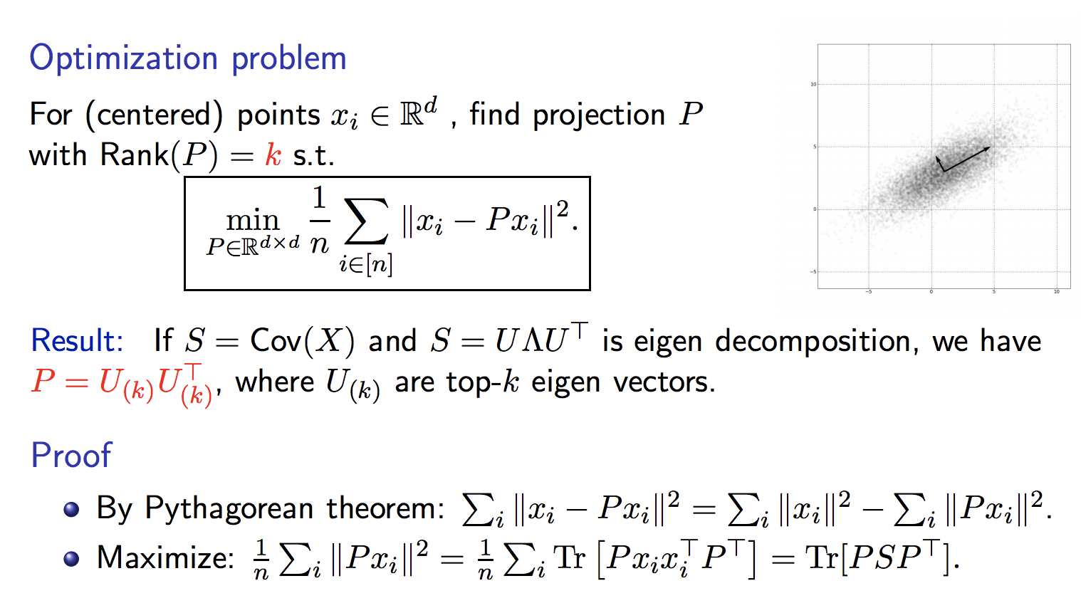
Simplest Spectral Method: PCA

Slide 4
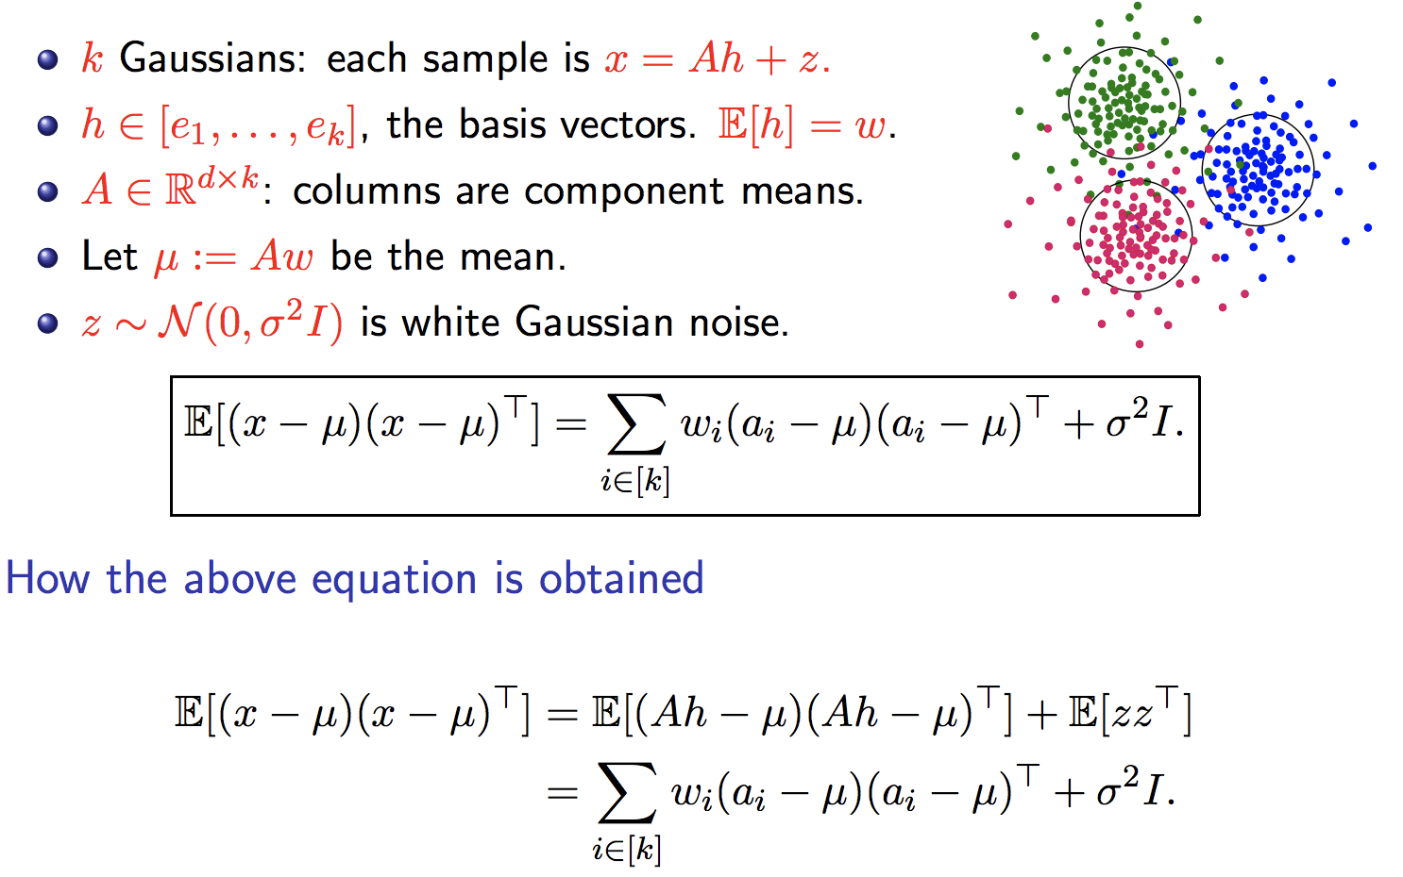
PCA on Gaussian Mixtures

Slide 5
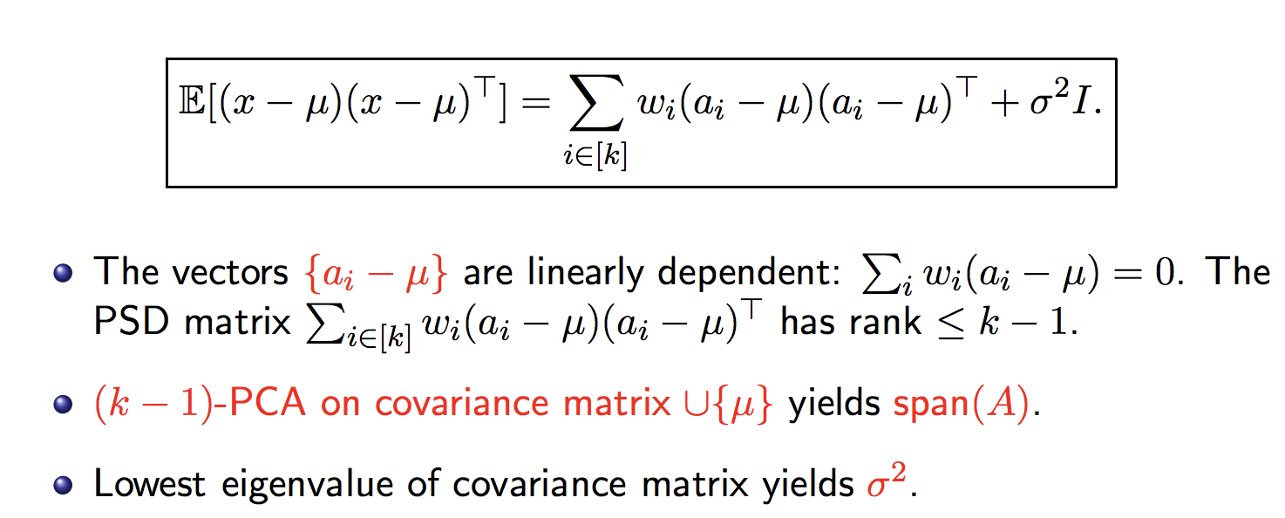
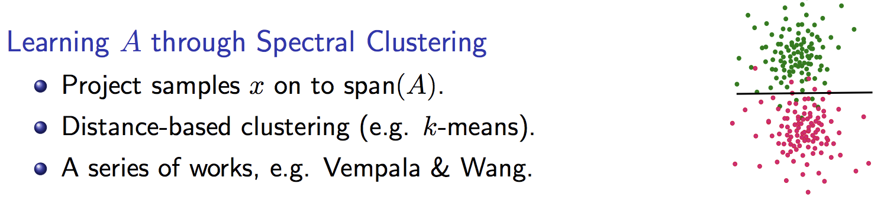
PCA on Gaussian Mixtures Cont.

Slide 6
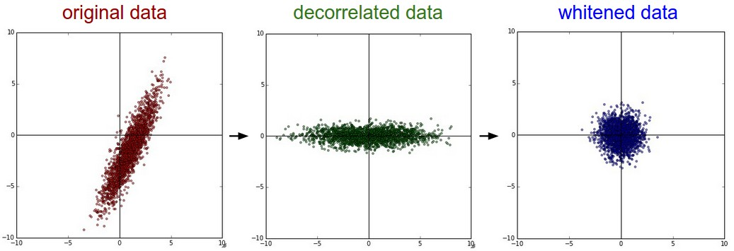
Whitening transform
Source: http://cs231n.github.io

Slide 7
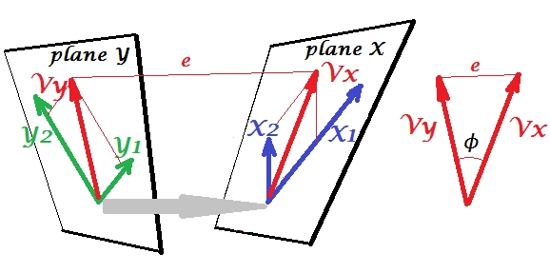
Canonical Correlation Analysis
What is wrong with just correlation?

Slide 8
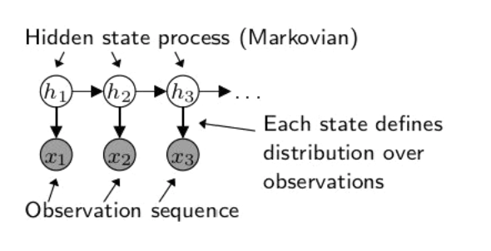
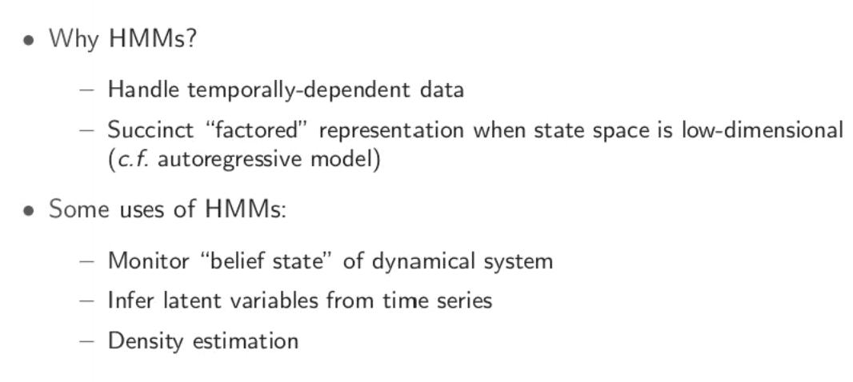
Hidden Markov Models
Source: slides from Daniel Hsu

Slide 9
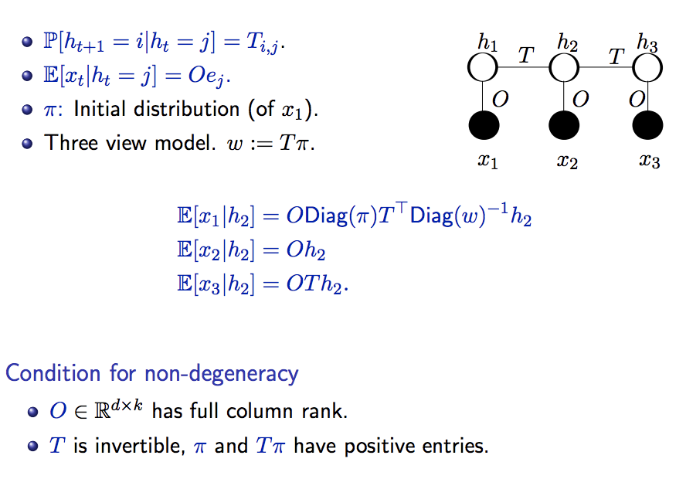
Discrete Hidden Markov Models

Slide 10
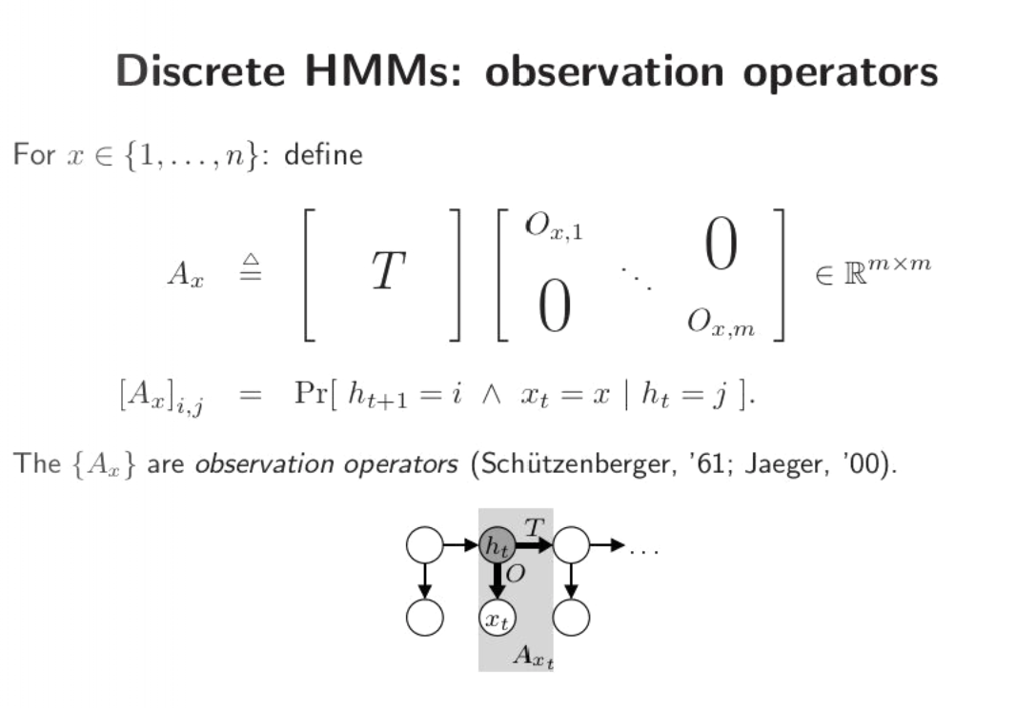
Observable operator in HMM
Source: slides from Daniel Hsu

Slide 11
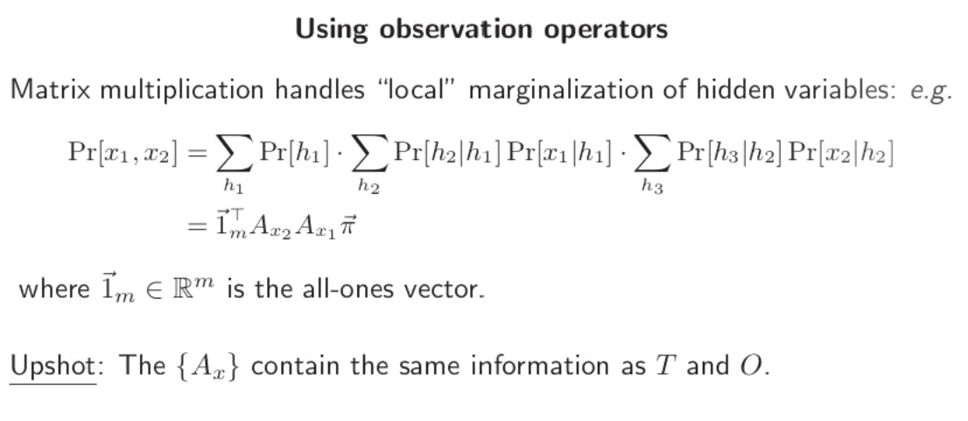
Observable operator in HMM contd.
Source: slides from Daniel Hsu

Slide 12
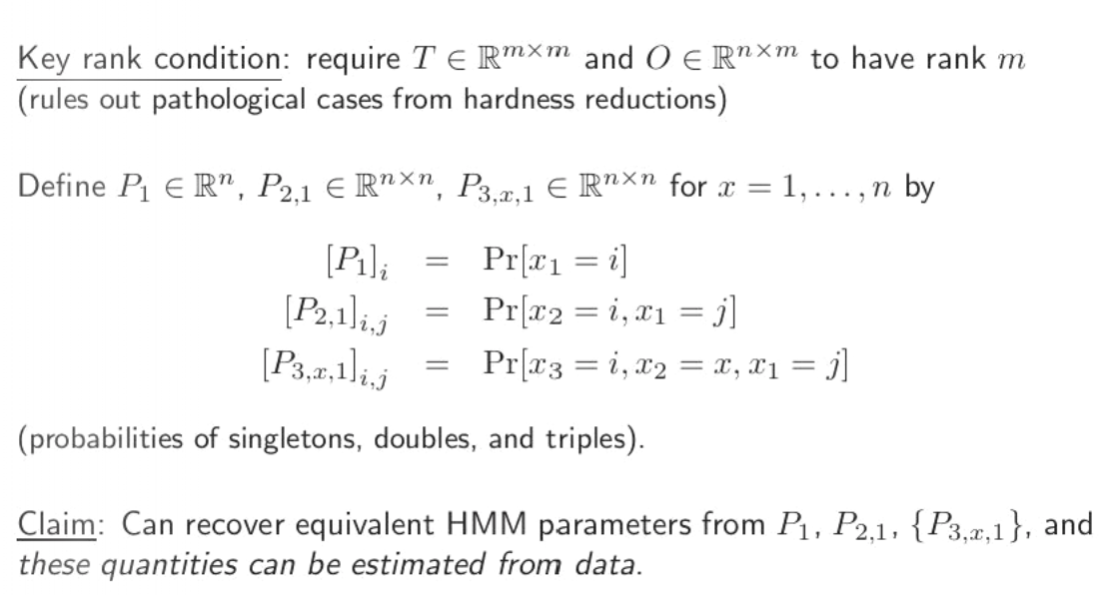
Learning Observable Operators in HMM
Source: slides from Daniel Hsu

Slide 13
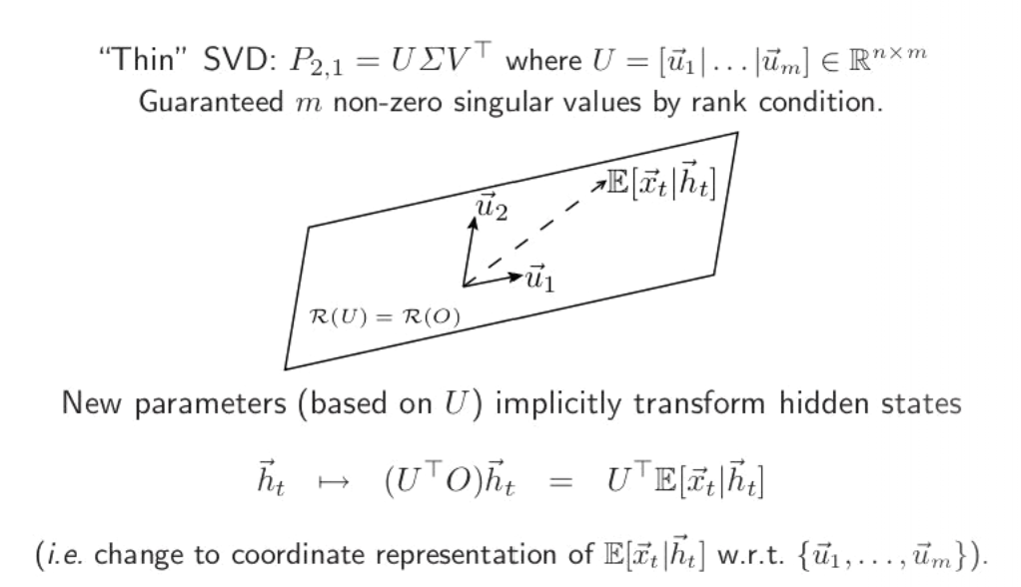
Learning Observable Operators in HMM cont.
Source: slides from Daniel Hsu

Slide 14
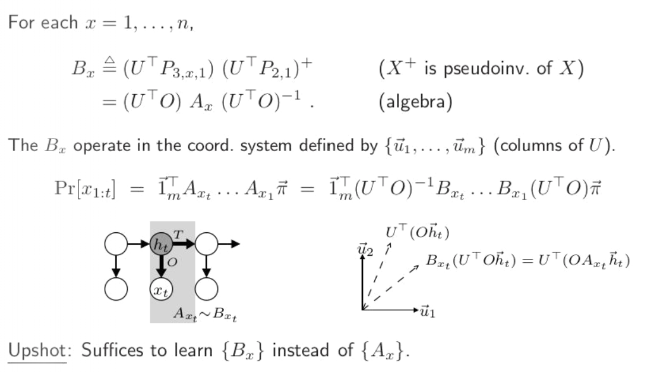
Learning Observable Operators in HMM cont.
Source: slides from Daniel Hsu

Slide 15
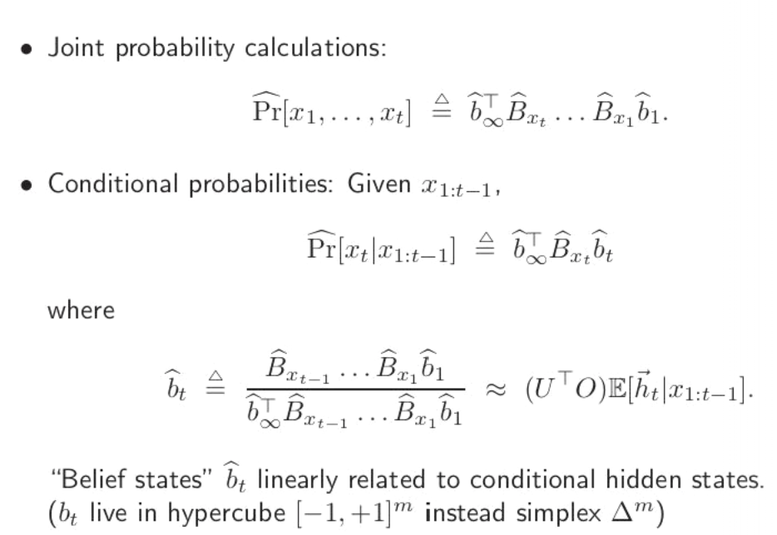
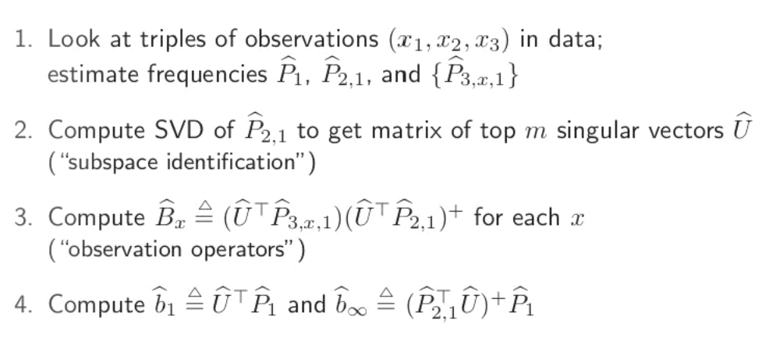
Learning Algorithm for HMM
Source: slides from Daniel Hsu

Slide 16
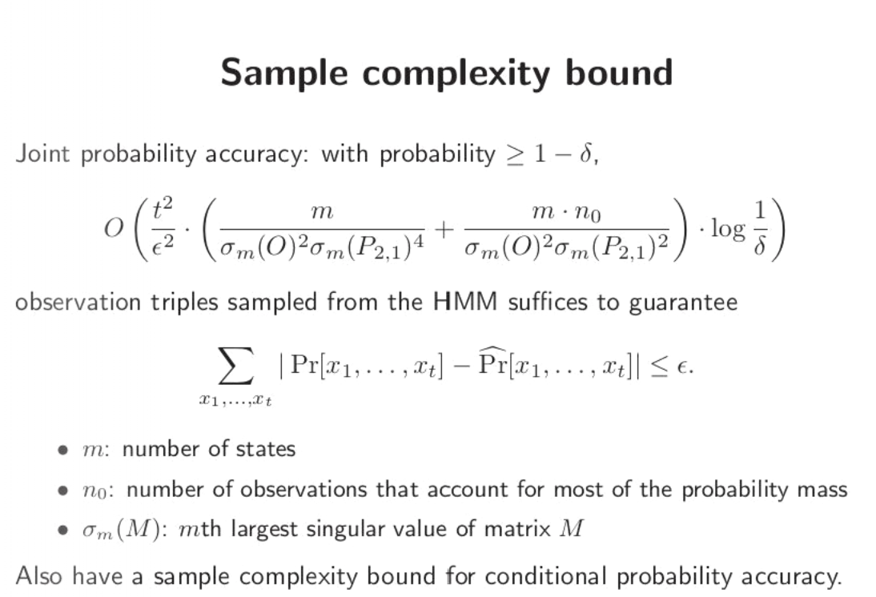
Learning Guarantees
Source: slides from Daniel Hsu

Slide 17
Lots of other applications of spectral methods
Extending HMMs to Partially observed Markov decision processes (POMDP) and Predictive state representations (PSR): passive vs active.
POMDP: Action based on each observation and can influence Markovian evolution of hidden state
PSR: No explicit Markovian assumption on hidden state. Directly predicts future (tests) based on past observations and actions (For linear PSR, similar to spectral updates in HMM)
Stochastic bandits in a low rank subspace (ask TA Sahin about it)

Slide 18
References
Matrix computations (textbook) by Golub and Van Loan
A spectral algorithm for learning hidden Markov models by Hsu, Kakade and Zhang.
Spectral Approaches to Learning Predictive Representations by Byron Boots (PhD thesis) https://apps.dtic.mil/dtic/tr/fulltext/u2/a566112.pdf

