Slide 1
Lecture 6 CMS 165
Spectral Methods: Tensor methods

Slide 2
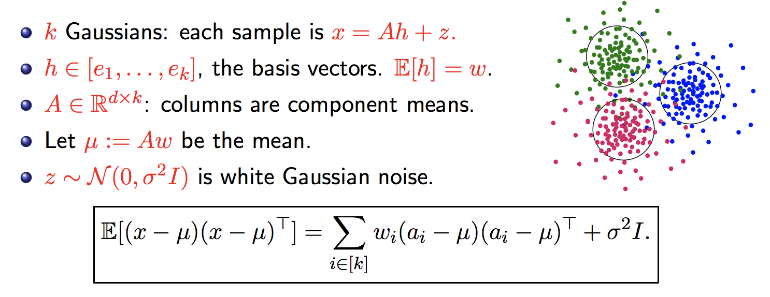
Recap: PCA on Gaussian Mixtures
Can obtain span(A).
But what about columns of A?

Slide 3
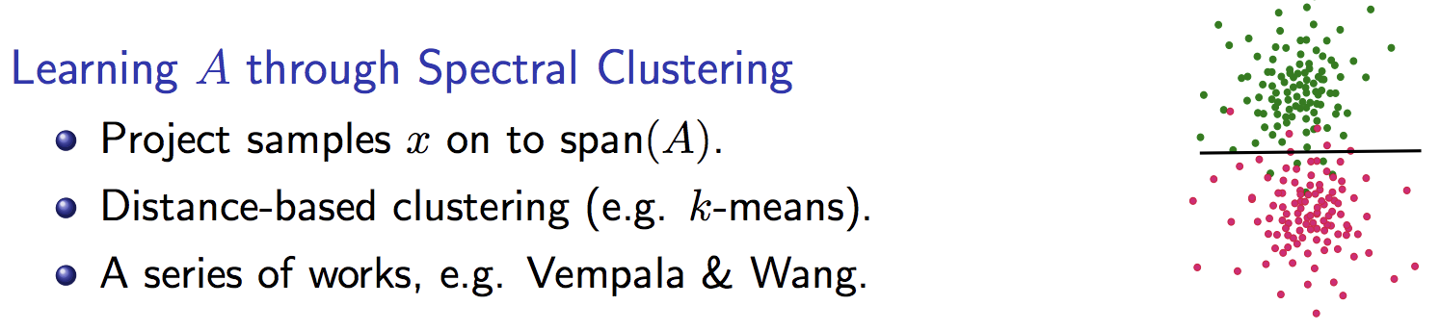
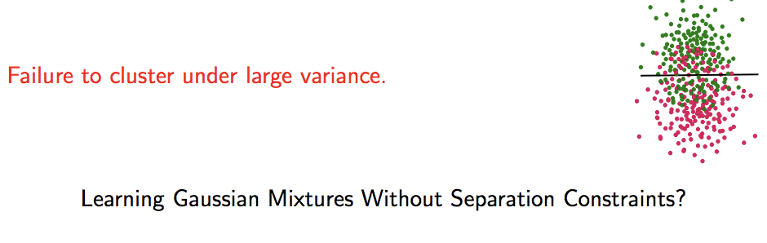
Learning Gaussian mixtures through clustering

Slide 4
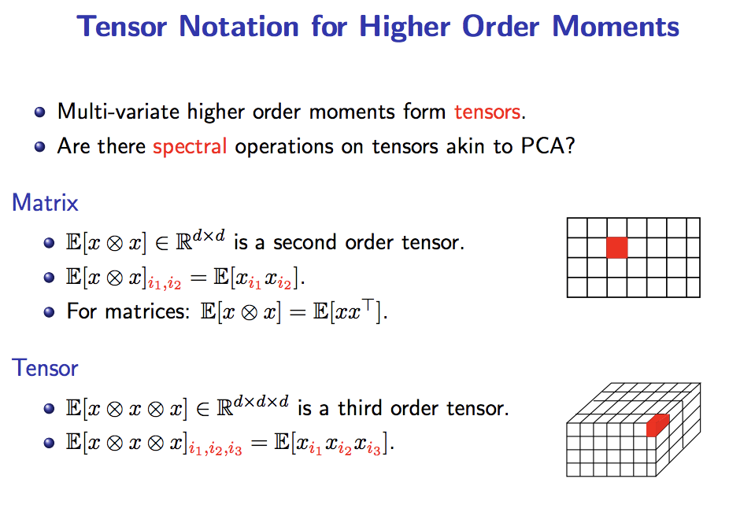

Slide 5
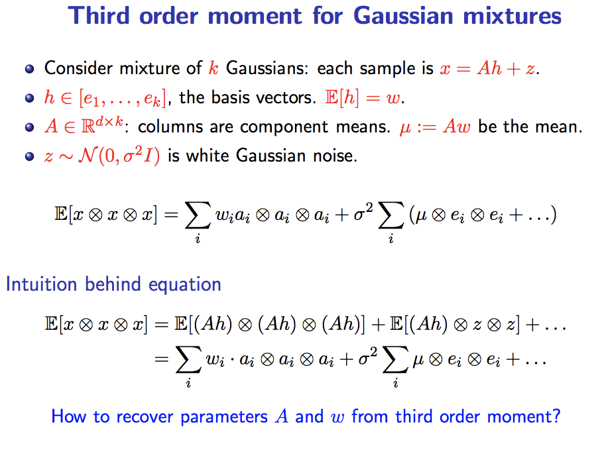

Slide 6
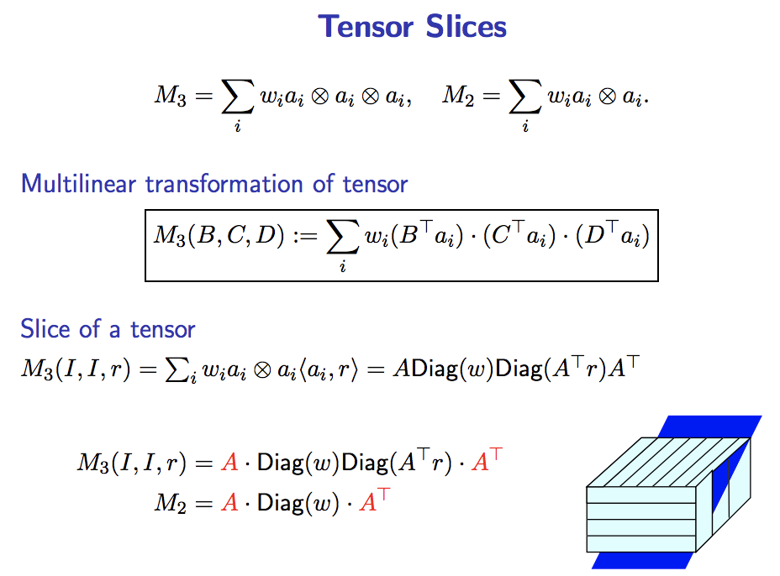

Slide 7
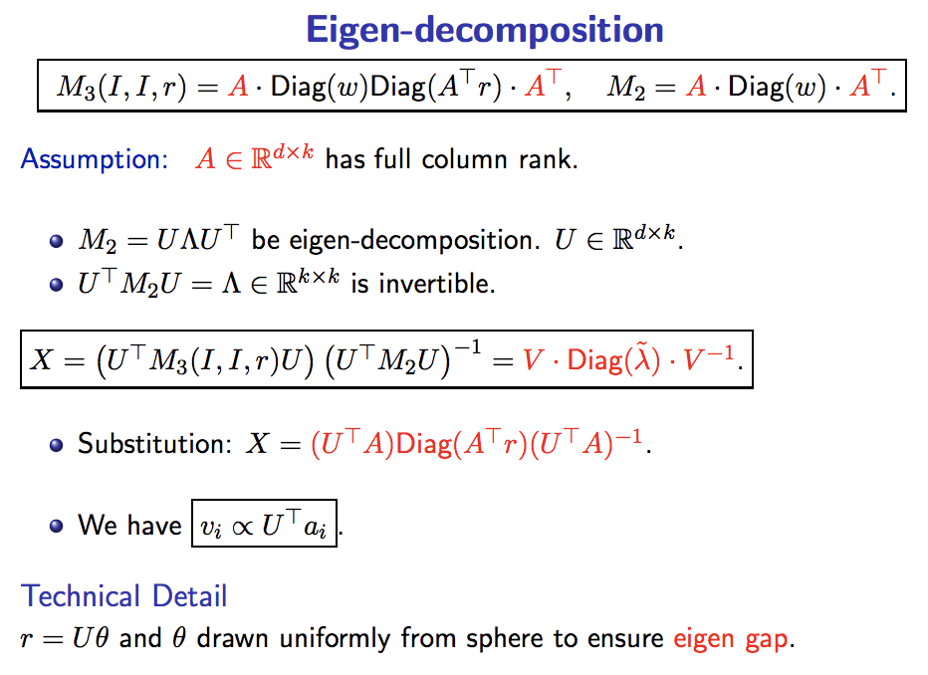

Slide 8
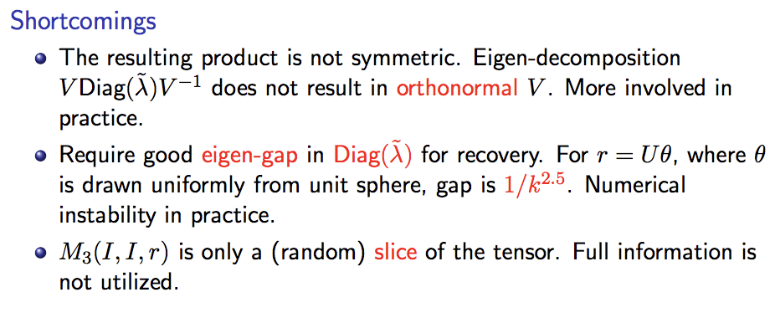

Slide 9
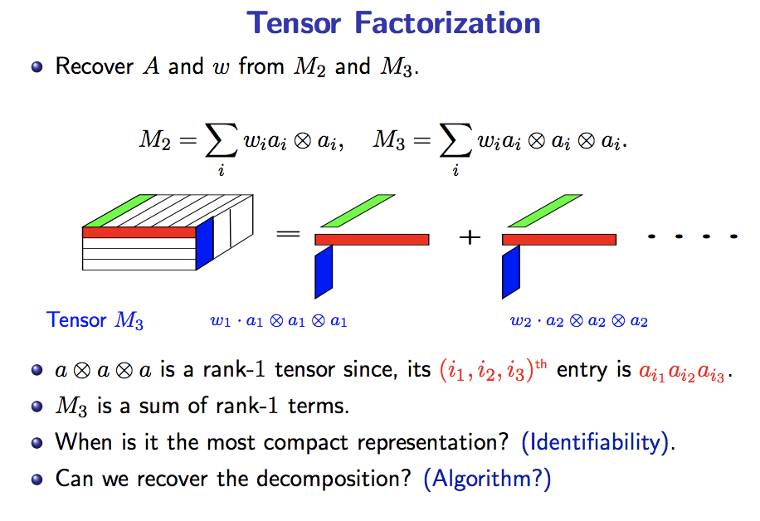

Slide 10
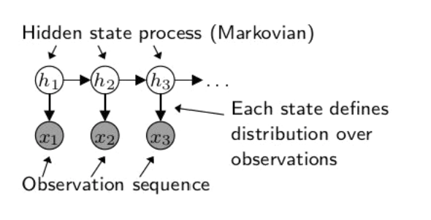
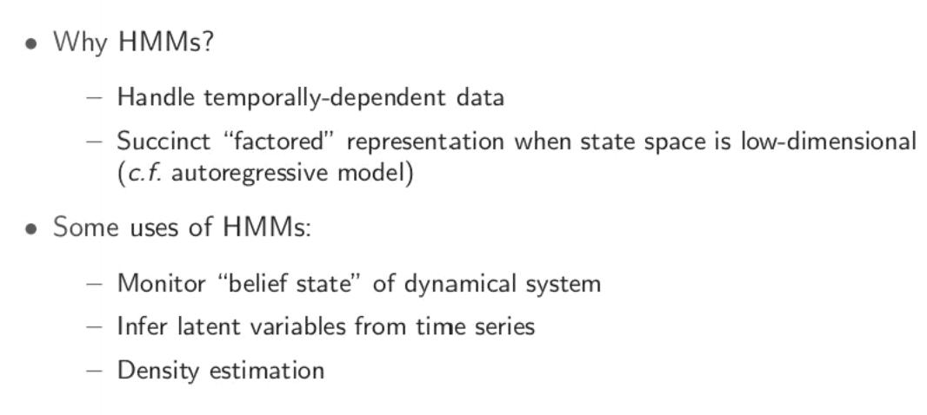
Hidden Markov Models
Source: slides from Daniel Hsu

Slide 11
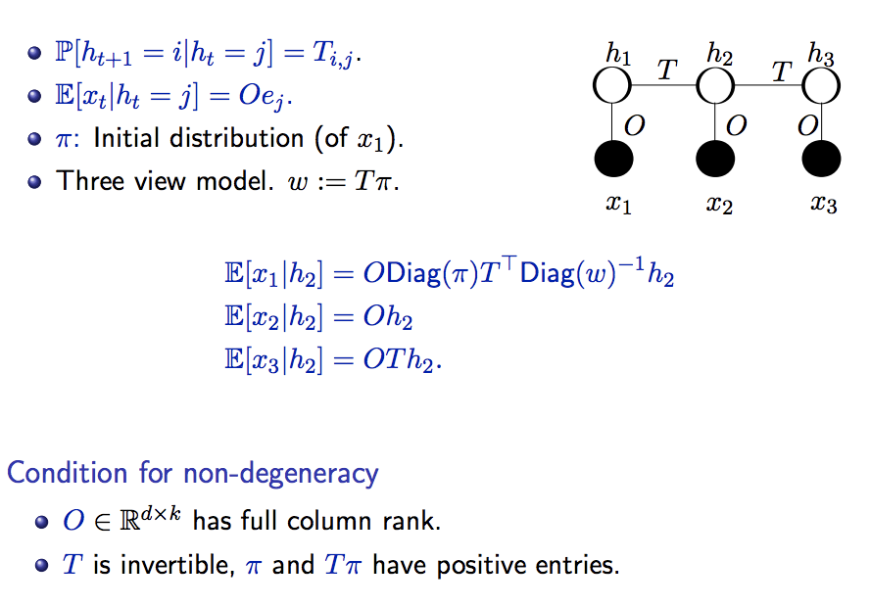
Discrete Hidden Markov Models

Slide 12
Lots of other applications of spectral methods
Extending HMMs to Partially observed Markov decision processes (POMDP) and Predictive state representations (PSR): passive vs active.
POMDP: Action based on each observation and can influence Markovian evolution of hidden state
PSR: No explicit Markovian assumption on hidden state. Directly predicts future (tests) based on past observations and actions (For linear PSR, similar to spectral updates in HMM)
Stochastic bandits in a low rank subspace (ask TA Sahin about it)

Slide 13
References
Monograph on spectral learning on matrices and tensors (preprint available on Piazza)
Slides from MLSS: available on http://tensorlab.cms.caltech.edu/users/anima/

