Slide 1
MB
BLACKBELT ON AGENTIC ABM — MEGABRAIN ACADEMY — MODULE 2
2. Selecting Target Accounts
Build an Ideal Customer Profile, score and rank accounts, and turn a long list of possible customers into a short list worth a dedicated program.

Slide 2
MB
2.1 Set the program goal before you touch a target list
— "Win new mid-market logos" and "grow existing accounts through cross-sell" are different programs with different target lists -- pick one before you build either
— Other goal shapes that show up in practice: shorten the sales cycle by engaging every buying-committee member at once, expand into a new department inside an existing account, improve win rate by getting exec sponsors involved earlier, reduce churn with proactive account plans
— Whatever the goal, write it as a number: e.g. "open a conversation with 40 accounts, close 2 pilot deals" -- not "raise awareness"

Slide 3
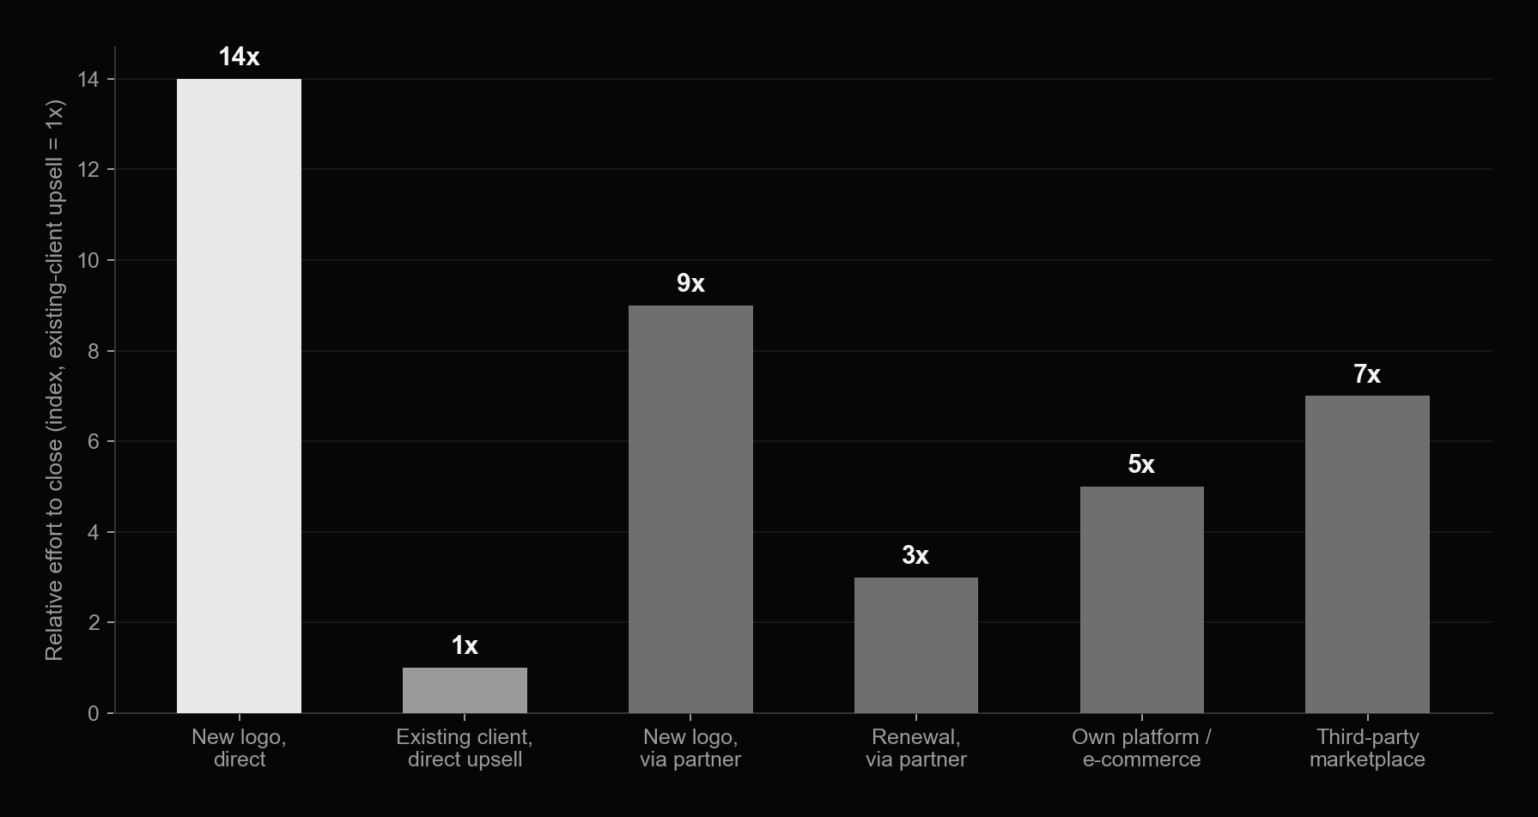
It's roughly 14x harder to win a new logo than to expand one
MB
Indexed to existing-client upsell = 1x. If your program goal is new-logo acquisition, budget and expect it to take longer than an expansion motion -- that's not a sign something is wrong.

Slide 4
MB
Pilot programs: the rule of one
— Don't bite off more than you can chew -- the most common first-time-ABM mistake is running a pilot across too many industries, tiers, and reps at once
— One industry. One account tier (e.g. cluster-ABM only). One relationship stage (cold, or already-met, or upsell -- not a mix). One marketer. One sales rep. One goal. One primary tactic.
— Cap the pilot at 20 target accounts maximum -- you can always run a second pilot once the first one proves the model

Slide 5

MB
2.2
Who WILL buy, not who COULD buy
An Ideal Customer Profile isn't a market-sizing exercise -- if the whole addressable market fits your profile, nothing has changed. A good ICP forces focus, drives personalization, picks the right channels, gives qualification calls a checklist, and feeds directly into the scoring model later this module. You can run more than one ICP -- just give each its own program.

Slide 6

MB
Align sales and marketing on the goal before the list exists
The single most common failure mode this module guards against: marketing builds a list nobody in sales believes in. Get both functions in the room before the first account gets scored.

Slide 7
MB
2.3 Six factor groups behind every ICP

Slide 8
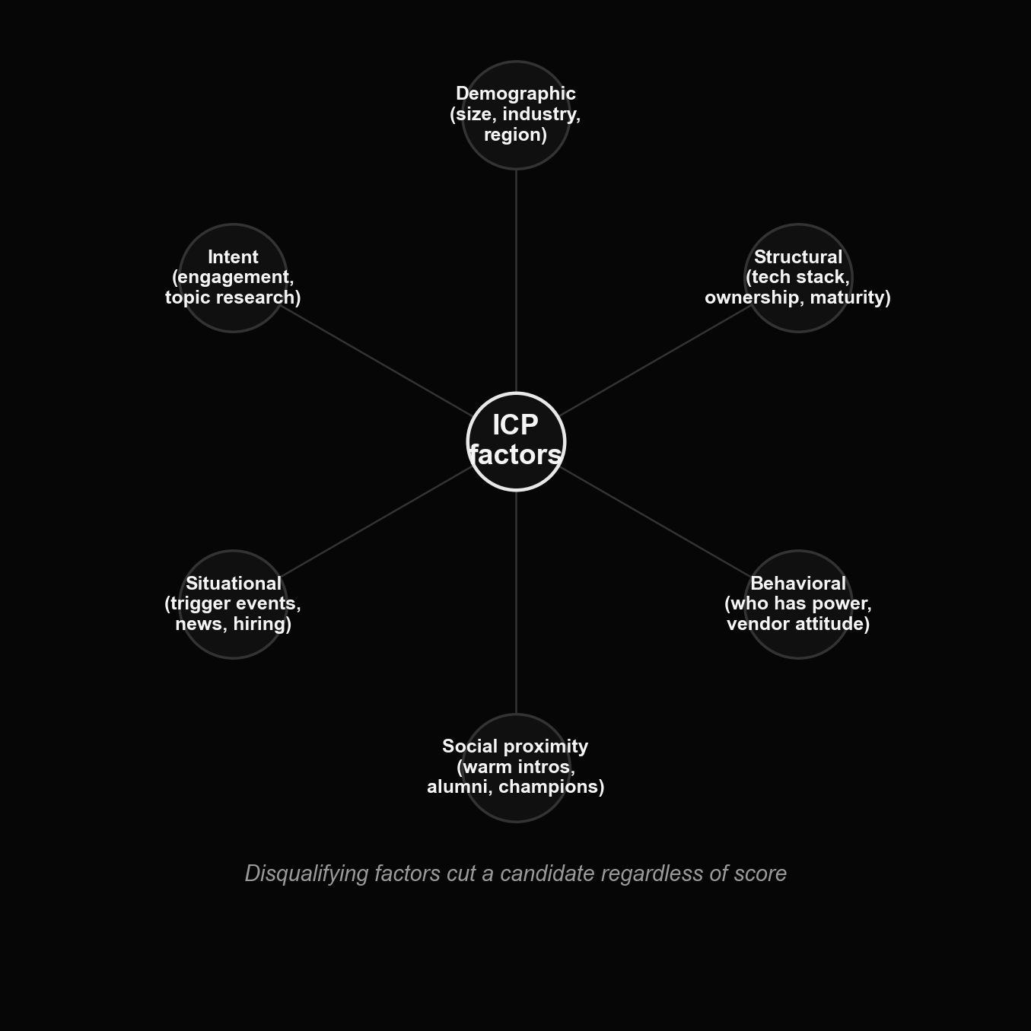
The six factor groups, plus a disqualifying-factors gate
MB
Demographic and structural factors describe the company. Behavioral and social-proximity factors describe how it acts and who you know there. Situational and intent factors describe timing -- is now the moment.

Slide 9
MB
Demographic & structural factors
— Demographic: employee count and revenue band, a ceiling above which the account gets too big to serve well, growth-rate segment (hyper-growth vs. stable), industry vertical and sub-vertical, HQ and branch locations
— Structural (binary, not scored on a scale): process maturity, independent company vs. regional subsidiary, market leader vs. fast-follower, centralized vs. decentralized decision-making, already using a competitor's product, an existing gap your product could fill, growth by acquisition vs. organic
— Structural factors cut cleanly -- a company either has the attribute or it doesn't, which makes them useful for separating "dream client" from "don't bother"

Slide 10
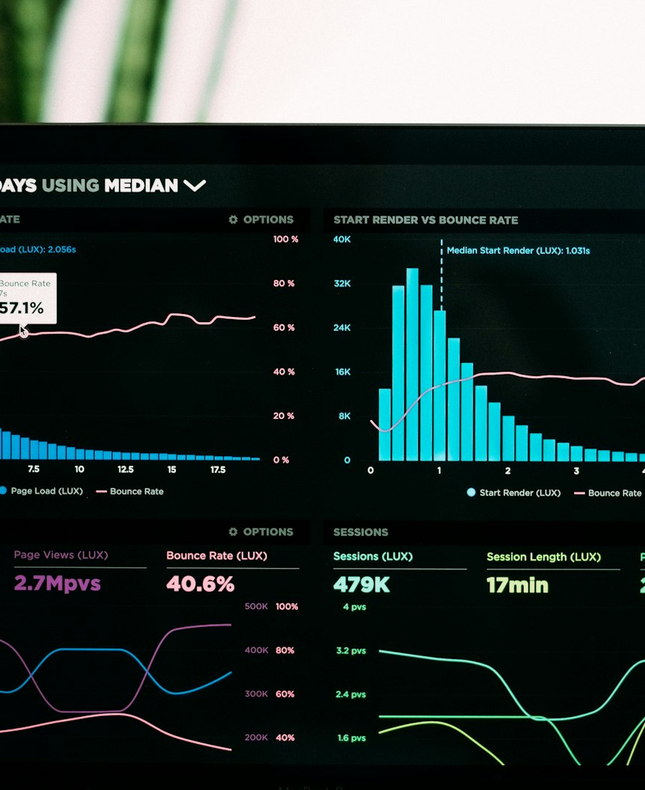
MB
Behavioral & situational factors need research, not a database export
Behavioral: which department actually holds budget power, and how open the company is to unproven vendors. Situational ("trigger events"): new leadership, M&A, a funding round, a hiring wave. About 75% of deals go to whichever vendor helps the buyer name the problem first -- these signals tell you when to show up.

Slide 11
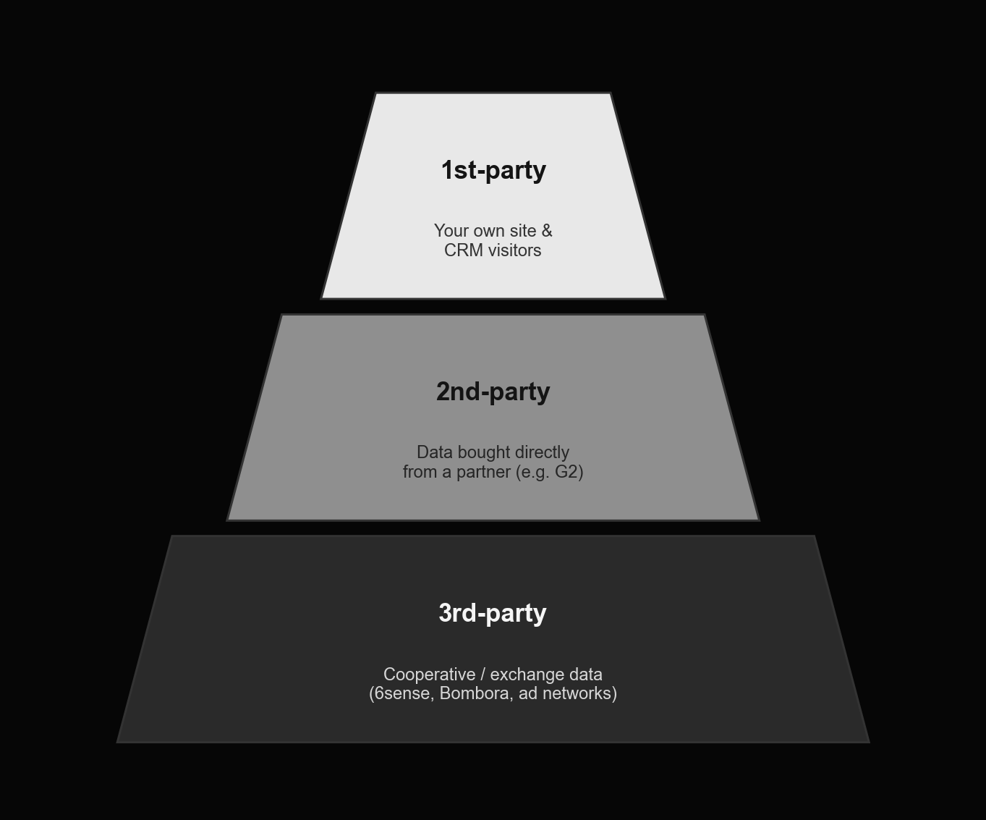
Intent data comes in three tiers
MB
1st-party is free and highest-trust but small. 3rd-party (cooperative/exchange data) has the broadest reach but is noisiest -- use it to widen the net, not to make the final call on an account.

Slide 12
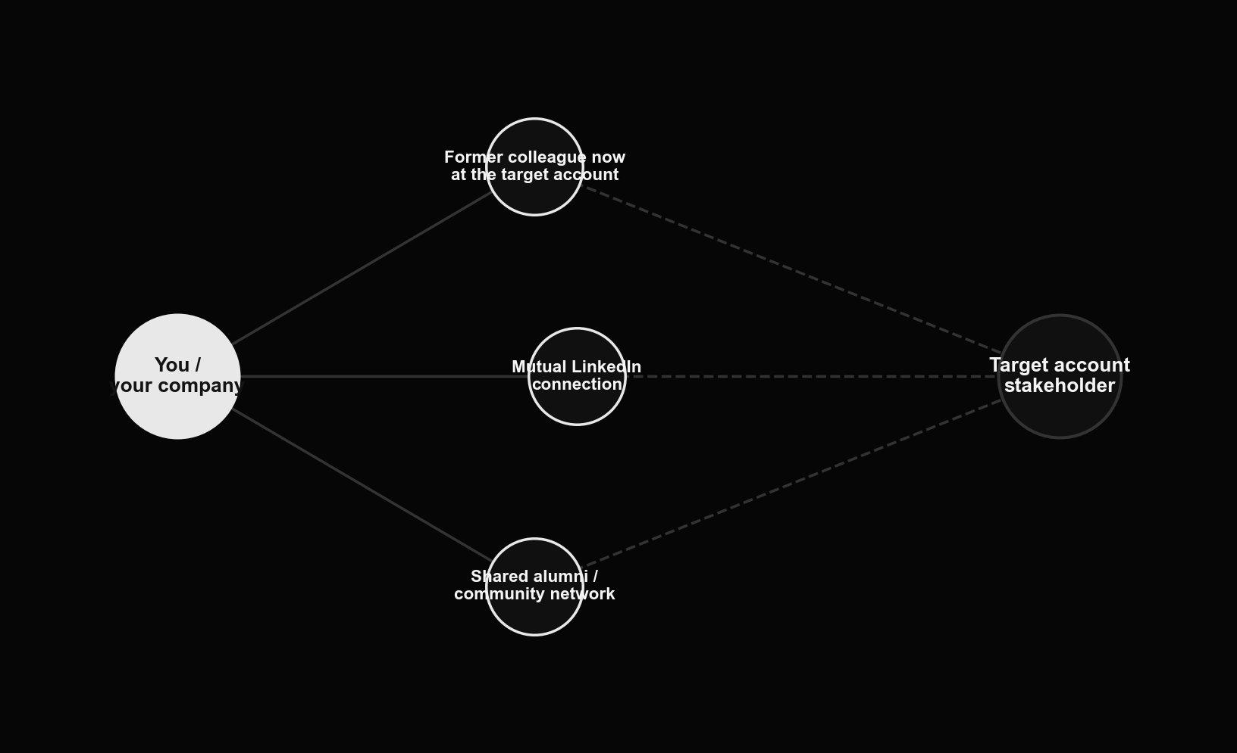
Social proximity: the warm-intro map
MB
A former colleague now at the target account, a mutual LinkedIn connection, or a shared alumni/community network all shorten the path to a first conversation -- map them before you cold-outreach.

Slide 13
MB
Disqualifying factors cut a candidate regardless of score
— No named budget owner for this category, and no near-term plan to create one
— A build-vs-buy culture with a large in-house engineering team already covering the same ground
— An account so large that a single logo would consume more delivery capacity than you can safely commit
— A product surface so narrow (or so broad) that it doesn't map to any real workflow at the account
— Locked into a multi-year contract with a direct competitor, with no offramp for 12+ months
— Write your own list -- disqualifiers are specific to your business, not a generic checklist

Slide 14
MB
2.4 Sourcing the raw account list

Slide 15

MB
From "everyone who could buy" to a workable raw list
The goal at this stage is volume with a light filter -- 20 to 50 candidate accounts that roughly match the demographic and structural factors above. Precision scoring comes later.

Slide 16
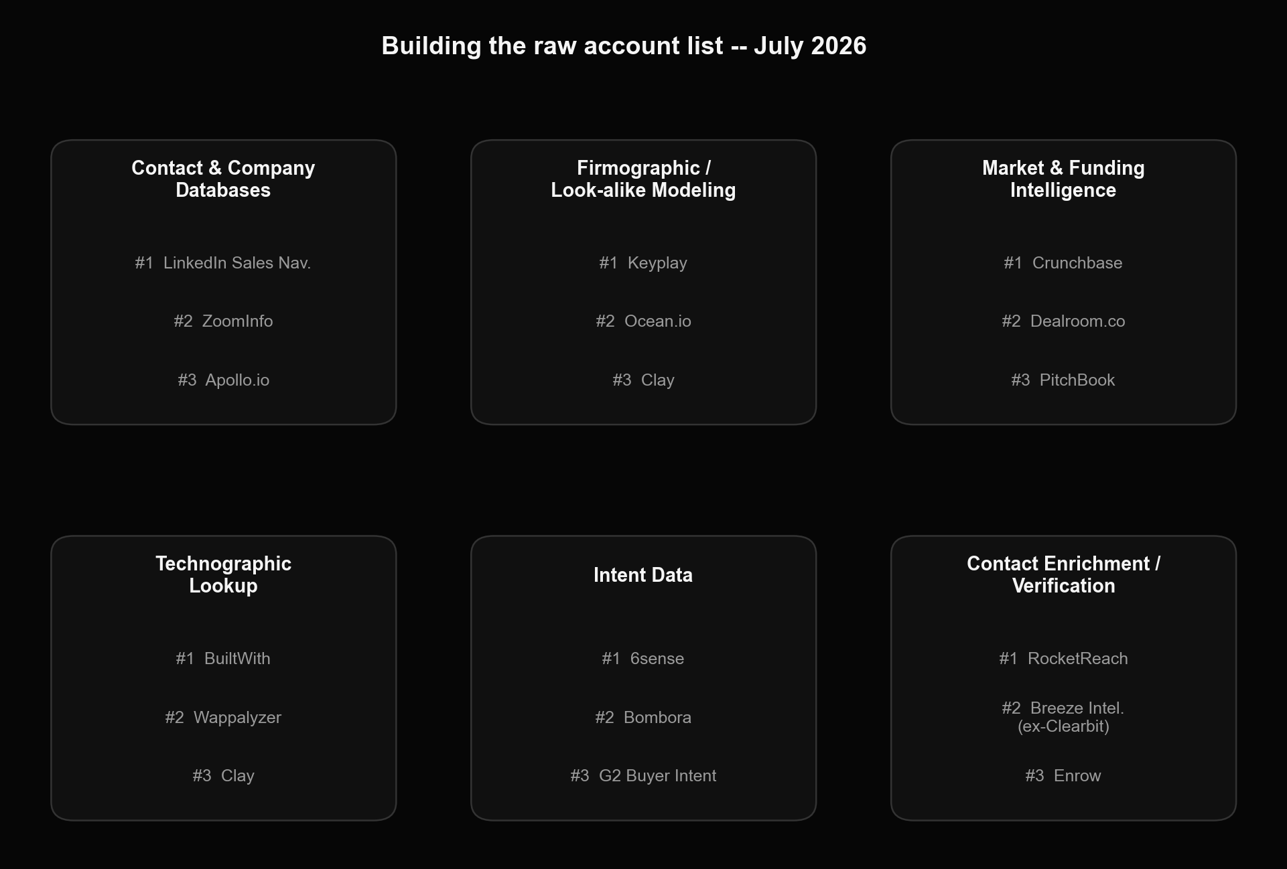
Where the raw list comes from
MB
Names verified current as of July 2026 -- Breeze Intelligence is HubSpot's rebrand of the former Clearbit, acquired December 2024. Look-alike modeling tools (Keyplay, Ocean.io) take a handful of your best customers and return companies that resemble them, which is a faster starting point than building demographic filters from scratch.

Slide 17
MB
2.5 Scoring and prioritizing the list

Slide 18
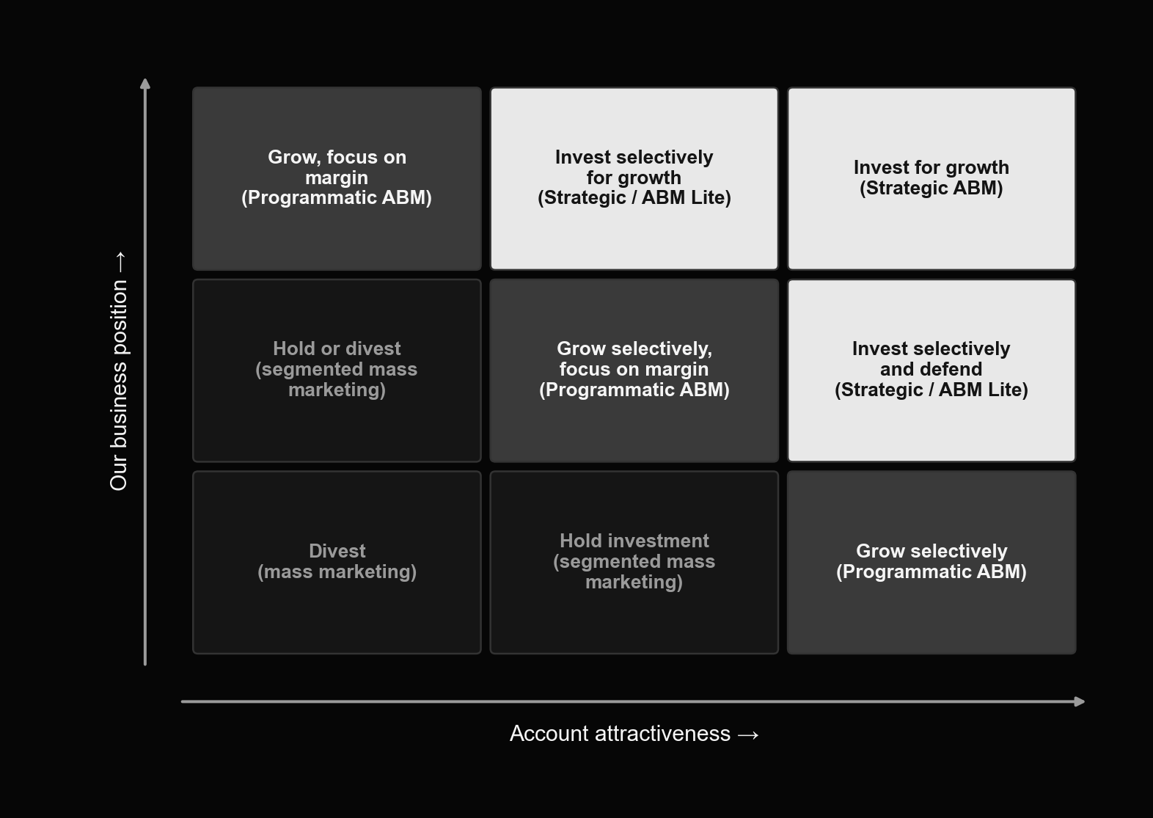
The GE/McKinsey grid, applied to account selection
MB
Score every raw-list account on two axes -- account attractiveness and your competitive/business position -- and the grid tells you the motion: invest in strategic ABM top-right, run programmatic ABM in the middle, and don't spend real budget bottom-left.

Slide 19
MB
A starting weighted-scoring model (adapt the weights to your business)
Factor | Weight | 1 point | 3 points | 5 points
Our business position
Industry fit | 0.5 | Commodity / raw materials | Capital equipment | Software / high-growth tech
Geography | 0.2 | Secondary market | Regional hub | Major metro / core market
Relationship warmth | 0.3 | No connection | 1st/2nd-degree LinkedIn | Personally acquainted
Account attractiveness
YoY revenue growth | 0.1 | Declining | Up to 10% | Over 10%
Digital maturity (site + email) | 0.3 | Neither in place | One of the two | Both, actively used
Agency / consultant experience | 0.3 | Never worked with one | Worked with one once | Ongoing relationship
Staff with relevant skills on payroll | 0.3 | None | One person | More than one

Slide 20
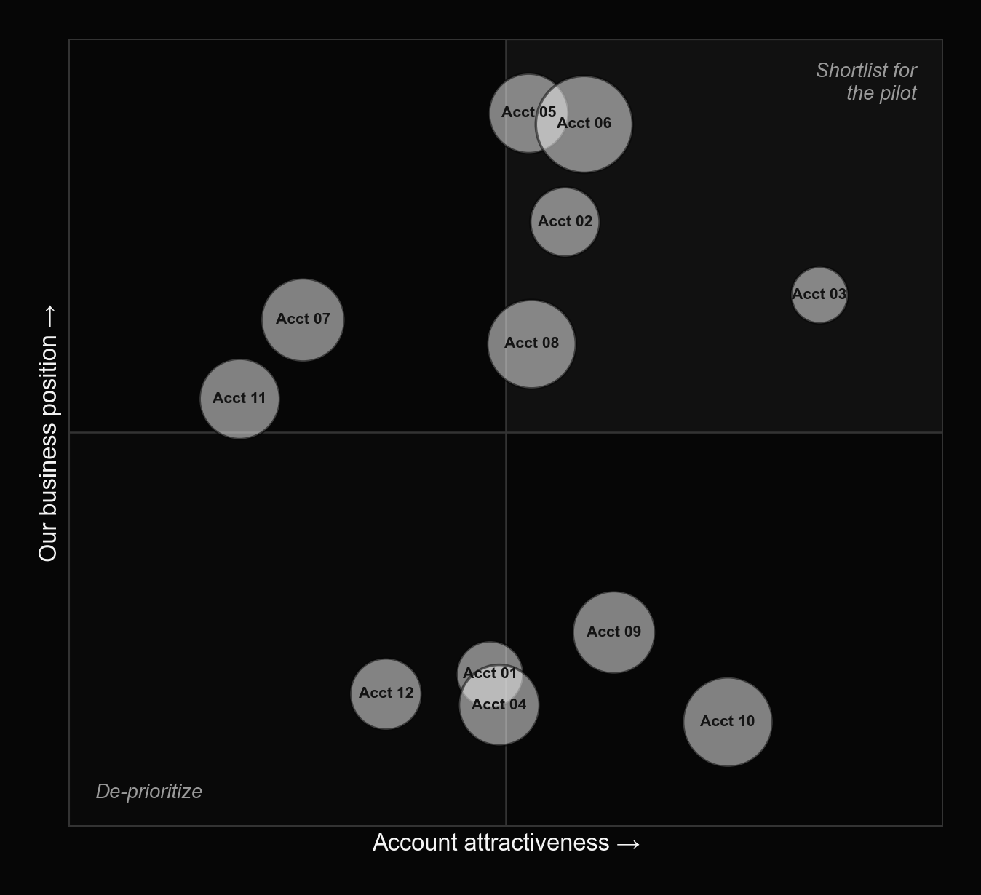
The raw list, scored and plotted
MB
Illustrative example -- bubble size is deal-size potential. The top-right quadrant becomes your pilot shortlist; everything bottom-left gets de-prioritized, not deleted.

Slide 21

MB
Run the final cut as a team, not a spreadsheet macro
Three things the source training flags here: get sales and marketing to agree on the final shortlist together, not separately; watch for accounts with a reputation as difficult or abusive to work with, however attractive they score; and expect this step to take longer than planned -- that's usually a sign you're doing it properly, not that something's wrong.

Slide 22
MB
Worked examples from the field

Slide 23
MB
Two published account-selection frameworks worth studying
— OneLogin's public ICP framework scores each account on five columns: Technical Attributes (the SaaS/IAM stack already in place), Business Attributes (digital-transformation initiatives, workforce distribution), Trigger / Compelling Event (a large-scale app deployment, a security incident), Product Interest (single sign-on at scale), and Pain Points (fragmented identity management). We're summarizing the framework here, not reproducing OneLogin's original slide -- worth finding and reading in full if this maps to your product.
— Fabiana Carpio Brunetti, then Director of Global ABM at Pure Storage, has published a five-factor account-selection model that goes beyond ICP fit alone: strategic alignment, revenue potential, engagement opportunity (social proximity), operational readiness, and internal-champion influence. Her core point: anchor the list in data, not just the sales team's gut feel about who they'd like to sell to.

Slide 24
MB
2.6 Agentic ABM in practice

Slide 25
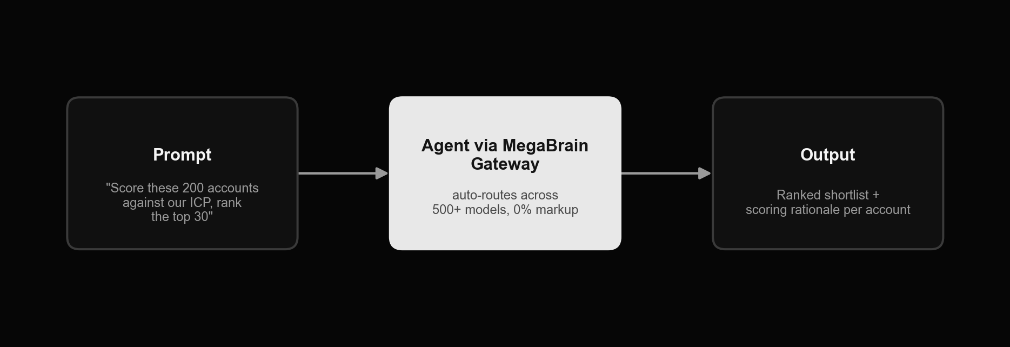
MegaBrain: an agent workflow for this module
MB
Feed the agent your raw list and your weighted scoring model in one prompt, routed through MegaBrain's model-agnostic gateway, and get back a ranked shortlist with a written rationale per account -- the scoring pass that used to take a workshop now takes one prompt, with the workshop still needed to sanity-check the output.

Slide 26

MB
Other agent tools for account selection & scoring
Clay -- pull firmographic, technographic and funding data per account and run your weighted formula across the whole list automatically. ZoomInfo Copilot -- AI-assisted account and buying-group identification layered on ZoomInfo's own database. A Perplexity or other deep-research agent -- given a seed list of best customers, research and write a first-draft ICP narrative. n8n / Make -- a scheduled workflow that re-scores the account list monthly as firmographic and intent data refreshes.

Slide 27
MB
Exercises

Slide 28
MB
Homework 1 -- score the attributes of your ideal client
— Using the seed lists from Module 1 (your best 10-15 and worst 10-15 existing customers), run a manual scoring pass across all six factor groups from 2.3 for each account
— For your best customers, answer: why did they choose you over competitors? What was happening inside their company around the time they bought? Who was involved in the buying process?
— Do the same for your worst customers, looking for the inverse pattern -- what do they have in common that your best customers don't?
— Write down every factor where best and worst customers clearly diverge -- that divergence is the raw material for your ICP

Slide 29
MB
Homework 2 -- build your raw account list
— Using the demographic and structural factors that came out of Homework 1, build a raw list of 20-50 candidate target accounts
— Pull from at least two source categories in the 2.4 landscape chart -- e.g. LinkedIn Sales Navigator plus one look-alike modeling tool -- don't rely on a single database
— Capture, at minimum: company name, domain, industry, employee-count band, and HQ location for every account on the list
— This raw list is deliberately loose -- resist the urge to over-filter here, that happens in Homework 3-4

Slide 30
MB
Homework 3 -- build your own scoring model
— Pick 3-5 factors for account attractiveness and 3-5 factors for your business position -- start from the table in 2.5 and adjust the factors and weights to your own business
— Assign a weight to each factor so that attractiveness weights sum to 1.0, and business-position weights separately sum to 1.0
— Define what a 1-point, 3-point, and 5-point answer looks like for every factor -- vague bands produce inconsistent scores
— If you genuinely don't know a factor's value for a given account yet, give every account the same default score for it rather than guessing account-by-account

Slide 31
MB
Homework 4 -- plot the matrix and cut the pilot shortlist
— Score every account on your raw list against the model from Homework 3, and plot each one on the GE/McKinsey grid from 2.5
— As a team (not solo), identify your 3-10 highest-priority accounts for the ABM pilot
— Every account on the pilot shortlist must share the same relationship stage (all cold, or all post-meeting, or all upsell) and the same segment/industry -- mixed shortlists are what section 2.1's "rule of one" is warning against
— Bring the finished shortlist and scoring model into Module 3 -- that's where you'll start building account intelligence on each name on the list

