Slide 1
MB
BLACKBELT ON AGENTIC ABM — MEGABRAIN ACADEMY — MODULE 3
3. Account Intelligence
Four levels of research, where to find it, and how to capture it in an account plan — so your personalization is built on fact, not a guess.

Slide 2
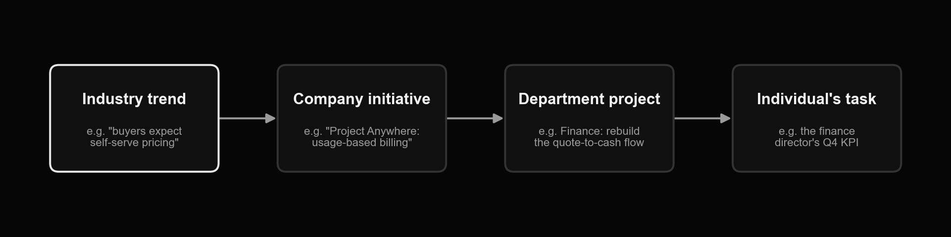
3.1 Why account intelligence: the cascade
MB
Most sales failures trace back to one thing: not understanding the individual's actual priorities. Research runs top-down so your pitch can land bottom-up.

Slide 3
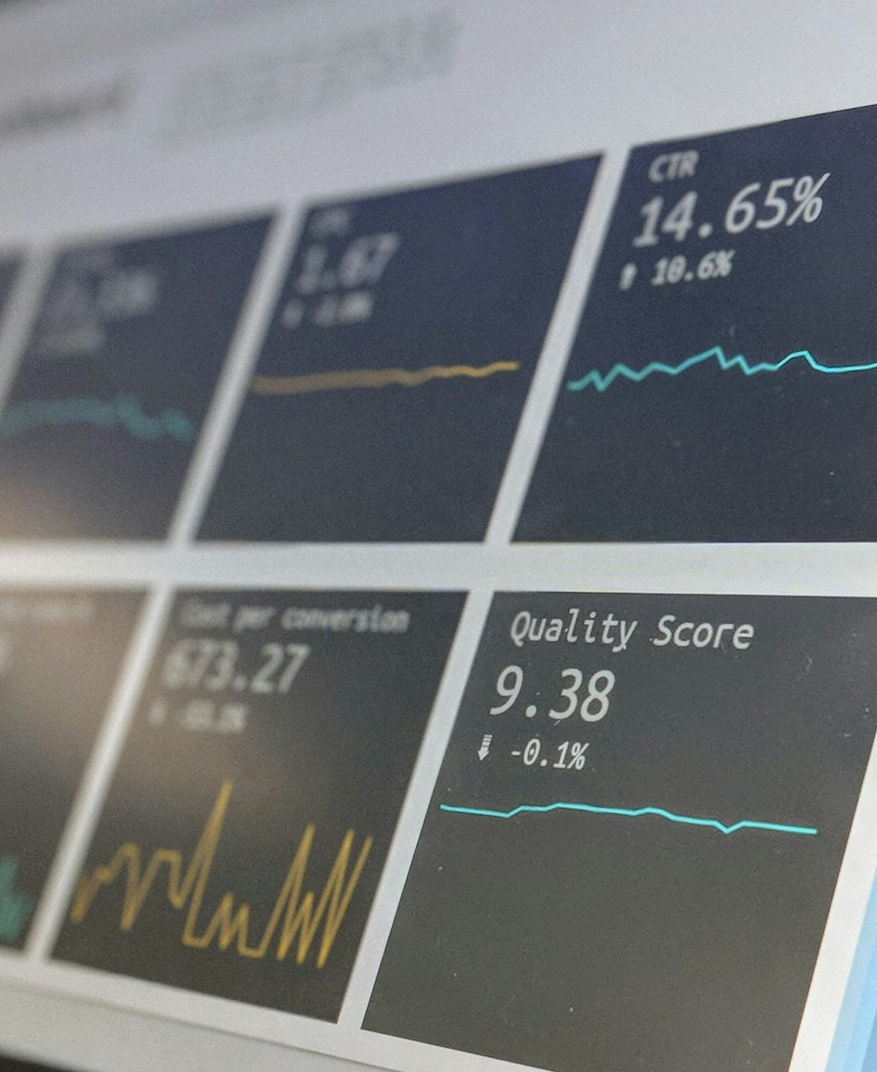
MB
3.1
Two questions before you start
How deep does this account need to go, and who's actually doing the digging? A 1:1 strategic account earns a full account plan; a cluster account gets a lighter template — but every account gets an answer to both questions before research starts.

Slide 4
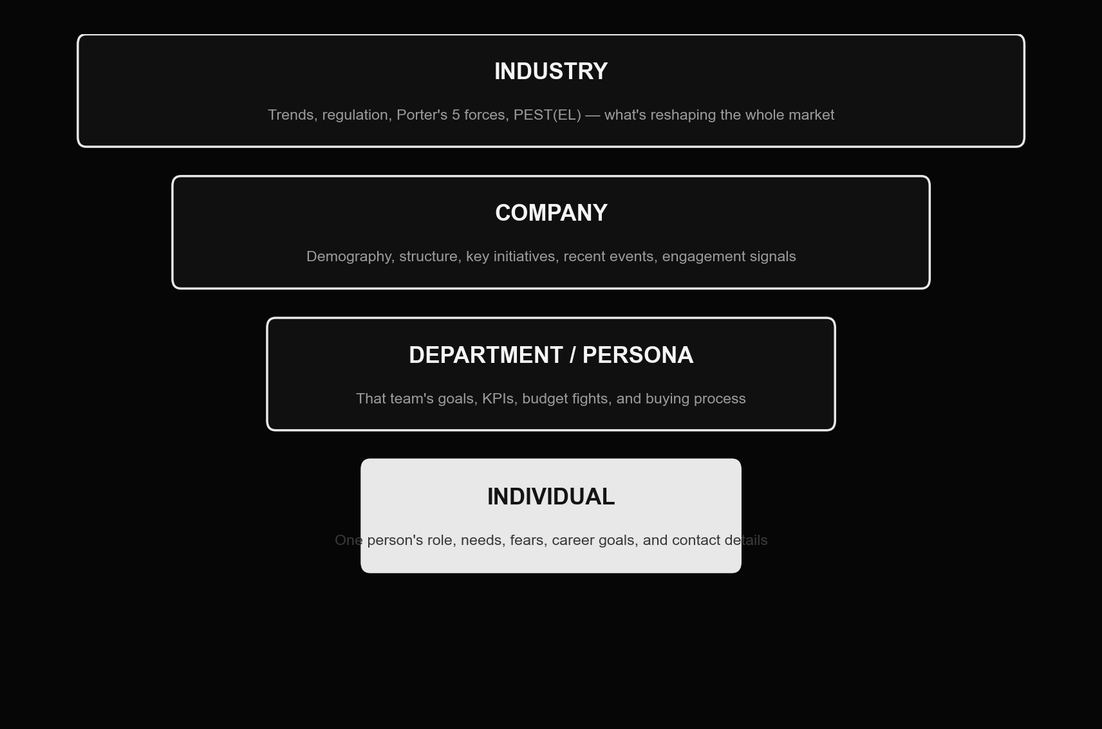
The four levels of account intelligence
MB
Widest at the top, most personal at the bottom. Skipping straight to the individual without the industry and company context above it is how personalization turns into guesswork.

Slide 5
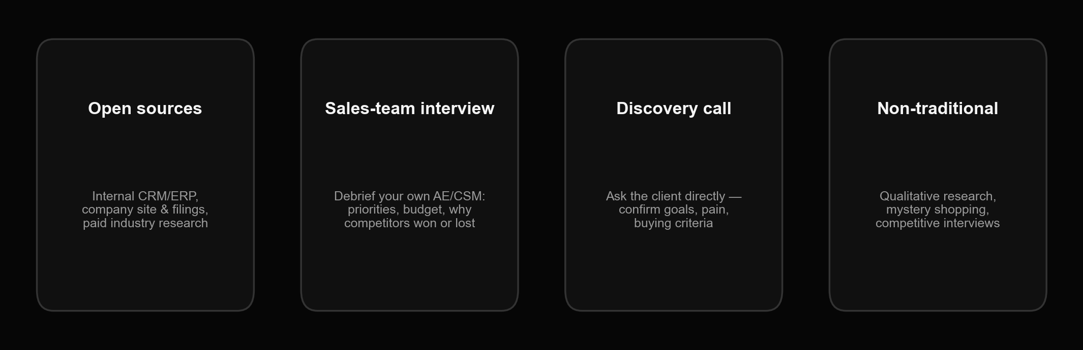
3.2 Where to find it — four source categories
MB
Open sources are the default. The other three take more effort per account, which is exactly why they're reserved for accounts worth the effort.

Slide 6
MB
What to ask your own sales team
— What are the client's current problems and priorities, as they've told you?
— What's the culture like inside the account — consensus-driven, top-down, slow, fast?
— What projects are already running with this client, and what's their status?
— Which of our strengths does the client actually notice and value?
— Which competitors are active in this account, and why did they win or lose the last deal?
— Is there any visibility into this account's budget for similar initiatives?
— Where have we been most successful with this client so far — and why?

Slide 7

MB
3.2
The discovery call: confirm, don't assume
Don't start at the top of the org chart — it's easier to get a straight answer lower down. Confirm the goals and pain points you already believe are true, ask which one is most urgent, and ask directly what criteria they'll use to choose a vendor.

Slide 8
MB
3.3 Company-level research: initiatives are the hook

Slide 9

MB
Key initiatives: your entry point into the account
A key initiative is a project outside day-to-day operations meant to change the company or its results — usually 3-5 years long, with a name and a measurable target ('from A to B'). Your offer needs to visibly move the needle on one of the account's top five, not just be generically relevant.

Slide 10
MB
Mapping your offer onto a business imperative
Field | Worked example
Business imperative | Employees expect secure access to company systems from any device, anywhere, anytime.
Client initiative | Project "Anywhere Workforce" — give every consultant remote-office-grade access to core systems.
Target audience | HR, IT and Finance leaders who know flexibility now equals productivity — but whose infrastructure wasn't built for it.
Our solution | A fully managed IT service supporting remote work on any device, billed on usage, with real-time reporting.
Benefits if they choose us | Better cash flow (opex not capex), IT freed from break-fix work, instant scaling with headcount changes.
Why us, not a competitor | Already running for 75 companies and 150,000 employees globally, on security-first infrastructure.

Slide 11
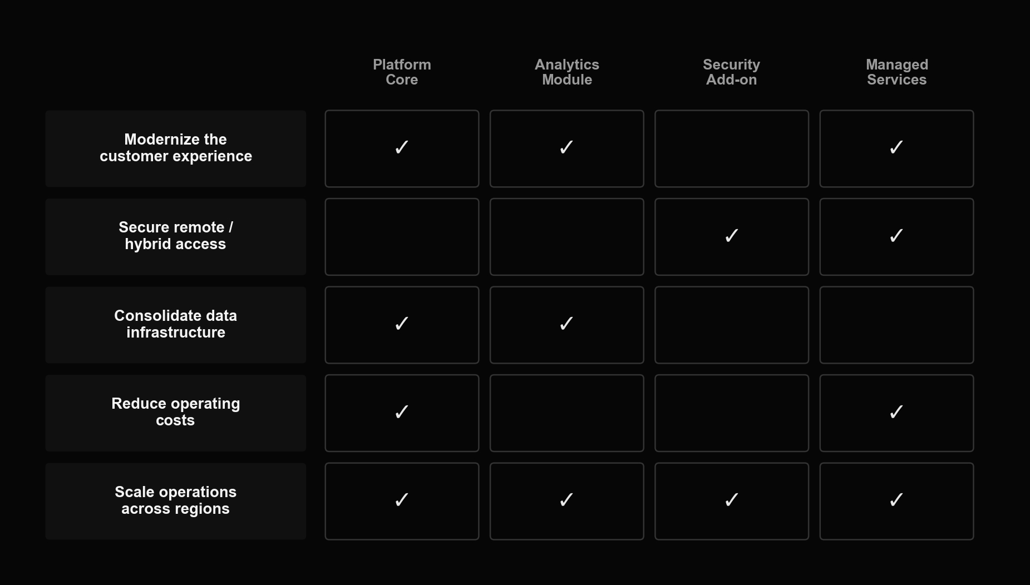
The opportunity matrix: initiatives × solution lines
MB
Once you've listed 3-7 key initiatives per account, map every product or service line you sell against them. Empty rows are accounts you can't yet justify chasing; empty columns are offers with no current story.

Slide 12
MB
Self-check before you pitch an initiative
— What are the account's 3-7 key initiatives — including ones that don't touch you directly?
— Which of those initiatives can your offer realistically attach to, and why?
— Who inside the account owns each initiative? (Often visible in annual reports, or from a conversation with a junior contact.)
— How is success on that initiative measured and rewarded internally?
— Which parts of the organization does the initiative actually touch — rarely just one department?
— Can you prove, not just assert, why your offer is necessary to that initiative's success?

Slide 13
MB
3.4 Persona and individual-level research

Slide 14

MB
3.4
What to capture on each stakeholder
Profile: photo, title and tenure, past roles, education, DISC/communication style, professional associations, talks and articles. Psychographics: personal needs, career goals, fears, family-relevant context. All of it feeds one purpose — a conversation that sounds like you already know them.

Slide 15
MB
Five ways to open a conversation with a decision-maker
— Content they authored — "Priya, I read your piece on vendor consolidation, and the point about hidden integration cost really landed..."
— Content they engaged with — "Marcus, I saw your comment on David Reyes' post about renewal pricing — sounds like that's a live issue for you too..."
— How they describe themselves — "Sarah, your profile says developing people is what you care about most — what's the biggest blocker to that this year?"
— Personal interests, hobbies, alma mater — a genuine, specific reference beats a generic compliment every time
— Their company's own news — "Congratulations on the 40% growth last quarter — I imagine that's put real strain on onboarding?"

Slide 16
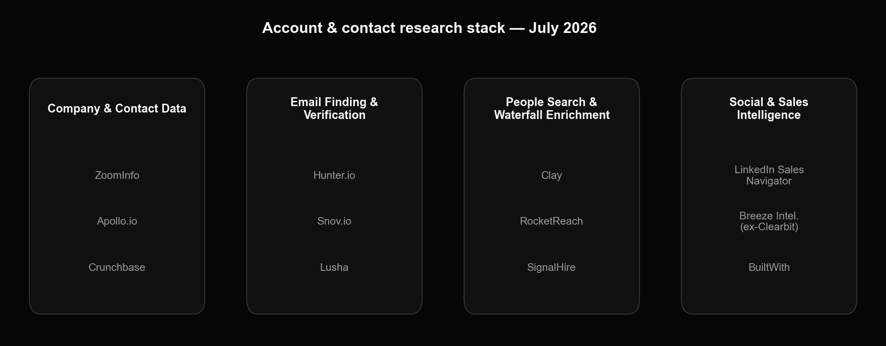
Account & contact research stack — July 2026
MB
No single tool wins every category — most teams chain 2-3 together (a "waterfall") so a miss on one provider gets picked up by the next.

Slide 17
MB
Boolean / X-ray search, and where the ethical line sits
— Boolean search: combine site: / company: / job-title operators to search a specific platform — e.g. site:linkedin.com/in "VP Marketing" "Acme Corp" — this is standard, public-web search craft, nothing exotic
— The original training also referenced a third-party "Google dorks for OSINT" cheat sheet as further reading — not reproduced here; search technique is genuinely useful, but always stay inside what's public and permitted
— The training also covered a "non-traditional sources" category: paid qualitative research, mystery shopping your own competitors, and interviews with former employees — these can be legitimate market research
— It also described impersonation-based tactics (fake tenders, pretexting phone calls to identify a decision-maker, scraping personal phone numbers from social platforms) — we're not reproducing the how-to: in the US/EU/UK this risks GDPR, CCPA, wiretap and computer-fraud exposure, not just an ethics question
— Rule of thumb: if the tactic depends on the target not knowing who you really are or what you're collecting, don't run it — full stop

Slide 18
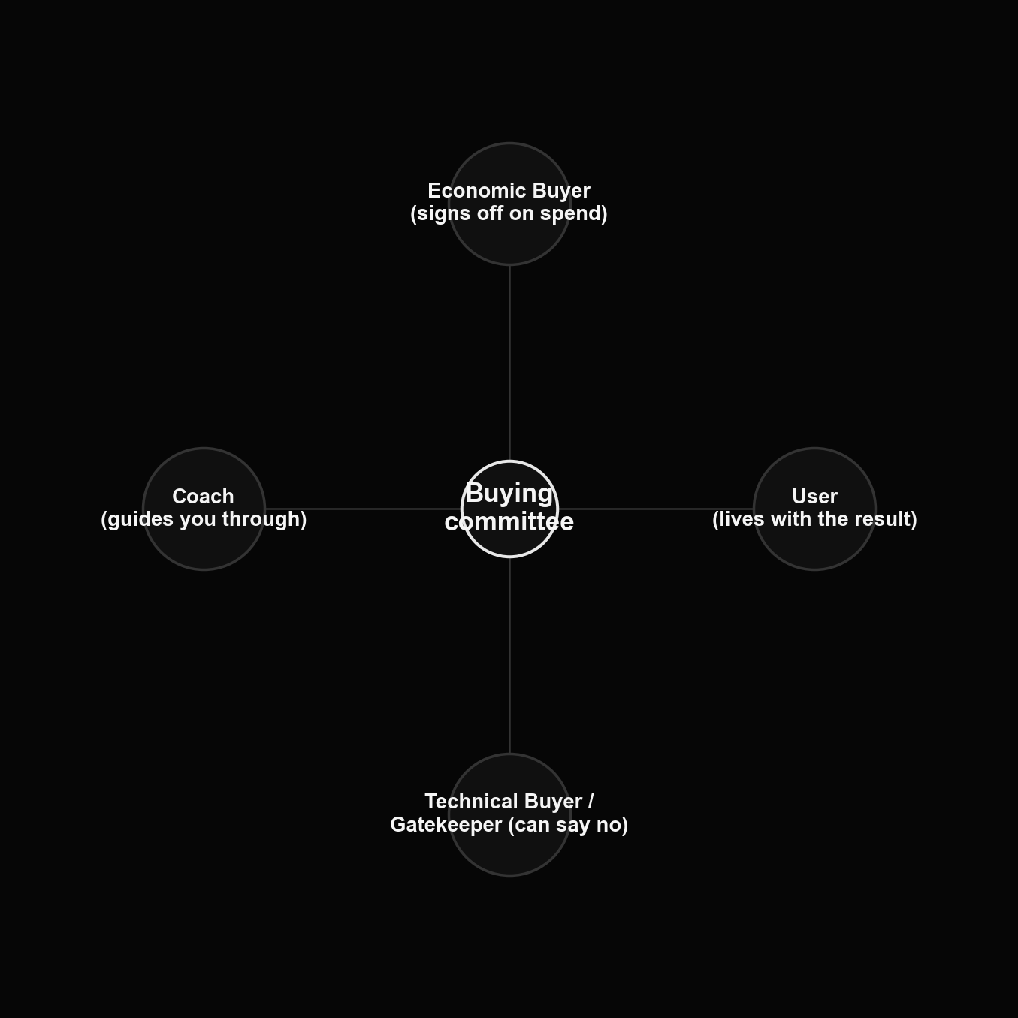
Roles inside the buying committee
MB
Exactly one economic buyer per deal; usually several users and several technical buyers/gatekeepers (professional "no" people who rarely control budget); and a coach you have to find and develop — they don't walk in the door on their own.

Slide 19
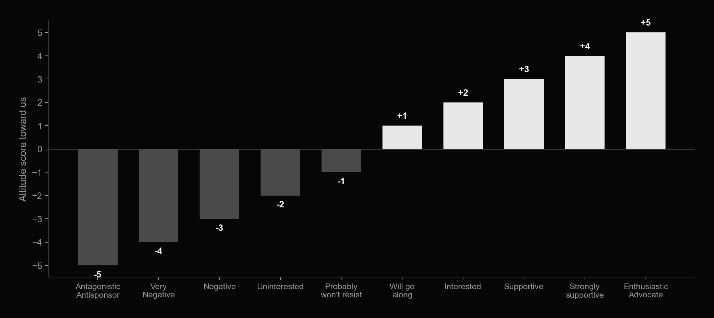
Scoring attitude toward you, stakeholder by stakeholder
MB
Score every named stakeholder on this -5 to +5 scale, alongside their role and degree of contact (none / brief / several touches / constantly in touch). The pattern across the whole committee is the real signal, not any single score.

Slide 20

MB
3.5
The relationship map
Once every stakeholder is scored, lay the buying committee out visually — reporting lines, who influences whom, where the gaps are. A simple diagramming tool is enough; the value is in forcing you to say out loud who you haven't met yet.

Slide 21
MB
Assembling the account plan
— Account overview — history, structure, business units, geography, key financials
— Relationship history and current install base — us vs. competitors
— Market trends, risks, and regulatory change relevant to this account
— Goals and key initiatives, plus a Power SWOT specific to this account
— Buying committee: org structure with roles, not just names
— Stakeholder scorecards: role, attitude, relationship strength, personal needs (see 3.4-3.5)
— Decision criteria vs. named competitors, and the opportunity matrix from 3.3
— A 6-month strategy and timeline, plus a working content and partner plan

Slide 22
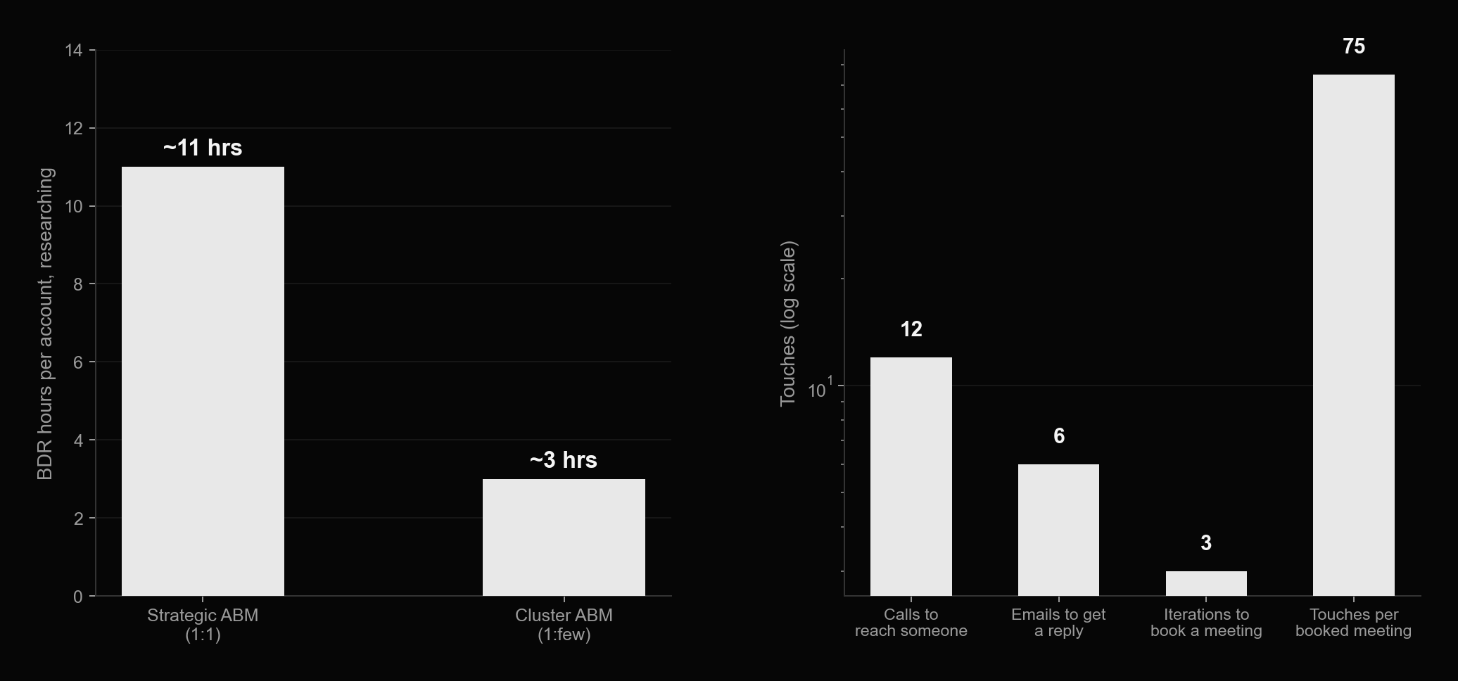
How much this actually costs in hours
MB
Budget research time by tier, not by wishful thinking — and set BDR expectations against the real math of outbound before Module 4's KPI targets.

Slide 23
MB
3.6 Agentic ABM in practice

Slide 24
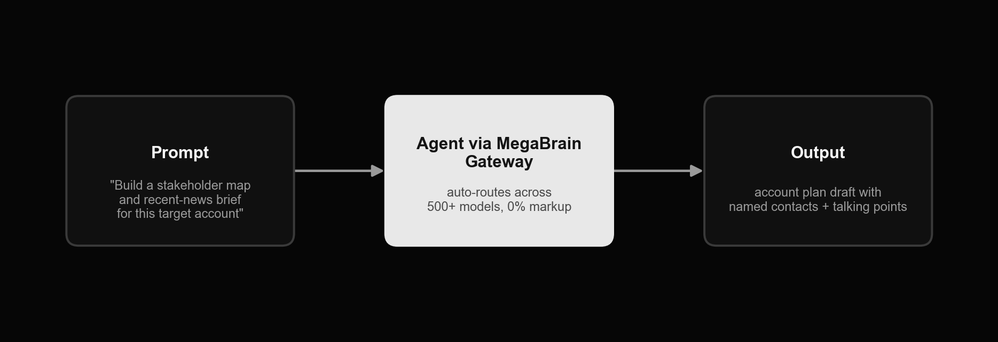
MegaBrain: an agent workflow for this module
MB
One prompt, routed through MegaBrain's model-agnostic gateway, turns a bare account name into a structured first-draft account plan — industry trends, company initiatives, and a stakeholder starting list, with sources cited so a human can verify before it goes anywhere near a prospect.

Slide 25
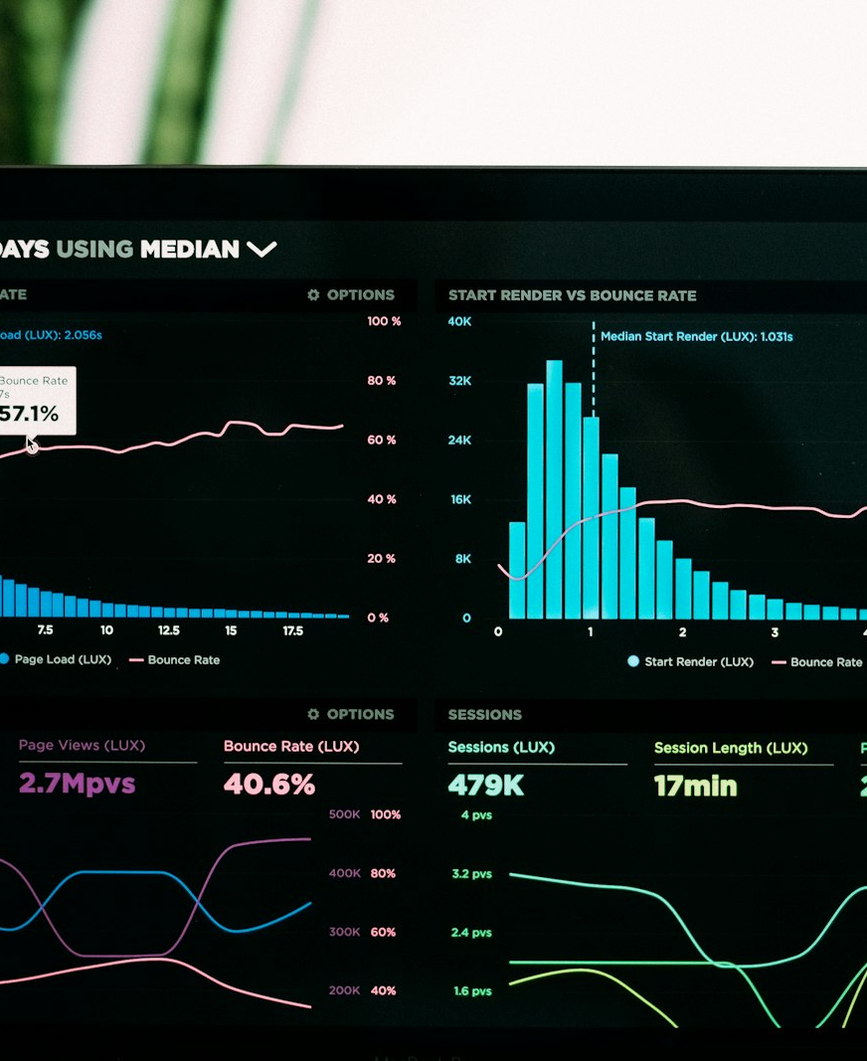
MB
Other agent tools for account research
Clay — chain multiple contact-data providers into one enrichment "waterfall" for your stakeholder list. LinkedIn Sales Navigator + an AI copilot — turn saved searches and alerts into a drafted account brief. A web-research / deep-research agent (e.g. a Perplexity- or ChatGPT-style deep-research mode) — summarize a target industry's 2026 trends with citations in minutes, not a day. Fireflies.ai or Otter.ai — auto-summarize a discovery call into the same fields your account plan needs, no manual note-taking.

Slide 26
MB
Exercises

Slide 27
MB
Homework 1 — build one full account plan
— Take the #1-ranked account from your Module 2 shortlist
— Fill in the account overview and relationship-history sections from open sources (site, news, any public filings)
— Identify 3-5 key initiatives for that account and write one line each on how your offer could attach to it
— Map at least 5 real stakeholders with role, attitude estimate, and degree of contact
— Run the opportunity matrix from 3.3 against your own product/service lines
— Have a colleague or manager sanity-check the plan for gaps within a week

Slide 28
MB
Homework 2 — run one real discovery call or sales debrief
— Book 30 minutes with your own AE/CSM/BDR who has touched this account, or with the client directly if you have a live relationship
— Take the question sets from 3.2 into the conversation — sales-team version if internal, discovery-call version if it's the client
— Write the answers straight into your account plan's "situation" and "key initiatives" fields, not into a separate notes doc
— Flag anything that contradicts what you assumed from open sources — that gap is usually the most useful finding

Slide 29
MB
Homework 3 — build your contact-data stack
— Pick two tools from the 3.4 landscape that cover different categories — e.g. LinkedIn Sales Navigator (from Module 1's Homework 3) plus Hunter.io or Apollo.io
— Sign up for the free tier or trial of each
— Enrich the stakeholder list from Homework 1: find a verified work email and LinkedIn URL for at least 5 people
— Validate at least 5 of the emails you find with a verification tool before you consider them usable

Slide 30
MB
Homework 4 — run an agent-built account brief through MegaBrain
— Using the MegaBrain account you set up in Module 1's Homework 4, write a research prompt for your Homework-1 account's industry: ask for recent trends, regulatory changes, and 5 named industry voices with sources
— Run a second prompt asking specifically for that account's public key initiatives and who owns them
— Paste both outputs into the relevant sections of your account plan, and verify every factual claim against its cited source before you trust it
— Note where the agent's draft was useful vs. where it guessed — bring both examples to the Module 4 session

